Slide 1
Advanced Aerospace Materials:
“Beyond The Next” Workshop
Location: National Institute of Aerospace
Sponsor: Chiefs Office, NASA Langley Research Center
Host: W. Keith Belvin, Principal Technologist, NASA STMD
What new materials with high performance structural properties are on the horizon beyond current development efforts?
What new combinatorial processing methods can be used to create new materials?
How can computational methods be used to accelerate the design, synthesis, processing, characterization, fabrication and testing of new materials?

Slide 2

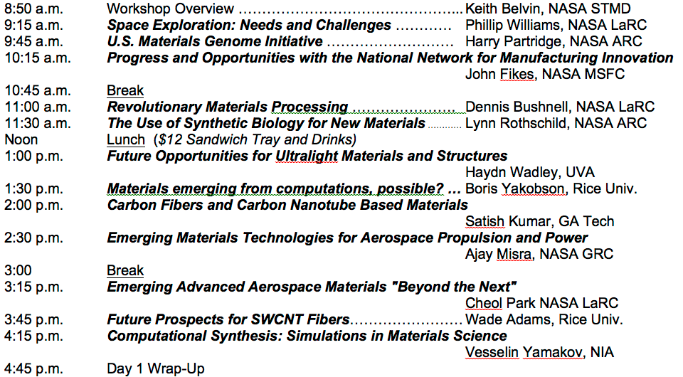
Day 1

Slide 3
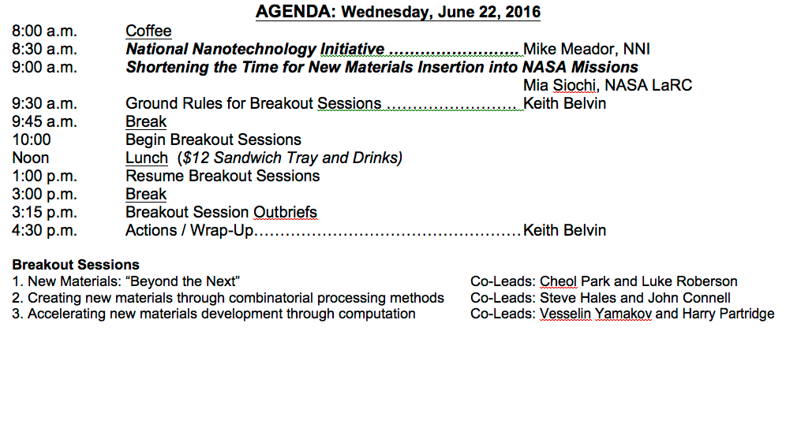
Day 2 Agenda
June 22, 2016

Slide 4


National Aeronautics and
Space Administration
Space Technology Mission Directorate
Lightweight Materials, Structures, & Advanced Manufacturing
Keith Belvin and John Vickers
Principal Technologists

Slide 5

Enabling Future Exploration Missions
Space Technology focus investments in 8 thrust areas that are key to
future NASA missions and enhance national space capabilities.
In- Space Propulsion
High Bandwidth Space Comm
Advanced Life Support & Resource Utilization
Entry Descent and Landing Systems
Space Robotic Systems
Lightweight Space Structures
Space Observatory Systems
Deep Space Navigation
Create improvements in thrust levels, specific power, and alternatives to traditional chemical propulsion systems for destination-agnostic, deep space exploration spacecraft systems.
External Application: Enhanced propulsion capabilities for Commercial and OGA Satellites
Substantially increase available bandwidth and data rates for near earth and deep space, currently limited by power and frequency allocation limits. Assure robust and reliable interconnected space network.
External Application:
High bandwidth for Commercial and OGA Satellites
Human exploration missions beyond low earth orbit will require highly reliable technologies (e.g. reclaiming water
reuse of trash, air revitalization) to minimize resupply requirements and increase independence from earth.
External Application:
Mining Industry and other closed environments; OGA
Permits more
capable science
and future human missions to terrestrial bodies. Includes, hypersonic and supersonic aerodynamic decelerators, next-
gen TPS materials,
retro-propulsion, instrumentation
and modeling.
External Application:
Returning commercial assets from space and research from ISS
Extends our reach by helping us remotely explore planetary bodies, manage in-space assets and support in-space operations by enhancing the efficacy of our operations.
External Application:
Human-safe Robotics for industrial use, disaster response, & overall autonomous operations
Targets large decreases in
structural mass for launch vehicles and spacecraft materials using nanotech, composites and in space manufacturing capabilities.
External Application:
Industrial Materials and Composites for large structures (rockets, aircraft)
Allows for more capable science and human exploration missions; enables more precise entry trajectories for inserting into orbits around planets and bodies like Mars, Europa, and Titan.
External Application:
Next Generation GPS and build new industrial base
Allows for significant gains in science capabilities including: coronagraph technology to characterize exo-planets, advances in surface materials and better control systems for large space optics.
External Application:
Industrial Materials, Earth Observation
Notes:
In-Space Propulsion – Continues solar electric propulsion development, high power hall thrusters; Initiates investments in nuclear thermal propulsion and hybrid chemical propulsion systems to decrease transit times; improve spacecraft safety and reliability and decrease cost
High Bandwidth Space Communication Systems – Includes near and deep space optical communication systems, advanced radio frequency communications, and advanced photonics systems
Advanced Life Support and Resource Utilization – Continuing to advance closed loop life support systems (>98% wastewater to water), atmospheric capture and conversion to breathing air (>75% CO₂ to O₂), trash treatment and reuse, plant growth and waste treatment, habitat surface cleanliness, regolith processing and dust mitigation technologies, development of alternative biological foods and nutrient products and advanced habitats with radiation mitigation technologies
Entry Descent and Landing Systems – Continues development of advanced thermal protection system materials, hypersonic and supersonic aerodynamic decelerators, precision landing and hazard avoidance technologies (sensors), supersonic parachute materials, terrain relative navigation, advances in modeling and validation techniques, entry systems instrumentation, and supersonic retro-propulsion
Space Robotic Systems – Advances in robotic sensing and perception, mobility and manipulation, rendezvous and docking, onboard and ground-based autonomous capabilities will drive these goals and enable satellite servicing capabilities; including human system interaction and mobility, sensing and perception, and autonomous performance
Lightweight Space Structures – Includes composite structures for cryogenic fuel tanks, ultra-lightweight core structures, deployable composite booms for small satellite applications, flexible materials for inflatable habitats, multifunctional materials incorporating sensors and monitoring systems and in-space robotic manufacturing and assembly of large scale structures, advanced metallic gears for next generation rovers.
Deep Space Navigation – Advanced atomic clocks, and x-ray detectors, and fast optical light gyroscopes for increased accuracy in deep space navigation
Space Observatory Systems – Coronograph and starshade technologies, mirror surface materials, and better control systems for space optics and detectors

Slide 6
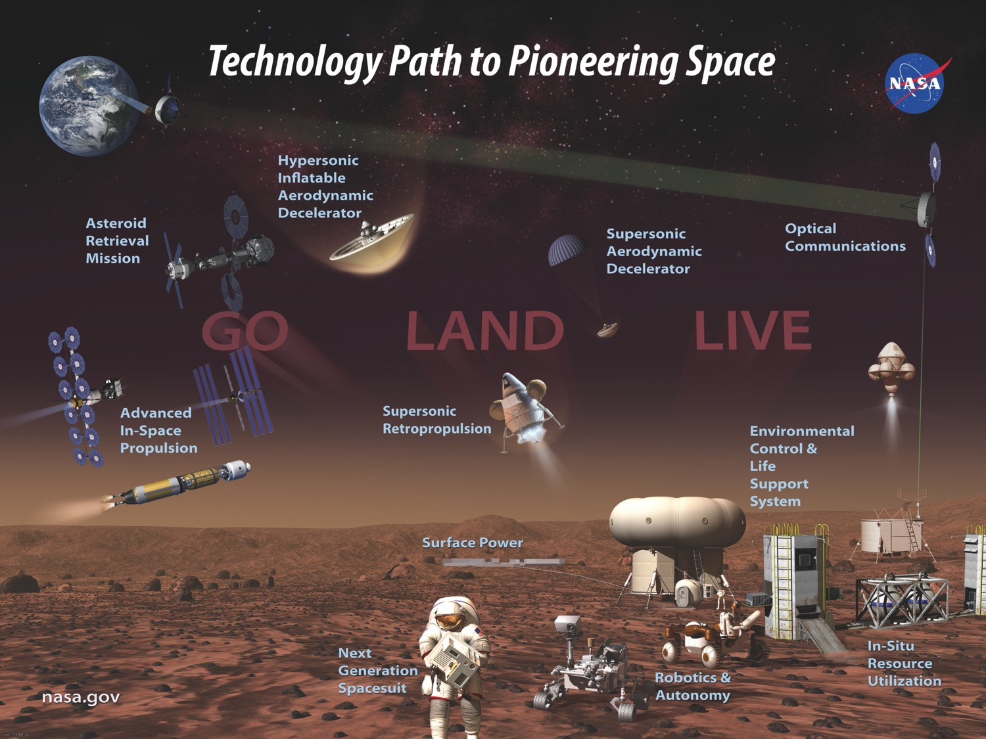
Lightweight Space Structures
6

Slide 7
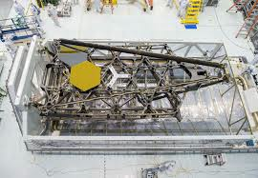
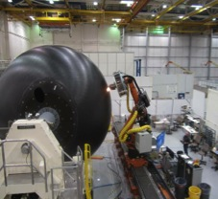
Lightweigth Materials, Structures and Advanced Manufacturing (LMSAM) - Addressing Critical Challenges
Through the technology strategy approach, each capability area addresses the agency priorities and big challenges only solvable by a comprehensive collaboration
Big Technical Goals
Impact Goals
Increased payload to Mars
50% reduction in overall manufacturing costs
50% reduction in mass compared to SOA
Accelerate the adoption of LMSAM space technologies
Increase resilience of space vehicles
Deliver innovative technologies that dramatically improve capabilities
Rapidly enable new capabilities

Slide 8
LMSAM Capability Areas
In-Space
Manufacturing
(ISM) and
In-Space Assembly (ISA)
Multifunctional
Materials,
Manufacturing,
And Structures
Multi-functional Materials
Structures and Materials for Extreme Environments
Human Rated Composites
Habitats
Cryogenic Tanks
Launch Vehicle Dry Structure
Space and Surface Vehicles
Science Platforms
ISA Simulation and Verification
ISM Simulation and Verification
Advanced System Concepts
ISA and ISM Operations
Deployables, Softgoods, Modularity
Advanced Manufacturing
Advanced Materials
Multifunctional Integration
Hot Structures and TPS
Cold Mechanisms
Dust/Radiation/Space Environmental Effects (SEE)

Slide 9



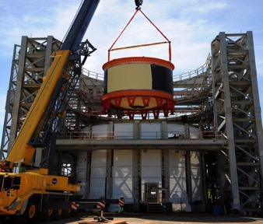
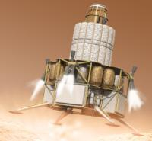
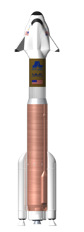

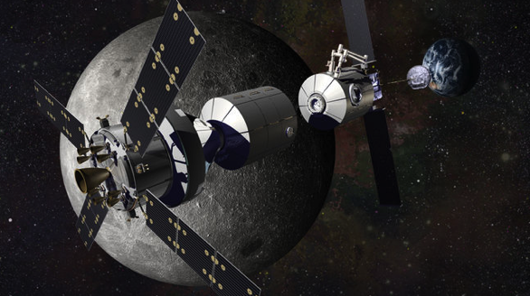
Human-Rated Composite Structures
Composites for Exploration
NASA Launch and Commercial Space
Deep Space Habitat

Slide 10
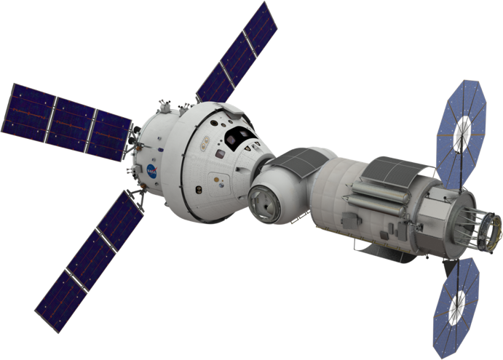
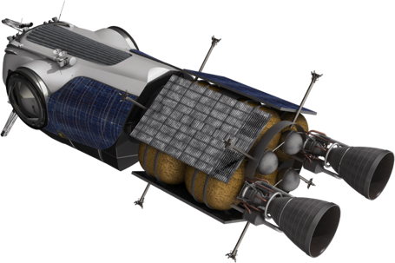
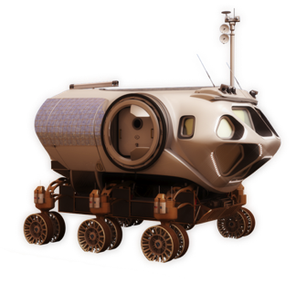
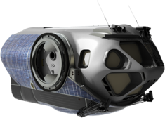
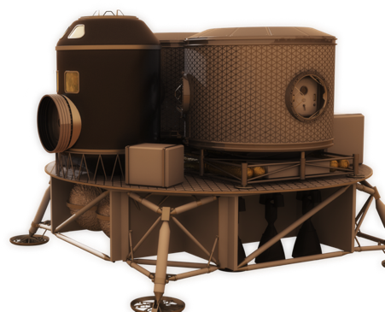
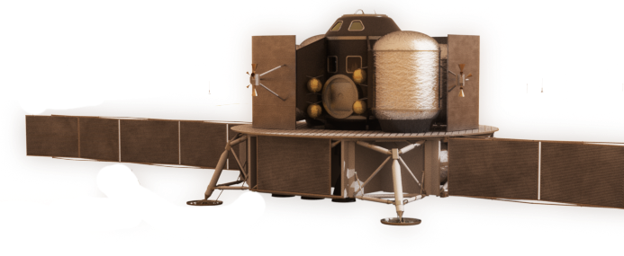
EMC Small Habitat Commonality
Mars System
Taxi
Initial Cis-lunar
Habitat
Mars Surface
Rover
Phobos Exploration
Vehicle (PEV)
Mars Crew
Lander
Mars Ascent
Vehicle (MAV)
Chris Moore – EMC presentation to the NAC Research Subcommittee, March 7, 2016

Slide 11
LMSAM Capability Areas
In-Space
Manufacturing
(iSM) and
In-Space Assembly (iSA)
(*iSS)
Multifunctional
Materials,
Manufacturing,
And Structures
Multi-functional Materials
Structures and Materials for Extreme Environments
Human Rated Composites
Habitats
Cryogenic Tanks
Launch Vehicle Dry Structure
Space and Surface Vehicles
iSA Simulation and Verification
iSM Simulation and Verification
Advanced System Concepts
iSA and iSM Operations/Agents
Deployables, Softgoods, Modularity
Advanced Manufacturing
Advanced Materials
Multifunctional Integration
Hot Structures and TPS
Cold Mechanisms
Dust/Radiation/Space Environmental Effects (SEE)
* in-Space Servicing (iSS) technology also

Slide 12
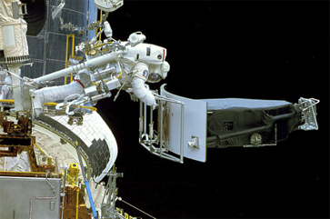
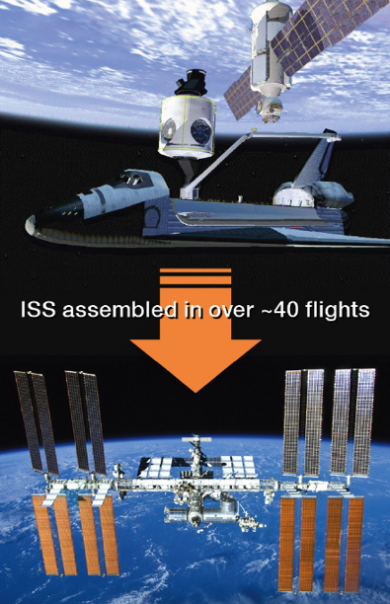
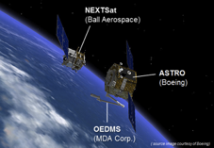
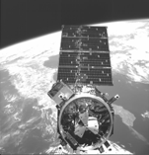
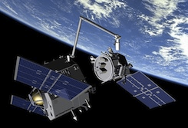
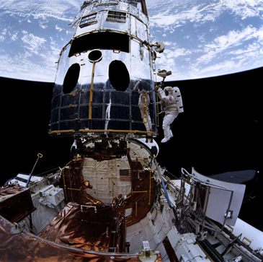
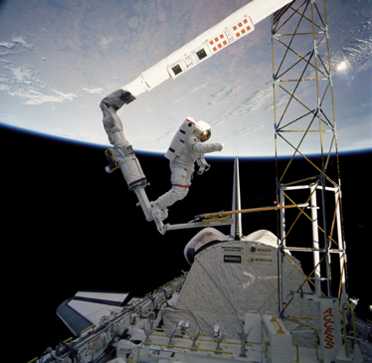
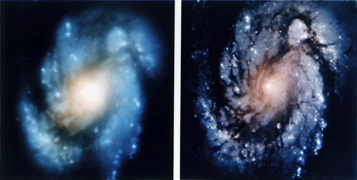
Background: History of Space Assembly Operations
Orbital Express (2007 DARPA)
Orbital Replacement Units
Fuel Transfer
ISS (1998-2011 International)
STS-61 Hubble (1993 NASA)
(1993, 1997, 1999, 2002, 2009)
EASE/ACCESS STS-61B (1985 NASA)

Slide 13
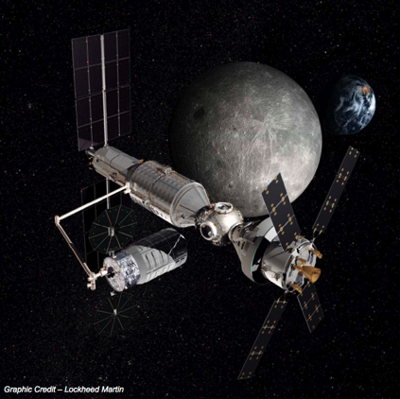
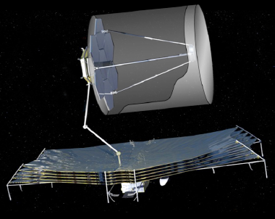
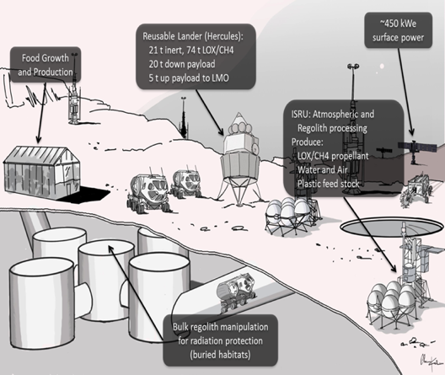
iSA & iSM: Exploration and Science
In-Space Assembly and Manufacturing Provides for Affordability and Resilience
Assembly provides aggregation of systems from multiple launches
Servicing and repair extend lifetime
Disassembly and reuse of radically changes the supply architecture
Complex deployments can be averted
High Definition Space Telescope (HDST)
12-20 meter Primary Mirror
High Dimensional Stability (10s of picometers)
Deploy/Assemble
  Thermal Sunshield
  Primary Mirror
  Secondary Mirror and Subsystems
Exploration Augmentation Module (EAM)
Module Based Design for Docking/Berthing
Modular Subsystems for repair/assembly
Long reach arms for berthing/disassembly
Surface ISRU – Manufacturing and Assembly
Design with low strength materials (polymers/ceramics)
Additive manufacturing of finite sized modules
Assembly of processed parts into systems
  Reversible joining technology
Notes:
Astronaut Jeffrey Hoffman, anchored to the end of the shuttle Endeavoru’s robo arm, prepares to install the Wide Field Camera 2 on Hubble.
http://www.cbsnews.com/news/hubble-space-telescope-marks-25-years-in-orbit/
Hubble Images before and after the STS-61 mission
https://en.wikipedia.org/wiki/STS-61
Orbital Express
http://www.vacco.com/space/couplings-and-disconnects
Astronaut Jerry L., Ross secured to the RMS, approaches the ACCESS Structure during STS-61B (1985)

Slide 14
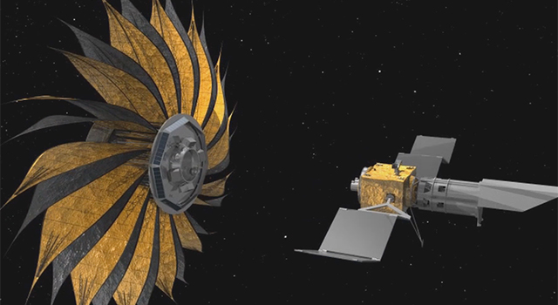

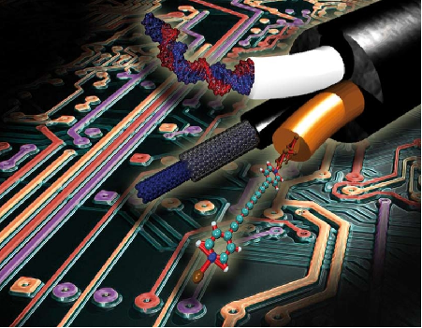
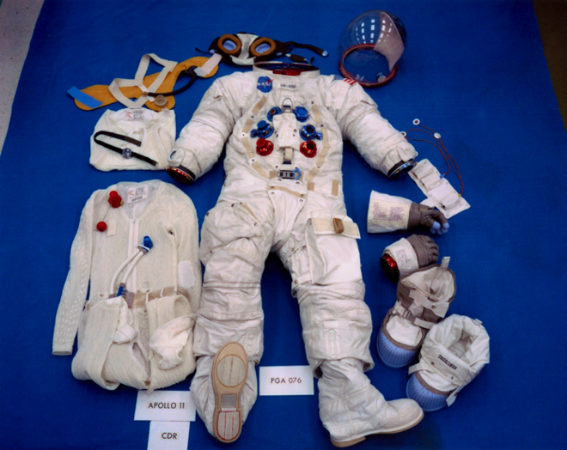
Multifunctional LMSAM
Functionally Graded Materials and Manufacturing
Deployable Structures (Starshade)
Integrated Function
SoftGood Systems

Slide 15

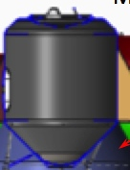
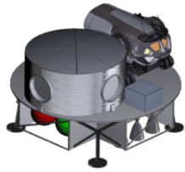
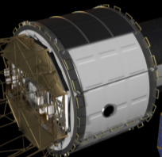
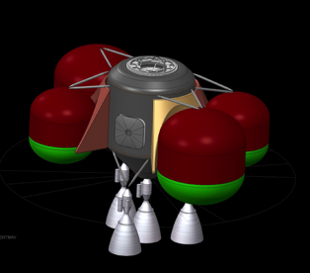
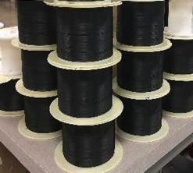
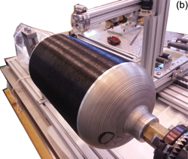
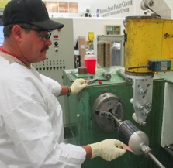
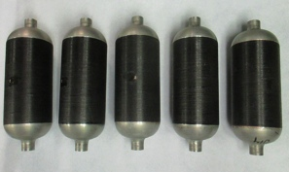
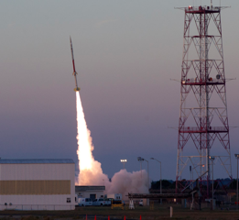
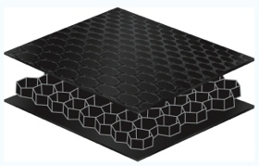
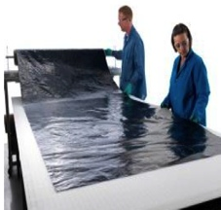
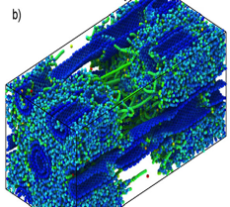
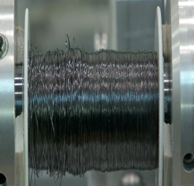
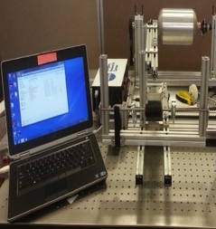
Space Technology Pipeline of Innovation:
CNT Materials Example
New Technology Partners
High TRL – Technology Demonstration Missions
SBIR Phase I, II & III
Flight Opportunities
  Wallops Sounding Rocket
Hybrid CF/CNT Demo Unit
Mid TRL - Game Changing Development
Commercial Scale
CNT Yarn Mfg
Demo Article Process Prototype
CNT COPV Mfg
CNT COPV Burst Test Articles
CNT COPV Flight Tests
Hybrid CF/CNT Composite
Low TRL
Computational Nanomaterials
High Strength CNT Yarn
CNT Processing Development
CNT Sheet
Early Stage
Space Tech Research Grants (ESI)
Center Innovation Fund
Center IRAD
15
Notes:
Panel Package Chart 19

Slide 16
LMSAM Capability Areas
In-Space
Manufacturing
(ISM) and
In-Space Assembly (ISA)
Multifunctional
Materials,
Manufacturing,
And Structures
Multi-functional Materials
Structures and Materials for Extreme Environments
Human Rated Composites
Habitats
Cryogenic Tanks
Launch Vehicle Dry Structure
Space and Surface Vehicles
ISA Simulation and Verification
ISM Simulation and Verification
Advanced System Concepts
ISA and ISM Operations
Deployables, Softgoods, Modularity
Advanced Manufacturing
Advanced Materials
Multifunctional Integration
Propulsion
Hot Structures and TPS
Cold Mechanisms
Dust/Radiation/Space Environmental Effects (SEE)

Slide 17
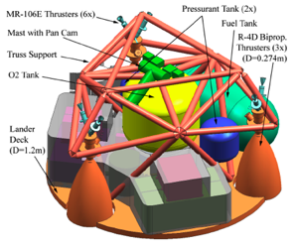
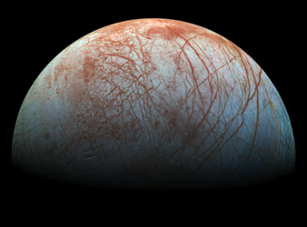

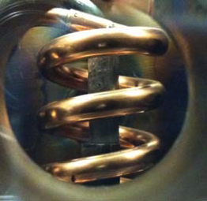
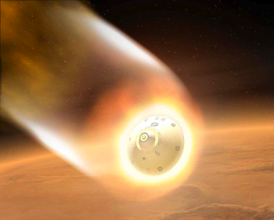
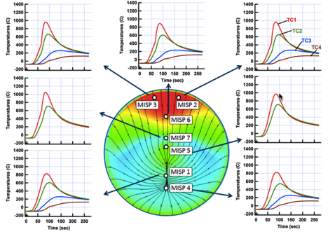
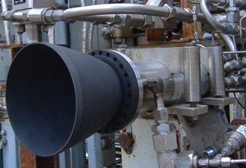
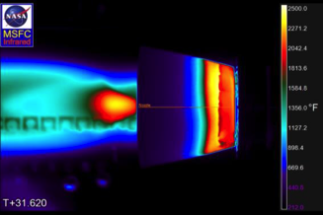

NASA Extreme Environments
Venus
737K Mean, 0.015% Sulfur Dioxide
Europa
Europa Lander
Launch ~2023
~50K min - 125K Max
MEDLI
NTP W/Re sample loaded into heating coil ~4000⁰F
Ocean Worlds
Micrometeoroid and Orbital Debris
C-C NE Attached to Engine ~2400⁰F
Multiple Commercial Engine Candidates

Slide 18










National Network for Manufacturing Innovation
Network Status and FY16 Plans
Future Network Goal: 45 Regional Hubs
Forthcoming Awards
Additive Manufacturing
Youngstown, OH
Integrated Photonics
Rochester, NY
Flexible Hybrid Electronics
San Jose, CA
Advanced Textiles
Smart
Manufacturing
New Institutes Planned for 2016
Open topic competitions
Digital Manufacturing
& Design
Chicago, IL
Lightweight Metal Manufacturing
Detroit, MI
Advanced
Fiber-Reinforced
Polymer Composites
Knoxville, TN
Wide Bandgap Semiconductors
Raleigh, NC
Selected topic competitions supporting agency mission,
using agency authorities and budgets

Slide 19



The Materials Genome Initiative
to decrease the cost and time-to-market by 50%
Develop a Materials Innovation Infrastructure
Achieve National goals in energy, security, and human welfare with advanced materials
Equip the next generation materials workforce
Materials Genome Initiative for Global Competitiveness

Slide 20

National Nanotechnology Initiative
The vision of the National Nanotechnology Initiative (NNI) is a future in which the ability to understand and control matter at the nanoscale leads to a revolution in technology and industry that benefits society.
The NNI expedites the discovery, development, and deployment of nanoscale science, engineering, and technology to serve the public good through a program of coordinated research and development aligned with the missions of the participating agencies. Advance a world-class nanotechnology research and development program;
Foster the transfer of new technologies into products for commercial and public benefit;
Develop and sustain educational resources, a skilled workforce, and a dynamic infrastructure and toolset to advance nanotechnology; and
Support responsible development of nanotechnology.

Slide 21





Materials Strategy
Driven by BlueSky Thinking
Keen awareness of OGA investments and NASA needs.

Slide 22
Day 1

