Slide 1
National Aeronautics and
Space Administration
Building a New Partnership
Progress and Opportunities with the National Network for Manufacturing Innovation
Presented by
John Fikes and John Vickers
Date
June 21, 2016

Slide 2
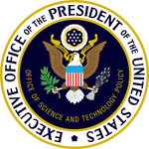
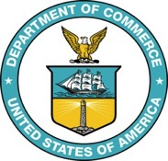
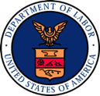
Interagency Advanced Manufacturing
National Program Office (AMNPO)
Executive Office of the President
Advanced Manufacturing
Partnership (AMP/PCAST)
Advanced Manufacturing
National Program Office
(hosted by DOC - NIST)
NSTC - Advanced Manufacturing Subcommittee
Notes:
AMNPO
In December 2011, U.S. Commerce Secretary formed the Advanced Manufacturing National Program Office (AMNPO). Hosted by the National Institute of Standards and Technology (NIST), the office is staffed by representatives from federal agencies with manufacturing-related missions as well as manufacturing companies and universities. The AMNPO is charged with: • Convening and enabling industry-led, private-public partnerships that focus on manufacturing innovation and engaging U.S. universities, and • Designing and implementing an integrated “whole of government” advanced manufacturing initiative to facilitate collaboration and information sharing across federal agencies.
By coordinating federal resources and programs, the AMNPO will enhance technology transfer in U.S. manufacturing industries and help companies overcome technical obstacles to scaling up production of new technologies. It will work to build more effective collaborations in identifying and addressing challenges and opportunities that span technology areas and cut across agency missions. A key AMNPO aim is to link federal efforts to the growing number of private-sector partnerships involving manufacturers, universities, state and local governments, and other organizations.
NSTC
The National Science and Technology Council (NSTC) was established by Executive Order on November 23, 1993. This Cabinet-level Council is the principal means within the executive branch to coordinate science and technology policy across the diverse entities that make up the Federal research and development enterprise. Chaired by the President, the membership of the NSTC is made up of the Vice President, the Director of the Office of Science and Technology Policy, Cabinet Secretaries and Agency Heads with significant science and technology responsibilities, and other White House officials.
A primary objective of the NSTC is the establishment of clear national goals for Federal science and technology investments in a broad array of areas spanning virtually all the mission areas of the executive branch.

Slide 3
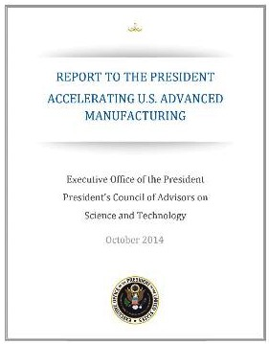
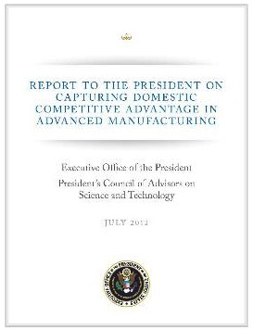
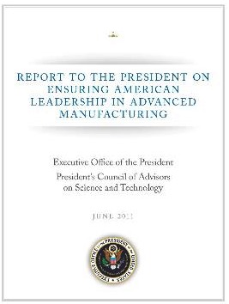
PCAST: The Independent Basis of NNMI
President’s Council of Advisors on Science and Technology
PCAST 2014
Recommends strong, collaborative network of Manufacturing Innovation Institutes
PCAST 2012
Recommends Manufacturing Innovation Institutes to address key market failure
PCAST 2011
Recommends Advanced Manufacturing Initiative as national innovation policy

Slide 4
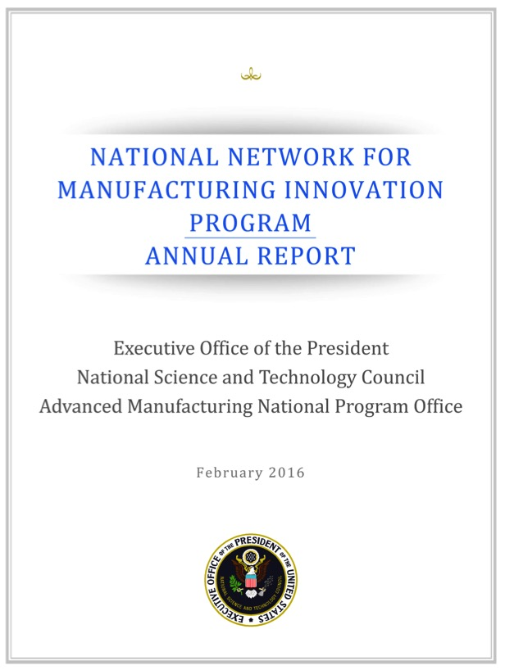
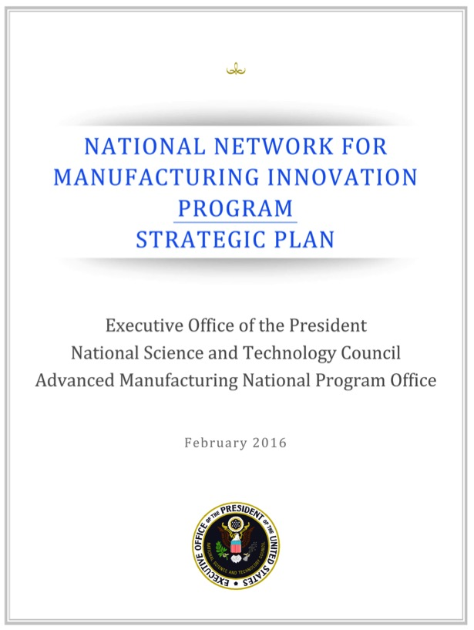
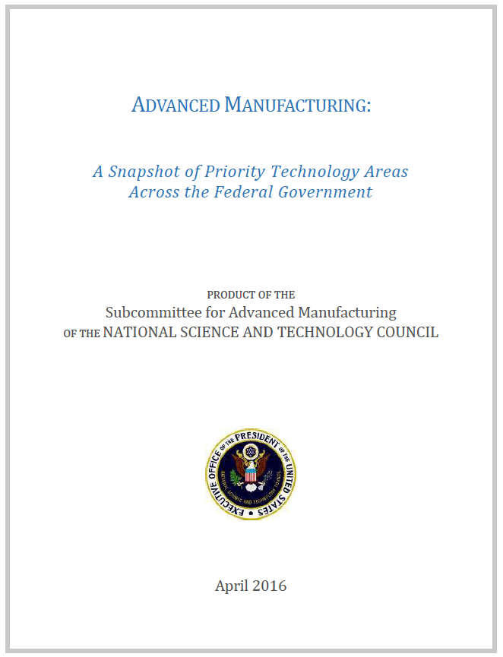
Recent NNMI Reports
First Annual Report
on the NNMI Program
“accomplishments of the established institutes are
Promising”
First Strategic Plan
on the NNMI Program
“identifies methods by which goals will be achieved and assessed”
Priority Technology Areas across the Government
“shared vision of the most important technologies for U.S. competitiveness”

Slide 5
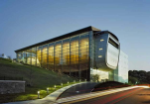
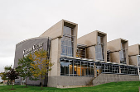
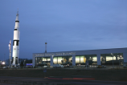
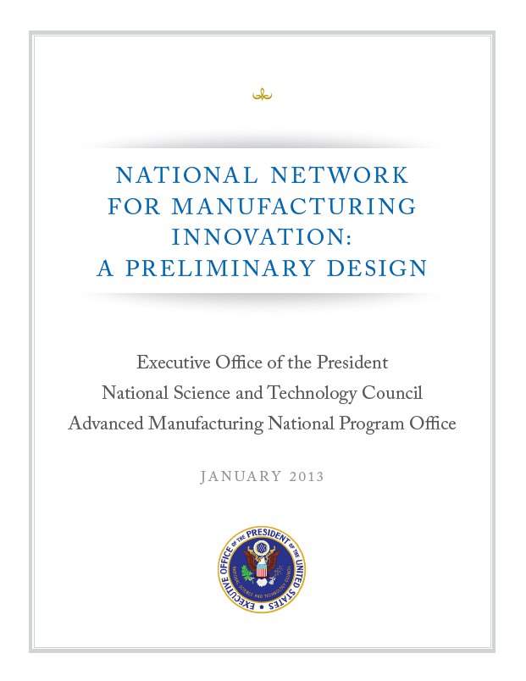
Public Engagement on Design Workshops & Request for Information
All Other 10%
Economic Development 6%
Broad & Diverse Stakeholder Input
1,200 voices on the NNMI Design!
Research & non-profits 8%
Federal State & Local Gov’t 14%
Rensselaer Polytechnic Institute
Troy New York
Cuyahoga Community College
Cleveland Ohio
University of Colorado
Boulder, Colorado
National Academies Beckman Center
Irvine California
U.S. Space and Rocket Center
Huntsville, Alabama

Slide 6
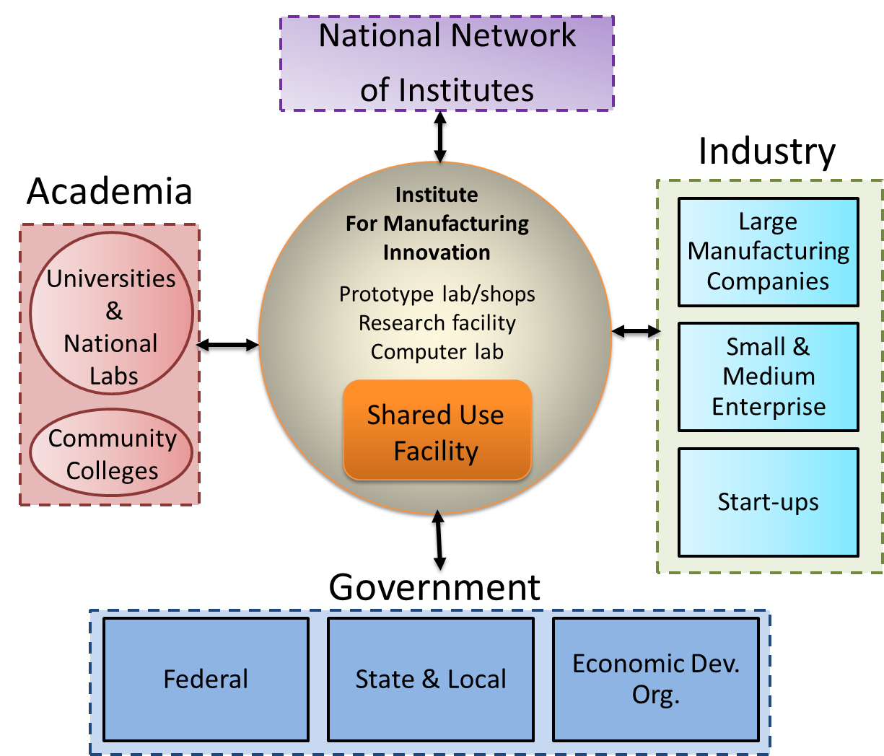
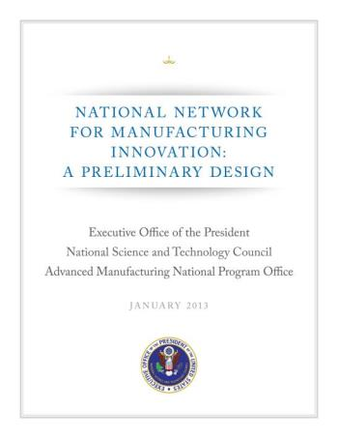
The Institute Design
Creating the space for Industry & Academia to collaborate
White House Report
NNMI Framework Design
January 2013

Slide 7
NNMI: Enabling a Manufacturing Renaissance
Accelerating Discovery to Application to Production
Establish a presence, at scale, in the “missing middle” of advanced manufacturing research
Create an Industrial Commons, supporting future “manufacturing hubs”, with active partnering between all stakeholders
Emphasize/support longer-term investments by industry
Combine R&D with workforce development and training
Overarching Objective: Unleash new U.S. advanced manufacturing capabilities and industries – for stronger global competitiveness and U.S. economic & national security
Federal startup investment: ~$70M/institute over 5-7 years
Institute Consortium owners must have minimum 1:1 co-investment

Slide 8
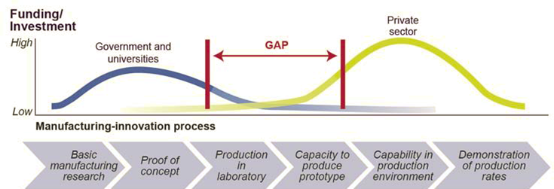
NNMI: Addressing the “Scale-up” Gap
Focus is to address market failure of insufficient industry R&D in the “missing middle” or “industrial commons” to de-risk promising new technologies
Basic R&D
Commercialization

Slide 9
The NNMI Mission
“The Network serves the Institutes, the Institutes connect through the Network, and the Program serves the Nation.”
Program Mission (Institutes + Network)
Advance American domestic manufacturing innovation by creating an effective manufacturing research and development infrastructure for U.S. industry and academia to solve industry-relevant problems.
Institute Mission
Create and strengthen American manufacturing hubs through sustainable industry-led innovation institutes that create, showcase, and deploy new capabilities.
Network Mission
Maximize the integrated impact of the manufacturing innovation institutes on U.S. manufacturing competitiveness.

Slide 10
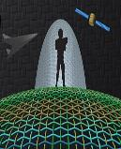
Building the Network
America Makes
Additive Manufacturing
DOD–Youngstown OH
DMDII
Digital Mfg & Design Innovation
DOD – Chicago IL
LIFT
Lightweight &
Modern Metals
DOD – Detroit MI
PowerAmerica
Power Electronics Manufacturing
DOE – Raleigh NC
IACMI
Adv. Composites
Manufacturing
DOE – Knoxville TN
Integrated Photonics
DOD- Rochester NY
Flexible Hybrid Electronics
DOD
San Jose CA
Smart Manufacturing
DOE
Los Angeles CA
Revolutionary Fibers & Textiles
DOD – Cambridge MA
Notes:
Recommendation #5: Create – through the National Economic Council, the Office of Science and Technology Policy, and the implementing agencies and departments – a shared National Network for Manufacturing Innovation (NNMI) governance structure that can ensure a return on investment for the NNMI’s many stakeholders by including input from various agencies as well as private sector experts, organized labor and academia.

Slide 11
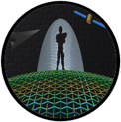
Network Goal: 45 Regional Hubs
Network Status and FY16 Plans
NSF/NIST Consortium for Advanced Manufacturing Foresights - University of Michigan
Additive Manufacturing
Youngstown, OH
Integrated Photonics
Rochester, NY
Flexible Hybrid Electronics
San Jose, CA
Smart Manufacturing
Los Angeles CA
Advanced Textiles
Cambridge, MA
New Institutes Planned for 2016
Open topic competitions
DOE - Modular Chemical Process Intensification
DOE - Reducing EMbodied-energy And Decreasing Emissions
DOD - Advanced Tissue Biofabrication
DOD – TBD topic
Digital Manufacturing & Design
Chicago, IL
Lightweight Metal Manufacturing
Detroit, MI
Advanced Fiber-Reinforced Polymer Composites
Knoxville, TN
Wide Bandgap Semiconductors
Raleigh, NC

Slide 12
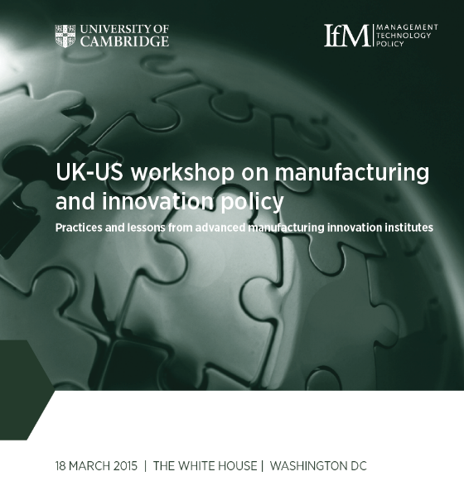
National Network for Manufacturing Innovation
NASA is an engaged partner with the other agencies in the activities of the National Advanced Manufacturing Program Office and in the manufacturing innovation institutes. We envision increased specific engagement.
Led by Space Technology Mission Directorate
Member of the interagency Advanced Manufacturing National Program Office (AMNPO)
Member of the NSTC Subcommittee on Advanced Manufacturing
NASA NNMI Collaboration
NASA intends to provide funding for institutes through STMD programs
Executive committee and technical advisory board members
Multiple Center Participation
Technology Roadmap Advisory Groups
NASA researchers can participate in technical projects in areas that align with NASA interests
STMD is providing FTE support for solicitations and institutes in the form of technical reviewers during the solicitation process and SME’s
Other related initiatives – Materials Genome Initiative, National Nanotechnology Initiative
White House National Week of Making – June 17th - 23rd
https://www.whitehouse.gov/the-press-office/2015/06/12/fact-sheet-new-commitments-support-president%E2%80%99s-nation-makers-initiative <https://www.whitehouse.gov/the-press-office/2015/06/12/fact-sheet-new-commitments-support-president%E2%80%99s-nation-makers-initiative>

Slide 13
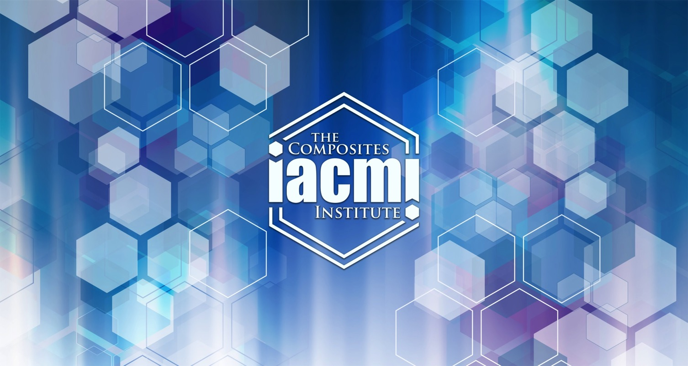
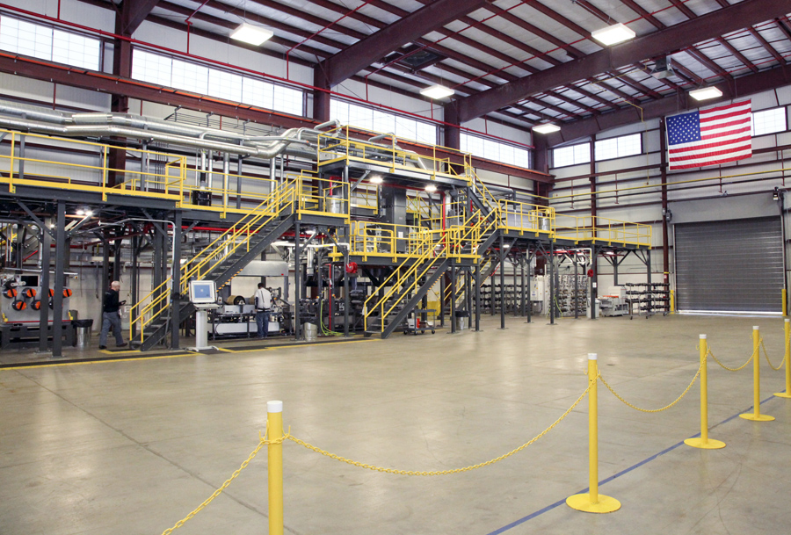
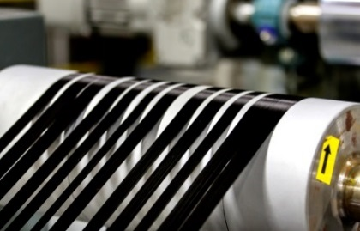
Institute of Advanced Composites Manufacturing Innovation
Example Institute: Composites Manufacturing

Slide 14
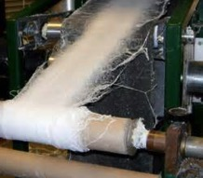
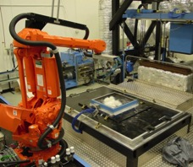
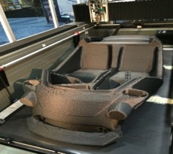
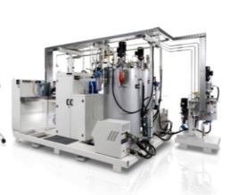
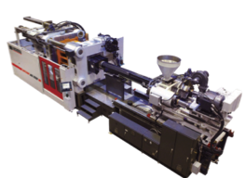
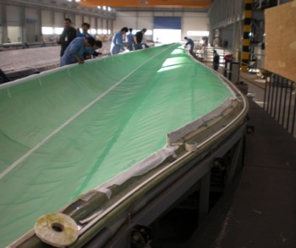
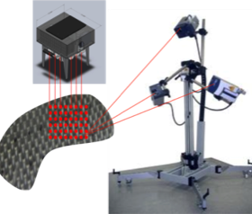
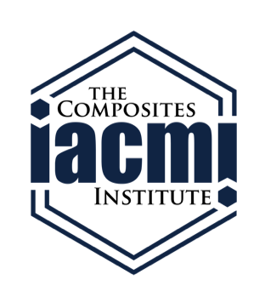
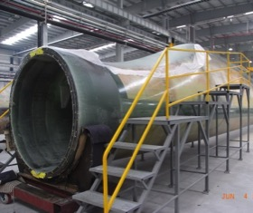
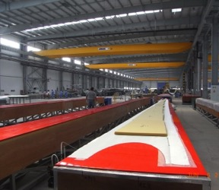
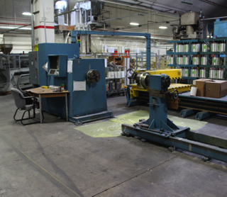
Advanced Composites Institute Profile
IACMI, The Composites Institute Knoxville, TN
Launched June 16, 2015
Agency sponsor: DOE
Startup funding: $70M public,
$159M co-investment
+344,000 square feet in five core regions – composite manufacturing, laboratory, instructional and collaboration space

Slide 15
1) Clear, unique Institute Focus
Each Institute has a clear mission based on a critical Industry need
Opportunity
Lightweight composites offer benefits to energy efficiency and renewable power generation, overcoming limitations through deployment of advanced technologies to make composite lower cost, faster, using less energy that can be readily recycled offer tremendous opportunities for US manufacturers.
Big Idea
The Institute will provide access to world-class resources to partner with industry and develop new low-cost, high-speed, and efficient manufacturing and recycling process technologies that will promote widespread use of advanced fiber-reinforced polymer composites.
At the new Institute, a world-class team of organizations from leading industrial manufacturers, material suppliers, software developers, government and academia will focus on lowering the overall manufacturing costs of advanced composites by 50 percent, reducing the energy used to make composites by 75 percent, and increasing the ability to recycle composites by more than 95 percent within the next decade.

Slide 16
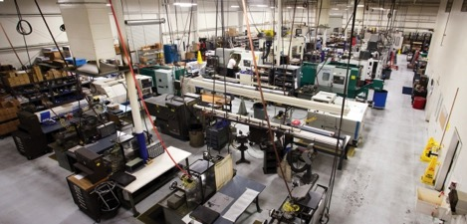
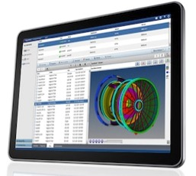
2) Clear Industry Value Proposition
Each Institute creates value for industry participation and funding
Access to Shared RD&D Resources: Leverage and provide access to equipment from lab to full-scale to enable demonstration and reduce risk for industry investment
Applied R&D: Leverage significant government, industry, and academic investments to develop innovative solutions to member challenges
Composites Virtual Factory: Provide access to end to end commercial modeling and simulation software for composite designers and manufacturers through a web based platform.
Workforce Training: Provide specialized training to prepare current and future workforces for the latest manufacturing methods and technologies

Slide 17
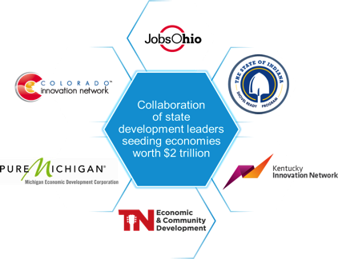
3) Strong Private-Public Partnership
Each Institute is operated by a consortium; serving a partnership of Industry, Academia and government
A partnership of world-class companies including:
Top universities including:
Economic Development Council to leverage state support and investment

Slide 18
4) Addressing Critical Challenges
By workshops and Technology Roadmaps, Each Institute works on the industry priorities and big challenges only solvable by collaboration
Five/Ten Year Technical Goals
25/50% lower carbon fiber–reinforced polymer (CFRP) cost
50/75% reduction in CFRP embodied energy
80/95% composite recyclability into useful products
Impact Goals
Enhanced energy productivity
Reduced life cycle energy consumption
Increased domestic production capacity
Job growth and economic development

Slide 19
5) Balanced Portfolio of Projects
From Technology Roadmaps and Strategic Investment Plan, Each Institute manages a balanced portfolio of real projects for Industry
Activity
Result
Strengthen infrastructure capacity:
- Materials and processing - Modeling and simulation
Innovation and workforce development in strategic areas with national benefit:
- Automotive - Wind - Compressed gas storage
1. First Projects
Identified in proposal to DOE
2. Technology Roadmap
Driven by IACMI CTO, Industry and Technology Advisory Board
Identifies key hurdles to high -impact, large scale advanced composites manufacturing
Prioritizes opportunities across the materials and manufacturing supply chain
3. Strategic Investment Plan
Driven by IACMI BOD and Technical Advisory Board
Changing the innovation cycle to enable rapid adoption and scale-up of advanced composites manufacturing
Aligns with strategic investment plan and technology roadmap
Emphasis on projects with high near term impact.
Project Call- open NOW
4. Open Project Call

