Slide 1
Global Earth Observations Based Machine Learning Framework for Monitoring Critical Natural and Man-made Infrastructure
Ranga Raju Vatsavai
Chancellors Faculty Excellence Associate Professor in Geospatial Analytics
Department of Computer Science, North Carolina State University (NCSU)
Associate Director, Center for Geospatial Analytics, NCSU
NASA Machine Learning Workshop
NASA Langley Research Center, VA. August 16-18, 2016

Slide 2
Outline
Big Spatiotemporal Data (Remote Sensing)
Applications
Algorithms
Outlook

Slide 3
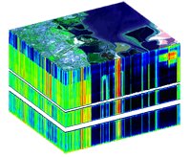
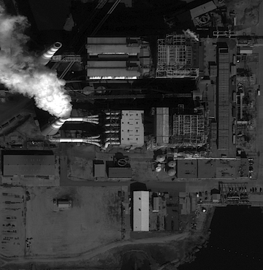
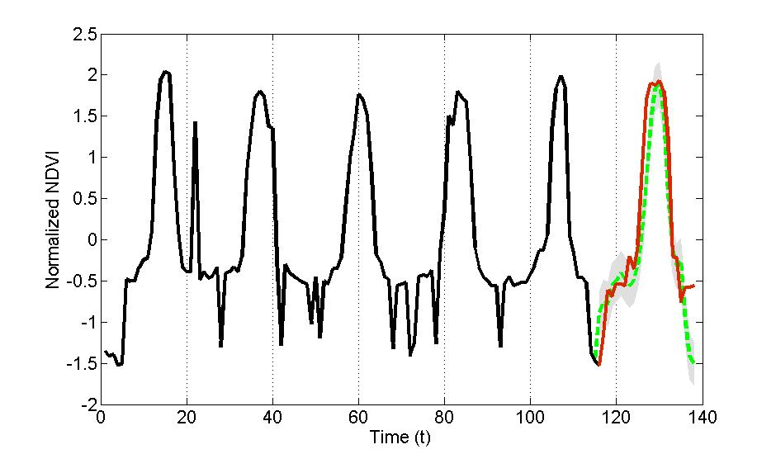
Big Remote Sensing (Spatiotemporal) Data
Spectral
AVIRIS (20m, 224B): Ondemand, airborne, 700km/hr.
ARIES (30m, 32B, 7 day)
AVIRIS Cube
Landsat-1 (MSS):
80m, 4B, 18 day revisit
1M (SPOT, IKONOS, WorldView)
High-resolution
Image
Spatial
1970’s
2000
Sub-meter (Aerial, WV2…)
AVHRR (1KM, 5B, 1 day)
MODIS (250m-1KM, 36B, 1-2 days)
B – Bands
m - meters
Temporal
5TB/day – Heterogeneous data

Slide 4
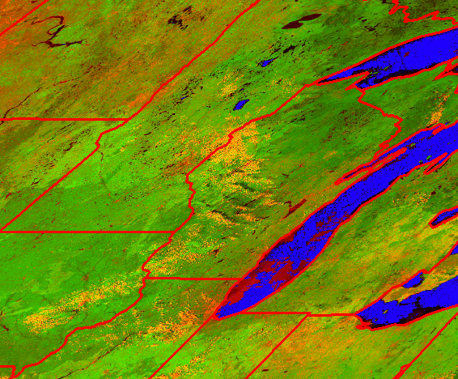
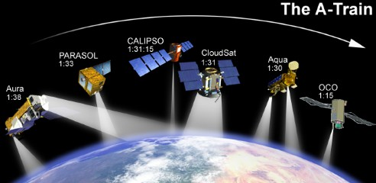
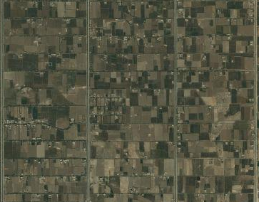

Remote Sensing
Coarse Resolution
~130 Earth Imaging Satellites
33 Countries + EU
Medium Resolution
NASA
ESA
High Resolution
Notes:
Sun sync = 800KM; geostationary = 35,000KM; CBERS-2 (1999).

Slide 5
Remote Sensing Data Examples
Coarse Resolution
Medium Resolution
High Resolution

Slide 6
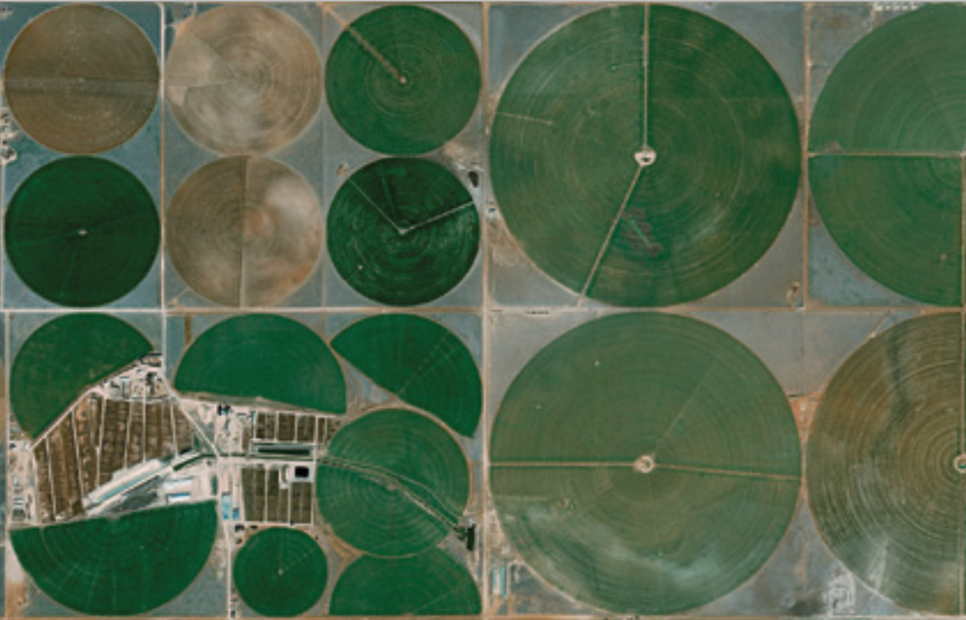
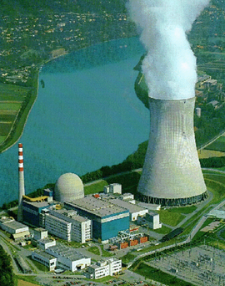
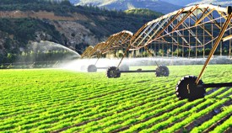
Applications: Food, Energy, Water
Agriculture accounts for 70 percent of total global freshwater withdrawals
Food production and supply chain consumes about 30 percent of total energy consumed globally
Fast forward: 2050 (~10 Billion population)
  60% more food is needed
  50% energy consumption
  10% increase of water usage in agriculture
Notes:
Water, energy and food are essential for human well-being, poverty reduction and sustainable development; an NSF priority (InFEWS)

Slide 7
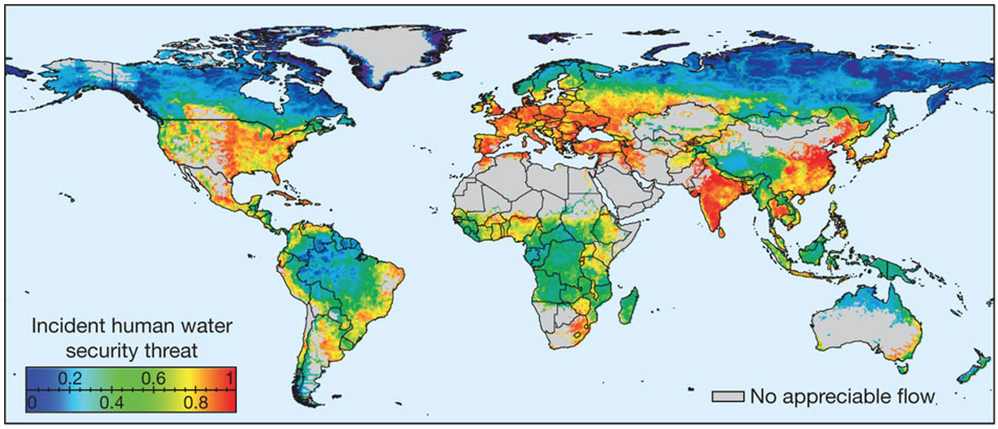

Global Threats to Human Water Security
C. J. Vörösmarty, et. al. Global threats to human water security and river biodiversity. Nature 467, 555–561 (30 September 2010).
C. J. Vörösmarty. Global water resources: Vulnerability from climate change and population growth. Science 289: 284-288. 2000.
Notes:
Clear decline in the state of the main fresh water resource for humankind: Rivers.
Fund development of and test cases for new ways of thinking for sustainable development in the water sector

Slide 8
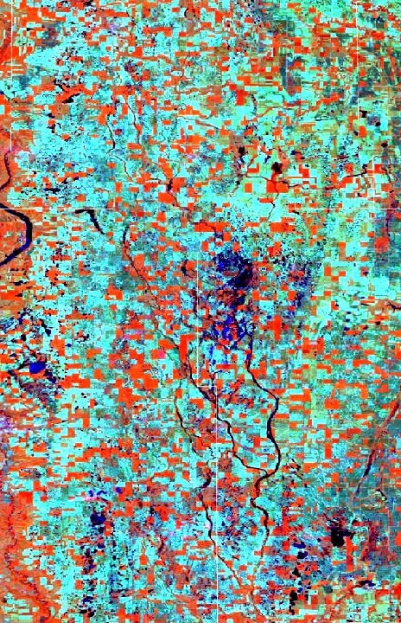
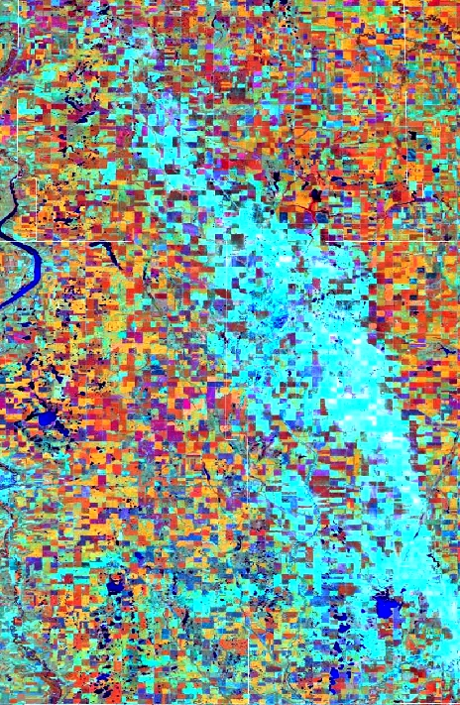
Food – Weather Threats

Slide 9
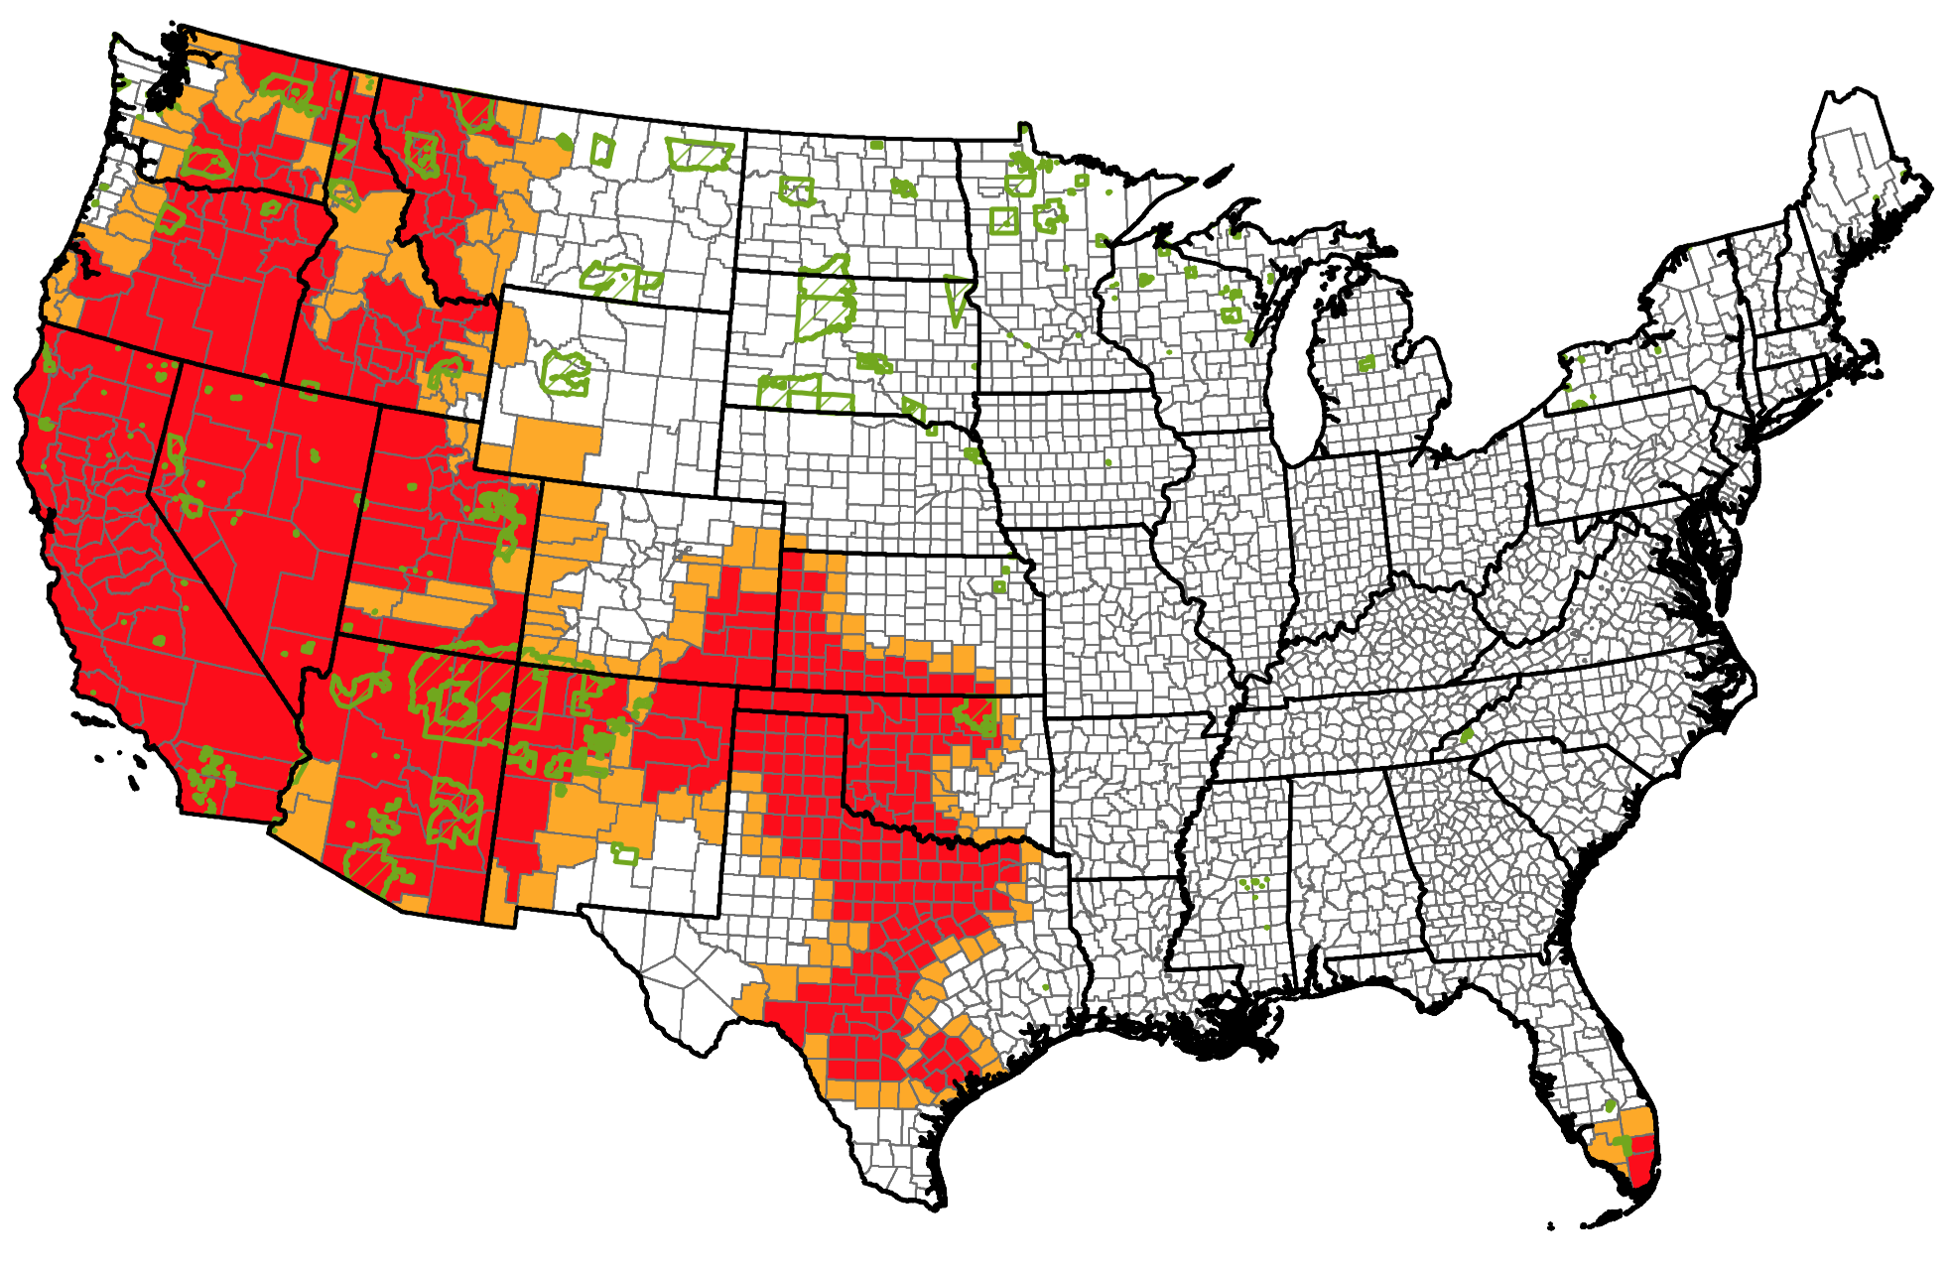
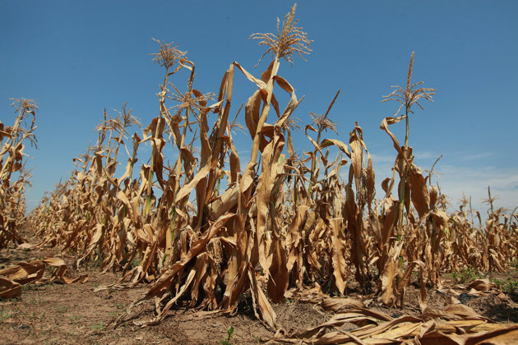
Droughts
USDA-2015

Slide 10
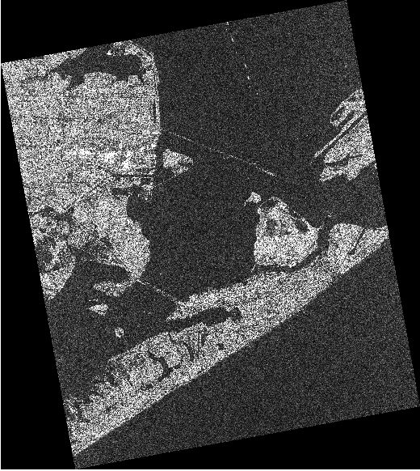
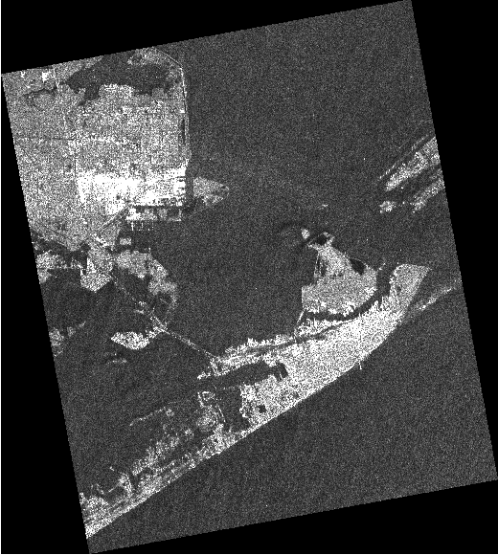
Flooding Damages
SAR Imagery during Ike – noise, spatial resolution (1.56m vs. 12.5m)
8/31/08
1.56m
9/13/08
12.5m
Flooded regions

Slide 11
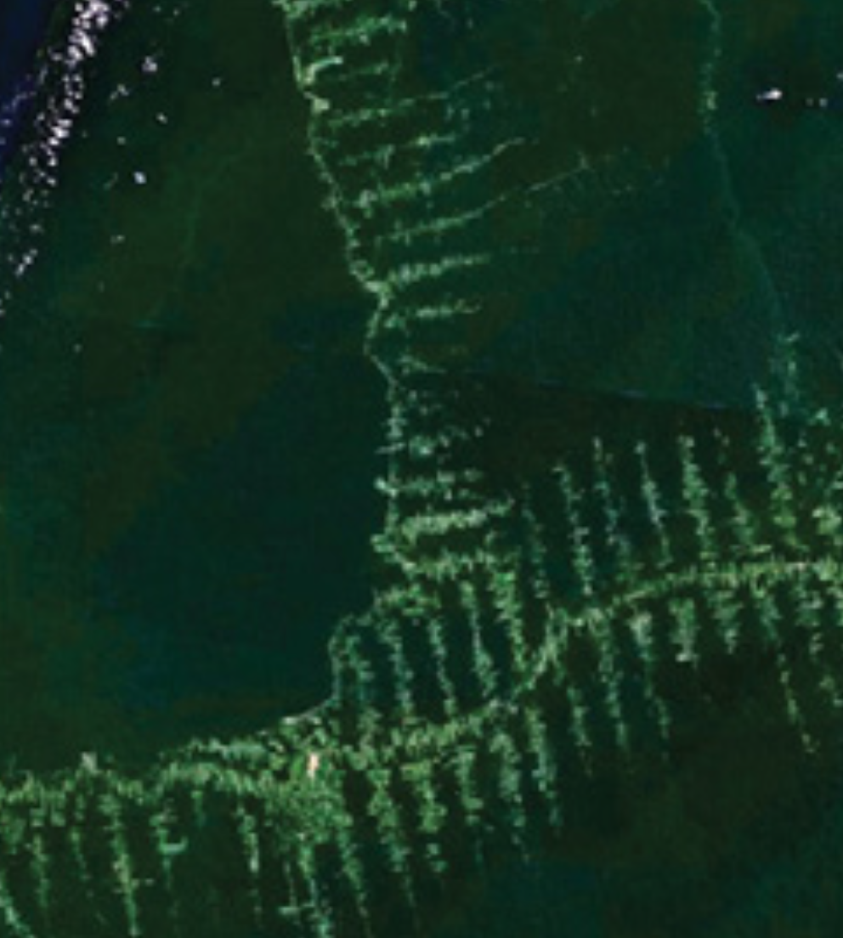
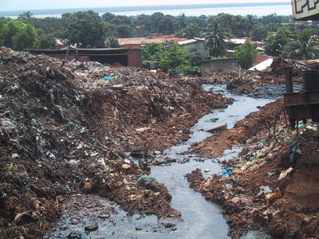
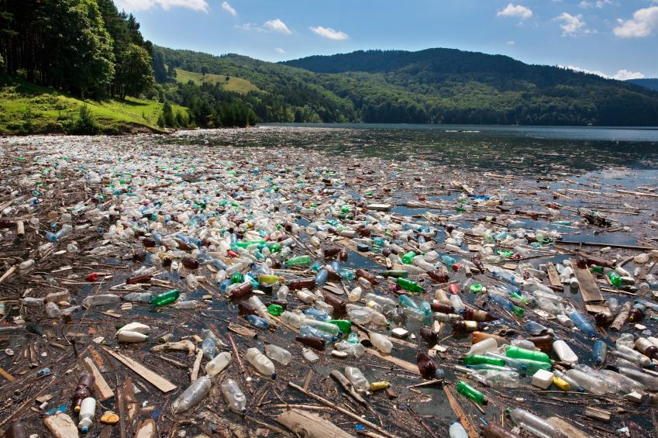
Human Impacts
Pollution
Deforestation

Slide 12
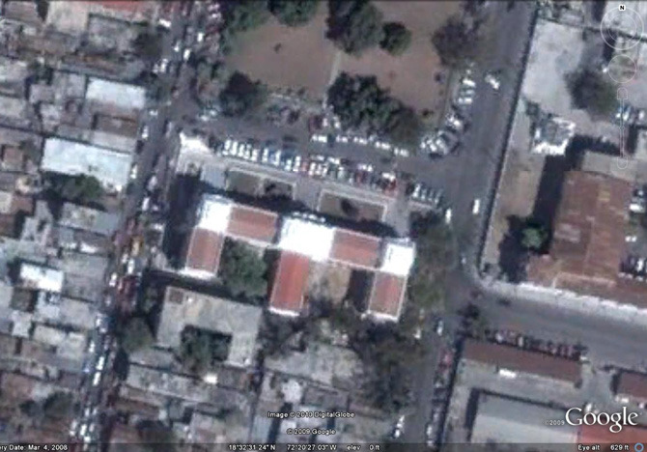
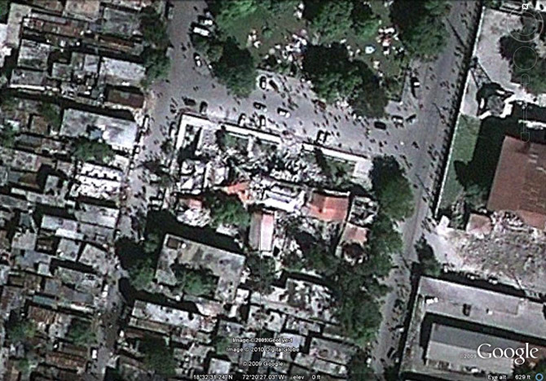
Finding Change Patterns: Infrastructure Damages
Haiti Earthquake Damages

Slide 13
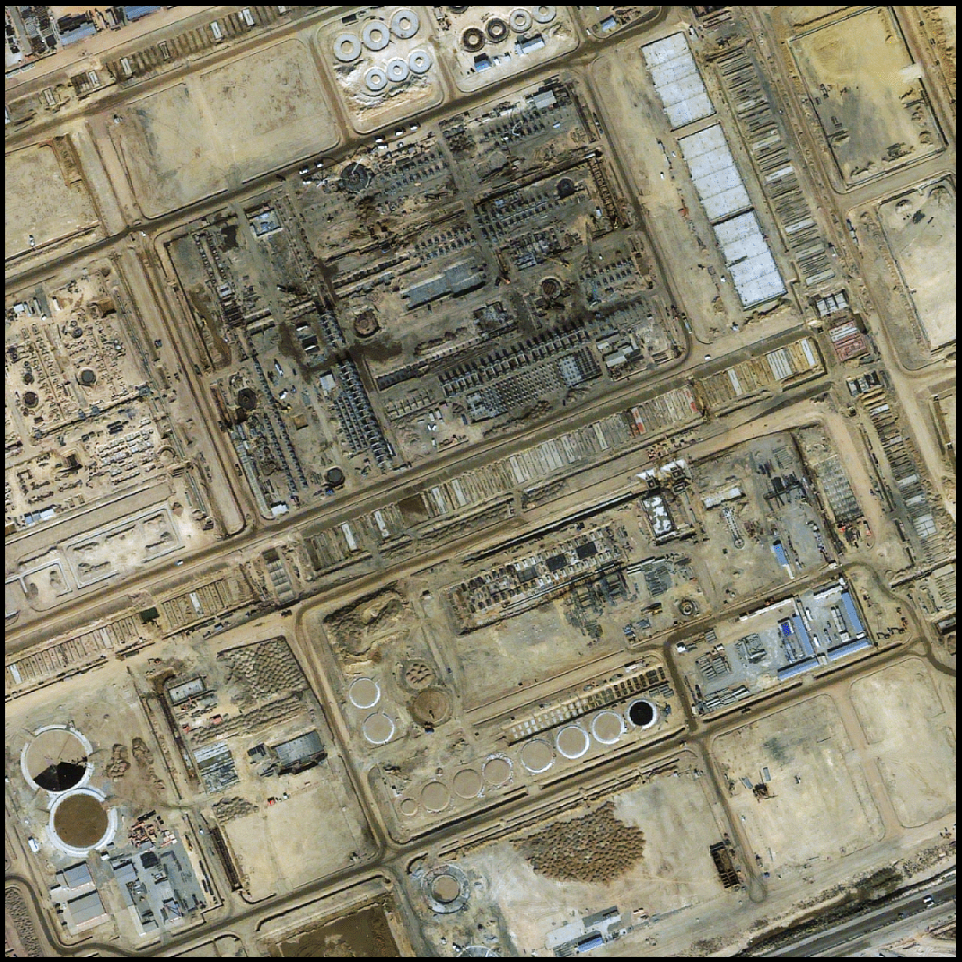
New Construction – Infer Intent
China
New Construction
Can you detect “what it is” based on early
signatures
Or before it is “camouflaged”

Slide 14

Afghanistan Opium Plantations
Drug trafficking operations in Afghanistan have hit record levels despite the $7.8 billion anti-narcotics campaign funded by the U.S. government since 2002. [Washington Examiner, 10/30/14]

Slide 15
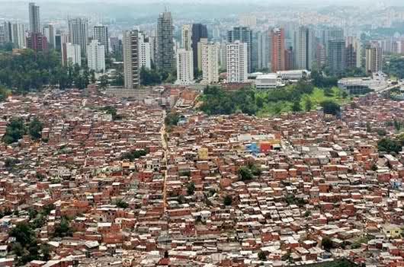
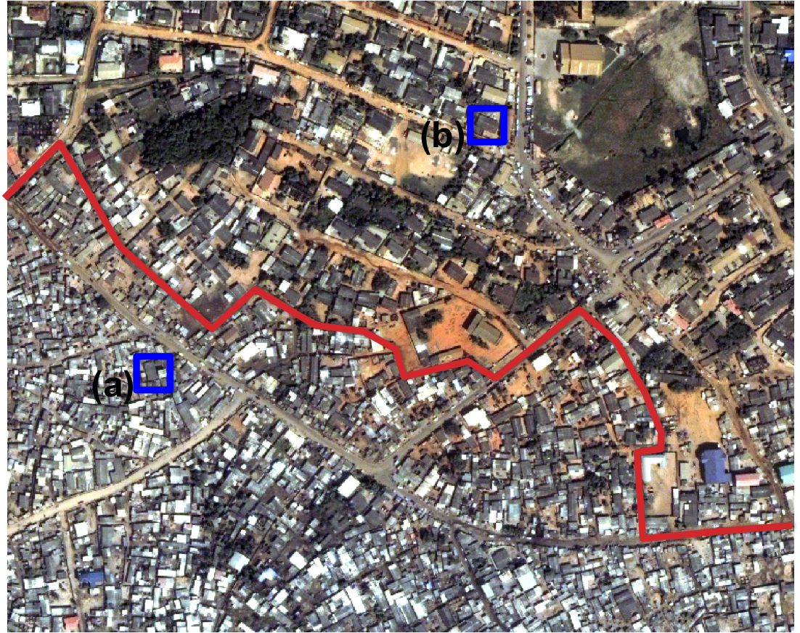
Slum Mapping
Mega Slums
Proportion of population living in slums is increasing
  1950: 0.08 Billion (3%),
  2000: 0.9 Billion (15%),
  2030: 2 Billion (25%)
High-resolution satellite image showing:
Informal settlements (slums) Vs.
Formal settlements
Notes:
Slum mapping requires very high-resolution (1 meter or less) satellite images, which poses both compute and I/O challenges (see next slide)

Slide 16
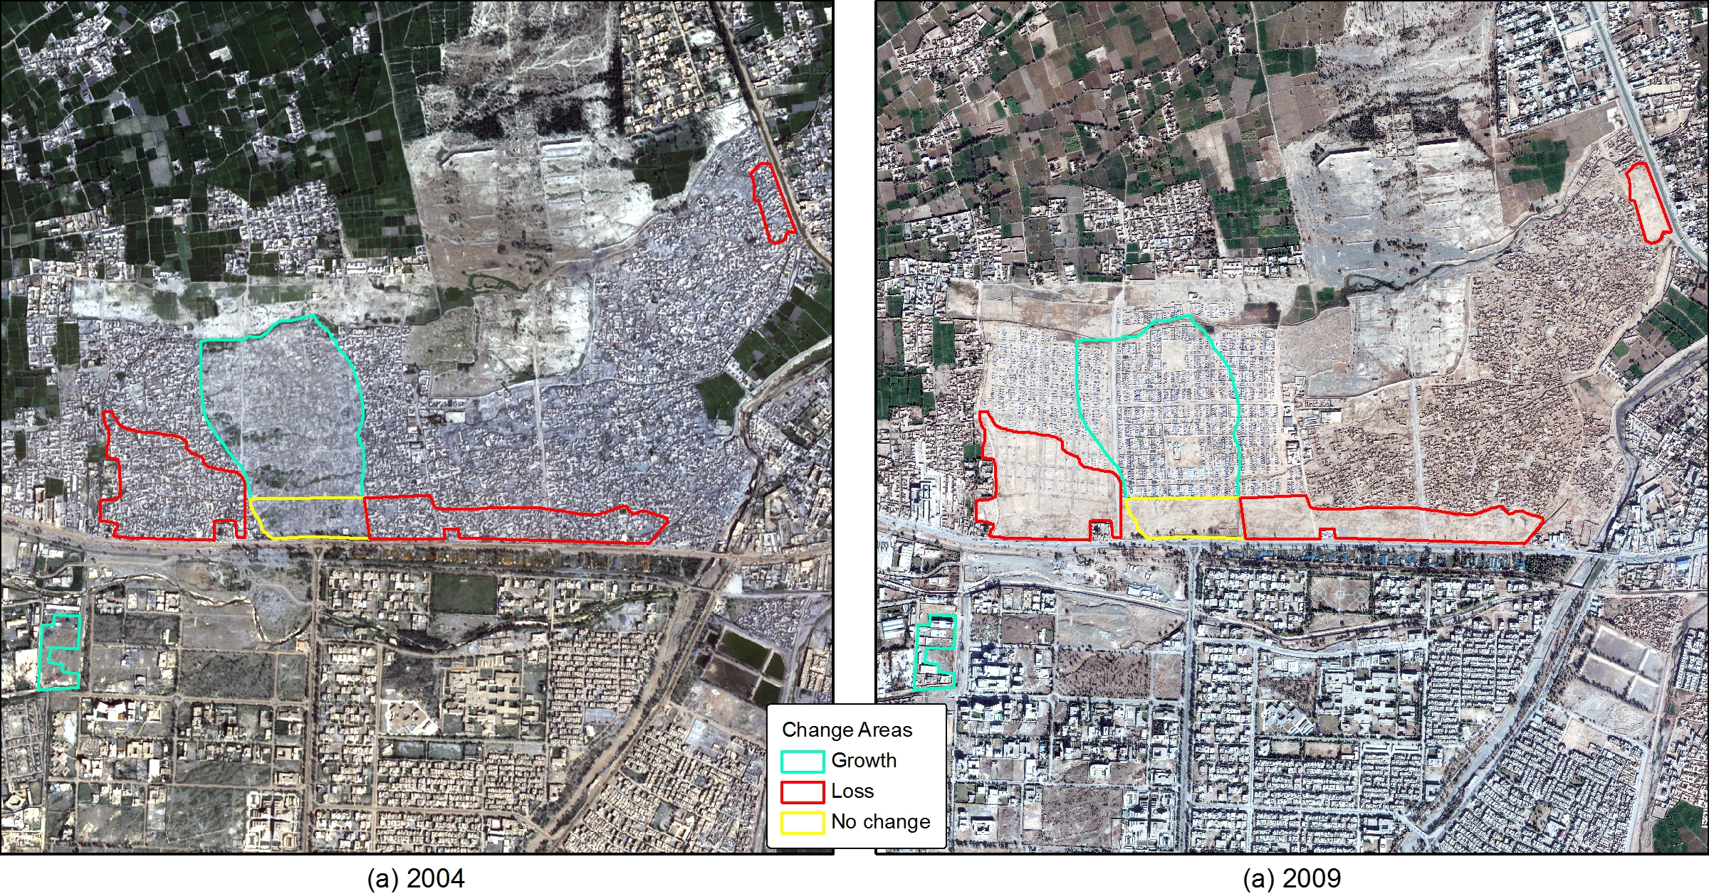
IDP Dynamics
Kacha Garhi Camp, Pakistan
Established 1980 for Afghan Refugees
QuickBird (2004 and 2009, 4B, 2.4m)

Slide 17
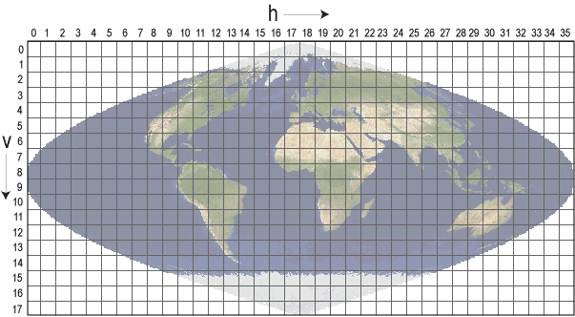
Big Data Challenges
Medium resolution (250 m)
  One Tile = 4800 x 4800 = 23,040,000 (250m)
  10 Trillion time series at Global Scale
  Temporal: Daily to Weakly composite
Very High Resolution (VHR) – 0.5 m
  Land surface ~150 Million km² translates
  600 Trillion pixels.
432 (Land) Tiles
Notes:
Remote sensing data is organized as tiled data products. One has to process 200+ land tiles; each tile (image) contains 23 million pixels (at 250 meter resolution) to 1.4 trillion pixels (at fine resolution of 1 meter). At present 60 cm (0.6 meter) resolution data is commercially available. Each pixel is a multi-dimensional vector (dimensions vary from 1 to ~250; depending on spectral resolution: multi-spectral to hyper-spectral). The land surface of Earth is approximately 149 million square kilometers, which translates into nearly 600 trillion pixels with half-meter resolution satellite imagery.

Slide 18
Role of Spatiotemporal Data Mining
Changes
Damages
Droughts
Cropping Patterns
Classification
Identify natural and man made infrastructures at global scale
Spatiotemporal Data Mining
Complex Patterns
Events
Correlations and Causality
Anomalies
Challenges
Computationally Expensive: O(n²) and O(n³)
IO Challenges (Tera- to Petabytes)

Slide 19
Algorithms for Change Monitoring and Mapping

Slide 20
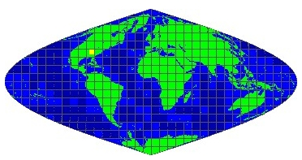
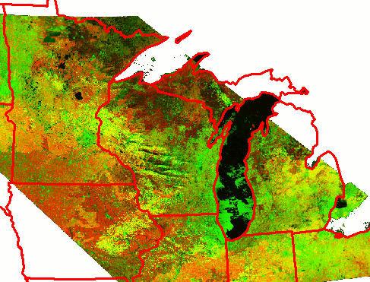
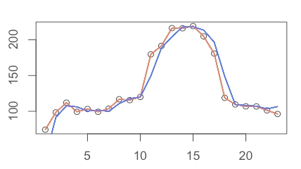
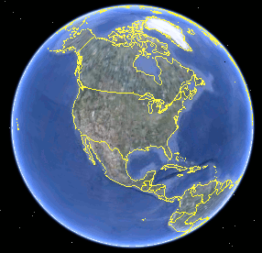
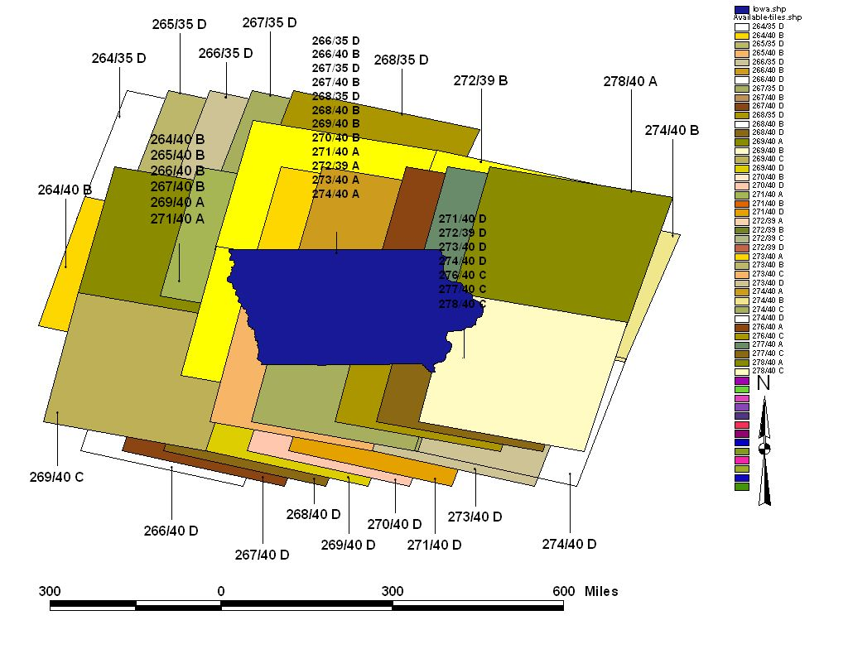
Biomass Monitoring Framework
ISIN Projection
UTM Projection
Filter Each Pixel
Image &
Ancillary Data
FTP-Pull
Change Detection
Time Series Based
  Time Series Prediction
Multidimensional Image Based
  Unsupervised Clustering
MODIS (4800x4800)
3 Bands, 250m, 8-days
2000-2009
H11V04, MOD09Q1
(LP DACC)
27GB; 432 products
Pre-processing
Reprojection
Atmospheric
Filtering
DVDs
AWiFS (12,300x12,000)
4 Bands, 56m
May-Sept. 2008
Iowa, (USDA)
130 Products
Characterize
Changes
Phenology-based
Type-based
GE Visualization

Slide 21
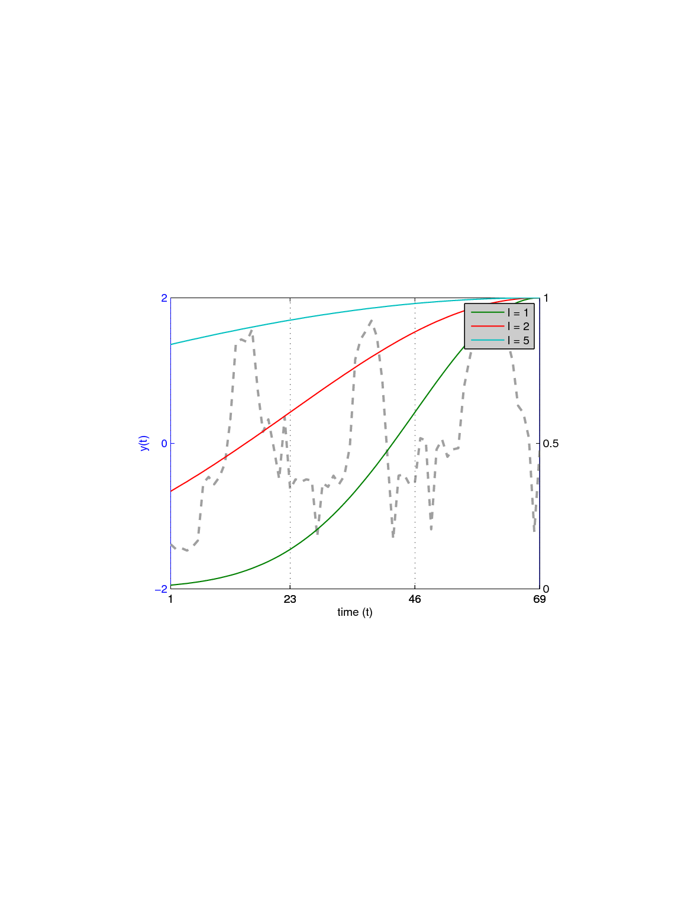
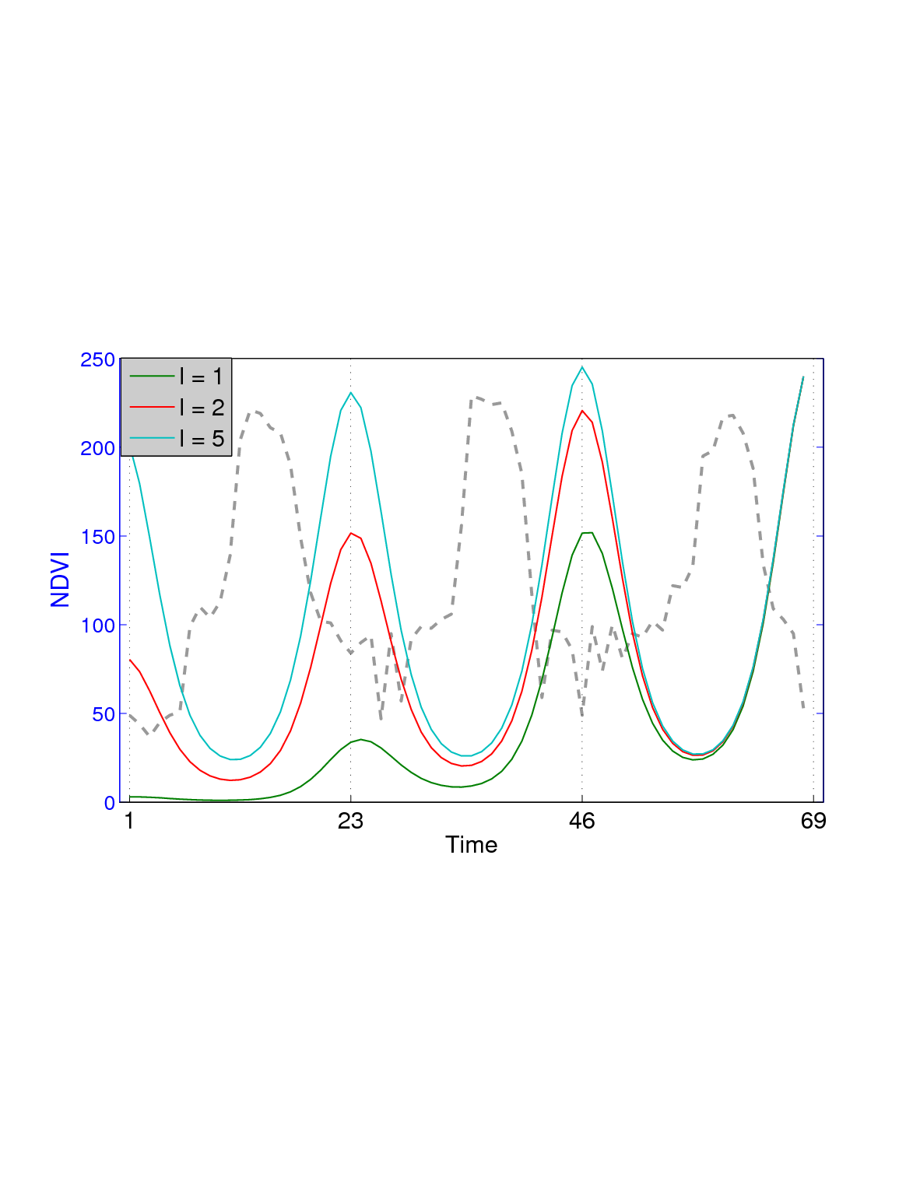
Gaussian Process (GP) Regression
GP Prior
Covariance
  Closer time instances should have similar values
  Can capture seasonality via sinusoid covariance function
Varun Chandola, Ranga Raju Vatsavai: A scalable gaussian process analysis algorithm for biomass monitoring. Statistical Analysis and Data Mining 4(4): 430-445 (2011)
Notes:
Target is a noisy version of latent function
Noise is assumed to be additive Gaussian, though this might not be the case
F can be a nonlinear function
X can be multivariate; y can be multivariate too, though that problem is more challenging

Slide 22
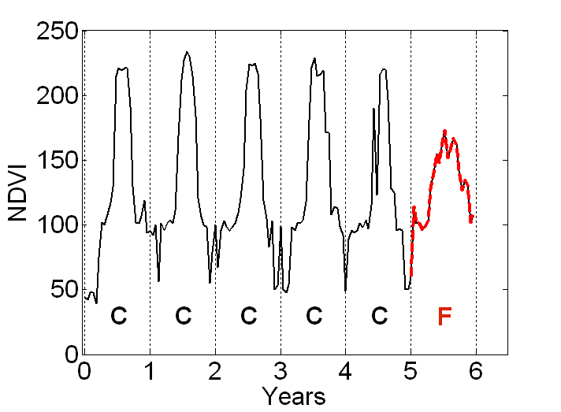
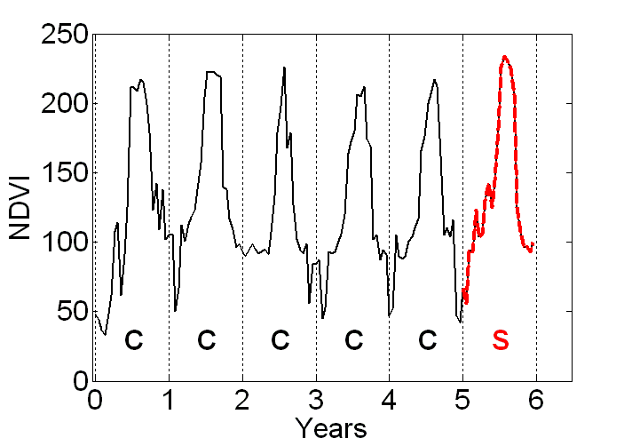
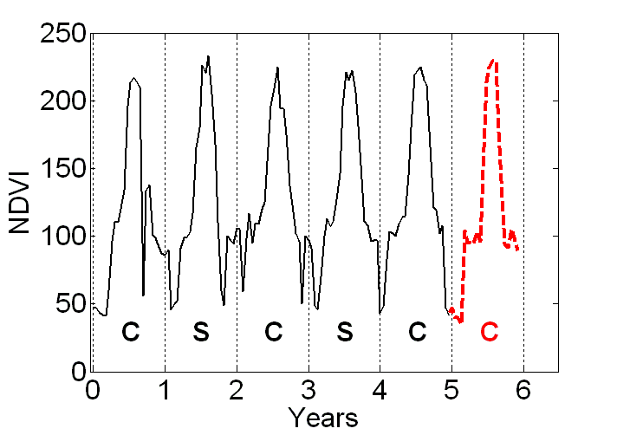
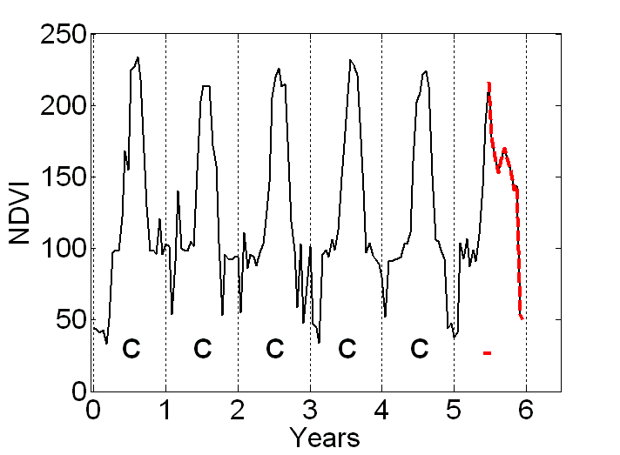
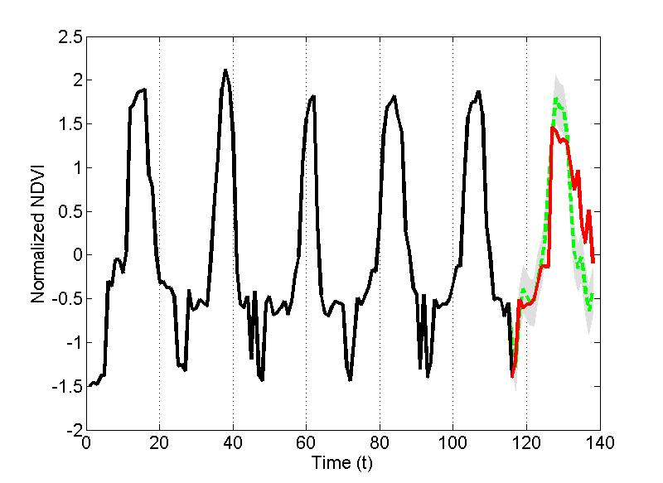
GP Based Change Detection
MODIS NDVI Time Series from Iowa
  6 years (2001 – 2006)
  23 observations per year
Trained for first 5 years and monitored last year
Accuracy was 88% on a validation set consisting of 97 labeled time series with 13 true changes
But, computation: O(n³), mem: O(n²)
Variance
Predicted
Observed
No Change
Change

Slide 23
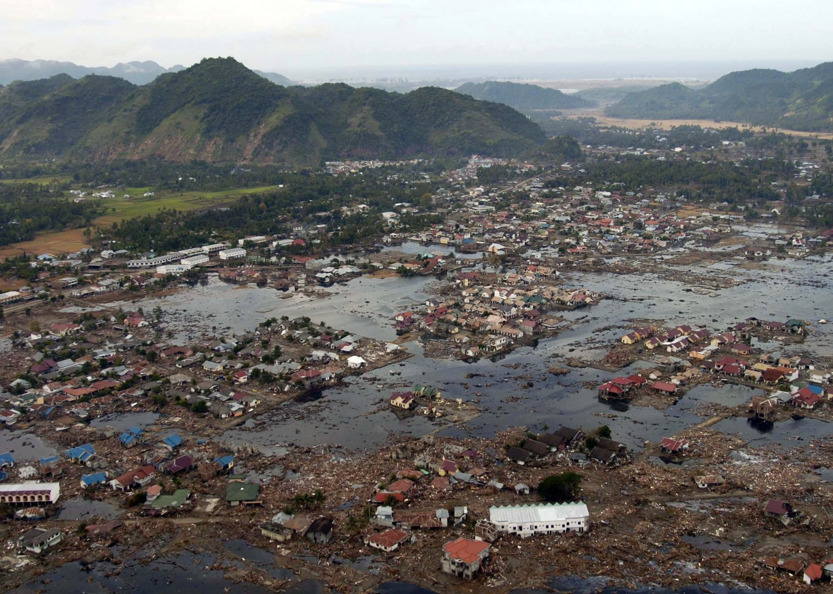
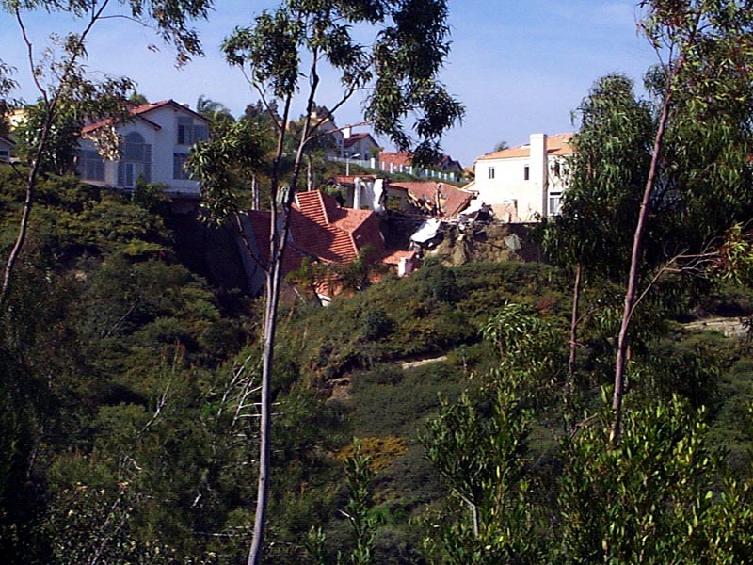
Damage Assessments
Settlement Dynamics
  Damages to existing structures
  New construction
Biomass
  Forest fires
  Floods and Hail Storms
  Disease

Slide 24
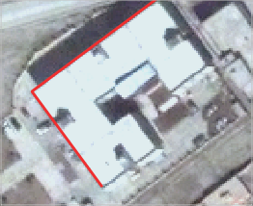
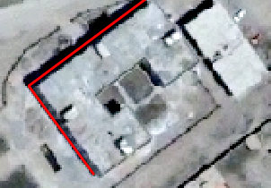
Pixel-based Change Detection
At each pixel, or small neighborhood
Mostly univariate
Multivariate (e.g., MAD) techniques produce multi-band change maps
Requires “thresholding” to generate change maps

Slide 25
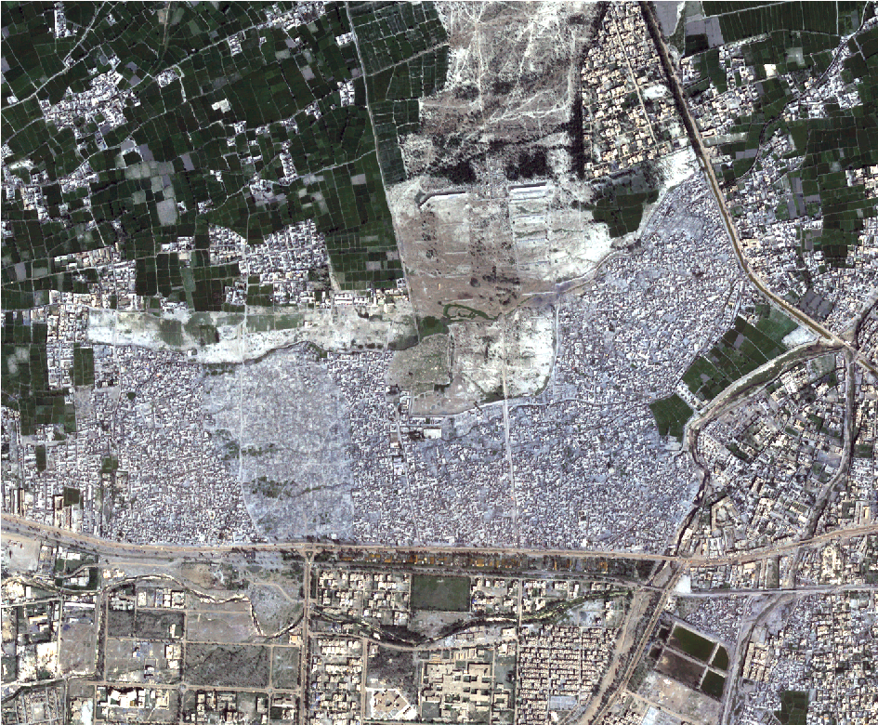
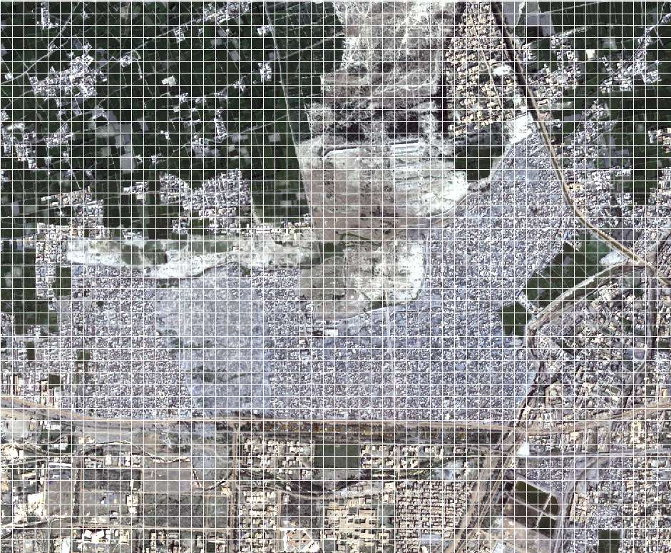
Probabilistic Change Detection
Convert to grids
Model each grid as statistical distribution
Compute “distance” between distributions
Distance as a feature
Build GMM on distance features
Clusters range from no-change to change

Slide 26
Probabilistic Change Detection
Convert to grids
Model each grid as statistical distribution
Compute “distance” between distributions
Distance as a feature
Build GMM on distance features
Clusters range from no-change to change
Multivariate Gaussian Distribution

Slide 27
Probabilistic Change Detection
Convert to grids
Model each grid as statistical distribution
Compute “distance” between distributions
Distance as a feature
Build GMM on distance features
Clusters range from no-change to change

Slide 28
Probabilistic Change Detection
t₁
Convert to grids
Model each grid as statistical distribution
Compute “distance” between distributions
Distance as a feature
Build GMM on distance features
Clusters range from no-change to change
t₂
t1
t2
Highly overlapping (no-change) to No overlap (change)

Slide 29
Application – IDP Dynamics
Kacha Garhi Camp, Pakistan
Established 1980 for Afghan Refugees
QuickBird (2004 and 2009, 4B, 2.4m)

Slide 30
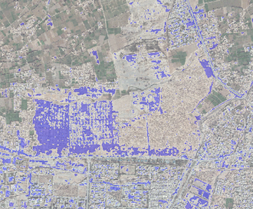
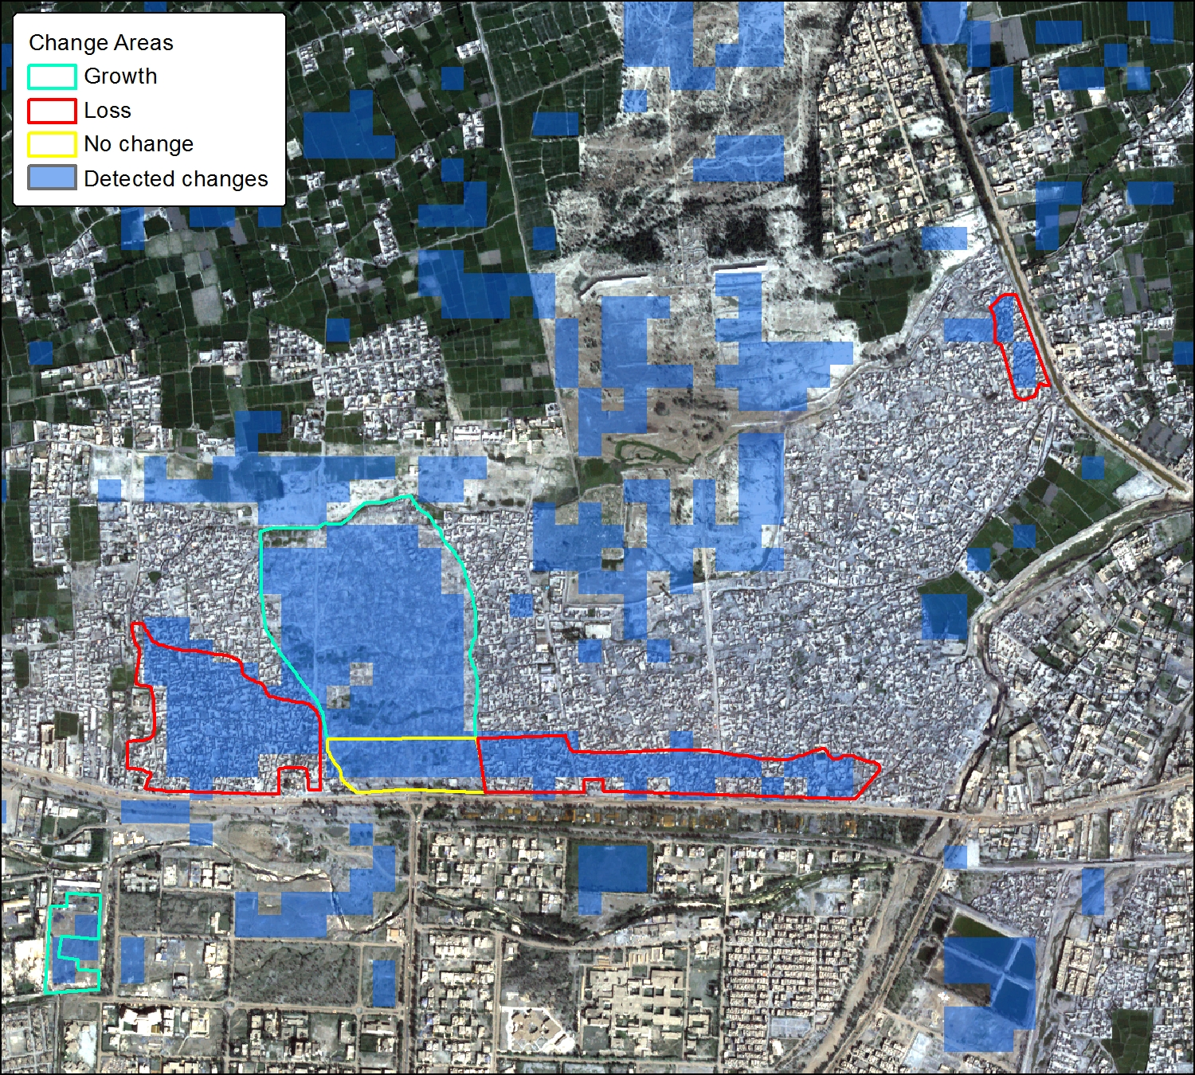
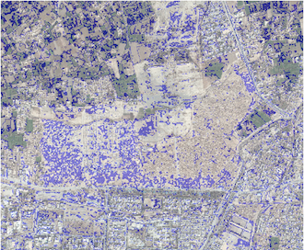
Experimental Results
Difference
Ratio
Probabilistic (85%)
Ranga Raju Vatsavai, Jordan Graesser: Probabilistic Change Detection Framework for Analyzing Settlement Dynamics Using Very High-resolution Satellite Imagery. ICCS 2012: 907-916

Slide 31
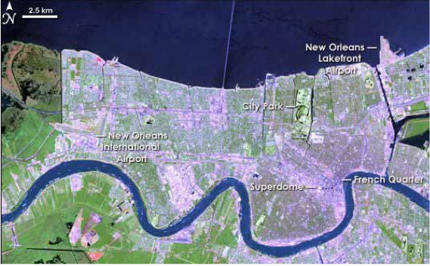
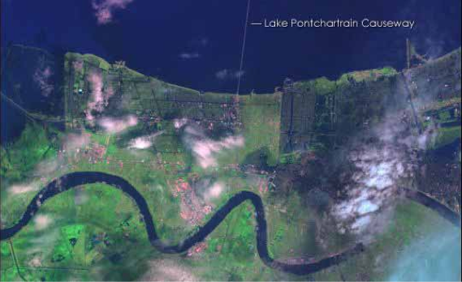
Problems With Optical Images
Optical images may not be suitable for change detection during climate related events due to clouds
Synthetic Aperture Radar (SAR)
  Penetrates clouds
  Speckle noise makes image exploitation hard
  Geometric configuration of image acquisition makes it difficult to compare
4/26/05
8/30/05

Slide 32
Flood Mapping With SAR Imagery
SAR Imagery during Ike – noise, spatial resolution (1.56m vs. 12.5m)
8/31/08
9/13/08

Slide 33
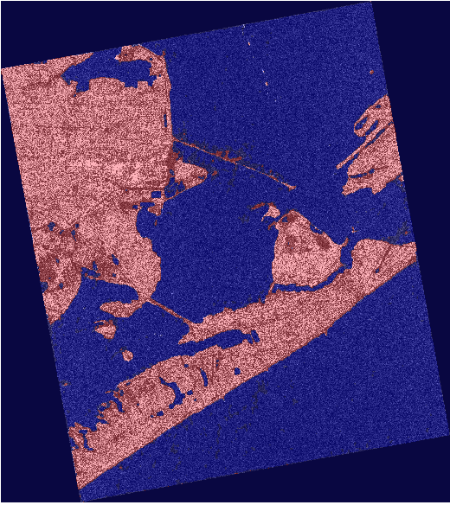

Results
Off-the-shelf techniques predict almost every pixel as change
Our Probabilistic
Framework
Ratio

Slide 34
Classification
  Insufficient Ground-truth
    Semi-supervised Learning
  Complex Objects
    Multiple Instance Learning

Slide 35
Training – Reality
In general, ground truth is less than optimal
#of training samples ~ (10 to 30) * (#of dimensions)
Challenges
    Costly ~ $500-$800 per plot (depends on geographic area)
    Accessibility, privacy concerns
      USFS may average 5% denied access
    Emergency situations
    Foreign/Un-friendly countries

Slide 36
How To Deal With Small Samples?
Dimensionality reduction (Ghosh et. al., MCC-02)
Increase number of samples
  Bagging [Brieman, ML-96]
Incorporate unlabeled samples
  Semi-supervised learning
    Self-training (Rosenberg, et. al. ACV-05)
    EM-based (Nigam et. al. JML-00)
    Co-Training (A. Blum and T. Mitchell. COLT-98)
Notes:
This slide needs lot of improvements
Kearns and Valiant [30, 31] were the first to pose the question of whether a “weak” learning
algorithm which performs just slightly better than random guessing in the PAC model can be
“boosted” into an arbitrarily accurate “strong” learning algorithm. Schapire [38] came up with the
first provable polynomial-time boosting algorithm in 1989. A year later, Freund [17] developed
a much more efficient boosting algorithm which, although optimal in a certain sense, nevertheless
suffered from certain practical drawbacks. The first experiments with these early boosting
algorithms were carried out by Drucker, Schapire and Simard [16] on an OCR task.
Bagging (= Bootstrap aggregating) produces replications of the training
set by sampling with replacement.
• Each replication of the training set has the same size as the original
set, but some examples can appear more than once while others don’t
appear at all.
• A classifier is generated from each replication.
• All classifiers are used to classify each sample from the test set using a
voting scheme.
---
Seff training – labeled model to predict labels for unlabled samples, select confident subset and add it to labeled

Slide 37

True Distribution
Estimated Distribution
(Small Samples; MLE are good asymptotically)

Slide 38

Initial Estimates +
Unlabeled Samples

Slide 39

Iteratively Update Parameters
Using Unlabeled Samples

Slide 40

Iteratively Update Parameters
Using Unlabeled Samples

Slide 41

Iteratively Update Parameters
Using Unlabeled Samples

Slide 42

Final parameters
after convergence

Slide 43
SSL at Convergence
Given D = D^{l}, D^{ul}
D^{l} to estimate (MLE) initial parameters
Repeat until converges
E-Step
M-Step
Output parameters

Slide 44
SSL Performance
SSL performance with respect to the best and worst BC results
Not Robust, Why?

Slide 45





Limitation of SSL
True Distribution
Labeled
Unlabeled
1
3
1
2
3
1
2
3
Match
2
Labeled +Unlabeled
1
3
1
3
1
3
Clustering
Adaptive Semi-supervised
Naïve Semi-supervised

Slide 46
Adaptive Semi-supervised Learning
Adaptive semi-supervised Learning
  Matching clusters with classes using statistical hypothesis testing with desired confidence threshold
  Pooling samples from matched cluster-class pairs to obtain new estimates
As number of samples increases, sample mean approaches the population mean
Assumptions
  Classes and Clusters are described by pdfs
  Pdfs for classes are distinguishable (separable)‏
  Pdfs for clusters are separable
  Parameters can be separately estimated
Model = GMM
L
UL
EM
D_{u}
Matching
Classifier (MLC, MAP)‏
Notes:
CI – A level C confidence interval for a parameter is an interval computed from sample data by a method that has probability C of producing an interval containing the true value of the parameter.
Law of large numbers says that the sample mean must approach the population mean as the size of sample grows.
Unbiasedness says that there is no systematic tendency to underestimate or overestimate the truth.
As estimate without an indication of its variability is of little value.

Slide 47


Finding Optimal Number of Clusters
G-Means
X-Means
Notes:
1-d projection, AD-test

Slide 48


GX-Means
Inputs: D, sample dataset; significance (default p-value = 0.05), initial K (default = 2), nClusters = K
Loop 1: WHILE (TRUE):
Loop 2: FOR 1:nClusters
Statistical test: Shapiro-Wilk test.
Check: IF a cluster fails statistical test,
THEN split that cluster into two
clusters using GMM-Clustering; increment nClusters and K;
ELSE accept cluster,
decrement nClusters
Clustering: GMM-Clustering(failed-cluster
data-samples, new K)
Merge: Compute KL-Divergence,
IF two-clusters are closer than threshold,
THEN decrement K
continue (Loop 2)
Check: IF nClusters = 0 (break, Loop 1)
Output: Parameter vector Θ.

Slide 49

GX-Means
Inputs: D, sample dataset; significance (default p-value = 0.05), initial K (default = 2), nClusters = K
Loop 1: WHILE (TRUE):
Loop 2: FOR 1:nClusters
Statistical test: Shapiro-Wilk test.
Check: IF a cluster fails statistical test,
THEN split that cluster into two
clusters using GMM-Clustering; increment nClusters and K;
ELSE accept cluster,
decrement nClusters
Clustering: GMM-Clustering(failed-cluster
data-samples, new K)
Merge: Compute KL-Divergence,
IF two-clusters are closer than threshold,
THEN decrement K
continue (Loop 2)
Check: IF nClusters = 0 (break, Loop 1)
Output: Parameter vector Θ.
True
(Accept)
False
(Split into Two)

Slide 50

GX-Means
Inputs: D, sample dataset; significance (default p-value = 0.05), initial K (default = 2), nClusters = K
Loop 1: WHILE (TRUE):
Loop 2: FOR 1:nClusters
Statistical test: Shapiro-Wilk test.
Check: IF a cluster fails statistical test,
THEN split that cluster into two
clusters using GMM-Clustering; increment nClusters and K;
ELSE accept cluster,
decrement nClusters
Clustering: GMM-Clustering(failed-cluster
data-samples, new K)
Merge: Compute KL-Divergence,
IF two-clusters are closer than threshold,
THEN decrement K
continue (Loop 2)
Check: IF nClusters = 0 (break, Loop 1)
Output: Parameter vector Θ.
True
(Accept)
False
(Split)

Slide 51
GX-Means
Inputs: D, sample dataset; significance (default p-value = 0.05), initial K (default = 2), nClusters = K
Loop 1: WHILE (TRUE):
Loop 2: FOR 1:nClusters
Statistical test: Shapiro-Wilk test.
Check: IF a cluster fails statistical test,
THEN split that cluster into two
clusters using GMM-Clustering; increment nClusters and K;
ELSE accept cluster,
decrement nClusters
Clustering: GMM-Clustering(failed-cluster
data-samples, new K)
Merge: Compute KL-Divergence,
IF two-clusters are closer than threshold,
THEN decrement K
continue (Loop 2)
Check: IF nClusters = 0 (break, Loop 1)
Output: Parameter vector Θ.

Slide 52

GX-Means
Inputs: D, sample dataset; significance (default p-value = 0.05), initial K (default = 2), nClusters = K
Loop 1: WHILE (TRUE):
Loop 2: FOR 1:nClusters
Statistical test: Shapiro-Wilk test.
Check: IF a cluster fails statistical test,
THEN split that cluster into two
clusters using GMM-Clustering; increment nClusters and K;
ELSE accept cluster,
decrement nClusters
Clustering: GMM-Clustering(failed-cluster
data-samples, new K)
Merge: Compute KL-Divergence,
IF two-clusters are closer than threshold,
THEN decrement K
continue (Loop 2)
Check: IF nClusters = 0 (break, Loop 1)
Output: Parameter vector Θ.
Ranga Raju Vatsavai, et. al: GX-Means: A model-based divide and merge algorithm for geospatial image clustering. ICCS 2011: 186-195

Slide 53
Spatial Semi-supervised Learning
MRF extension for GMM/EM has no closed-form solution*
Modified E-Step:
    Optimize contextual energy
    Repeat (fixed number of iterations)
  Update e_{ij}
*Ranga Raju Vatsavai, Shashi Shekhar, Thomas E. Burk: An efficient spatial semi-supervised learning algorithm. IJPEDS 22(6): 427-437 (2007)

Slide 54




Experimental Results
Comparison of S-SSL with BC, BC-MRF, SSL
Often accuracy is not true indicator of the quality of the product
BC (60%)
SSL (68%)
BC-MRF (65%)
S-SSL (72%)

Slide 55



Slum Mapping
Proportion of population living in slums is increasing
  1950: 0.08 Billion (3%),
  2000: 0.9 Billion (15%),
  2030: 2 Billion (25%)
Most Vulnerable to disasters
Mega Slums: Rio
West African Cholera
Bangladesh
-Fires
Notes:
Source: UN-HABITAT
Between 1978 and 2000, there were more murders in Rio de Janeiro than in the entire nation of Colombia. A parallel state emerged, where favela residents had to get permission from armed drug-trafficking gangs to go in and out of their own neighborhoods.
As Rio de Janeiro gears up for the World Cup and Olympics, police have begun to patrol a selected number of favelas for the first time, in areas near where the games will take place, as part of a program called UPP (Police Pacification Unit).

Slide 56
What are we good at?
Pixel-based (aka Single-instance): Matured
Object-based:
  Segmentation (challenging task)
  Feature extraction (matured)
  Single-instance classification (matured)
Complex Object-based: New
Segmentation
Graph-based
GMM/EM
…
Feature Extraction
Texture
Classification – Training
Bayesian
Neural
…
Classification – Testing
Contingency Table
Mean Shift
…
Shape features (area, perimeter, compactness, …)
Decision Trees
SVM
ROC
Kappa

Slide 57
Pixel-Based Classification
Pixel-based or single-instance classification
Pixels from different objects
Difficult to distinguish

Slide 58

Object-Based Classification
Object based classification
Objects (buildings) from different neighborhoods
Good for recognizing objects, but difficult to distinguish neighborhoods

Slide 59



Object Based Classification
Mean Shift Segmentation + SVM Classification
Object based methods are more effective than pixel based methods for VHR images
Shape features may help discriminate between object types (large buildings vs. small buildings)
Classification is still single instance learning

Slide 60
Complex Object-Based Classification
Complex object (patch) based classification
Focus is not objects – but the distribution of objects within a patch
Good for recognizing complex patterns – neighborhoods

Slide 61


















Complex Object Based Image Analysis
Objective is same as pixel-based, however instead of pixels we are dealing with patches
  Given a model (set of image patches)
  Predict class label for a new sample (patch)
Informal
Water
Challenges:
How to compute similarity between patches?
Moving from single instance learning to multiple instance learning
Q
Formal
Forest
Training Objects (Bags)

Slide 62
Single Instance Vs. Multiple Instance Learning
Positive
Each window (segment/object) is modeled as bag of points
Each bag is labeled as +1/-1
A new bag is positive if at least one instance in the bag is on the positive side of the decision surface
A new bag is is negative if all points in the bag are on the negative side of the decision surface
Negative
Single Instance Learning
Multiple Instance Learning

Slide 63
Nearest Neighbor Solution
How to compute similarity between patches?
  Citation-KNN
    Hausdorff distance
Citation-KNN:
O(n²Nd)
Training
Bag (B²)
Training
Bag (B¹)
Query
Bag
n = number of elements in a patch/bag
N = number of training bags
d = dimensionality
Training
Bag (B³)
Notes:
HD: measures how far two subsets of a metric space are from each other. Informally, two sets are close in the Hausdorff distance if every point of either set is close to some point of the other set. In other words, it is the greatest of all the distances from a point in one set to the closest point in the other set.

Slide 64
Gaussian MIL
Instead of Hausdorff distance, compute KL Divergence
Informal
Water
Formal
1
Formal = 3
Informal = 2
=> C = Formal
2
5
3
2
1
4
Q
3
5
K=5
4
6
7
Ranked list of matches
G
Informal
8
R
Formal
Forest
Training Objects (Bags)

Slide 65


GMIL Classification Output
FCC (RGB)
FCC (RGB) + GMIL Classification Overlay
Ranga Raju Vatsavai: Gaussian multiple instance learning approach for mapping the slums of the world using very high resolution imagery. KDD 2013: 1419-1426

Slide 66
Experimental Results
City | Citaiton-KNN | Regression | RF | MLP | NB | GMIL Model
Accra | 76.25 | 71.25 | 72.08 | 69.58 | 75.66 | 95.66
Caracas | 82.96 | 78.15 | 81.85 | 81.81 | 74.07 | 85.00
La Paz | 80.97 | 77.17 | 78.26 | 80.23 | 76.08 | 83.25
Kandahar | 79.78 | 64.89 | 69.14 | 73.93 | 60.1 | 81.20
DigitalGlobe CitySphere Imagery
Spatial Resolution
  0.6 meters
Spectral Resolution
  3 Bands (RGB)
Milwaukee, Wisconsin, USA
RGB, 1 meter
Downtown (82/89)
Residential (49/42)
Grass (13/8)
Trees (7/11)
Feature (NDVI, ED)
GMIL (82.8%)
GMIL-IF (79.7%, 81.6%)
GMIL-IF
Vatsavai, IEEE Big Data Congress, 2015
Vatsavai, KDD-2013

Slide 67
Big Spatial Data Challenges and HPC

Slide 68
Big Spatial Data Challenges
Data
~ TBs
Feature
Extraction
SIFT/ SURF
Feature
Selection
PCA
Compression
Model Generation and Prediction
Evaluation
Accuracy
Scalability
I/O Read
I/O Write
~50x Input
I/O Read and Write
Multisource and Spatial
O(n²) and O(n³)
Big Data (Global Scale Problems)
Cyber Infrastructure (Enabling Technology)
Knowledge Discovery (Compute & IO Challenges)

Slide 69
Parallelization Results
Gaussian Process (GP) Learning
Computation: O(t³)
Memory: O(t²)
CBLAS for basic operations
CLAPACK for Cholesky decomposition
Task: estimate hyper-parameters for 1 million time series
Machine;
  Frost – SGI Altrix ICE 8200
  128 Compute nodes, 16 virtual cores/node, 24GB

Slide 70

Distributed GMM Clustering
Expectation Maximization is a local optimization algorithm
  Different initialization
Multiple sampling
Local model at each node
Global model from local models
Pair-wise KLDivergence
MapReduce Implementation

Slide 71




Change Detection
Shared Memory; OpenMP Parallelization
Node: 16 Core Intel Xeon, 64 GB
1m, RGB, 6972x6984

Slide 72
GMIL Classification
Node Configuration
  2 x Dual Xeon X5690 Processor, Hexa 3.46GHz cores, 12MB L3 Cache
  48GB 1333MHz ECC DDR3
Data: 1 Km²; 1M pixels; 10x10 block
Scalability Results
  Citation-KNN: 27.8 Hours
  Approximate Citation-KNN: 22.22 Hours
  Parallel Citation-KNN: 2.62 Hours
  GMIL: 3.1 Hours
  GMIL-IF: 51 Minutes
  Parallel GMIL: 20 minutes
CKNN > A-CKNN (1.25x) > P-CKNN (10.6x)
CKNN > GMIL (8.97x) > GMIL-IF (3.7x)

Slide 73
Summary
Better Data Collection Methods
  Improvements in spatial, spectral, temporal resolutions
  Big spatial and temporal data
Better (Newer) Machine Learning Models
Novel HPC Architectures
  1 TF @ 10 W (credit card sized supercomputers)
Future
  Novel and scalable machine learning algorithms that deal with heterogeneity, complex relationships, and domain constraints
  Onboard processing/edge computing
  Need to bring research prototypes to user community

Slide 74
Acknowledgements
Initial work was carried out at the Oak Ridge National Laboratory
Collaborators: V. Chandola, B. Bhaduri, J. Grasser, A. Cheriyadat, E. Bright, S. Shekhar, V. Kumar, J. Ghosh, S. Ranka
STAC Group Members @ NCSU
Center for Geospatial Analytics @ NCSU

