Slide 1

Advanced Aerospace Materials: “Beyond the Next” Workshop
June 21-22, 2016
Future Prospects for SWCNT Fibers -- Can We Approach the Staudinger Continuous Crystal Limit for Single Wall Carbon Nanotube Fibers?
¹W. Wade Adams, ¹Edwin L. Thomas,
and ²Satish Kumar
¹Rice University, Houston, TX
²Georgia Institute of technology

Slide 2
Ultimate Properties of Polymers
Staudinger Continuous Crystal Model
Perfect orientation
Perfect lateral order
Few chain end defects (HMW)
+
INTRINSIC CHAIN PROPERTIES
Hermann Staudinger, Die Hochmolekularen Organischen Verbindungen, Berlin: Springer p.111 (1932)

Slide 3
80 Years Ago…
“We recognized in the 30’s that the best polymer would be a rigid rod…
but we just did not know how to make one!”
Herman F. Mark, to Wade Adams at the
MRS Meeting, December 1988,
First Ever Symposium on Rigid Rod Polymers

Slide 4
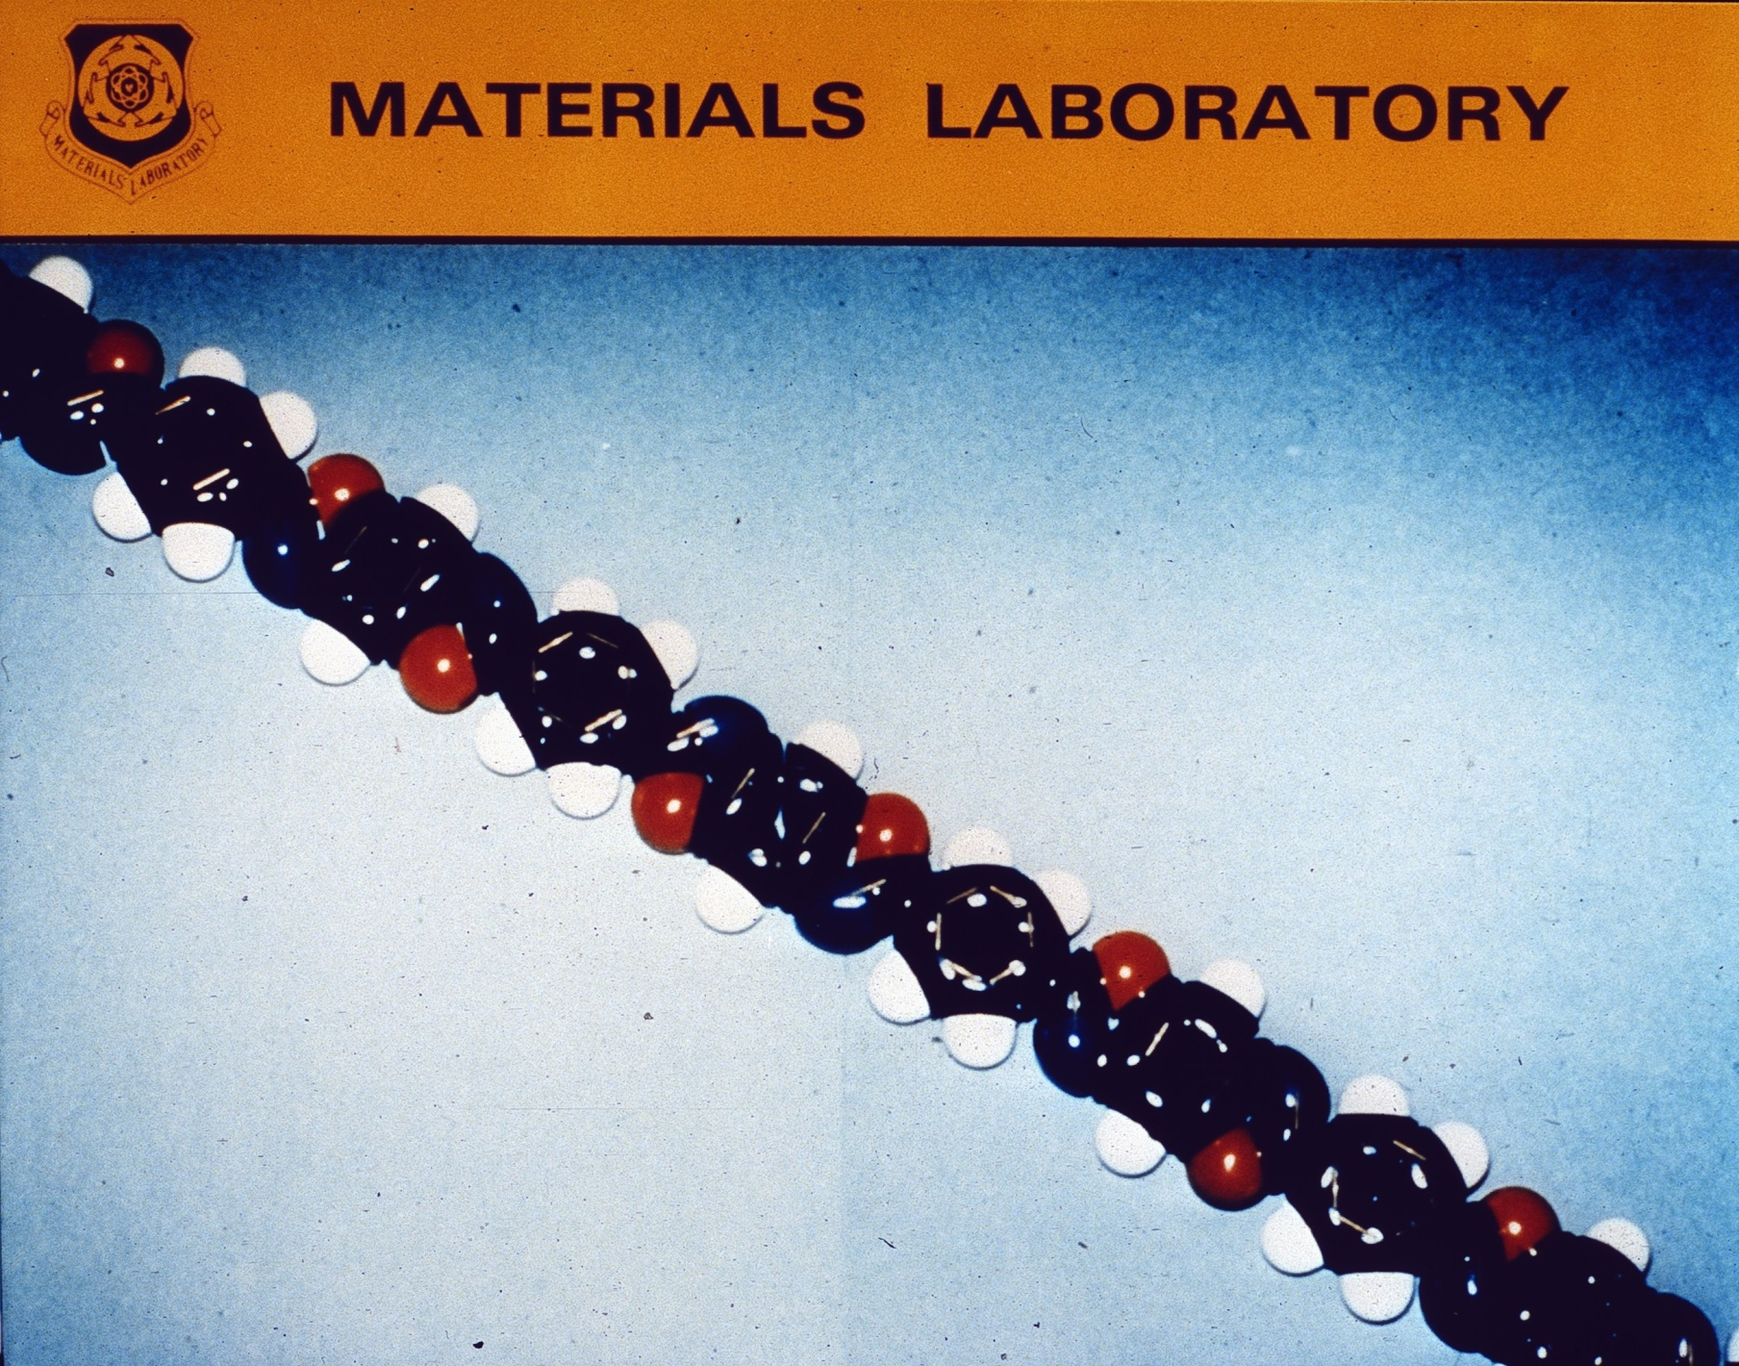
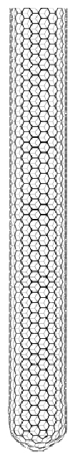

Slide 5
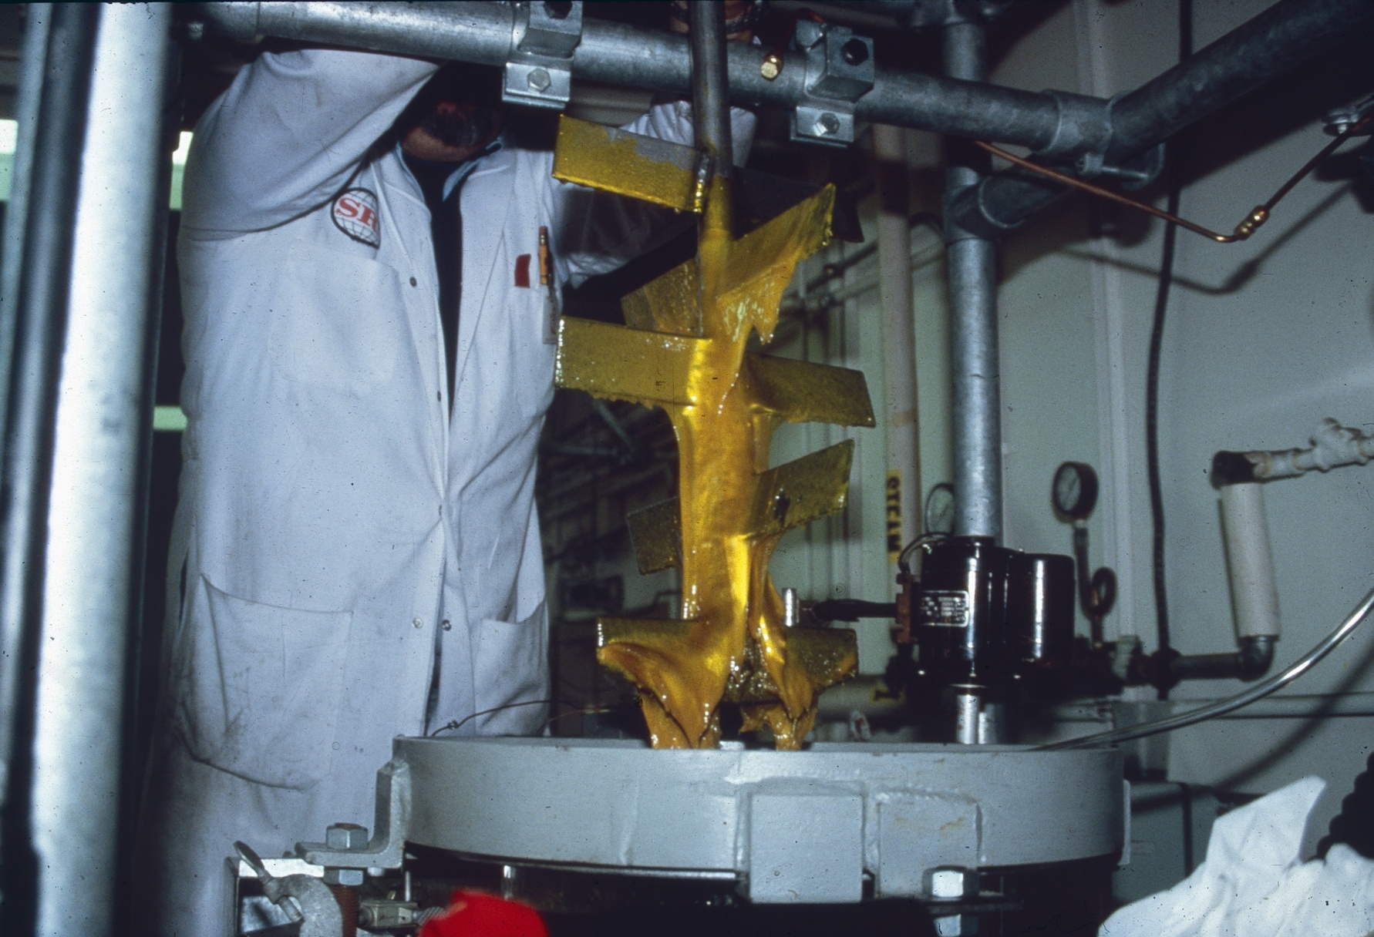
Liquid Crystalline PBO as synthesized from PPA at SRI International

Slide 6
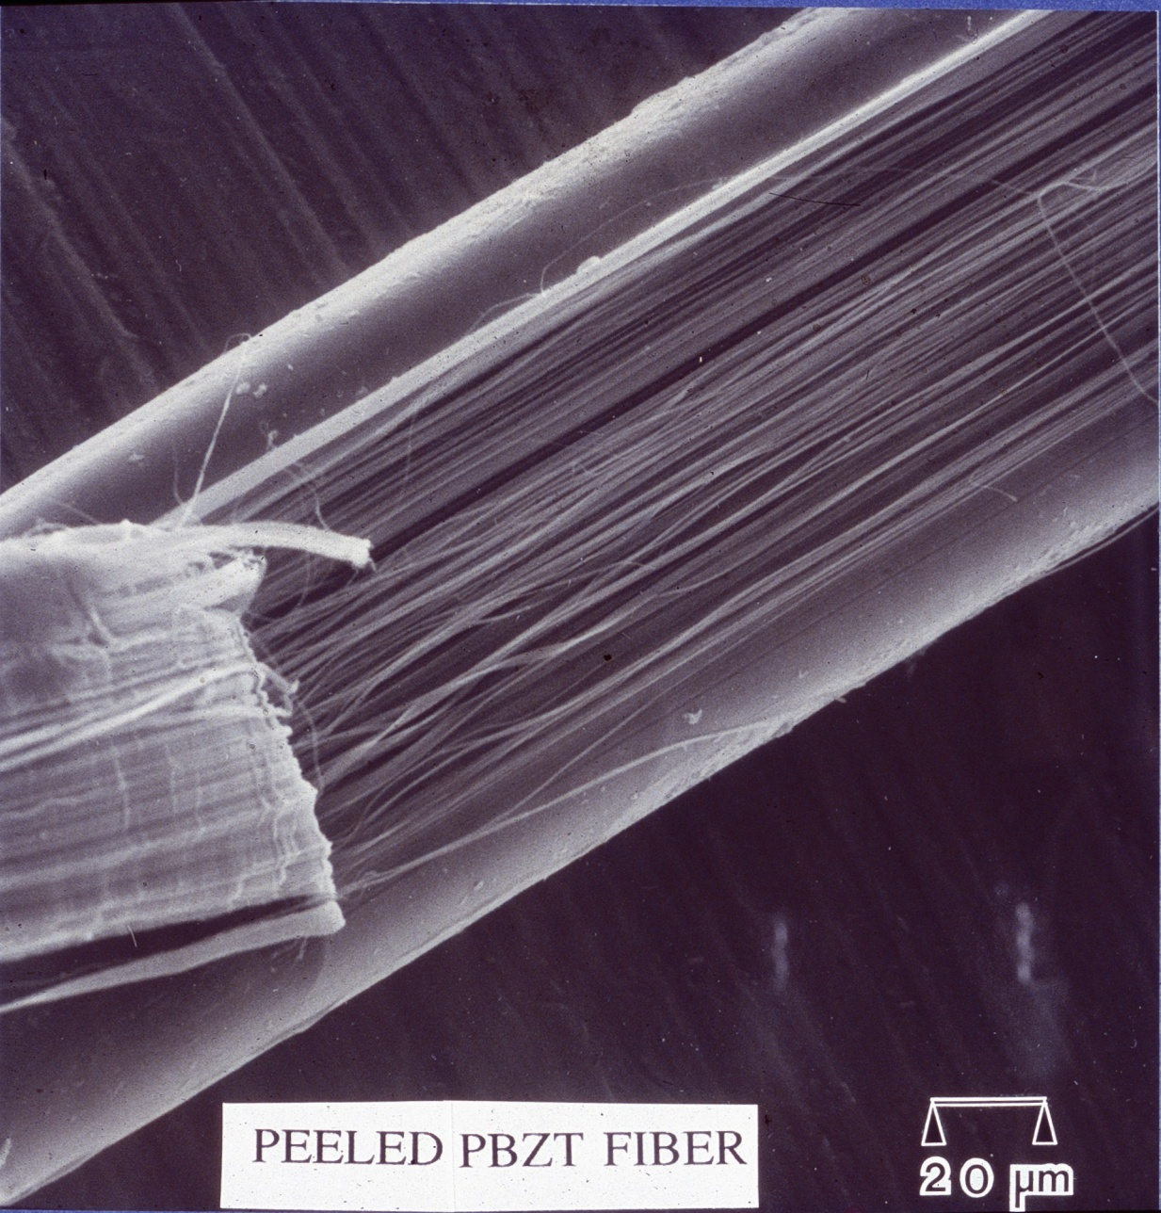
Liquid crystalline solutions of PBZT and PBO were spun into fibers by dry-jet wet-spinning into water as a coagulant, washed, dried then heat-treated under tension to produce highly ordered, strong fibers.
Morphology and mechanical property studies were performed at AFML, and at UMass, with Ned Thomas as the PI.

Slide 7

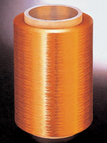
The world's strongest fiber, Zylon.
The World's Strongest Fiber
Toyobo Co., Ltd.
Zylon®, the world's strongest fiber, contradicts almost everything we know about fibers and fabrics. Zylon is made by mixing a polymer called PBO (para-phenylene benzobisoxazole), while forcing it through a spinning machine. PBO has a chemical structure that is difficult to process, but a major manufacturer of fibers, Toyobo Co., Ltd., has succeeded in producing this "super fiber." Zylon's tensile strength is about 10 times that of steel—a Zylon thread only 1 mm thick can hold an object weighing 450 kg! Zylon has excellent flame resistance, withstanding temperatures up to 650°C, and is more impact-resistant than even steel or carbon.
http://www.toyobo.co.jp/e/index.htm

Slide 8

Dyneema HB50

Slide 9

2008 Senior Division
First-Place Winning Essay
Nicole Clark, Centennial High School, Boise, Idaho
Spider Silk: The World's Strongest Fiber
While it took years of intense research to produce spider silk proteins from transgenic goats, this accomplished feat has proven to be only the beginning of fascinating discoveries that are now unfolding at an exponential rate. Scientists, doctors, engineers, and manufacturers may now begin incorporating Biosteel into countless products. As the Army microbiologist Steve Arcidiacono notes with satisfaction, Nexia’s successful production of the spider silk is “a big step forward” (Chea). Scientists are taking this “big step” into the future of technology, and, armed with an abundant supply of the world’s strongest fiber, this future could witness inspiring inventions that will improve the lives of countless human beings.
http://thechallenge.dupont.com/senioressay.html

Slide 10


Producing the Strongest Materials on Earth...
CNT Technologies is producing a carbon nanotube fiber "SuperThread" with a higher specific strength and higher specific modulus than any available engineering material. On a strength-to-weight comparison it is the strongest and stiffest material on earth.

Slide 11
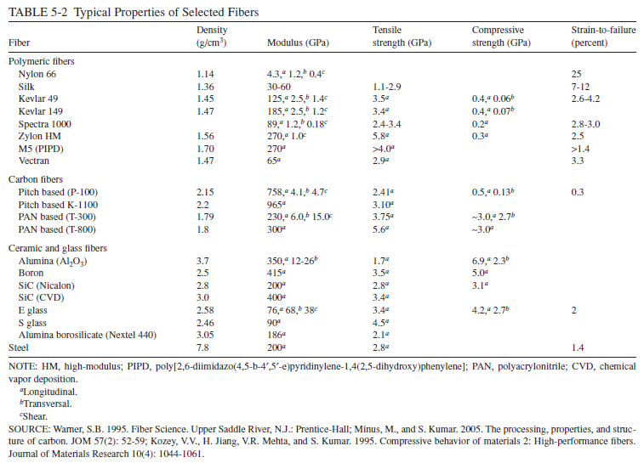

NRC Report 2011

Slide 12
Strength of Commercial Organic Fibers - 2012
MWNTs – XL’d
SWNTs
Natural Fibers
Wet Spun Cellulose
Liquid Crystal
Kevlar
Melt Spun Nylon
PBO & Graphite
MWNT fibers
1st Gen
2nd Gen
3rd Gen
5th Gen
4th Gen
Based upon the NRC Report NMAB-458, April 1992.
Notes:
12

Slide 13
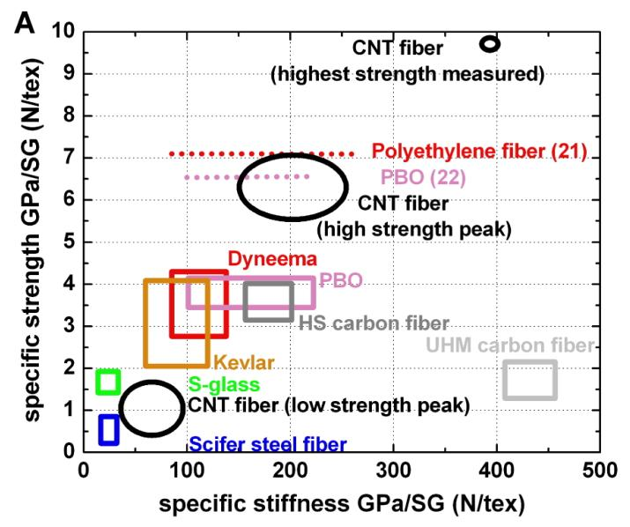
More recent comparisons ….
Alan Windle,
Cambridge Univ.
July 2008

Slide 14
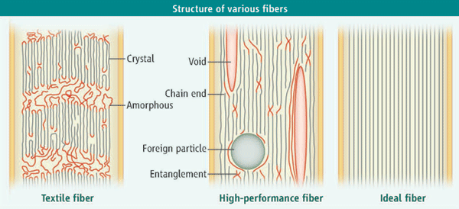
Schematic structures of various fibers. With decreasing disorder and defect density, the fiber strength increases (left to right). (Left) Typical commodity textile fiber contains amorphous and crystalline regions as well as voids and foreign particles; tensile strength, ~0.5 GPa. (Middle) High-performance polymer fibers contain chain ends, entanglements, voids, and defects; tensile strength, ~5 GPa. The structure of currently produced carbon nanotube fibers resembles this structure. In addition, carbon nanotube fibers often contain foreign particles in the form of catalysts. (Right) On the basis of predicted strain to failure (15), ideal carbon nanotube fibers without defects or entanglements will have a specific tensile strength of 70 N/tex; for a single-wall carbon nanotube fiber with a diameter of 2 nm, this would translate to a tensile strength of 70 GPa.
H.G. Chae and Satish Kumar, Science, 319 pp 908-909, 15 Feb 2008
Perspective:
“Making Strong Fibers”

Slide 15
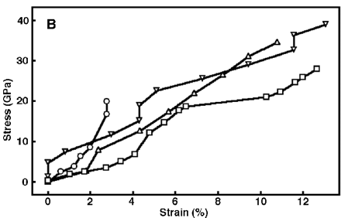
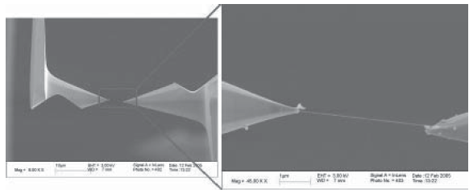
Measurements on Individual CNTs
Estimate of ~40-50 GPa tensile strength
Ruoff et al, Rev.Adv.Mater.Sci 10 (2005) 110-117

Slide 17
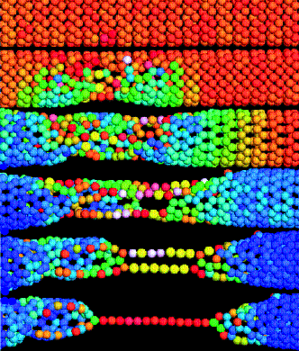
Predicted
Tensile Strength
of single-wall
Nanotubes
>100 GPa
>20% strain
to failure
Boris Yakobson,
Comp. Mat. Sci.
8, 341 (1997).

Slide 18
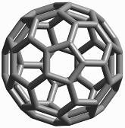
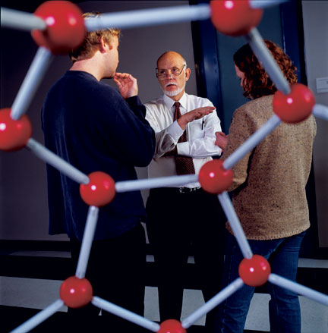
Professor Richard E. Smalley
1943 - 2005
Nobel Prize in Chemistry 1996
A 6 week summer project in 1985
2 – page paper in Nature
C60
Buckminster-
fullerene:
Buckyballs
with Robert F. Curl and Harold Kroto

Slide 19
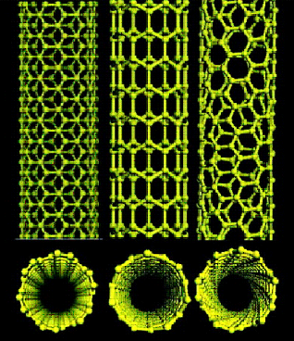
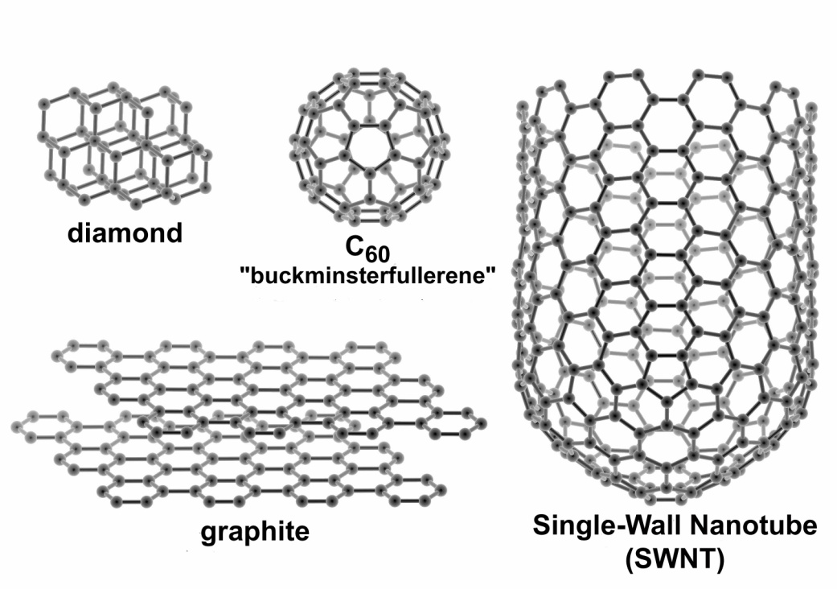
Why Single Wall Carbon Nanotubes?
MOLECULAR PERFECTION & EXTREME PERFORMANCE
The Strongest Fiber Possible.
Selectable Electrical Properties
  Metallic Tubes Better Than Copper
  Semiconductors Better Than InSb or GaAs
Thermal Conductivity of Diamond.
The Unique Chemistry of Carbon.
The Scale and Perfection of DNA.
The Ultimately Versatile Engineering Material.

Slide 20

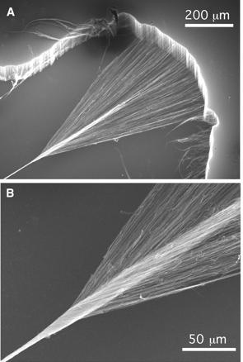
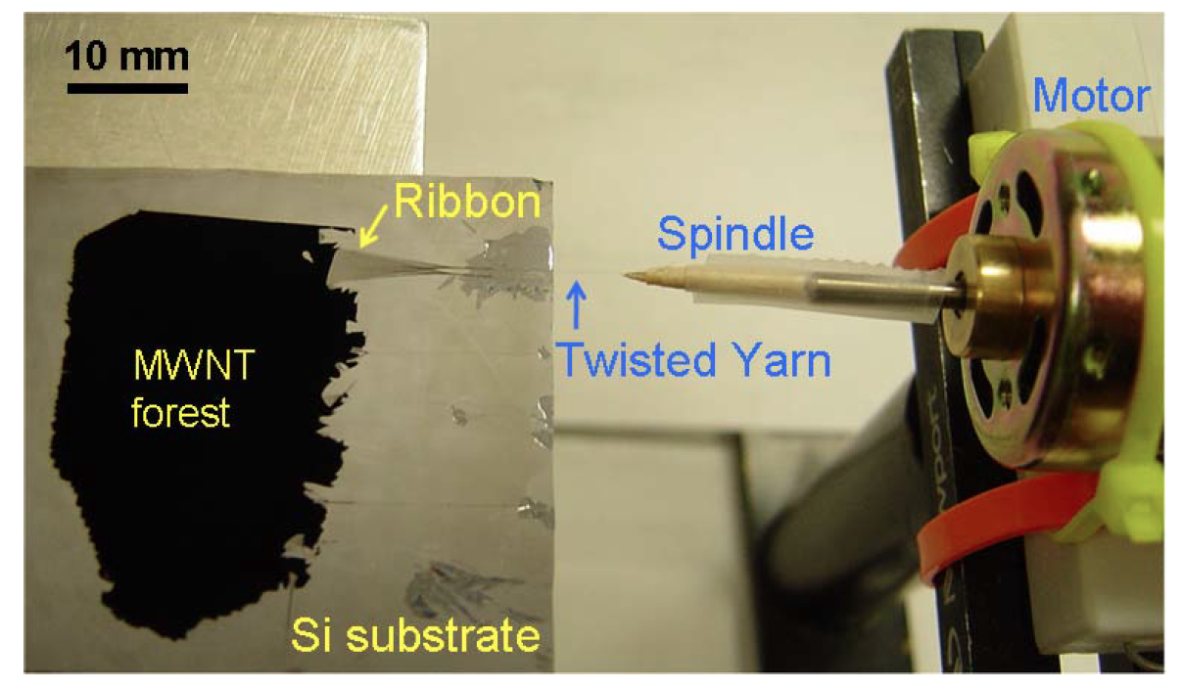
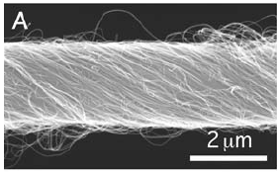
ALTERNATIVE ROUTES FOR MAKING FIBERS
By ~2002-2003, the difficulties of making fibers by fluid methods were so frustrating that solid-state methods were introduced
Textile-like method
Slow growth, slow spinning
Poor CNT alignment
Baughman’s group: Zhang et al, Science, 306, 1358 , 2004; CNT Tech, General Nano…

Slide 21
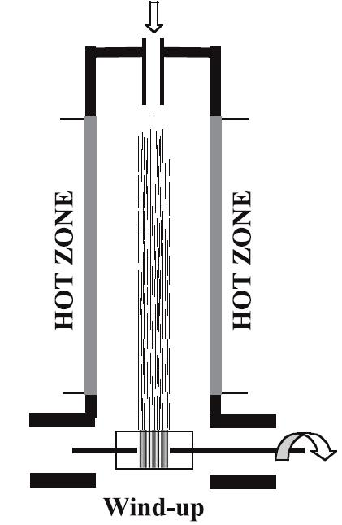
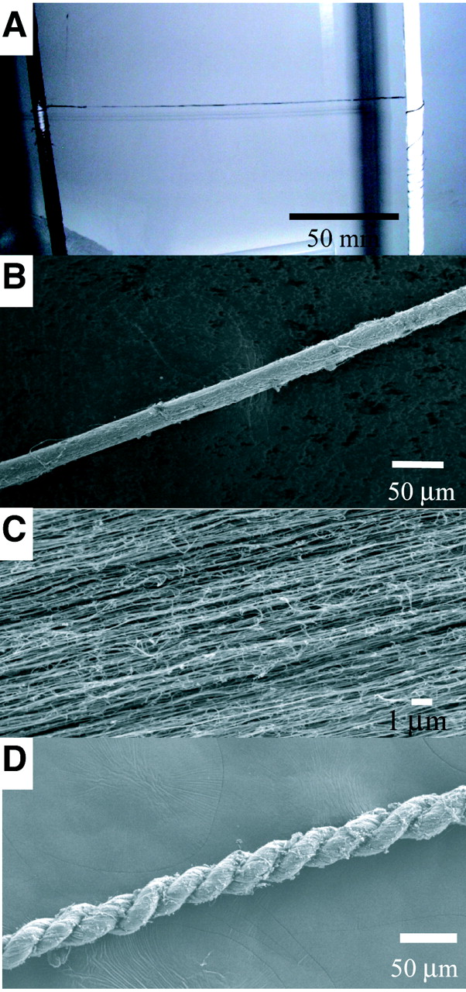
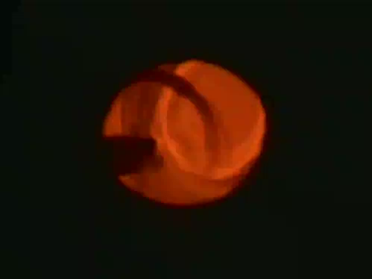
ALTERNATIVE ROUTES FOR MAKING FIBERS
Direct spinning alternative (also: Nanocomp, NH, USA)
One-step process
Porous microstructure
Unknown scalability, currently attempted by joint venture of Q-Flo and Plasan Sasa
Alan Windle’s group: Li et al, Science, 304, 276, 2004

Slide 22
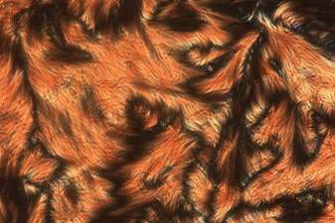
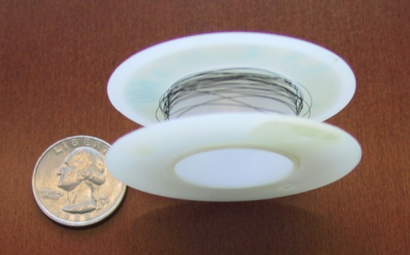

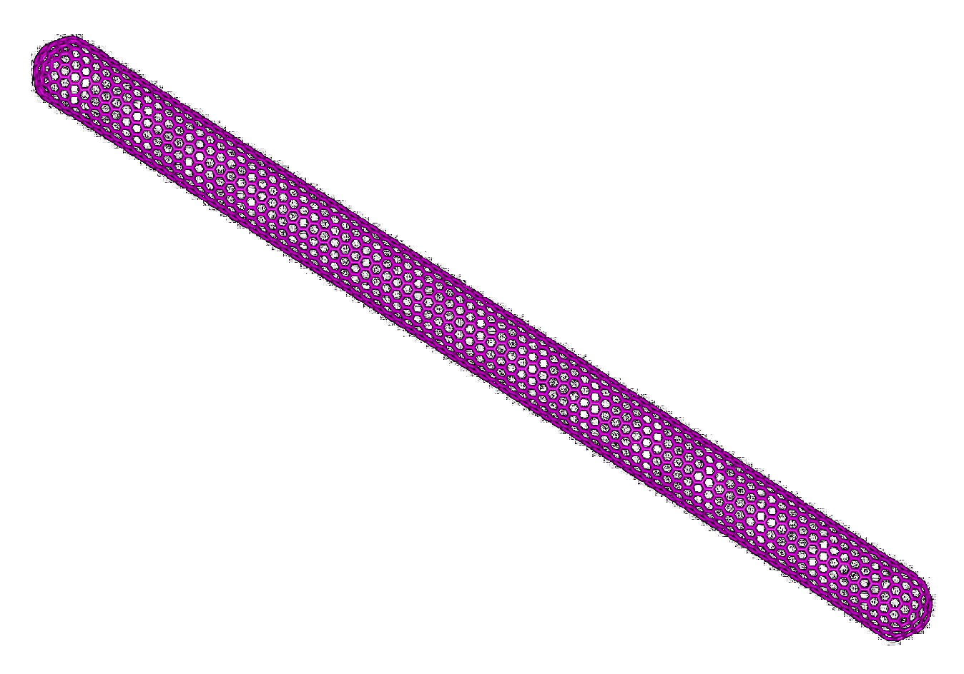
Challenges and Barriers to going from Nanoscale to Microscale Assemblages – Tubes to Sheets, Yarns, Fibers
Nanotube Assemblages for Structures Workshop
Georgia Tech, Atlanta (GA), 17 April 2012
Matteo Pasquali
Departments of Chemical & Biomolecular Engineering and Chemistry,
The Smalley Institute for Nanoscale Science & Technology
The Ken Kennedy Institute for Information Technology
Rice University, Houston, TX; mp@rice.edu

Slide 23
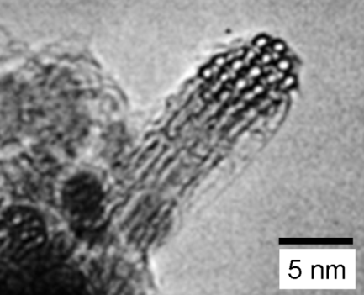
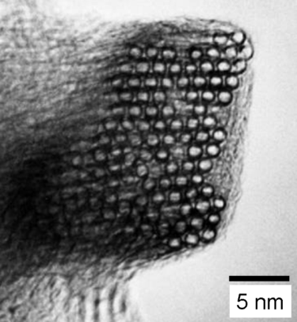
SWNT DISPERSION CHALLENGES
Nikolaev 1999
Spontaneous bundling
Difficult to disperse
Requires special solvents
(similar to PPTA and PBO)
HiPco
Laser Oven
Dispersion
options:
Surfactant
+ Sonication
High shear
mixing
Functionalization
Known to shorten
nanotubes
Ineffective at small length scale
Possible loss of
electronic properties
Caveats:
CNT solution concentration achievable using ordinary liquids and surfactants:
Cylcohexyl-pyrrolidone (CHP): 3.5 mg/mL
Dimethylformamide (DMF): ~0.125 mg/mL
1,2-Dichlorobenzene: ~0.1 mg/mL
Surfactants such as SDS and SDBS: 0.4 – 0.6 mg/mL
NO SOLVENT!!!
Bergin & Coleman:
ACS Nano, 3(8), 2340, 2009
J. Phys. Chem. 114(1), 231, 2010
Notes:
23

Slide 24
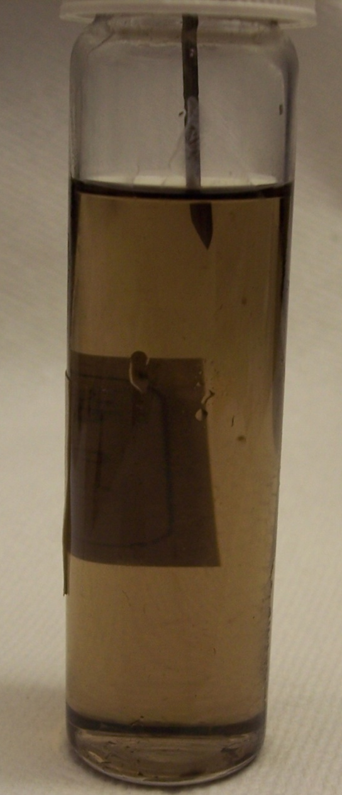
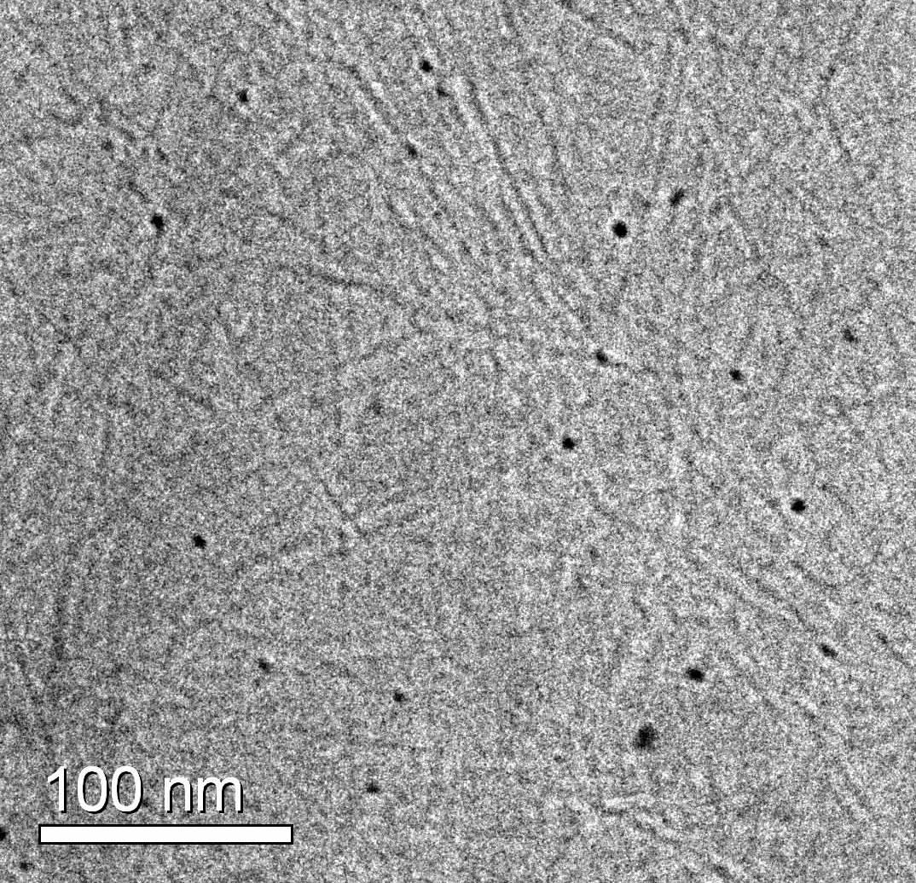
CRYO-TEM OF ISOTROPIC SOLUTIONS
First cryo-TEM imaging of superacids
Conclusive evidence of individual SWNT dispersion: true solvent!
60 min
HiPco SWNTs 1100 ppm
Chlorosulfonic acid
Dissolved fiber
Collaboration with Ishi Talmon & Yachin Cohen Technion (Israel)
Davis, Pasquali et al, Nature Nanotech, 4, 830, 2009
Notes:
24

Slide 25
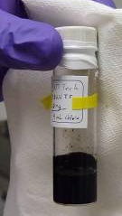
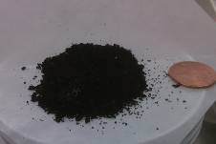
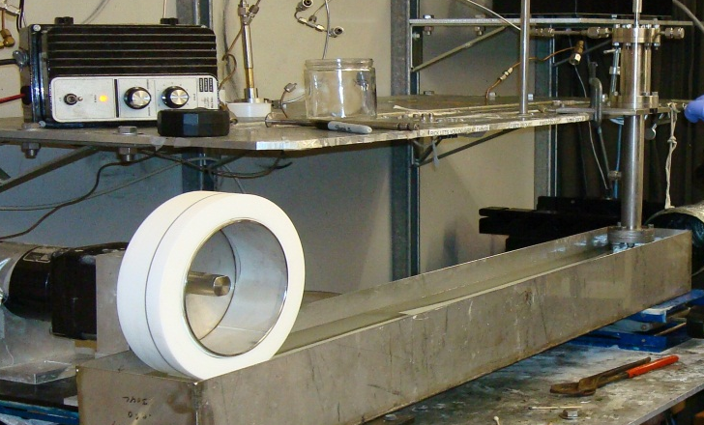
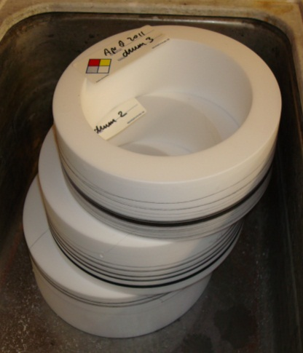
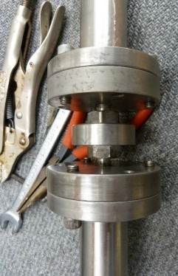
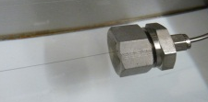
CNT/ACID WET SPINNING PROCESS
Acid
Fresh Nanotubes
Quenching
Mixing
Recovered
Nanotubes
Dope waste
Further processing
Spin dope loading
Drying
(Offline)
Filtration
(Offline)
Extrusion
Coagulation
Winding
Washing
(Offline)
Coagulant (Water, acetone)
Offline; water
Very similar to Kevlar (DuPont) & Twaron (Teijin)

Slide 26
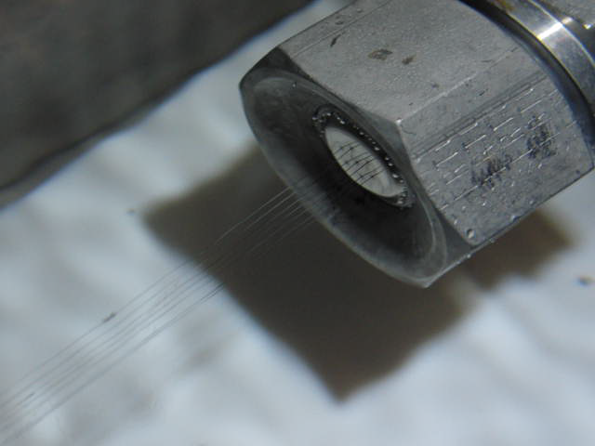
FIBER SPINNING AT RICE UNIVERSITY
  Collaboration with Teijin, manufacturers of Twaron (PPTA) and Toho Tenax (C fibers)

Slide 27
MULTIFUNCTIONALITY

Slide 28
WHERE ARE WE?
Property | Units | Best CNT fiber | Ideal single CNT | Fraction | Best fiber material
Density | g/cm³ | 0.8-1.3 | 1.6 |  | 1.6-1.8 | PPTA, C fiber
Tensile strength | GPa | 1.8 | 37 | 4.9% | 6 | C fiber (PAN)
Young modulus | TPa | 0.2 | 1 | 20% | 1 | G fiber (pitch)
Thermal cond. | kW/m K | 0.6 | 3 | 20% | 1 | G fiber (pitch)
Electrical cond. | MS/m | 5.5 | 100 | 5.5% | 65 | Silver
Electrical resistivity | μΩ cm | 18 | 1 |  | 1.55 | Silver
Notes:
Update citations? (Rich thesis? Science paper?)
28

Slide 29
How could we make stronger SWNT Fibers?
Longer nanotubes
Perfect nanotubes
Flatter nanotubes
Lumpy nanotubes
Different solvents with easier/better/slower coagulation
Purer solutions
Uniform diameter nanotubes
Uniform chirality nanotubes
Better alignment
Smaller diameter fibers
Crosslinked nanotubes
Perfect orientation
Perfect lateral order
Few chain end defects (long tubes)
Intrinsic chain properties

Slide 30
CNT Length vs. strength
Failure can occur due to inter-rod slippage
>10 μm (1nm diameter) is the ultimate length estimated by Yakobson and coworkers.
Yakobson, B.I., et al., Carbon, 38, 1675, 2000.
Notes:
30
30

Slide 31
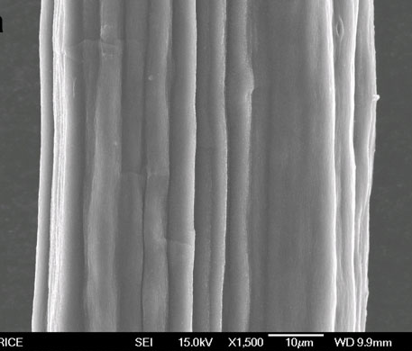

ROUTE TO BETTER FIBER
Longer CNTs
Higher spinning concentration
  Behabtu, Pasquali, et al.,
  Nano Today (2008)
  Yakobson (2000)
Windle
2005,
2007
Rice 2012
1μm
Rice 2008
wet spun
UT Dallas
2004
solid-state spun
Rice 2004
LANL /
CNT Tech
Notes:
31
31
31
31
We probably want these SEM images to pop up after first click

Slide 32
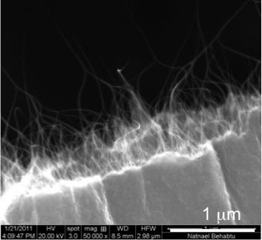
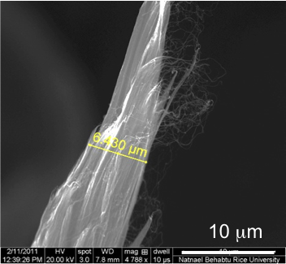

Break-ends: short vs. long CNTs
Short (~500nm) CNT
Long (~4 μm) CNT
Longer nanotubes have larger broken-end fibrils

Slide 33
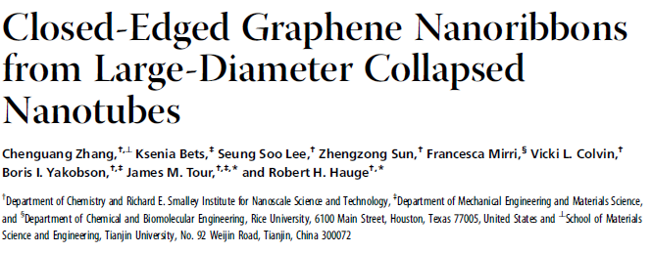

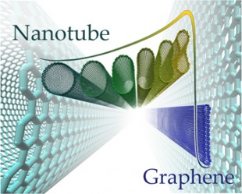
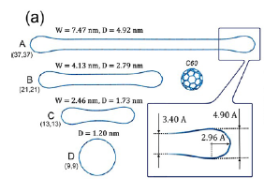
Energy equivalence point for round and flat nanotubes is 2.6 and 4.0 nm for SWNT and DWNT respiectively.

Slide 34
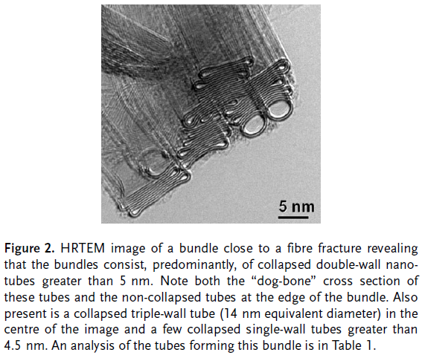

Slide 35
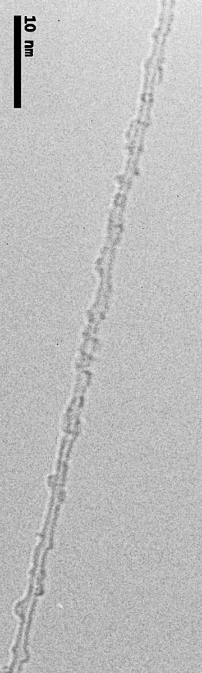
Triazene Functionalization to Unbundled f-SWNTs
J. Tour, J. Hudson, J. Stephenson
Notes:
35

Slide 36

Arriving atoms (dimers) follow step-terrace mechanism, recognized in epitaxial growth of crystals, essentially following atomic-threads of their predecessors…
K ~ sin θ
Chemistry World

Slide 37
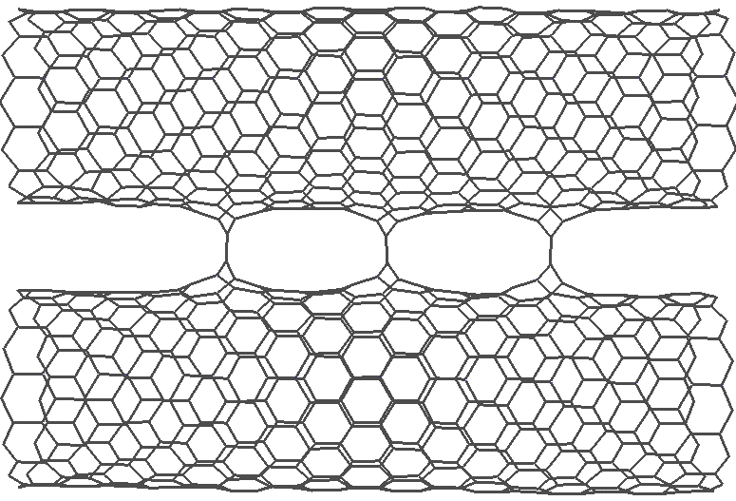

Metastable all-sp² C₂-links annealed at 500 K
7
7

Slide 38
How do we make stronger SWNT Fibers?
Longer nanotubes
Perfect nanotubes
Flatter nanotubes
Lumpy nanotubes
Different solvent with easier coagulation
Purer solutions
Uniform diameter nanotubes
Uniform chirality nanotubes
Higher alignment
Smaller diameter fibers
Crosslinked nanotubes

Slide 39
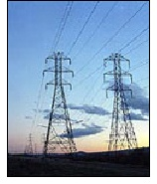
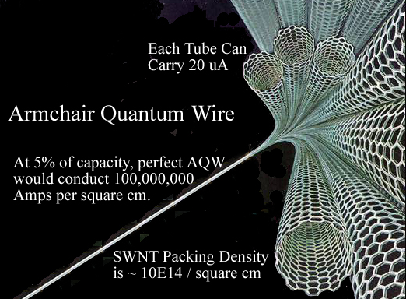
SWNT Quantum Wire
Cable of aligned armchair SWNTs
High purity, quality, cost-effective
Extremely high current capacity
Today’s grid 1000-5000 A/cm²
Expected Features
1-10x Copper Conductivity
6x Less Mass
Stronger Than Steel
Zero Thermal Expansion
Key Grid Benefits
Reduced Power Loss
Low-to-No Sag
Reduced Mass
Higher Power Density

Slide 40
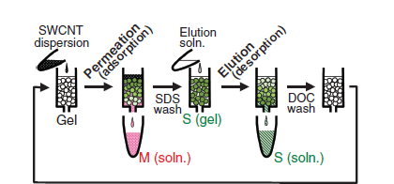

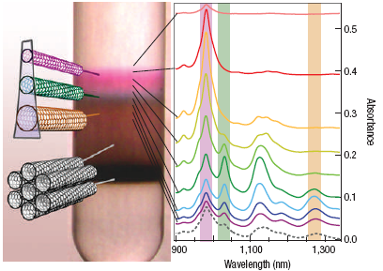

3 Routes to Large Quantities of Armchair SWNT
Sort Large Quantities of SWNTs
Sort Small Quantities of SWNTs
Amplify
Grow Only Armchair SWNTs (catalyst tuning)
Fe
Fe/Co
Ni
Fe
Ni

Slide 41
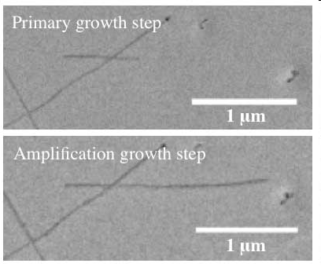
‘Amplified’ nanotubes may power the future
Andrew Barron’s lab has demonstrated a way to take small batches of individual armchair nanotubes and make them grow dramatically longer
  Up to 90% of the nanotubes in a batch can now be amplified to significant lengths
Goal is the development of a single furnace to grow nanotubes from scratch, cap them with new catalyst, amplify them, and put out a steady stream of fiber for cables.
Explored a range of growth/etch
conditions – T, gas composition (Ar,
methane, H₂ ), pressure for Fe-Co
catalyts to find sweet spot for second
growth versus etching.
Extending now to single chirality
separated SWNTs.
Nano Lett. 11, 2871-2874 (2011)

Slide 42
80+ Years Since Staudinger
Solid-state spun nanotube fibers are leading in properties – are they scalable or affordable, and can they really get much better?
Liquid Crystal solution-spun fibers need a burst of progress – but they should be scalable, affordable, and can get a lot better!
Chirality control essential for specific applications – affordable?
Tube length, tube perfection, impurities, morphology control (orientation, packing, entanglement, interphases) are big issues

Slide 43
Possible Action Item
To push the USA fiber world into the future, start a new Alliance for Advanced Fiber Research and Manufacturing (AAFiRM)
Co-centered at Rice and Georgia Tech
Other academic participants
Corporate Members (small and large)
Federal (NASA++) and state support

Slide 44
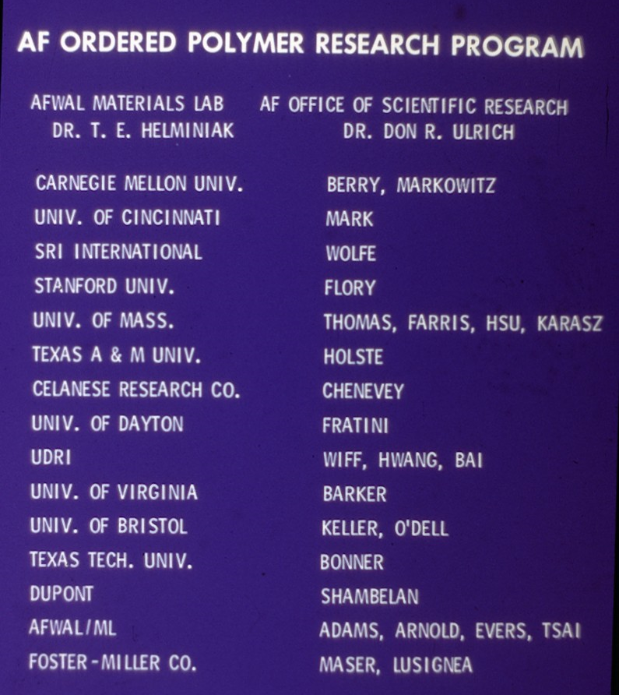
Team as of about 1985. Later added Dow Chemical, and Ron Eby at JHU/
U. Akron.
$100M over 10 years in 1980-1990 - USAF
+ $100M Dow development

Slide 45
Roadblocks
Vision without funding is hallucination.
    Da Hsuan Feng – UT Dallas
Vision without hardware is delusion.
    Lockheed engineer
Money buys progress.
    John Przybysz – Northrup Grumman

Slide 46


Slide 48

Specific Penetration Energy for Various Materials
Comparison of Material-dependent Energy Dissipation MLG vs. Steel
 | 600 m/s | 900m/s
ML Graphene | 0.95 MJ/kg | 0.83 MJ/kg
Steel | 0.08 MJ/kg | 0.11 MJ/kg
Ratio | 12× | 8×
Science 346, 1092 (2014);

Slide 49
FINI

Slide 50

FOR DISCUSSION
Manufacturing challenges
  Long CNTs, above 10 μm
  High-quality sidewalls
  Need gram-level for proof-of-concept
  Packing & alignment through processing
Limitations on understanding
  Many!!
  What’s the critical length needed for ultimate strength?
  Dependence on CNT type?
  Many questions on liquid phase: parallels with classical polymer & colloid science, but also differences; gels vs. glasses? Liquid crystals?
Alternative manufacturing routes?
  Probably variations on the theme; polymer-like processing for 2D & 3D
Technology limited or resource limited
  Both; CNT manufacturing for proof of concept
  Applications cannot be tested on single-filament fibers
  Design for new properties rather than ask for new properties?
Chae & Kumar, 2008

Slide 51
Backup slides

Slide 52
Rigid-Rod Polymer Scientific Issues [list from ~1980]
Phase Diagram- incl. XL solvates
Solubility- limits, enhancements
Liquid Crystal Theory- pendant size, flexibility, copolymers
Microfibrils- origins, size, control
Morphology of LC Solutions- fractionation, bundling, fibrils- dynamics
Computational Chemistry- verify complicated properties: shape, mechanical, optical, NLO…
Stiffness vs. Rigidity- understand E vs. structure
Understanding Structure / Transport Properties
  electrical conductivity
  Thermal
  Diffusion
NLO- nematic, long chain required?
Quantitative Description of Axial Disorder- will rods pack in 3D?
Origin of 4-point SAXS Pattern
Causes of Nonlinearity- E vs. T, stress
Reasons for Modulus, Strength Limitations- processing
Reasons for Low Compressive Strength – Microfibril buckling, intermolecular interactions
These are the same issues facing SWNT researchers today

