Slide 1
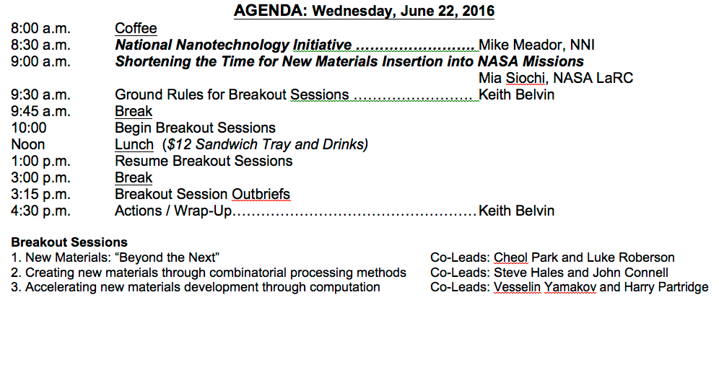
Day 2 Agenda June 22, 2016

Slide 2
Advanced Aerospace Materials: “Beyond The Next” Workshop
Day 2 Breakout Sessions
What new materials with high performance structural properties are on the horizon beyond current development efforts?
What new combinatorial processing methods can be used to create new materials?
How can computational methods be used to accelerate the design, synthesis, processing, characterization, fabrication and testing of new materials?

Slide 3

BlueSky
Develops highly creative solutions to a problem
Invites the experience of the group into play
Unlocks innovation
Brings team members together
An effective brainstorming session…
Notes:
From NAVSEA GB – M4, slide 3

Slide 4
Brainstorming
What – defines the problem to everyone
How
Knowledgeable Team members
State the specific problem
Establish ground rules
Structured Method
Free for All
Generate and record all ideas
Without evaluation
Without criticism
Without constraint
When ideas slow down,
Allow time for all members to reflect
Encourage them to build on others ideas - sometimes most creative ideas
Review ideas for clarity and to increase the groups understanding

Slide 5
Breakout Sessions
Panels
New Materials: “Beyond the Next”
2. Creating new materials through combinatorial processing method
3. Accelerating new materials development through computation
Panel 1
Cheol Park
and
Luke Roberson
Panel 2
Steve Hales
and
John Connell
Panel 3
Vesselin Yamakov
and
Harry Partridge

Slide 6
So What’s the Product
A list of ten ideas/tech areas within your panel that NASA should consider for investment to accelerate development.
Then, an assessment of NASA’s role – Lead – Watch –Follow
Report out to the Full Group on rationale for Tech Area and Role.
In report out, comment on integration across new materials, processing innovation, and computational acceleration.

Slide 7
Key roles: technology leader (L), fast follower (F), and technology watcher (W).
Technology leader role (e.g., entry descent and landing, deep-space operations, long duration life support), NASA is a lead investor and creates or invents novel technologies through research, development and demonstration in areas that are critical enablers of NASA core missions and associated platforms.
Fast follower role, NASA rapidly adopts, adapts, and/or accelerates technologies originating from external organizations (OGA, Industry, Academia) who are leaders and primary investors in focused S&T areas as part of their core functions.
Technology watcher role, NASA uses and leverages others’ S&T investments in areas that are not our primary or core functions (e.g., commercial commodity information technology, commercial communications).
Note the workshop should assign the NASA role for each technology area that the panel identifies. Roles are to be assigned using the consensus of your panel experts and could change depending upon future resources, priorities, and/or technology advancements.

Slide 8
An Approach to the Breakout Discussion
You have two 2 hour blocks:
Spend the first 2 hour block brainstorming (Bluesky) – constrained only by the physics, not assumptions.
Lunch
Spend the first hour of the second block deriving the list of top ten ideas/concepts/tech areas.
Spend the second hour of the second block identifying the NASA role (L, F, W) and prepare for group report out.

Slide 9
Day 2 Agenda June 22, 2016

Slide 10

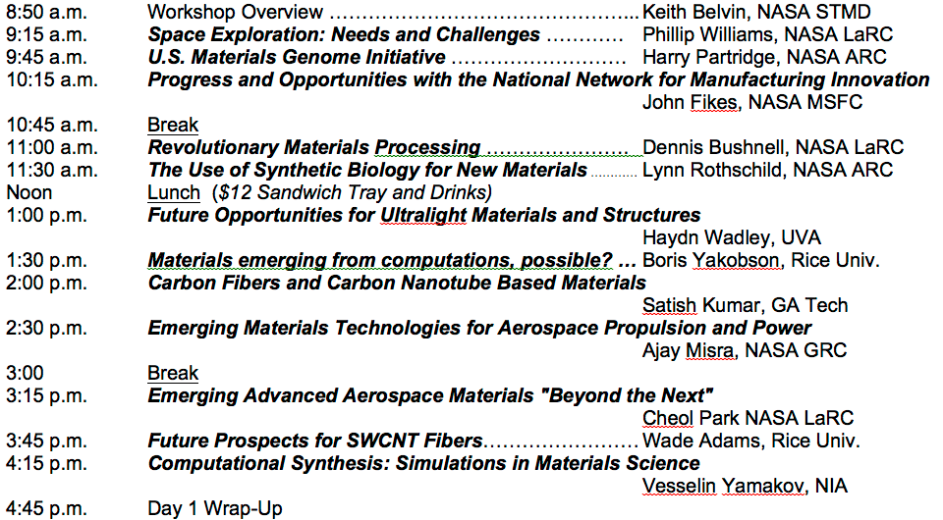
Day 1

