Slide 1
BlueSky Advanced Aerospace Materials Workshop: Breakout Session
Breakout Sessions
1. New Materials “Beyond the Next”
2. Creating new materials through combinatorial processing methods
3. Accelerating new materials development through computation
Panel 1 - New Materials “Beyond the Next”

Slide 2
What new materials with high performance structural properties are on the horizon beyond current development efforts?
1. Since the new discovery of fullerenes, carbon nanotubes, boron nitride nanotubes, graphenes, various functional nano materials, 2D heterogeneous materials, and metamateials, significant funding has been spent in this NST area and numerous papers have been published. However, there has been very little payoff compared to the invested funding and publications. → How to expedite the process from the inception to realization (payoff)?
- If there are success cases, what are they?
- What are the key parameters for successes and what are the reasons for this little payoff?
- What should be done to achieve more successful payoff rapidly?
- Shall we focus on allocating resources for more application research?
- If yes, how can we coordinate new efforts for this new direction to influence?
2. What are the most promising areas to generate more and more success story in the future? → What is the most bluesky topics in materials areas relevant to aerospace applications?
- How shall we identify the areas or products?
- Are there any specific products that we should work together to generate success story in a short period time?

Slide 3
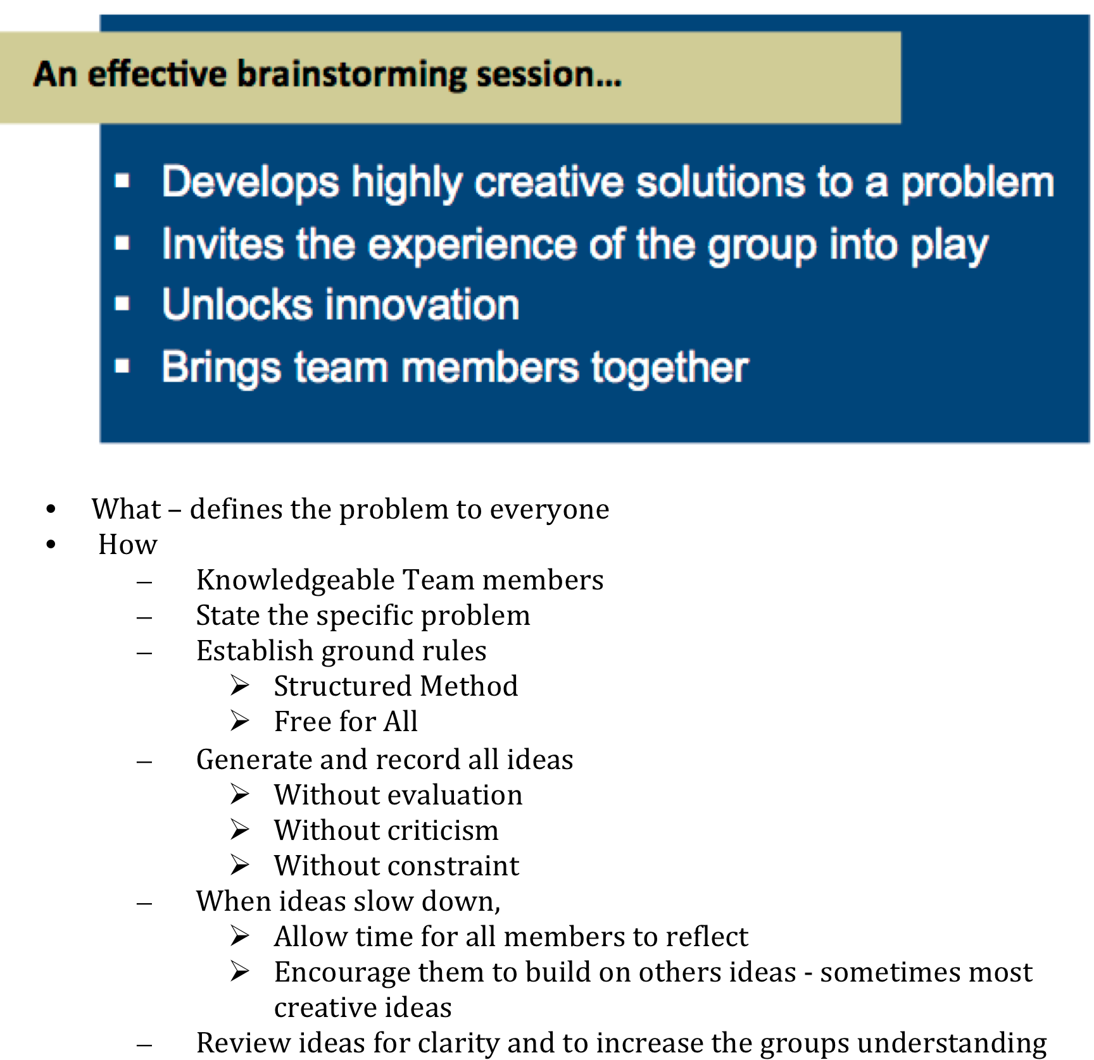

Slide 4
Appendix C. *S&T Roles: Lead, Follow, Watch
Key roles: technology leader (L), fast follower (F), and technology watcher (W).
Technology leader role (e.g., entry descent and landing, deep-space operations, long duration life support), NASA is a lead investor and creates or invents novel technologies through research, development and demonstration in areas that are critical enablers of NASA core missions and associated platforms.
Fast follower role, NASA rapidly adopts, adapts, and/or accelerates technologies originating from external organizations (OGA, Industry, Academia) who are leaders and primary investors in focused S&T areas as part of their core functions.
Technology watcher role, NASA uses and leverages others’ S&T investments in areas that are not our primary or core functions (e.g., commercial commodity information technology, commercial communications).
Note the workshop should assign the NASA role for each technology area that the panel identifies. Roles are to be assigned using the consensus of your panel experts and could change depending upon future resources, priorities, and/or technology advancements.
*Adapted from definitions in “Global Horizons Final Report”, United States Air Force Global Science and Technology Vision, AF/ST TR 13-01 21 June 2013

