Slide 1
Big Data & Machine Learning
With Applications to Aerospace
NASA Machine Learning Workshop
August, 2016
Jaime Carbonell and colleagues
Language Technologies Institute
School of Computer Science
Carnegie Mellon University
www.cs.cmu.edu/~jgc

Slide 2
Computer Science and
Related Disciplines
Fine
Arts
Systems
+ Theory
Entertain
Tech
Lang
Tech
Comp
Bio
Math,
Stats
Sciences
Machine
Learning
Human-Comp
Interaction
Robotics
Computer
Science
Humanities
Engineering

Slide 3
Computer Science and
Related Disciplines
Fine
Arts
Systems
+ Theory
Entertain
Tech
Lang
Tech
Comp
Bio
Scalable Machine Learning This presentation
Math,
Stats
Sciences
Machine
Learning
Human-Comp
Interaction
Robotics
Computer
Science
Humanities
Engineering

Slide 4
AI is Becoming Central to the World Economy (Davos 2016)
“The fourth Industrial Revolution” is characterized by:
  “Ubiquitous and mobile internet”,
  “Smaller and more powerful sensors”,
  “Artificial Intelligence”, and
  “Machine Learning”
-- Prof. Klaus Schwab, founder of the Davos World Economic Forum, 2016
Need to focus on content, not hype

Slide 5
Key Components of AI
Perception
  Vision, sonar, lidar, haptics, …
Action
  Locomotion, manipulation, …
Reasoning
  Planning, goal-oriented behavior, projection, …
Communication
  Language, speech, dialog, social nets, …
Learning
  Adaptation, reflection, knowledge acquisition, …

Slide 6
Key Components of AI
Perception
  Vision, sonar, lidar, haptics, …
Action
  Locomotion, manipulation, …
Reasoning
  Planning, goal-oriented behavior, projection, …
Communication
  Language, speech, dialog, social nets, …
Learning ← This presentation
  Adaptation, reflection, knowledge acquisition, …
My research

Slide 7
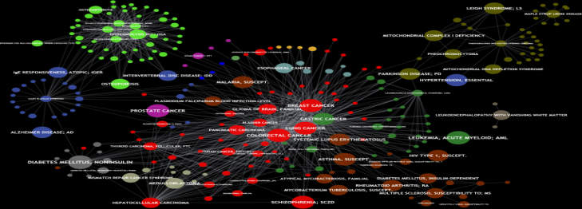
Big Data: How Big is Big?
Dimensions of Big Data Analytics
Large-scale : Terabytes → Petabytes → Exobytes
Billions++ of entries:
Terabyes/Petabyes of data
High-complexity
Trillions of potential relations
among entries (graphs)
High-Dimensional
Millions of attributes per entry
(but typically sparse encoding)

Slide 8


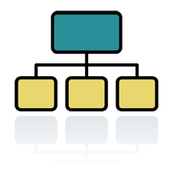
AI and The Big-Data “Stack”
Analytics/AI/Inference
-- Machine Learning
-- NLP. Data/text mining
Insights, Alerts, Visualization
Big-Data Architecture
-- Spark/Graphlab
-- NoSQL
Sensors
Big-Data “Plumbing”
-- Cloud/Storage
-- Resource Allocator
Historical & Normative Data
Knowledge base
Notes:
Analytics: Carbonell, Yang, Mitchell, …
Architecture: Faloutsos, Starzl, …
Plumbing: Gibson, Ganger, …

Slide 9
Trends in Machine Learning
“Deep” Learning (DNNs): vision, speech, NLP
Reinforcement Learning: robotics
Large-margin methods (SVM): classification
Graphical models: strong priors, domain K.
How to cope with label sparsity?
(Pro)Active learning: optimizing external help
Transfer/Multitask learning: related new domains
Transductive/semi-supervised learning:
(Pro)Active teaching: …coming next?

Slide 10
Machine Learning in a Nutshell
Training data:
  Special case:
Functional space:
Fitness Criterion:
  a.k.a. loss function
Sampling Strategy:

Slide 11
Why is Active Learning Important?
Labeled data volumes << unlabeled data volumes
  1.2% of all proteins have known structures
  < .01% of all galaxies in the Sloan Sky Survey have consensus type labels
  < .0001% of all web pages have topic labels
  << E-10% of all internet sessions are labeled as to fraudulence (malware, etc.)
  < .0001% of all financial transactions investigated w.r.t. fraudulence
If labeling is costly, or limited, select the instances with maximal impact for learning

Slide 12
Sampling Strategies
Random sampling (preserves distribution)
Uncertainty sampling (Lewis, 1996; Tong & Koller, 2000)
  proximity to decision boundary
  maximal distance to labeled x’s
Density sampling (kNN-inspired McCallum & Nigam, 2004)
Representative sampling (Xu et al, 2003)
Instability sampling: Max disagreement (probability-weighted)
  x’s that maximally change decision boundary
Ensemble Strategies
  Boosting-like ensemble (Baram, 2003)
  DUAL (Donmez & Carbonell, 2007)
    Dynamically switches strategies from Density-Based to Uncertainty-Based by estimating derivative of expected residual error reduction

Slide 13
Which point to sample?
Grey = unlabeled
Red = class A
Brown = class B

Slide 14
Density-Based Sampling
Centroid of largest unsampled cluster

Slide 15
Uncertainty Sampling
Closest to decision boundary

Slide 16
Maximal Diversity Sampling
Maximally distant from labeled x’s

Slide 17
Ensemble-Based Possibilities
Uncertainty + Diversity criteria
Density + uncertainty criteria

Slide 18



Maximum disagreement on Classifier Committee
How to measure the disagreement
  Vote Entropy
  KL Divergence
# of votes that the label receives
Classifier prob of label
Consensus probability that the label is correct
Notes:
C is the commiitee aize
Denominator term is the consensus that is correct
Seperability
Largest averahe distance btw the label distirbutions of any member nf the consensud
Soft if we consider each commiitee members accuracy

Slide 19
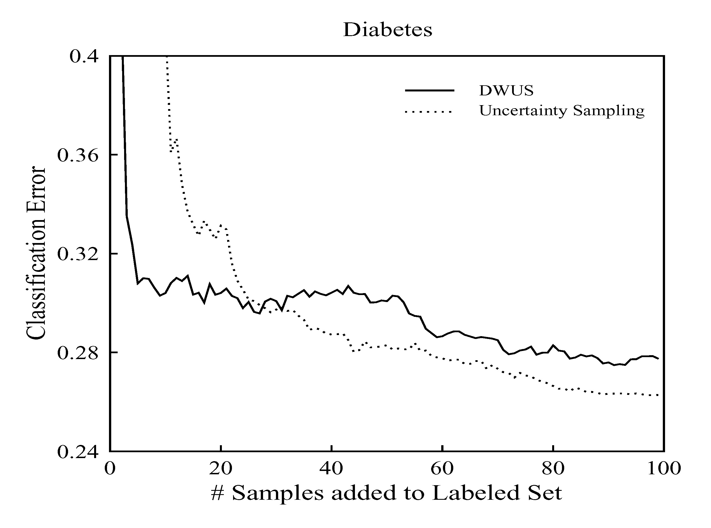
Strategy Selection: A Surprise
There is No Universal Optimum
Optimal operating range for AL sampling strategies differs
How to get the best of both worlds?
(Hint: ensemble methods)

Slide 20


How does DUAL do better?
Runs DWUS until it estimates a cross-over
Monitor the change in expected error at each iteration to detect when it is stuck in local minima
DUAL uses a mixture model after the cross-over ( saturation ) point
Our goal should be to minimize the expected future error
  If we knew the future error of Uncertainty Sampling (US) to be zero, then we’d force
  But in practice, we do not know it
Notes:
Given the motivation, we can now talk about DUAL. We said before that DUAL combines the best of both worlds. And here we see how.
DUAL runs DWUS until it estimates that it has stabilized. It does so by estimating when the derivative of the expected error
becomes zero because it tells us the error is not changing anymore
It monitors the change in the expected error at each iteration. and when it becomes close to zero then it switches criteria.
After deciding to switch, its sampling strategy becomes a linear combination of density and uncertainty.
Pi is the weight of the uncertainty score and 1-pi is the weight of the density score. At the end of the day, all we want is to minimize the expected future error.
If we knew that in the future uncertainty sampling will have a zero error, then we’d force pi to be equal to 1 so that we’d sample acc. to uncertainty of each point. Unfortunately, we don’t know the future error.

Slide 21
Results: DUAL vs DWUS
Notes:
Even though we conducted tests on 6 datasets, today I show you only four because of the time constraints.
For instance, this figure compares DUAL vs DWUS. We see that DUAL reduces the error to a lower level.

Slide 22
Active Learning is Awesome, but … is it Enough?
Traditional
Active
Learning
Single Perfect Source
Fixed Labeling Cost
CIKM ‘08
Multiple Sources
Varying-Cost Model
Going
Beyond
Differing
Expertise
Answer
Reluctance
Task
Difficulty
Expertise
Level
Labeling Noise
Proactive
Learning
SDM_sub ‘10
Ambiguity
JMLR_’09
KDD ‘09
Fixed over time
Time-varying
Notes:
By now, I hope I convinced you that active learning is a wonderfully useful tool. And yet, there are problems with the traditional setting.
First of all, traditional active learning assumes that there is a single oracle that always answers and answers correctly. It also assumes that the labeling cost is fixed per instance. But, there are many situations (and I will show you a few examples) that these assumptions fail. Thus, there is a necessity to relax these assumptions. We use the term proactive learning to refer to this new discipline that relaxes these assumptions and make active learning to reach more practical applications. More specifically, proactive learning focuses on learning with multiple oracles with … Also, the cost of labeling may vary depending on the task difficulty, or the ambiguity to label, or simply the expert may charge more compared to a non-expert and so on. In this talk, I will mainly focus on multiple oracles with labeling noise in both stationary and non-stationary cases. I have also done preliminary work considering varying-cost, but that won’t be the focus of my talk today.
Put a …. box around varying-cost model to mention that you did preliminary investigation on them also put references to your own work
Put an extra slide after this to say that there are situations where you can have multiple labelings
First of all say what might be an oracle, give examples, and then I will talk about where these multiple oracles can be found

Slide 23
Active vs Proactive Learning
 | Active Learning | Proactive Learning
Number of Oracles | Individual (only one) | Multiple, with different capabilities, costs and areas of expertise
Reliability | Infallible (100% right) | Variable across oracles and queries, depending on difficulty, expertise, …
Reluctance | Indefatigable (always answers) | Variable across oracles and queries, depending on workload, certainty, …
Cost per query | Invariant (free or constant) | Variable across oracles and queries, depending on workload, difficulty, …
Note: “Oracle” ∈ {expert, experiment, computation, …}

Slide 24
Scenario: Reluctance
2 oracles:
  reliable oracle: expensive but always answers with a correct label
  reluctant oracle: cheap but may not respond to some queries
Define a utility score as expected value of information at unit cost
Notes:
Let us start with discussing First scenario. In this scenario, we assume there exist 2 oracles: one is a perfectly reliable oracle which always answers with the correct label
the other is a reluctant oracle that may not respond to all queries. Obviously, the reliable oracle costs more than the reluctant one but both charge uniform fees over instances.
We define utility of instance-oracle pair as the expected value of information to the learner if the label of x is queried from oracle k at unit cost. There are two components
in this formula to be estimated. One is the value of information for labeling the instance, and the second is the probability of actually obtaining the information from the oracle for that
particular instance. Value function can be substituted with your favorite active sampling criterion. We used a density-weighted uncertainty scoring function we developed in one
of our earlier work. I will not go into the details of that since it is not essential for this work here. If you’re interested you can read it in the paper. I’d rather spend time on the discussion for the unreliability of the oracle which is defined in terms of reluctance in this scenario. There are two issues with oracle reluctance. One is how we can simulate it since we do not currently have any benchmark collection that provides us with oracle properties. The second is how we can learn it since we don’t know in advance for what types of queries the oracle becomes reluctant to.

Slide 25
How to estimate ?
Cluster unlabeled data using k-means
Ask the label of each cluster centroid to the reluctant oracle. If
  label received: increase of nearby points
  no label: decrease of nearby points
equals 1 when label received, -1 otherwise
# clusters depend on the clustering budget and oracle fee
Notes:
Now, let us see how we can estimate the oracle reliability. We assume we are not given this information in advance. Hence, we dont know when the oracle becomes reluctant although we know which oracle is perfect and which one is reluctant. The way we estimate it is as follows:
First we cluster the data using k-means. Then, we query the label of each cluster centroid to the reluctant oracle. We assume that the oracle will be unreliable for
similar points. So, we propagate the information we obtain by querying the centroid to nearby points. If we receive a label, then we increase... othwerwise we decrease it
using this formula here. Everything starts with random guess, .5 probability and then if the indicator function h is 1 (meaning that we receive the label of the centroid) then this probability increases proportional to the proximity to the centroid.
The number of clusters depends on the clustering budget allocated for this exploration phase and the cost of the oracle.

Slide 26
What If Oracles Change Over Time?
So far we learned oracle properties: Cost, Reliability, Reluctance
  Assumed these properties remain constant
  What if Oracle improves? Or gets tired?
Assume gradual change in Oracle properties
  Bound temporal derivative
  But, what if previously poor oracle is totally ignored by optimal strategy (never sampled)?
  Exploration vs Exploitation tradeoff

Slide 27
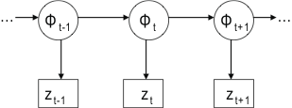

Sequential Bayesian Filtering
SDM ‘10
Changing Accuracy with time t
Tracking the states of multiple systems as each evolves over time
Sequentially arriving observations (noisy labels)
Goal: Estimate posterior
distribution
Noisy labels
Notes:
As I said, we tackle this problem by formulating it as a sequential bayesian estimation. We have a system that is evolving over time. In this system, each node represents the changing accuracy of the source which is unobserved; this essentially represents an unobserved first-order Markov process. What we observe is the sequentially arriving noisy labels generated by the accuracy at the corresponding time step. The goal is to estimate the posterior distribution of the accuracy based on the history of observations. Cause if we know the distribution, then we can estimate almost any quantity of interest, like the expected accuracy at any given time.

Slide 28

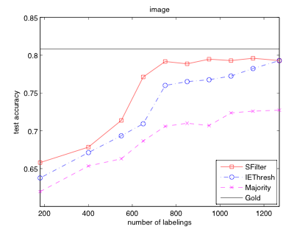
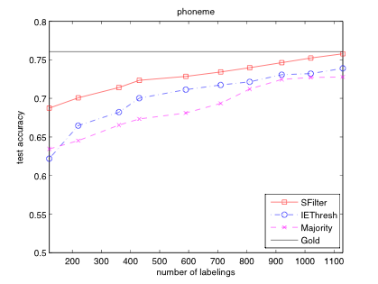
Does Tracking Predictor Accuracy Actually Help in Proactive Learning?
SDM ‘10
Notes:
One of the advantages of using this framework is that we can predict the true label at any time t by using the estimated expected accuracy of each source selected at time t and the noisy labels they omit. And train a logistic regression classifier on the data labeled by each method and tested the classifier on a held-out test set. The y-axis shows the test accuracy and the x-axis shows the number of source queries issued. We compared our method against two baselines that uses majority voting to predict the true label. The purple line uses all sources and take their majority vote and the blue line is our IE method that selects a subset of sources and use only their majority vote. None of these techniques take the time-varying accuracy into account. The horizontal black line is the performance of a classifier trained on the true labels. Clearly, we get close to the gold standard level and significantly outperform the baselines. That means we can produce clean and reliable datasets even when we do not know what the true labels are.

Slide 29
Proactive Learning in Early Detection of Malware

Slide 30

Boeing-CMU Aerospace Data Analytics Lab
Just after Takeoff
Dreamliner Maiden Flight
15-December-2009

Slide 31
F/A-18 Maintenance Decision Support
Past: Reactive, Improve flight readiness
Computer-assisted diagnoses of F/A-18 troubles
  Statistical learning problem
Computer-assisted expert finding
  Statistical recommendation (“collaborative filtering”) problem
Computer-assisted resolution recommendation
  Information retrieval problem
From research prototypes to operational systems
  Software engineering problem (not done by CMU)

Slide 32
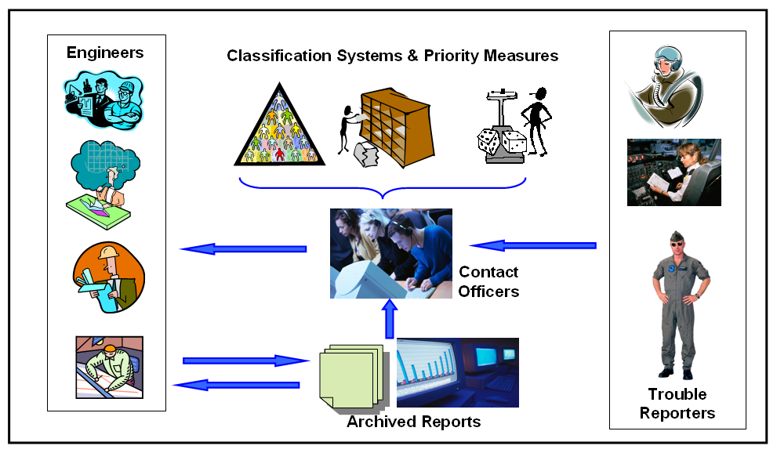
Information flow:
Aircraft trouble reports
Classifiers
Recom. System
Search Engine

Slide 33
The Task: Get the right plane to the right process, right facility, and right engineers
Each Operation requires selection of one from many
  VSE: 18 categories, 83 sub-categories
  “Application”: 28 categories
  “Priority”: 5 categories
  “Engineer”: 48 experts (“categories”)
We induce one classifier per category
  Producing a probability estimates of correct assignments

Slide 34
Boeing Aerospace ML Challenges
(Now: Proactive, Commercial Aviation)
Optimizing parts/assembly/systems preventive maintenance: Minimize airplane downtime
Multi-media time-series prediction
  Text (maintenance reports)
  Sensors (onboard, downloaded)
  Parts networks (demand forecasting)
  Fleet mix/ageing
Sensor data alone → Terabytes in raw form
Very few serious malfunctions → few labels

Slide 35

Active Learning for MT
Parallel corpus
Expert
Translator
S,T
Trainer
S
Model
Sampled corpus
MT System
Source
Language
Corpus
Active
Learner

Slide 36

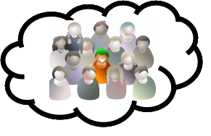
ProActive Crowd Translation
S,T₁
S,T₂
Trainer
.
.
.
Translation
Selection
S,T_{n}
Model
S
Sentence
Selection
MT System
Source
Language
Corpus
ACT
Framework

Slide 37
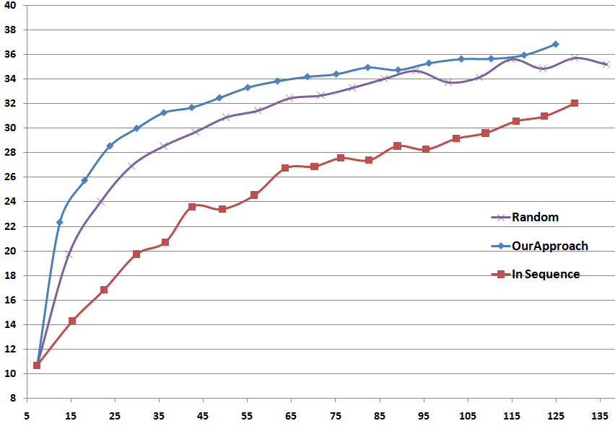
Active Learning Strategy:
Diminishing Density Weighted Diversity Sampling
Experiments:
Language Pair: Spanish-English
Iterations: 20
Batch Size: 1000 sentences each
Translation: Moses Phrase SMT
Development Set: 343 sens
Test Set: 506 sens
Graph:
X: Performance (BLEU )
Y: Data (Thousand words)

Slide 38
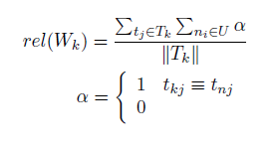
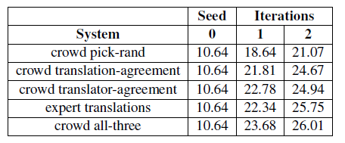
Translation Selection from AMT
Crowds beat experts
Translator Reliability
Translation Selection:

Slide 39




MT via LSTM (DNNs + Sequence)
I'd
like
a
beer
stop
STOP
→
I'd
like
a
beer
Attention history:

Slide 40
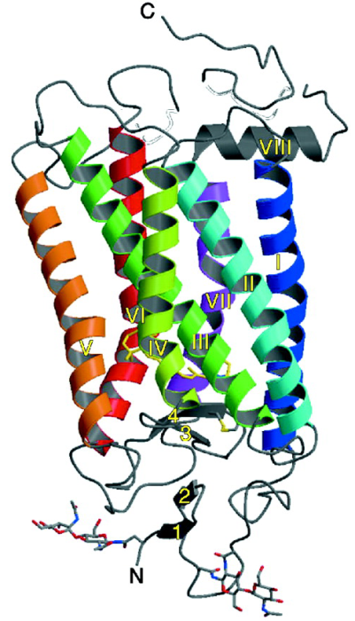
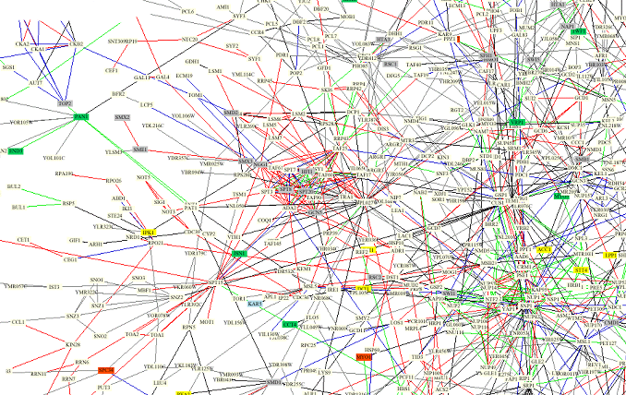
(Borrowed from: Judith Klein-Seetharaman)
P^{ROTEIN}S
Sequence → Structure → Function
Primary Sequence
MNGTEGPNFY VPFSNKTGVV RSPFEAPQYY LAEPWQFSML AAYMFLLIML GFPINFLTLY VTVQHKKLRT PLNYILLNLA VADLFMVFGG FTTTLYTSLH GYFVFGPTGC NLEGFFATLG GEIALWSLVV LAIERYVVVC KPMSNFRFGE NHAIMGVAFT WVMALACAAP PLVGWSRYIP EGMQCSCGID YYTPHEETNN ESFVIYMFVV HFIIPLIVIF FCYGQLVFTV KEAAAQQQES ATTQKAEKEV TRMVIIMVIA FLICWLPYAG VAFYIFTHQG SDFGPIFMTI PAFFAKTSAV YNPVIYIMMN KQFRNCMVTT LCCGKNPLGD DEASTTVSKT ETSQVAPA
Folding
3D Structure
Complex function within network of proteins
Normal
Notes:
However, you can also go to a different position, and change it. This does not result in any change in 3d structure or function, and cell is normal.

Slide 41
P^{ROTEIN}S
Sequence → Structure → Function
Primary Sequence
MNGTEGPNFY VPFSNKTGVV RSPFEAPQYY LAEPWQFSML AAYMFLLIML GFPINFLTLY VTVQHKKLRT PLNYILLNLA VADLFMVFGG FTTTLYTSLH GYFVFGPTGC NLEGFFATLG GEIALWSLVV LAIERYVVVC KPMSNFRFGE NHAIMGVAFT WVMALACAAP PLVGWSRYIP EGMQCSCGID YYTPHEETNN ESFVIYMFVV HFIIPLIVIF FCYGQLVFTV KEAAAQQQES ATTQKAEKEV TRMVIIMVIA FLICWLPYAG VAFYIFTHQG SDFGPIFMTI PAFFAKTSAV YNPVIYIMMN KQFRNCMVTT LCCGKNPLGD DEASTTVSKT ETSQVAPA
Folding
3D Structure
Complex function within network of proteins
Cancer: unckecked cellular replicaiton
Notes:
Each protein is part of a huge complicated network of interacting proteins.
What happens when you change this sequence? For example, change this letter to a differerent letter. Then it is no longer at its place in the context of the other proteins.

Slide 42
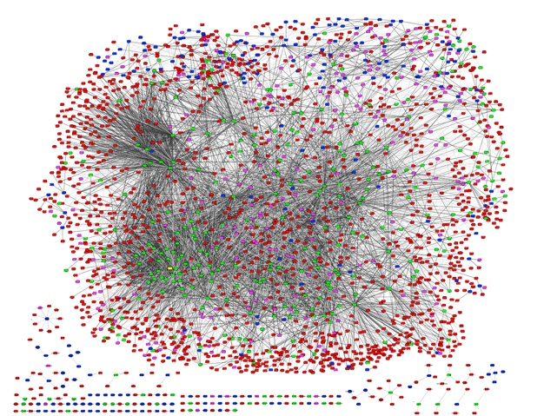
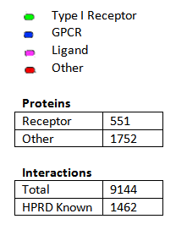
Computational Virology via PPI’s
Degree distribution / Hub analysis / Disease checking
Graph modules analysis (from bi-clustering study)
Protein-family based graph patterns: receptors / subclasses / ligands / etc
42
Notes:
Due to the time and cost limitation, we can not validate all the predicted interactions..
We make use of the global analysis to find interesting biological hypothesis for further testing..
42

Slide 43
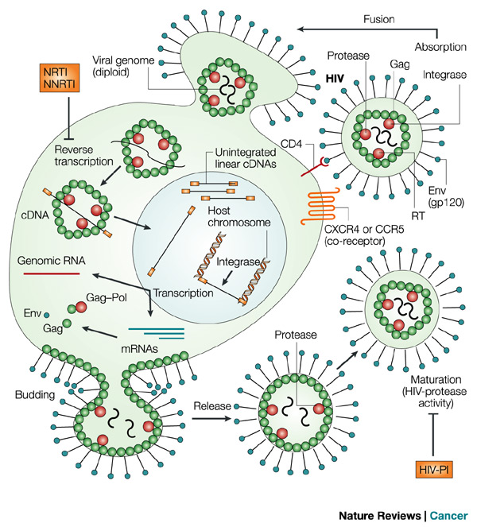
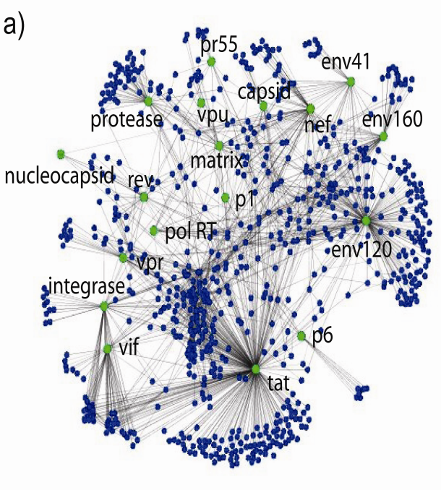
HIV-1 host protein interactions
Fusion
HIV-1 depends on the cellular machinery in every aspect of its life cycle.
Reverse
transcription
Transcription
Budding
Maturation
Peterlin and Torono, Nature Rev Immu 2003.

Slide 44
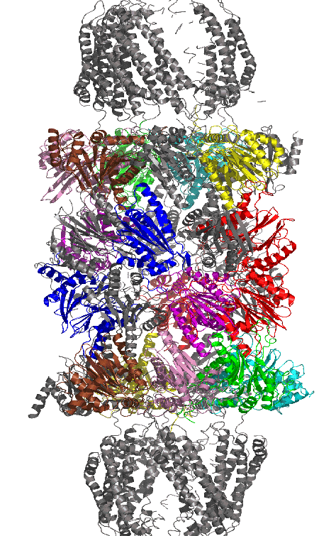
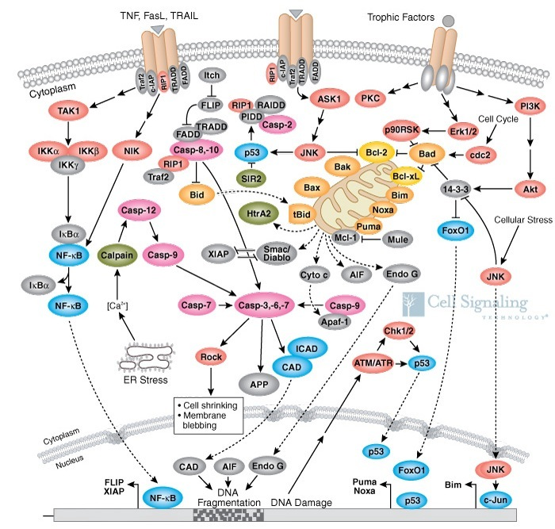
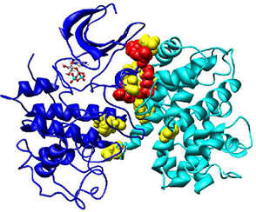
PPIs: Protein-Protein Interactions
The cell machinery is run by the proteins
  Enzymatic activities, replication, translation, transport, signaling, structural
Proteins interact with each other to perform these functions
Through physical contact
Indirectly
in a protein complex
Indirectly in pathway
http://www.cellsignal.com/reference/pathway/Apoptosis_Overview.html
Notes:
Considering the possible diverse background of audience today,
I would give a simple introduction of related biological knowledge
In the following several slides. For those of you who knows all this
very well, please forgive the simplicity.
To get a better understanding why we want to study protein interactions,
I made an analogy from protein to human beings …
Proteins live in the Cell. Cell is simplest living units of every organism …
it is the basic units of every life.
(The structural and functional unit of all known living organisms)
Proteins are the main actors that participate in every
functions in the cell…
which is just like our human society …. City is the basic unit …
And human beings are the main actors

Slide 45

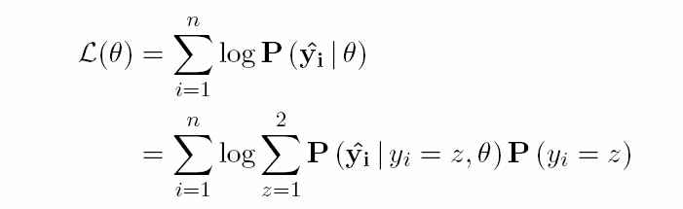
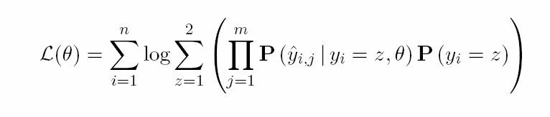
Estimating expert labeling accuracies
Solve this
through expectation maximization
Assuming experts are conditionally independent given true label

Slide 46
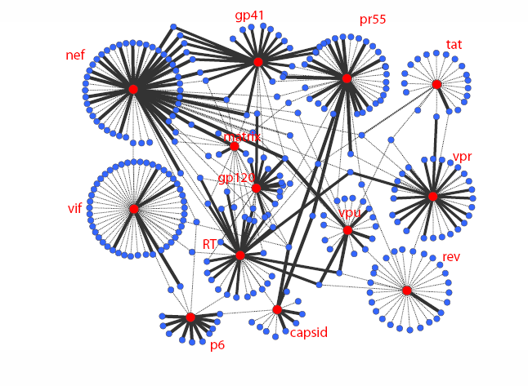
Refined interactome
Solid line: probability of being a direct interaction is ≥0.5
Dashed line: probability of being a direct interaction is <0.5
Edge thickness indicates confidence in the interaction

Slide 47
Transfer/Multi-Task Learning
Basic Idea: Map invariant properties from similar tasks previously learning tasks
Challenges: What to retain? How to modify?
History:
  Transformation/Derivational Analogy (1980s)
  Case-Based Reasoning (1980s-1990s)
  “Modern” Transfer Multi-Task (2000’s)
New focus: beyond transferring priors & features
  Regularizers to maximize transfer
  Structural biases

Slide 48

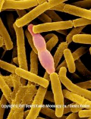
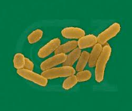
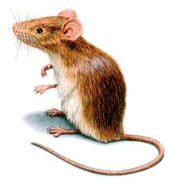
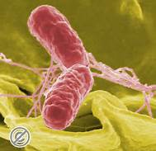
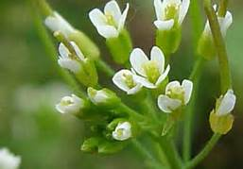
Host-pathogen interactions :
The Multitask Landscape
Homologous proteins due to common ancestors
Firmicutes
B. anthracis
H. sapiens
Bacteria
Vertebrates
Y. pestis
M. musculus
Protists
Enterobacteria
S. typhi
Plants
A. Thaliana

Slide 49
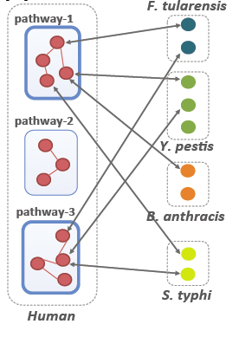
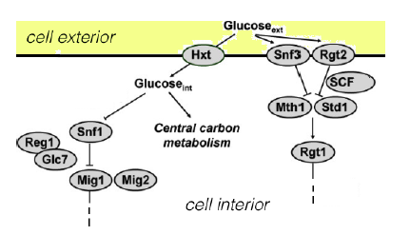
Common Biological Pathways
The “Glucose Transport Pathway”

Slide 50






Multi-task Objective
For m tasks with parameters
Minimize empirical error
Enforce commonality hypothesis
Prevent overfitting
Empirical loss
Pathway regularizer
L2 regularizer

Slide 51
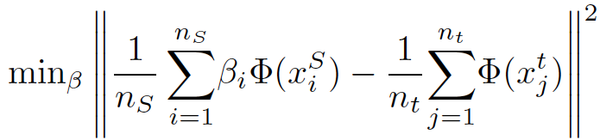
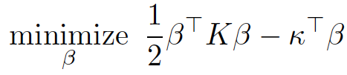
Kernel Mean Matching
KMM allows us to “soft select” examples
Reweighs source examples to make them look similar to target examples
-- MMD
Spectrum RBF Kernel
- based on protein sequence n-grams
Notes:
Based on a feature map phi, KMM compares the mean of the reweighted source feature vectors with the mean of the target feature vectors. Clearly if the two distributions were identical, the means would be the same. For sufficiently rich phi such as gaussian kernels, matching the means is identical to matching the two distributions. Hence we can minimize the distance over all possible reweightings. This function is also called Maximum Mean Discrepancy (MMD).
Doing some simple algebra on this gives us this kernalized function.

Slide 52
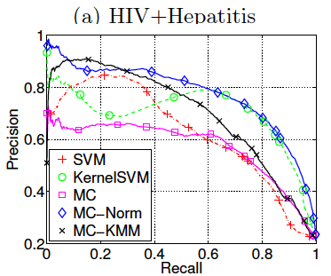
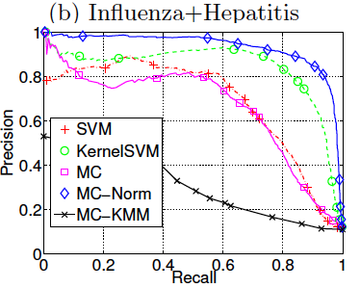
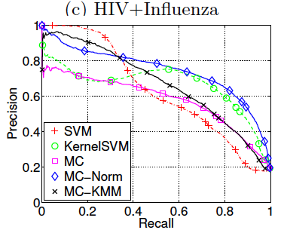
AUC-PR on source
2 source tasks
Train on 80%, test on 20%
P, R measured on positives

Slide 53
Parting Thoughts
Multi-task/Transfer Learning
  It really works! (referral nets, recommendation systems, proteomics, prerequisite graphs, …)
  Fanciest method may not be best (e.g. KMM)
Proactive Learning
  It too really works! (MT, malware detection, proteomics, recommendation systems)
  Somehow the ML field has not yet embraced it
Both cope with label sparsity – necessary no matter what baseline ML method used

Slide 54

THANK YOU!

Slide 55
The Big-Data “Stack”
Analytics Algorithms
-- Machine Learning
-- Pattern Detection
Alerts, Visualization
Big-Data Architecture
-- Hadoop/H-Table
-- Asynch/Pegasus
Sensors
Big-Data “Plumbing”
-- Cloud/Storage
-- Resource Allocator
Historical & Normative Data
Knowledge base
Notes:
Analytics: Carbonell, Yang, Mitchell, …
Architecture: Faloutsos, Starzl, …
Plumbing: Gibson, Ganger, …

Slide 56
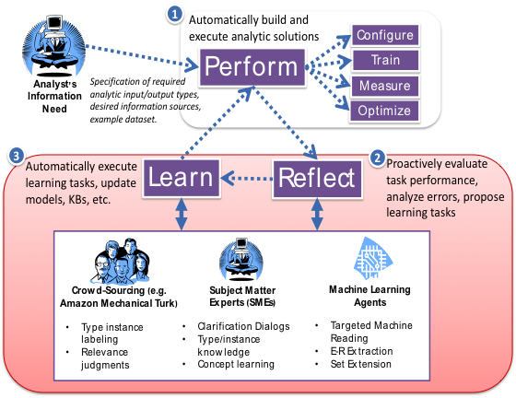
LTI COG (aka Agent) Architecture

Slide 57
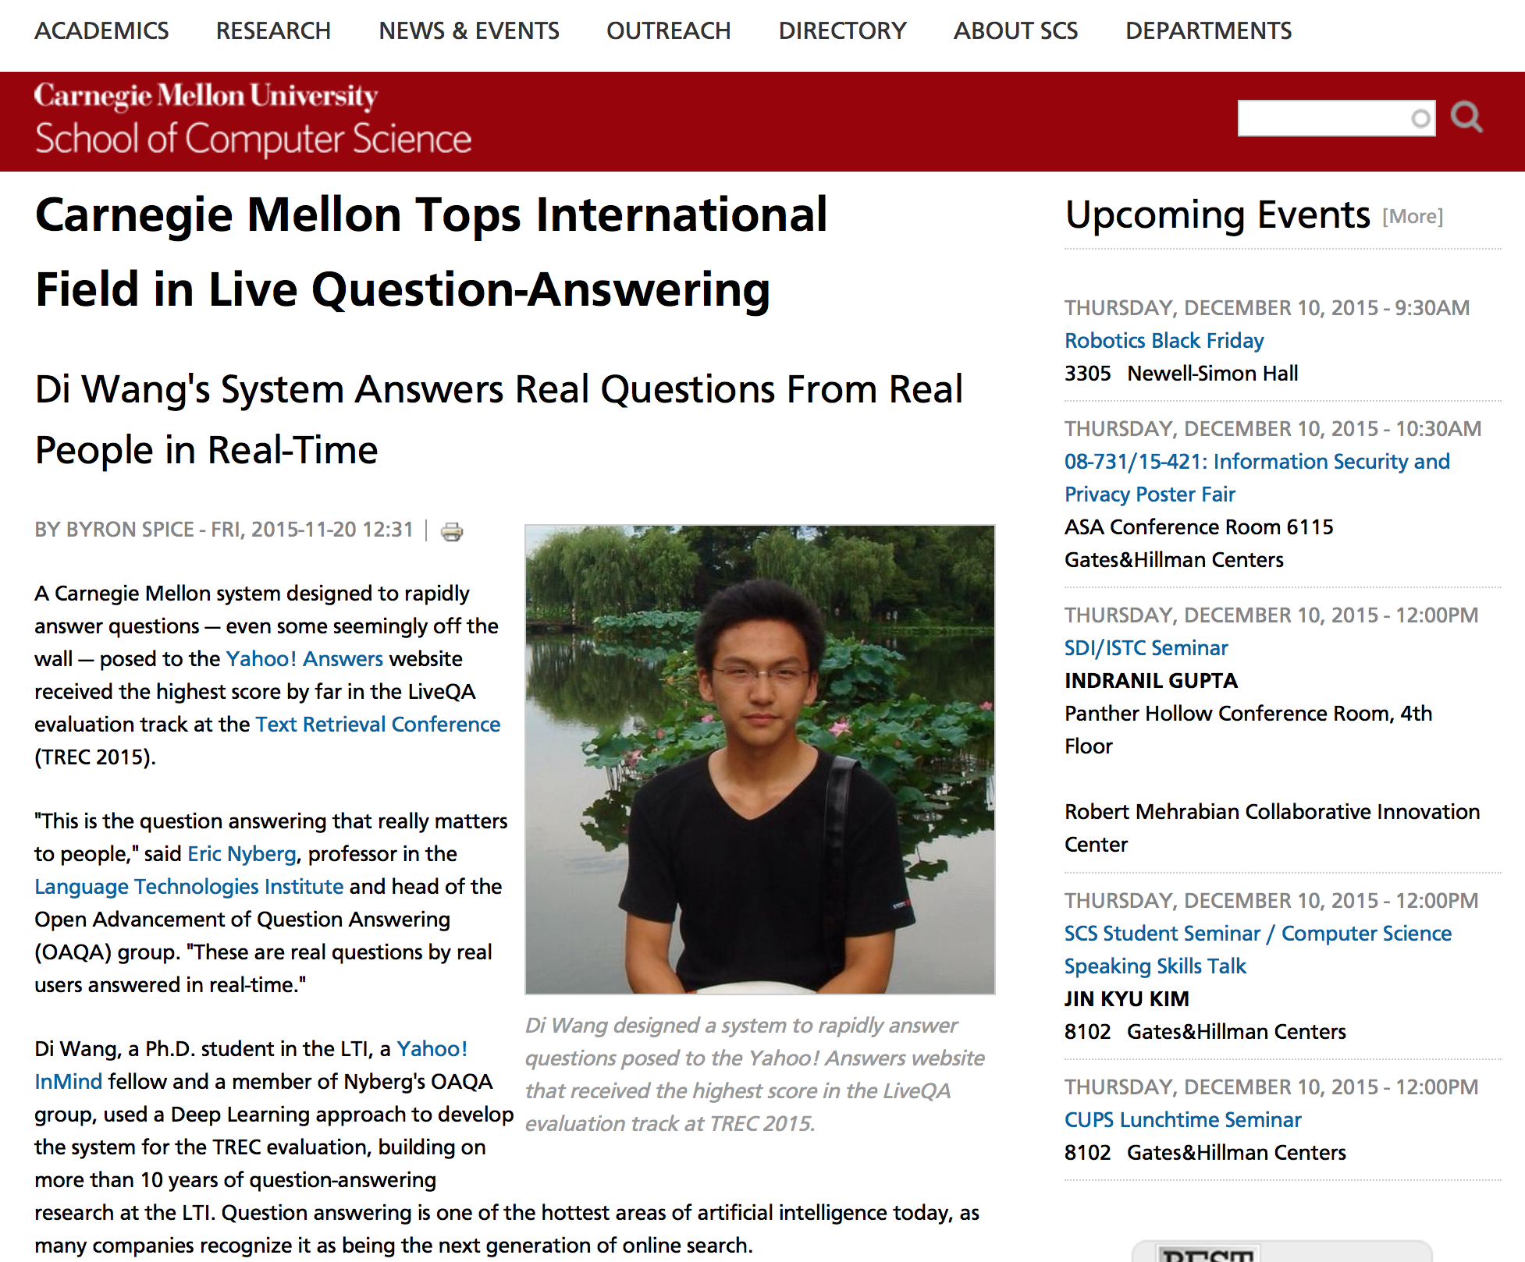
Used Deep Learning (LDSTA)
model trained on Yahoo!
answers data to match questions
with answer-bearing sentences

Slide 58
