Slide 1
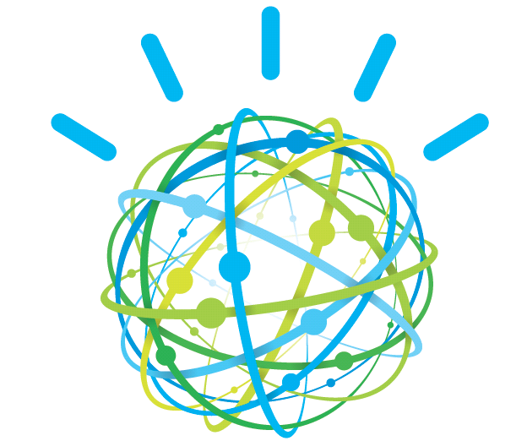

Cognitive Computing and in Research, Operations, and Medicine
Christopher Codella, Ph.D.
IBM Distinguished Engineer, Watson Public Sector CTO
Notes:
1

Slide 2
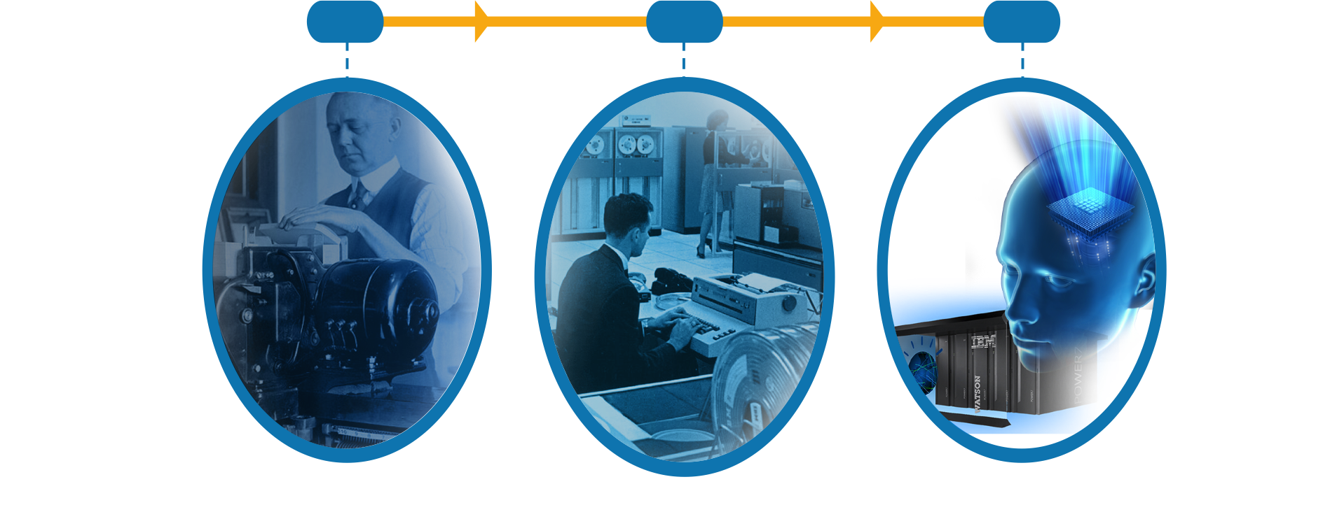
Watson Ushers In a New Era of Computing
Tabulating
Systems Era
Programmable
Systems Era
Cognitive
Systems Era
1900
1950
2011
2
Notes:
Main Point: Watson represents a whole new class of industry specific solutions called cognitive systems. It builds on the current paradigm of Programmatic Systems and is not meant to be a replacement; programmatic systems will be with us for the foreseeable future. But in many cases, keeping pace with the demands of an increasingly complex business environment and challenges requires a paradigm shift in what we should expect from IT. We need an approach that recognizes today’s realities and treats them as opportunities rather than challenges.
Further speaking points: For example, most digitized information of the past was structured. It was organized into tables, stored in easily identified cells in databases, and easily searched and accessed. Unstructured information was largely ignored as too difficult to utilize…and therefore it lay fallow. Similarly, traditional IT has largely limited itself to deterministic applications. 2+2=4. 100cm in a meter. Situations where there is only one answer to a question But this rules out a whole world of real world situations that have a more probabilistic outcome. It is very likely that the car will not start because of a dead battery but there is a chance there is a clog in the fuel line. It is very likely to be sunny tomorrow but it may rain. Traditional IT relies on search to find the location of a key phrase. Emerging IT gathers information and combines it for true discovery. Traditional IT can handle only small sets of focused data while IT today must live with big data. And traditional IT interacts with machine language while what we as users really need is interaction the way we ourselves communicate – in natural language.
Three distinguishing features:
Non-deterministic
Learning
Natural language (sometimes)
Cognitive systems are characterized by the ability to learn using intelligent agents. A cognitive system perceives its environment and takes actions that maximize its chances of success.
John McCarthy coined the term, “Artificial Intelligence” in 1955. He defined it as "the science and engineering of making intelligent machines".
Today machines learn via supervised and unsupervised methods
What is machine Learning?
Teaching computer about the world
How to apply machine learning
Observe the world
Develop models that match observations
Teach computer to learn these models
Applied learned models to the world
2

Slide 3
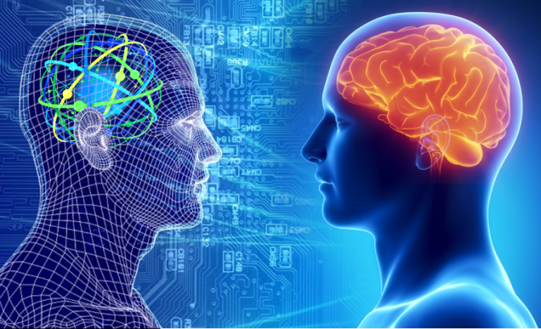
What is Cognitive Computing?
Cognitive systems are able to learn their behavior through education
Support forms of expression that are more natural for human interaction
Whose primary value is their expertise; and
That continue to evolve as they experience new information
… and does so at enormous scale.

Slide 4
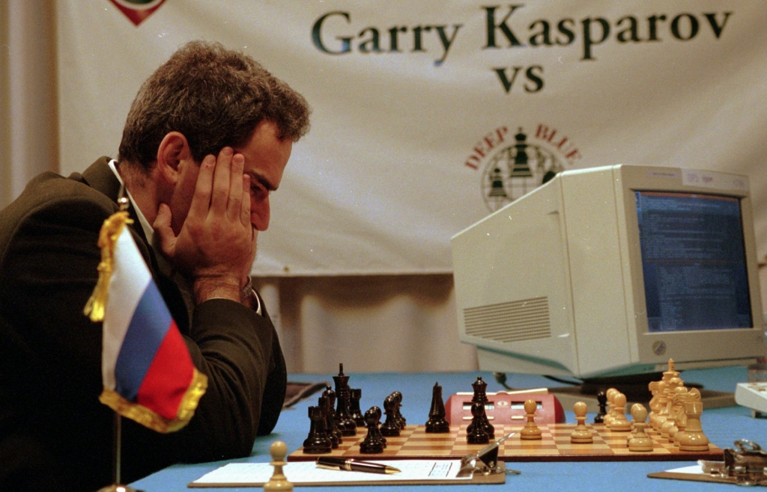
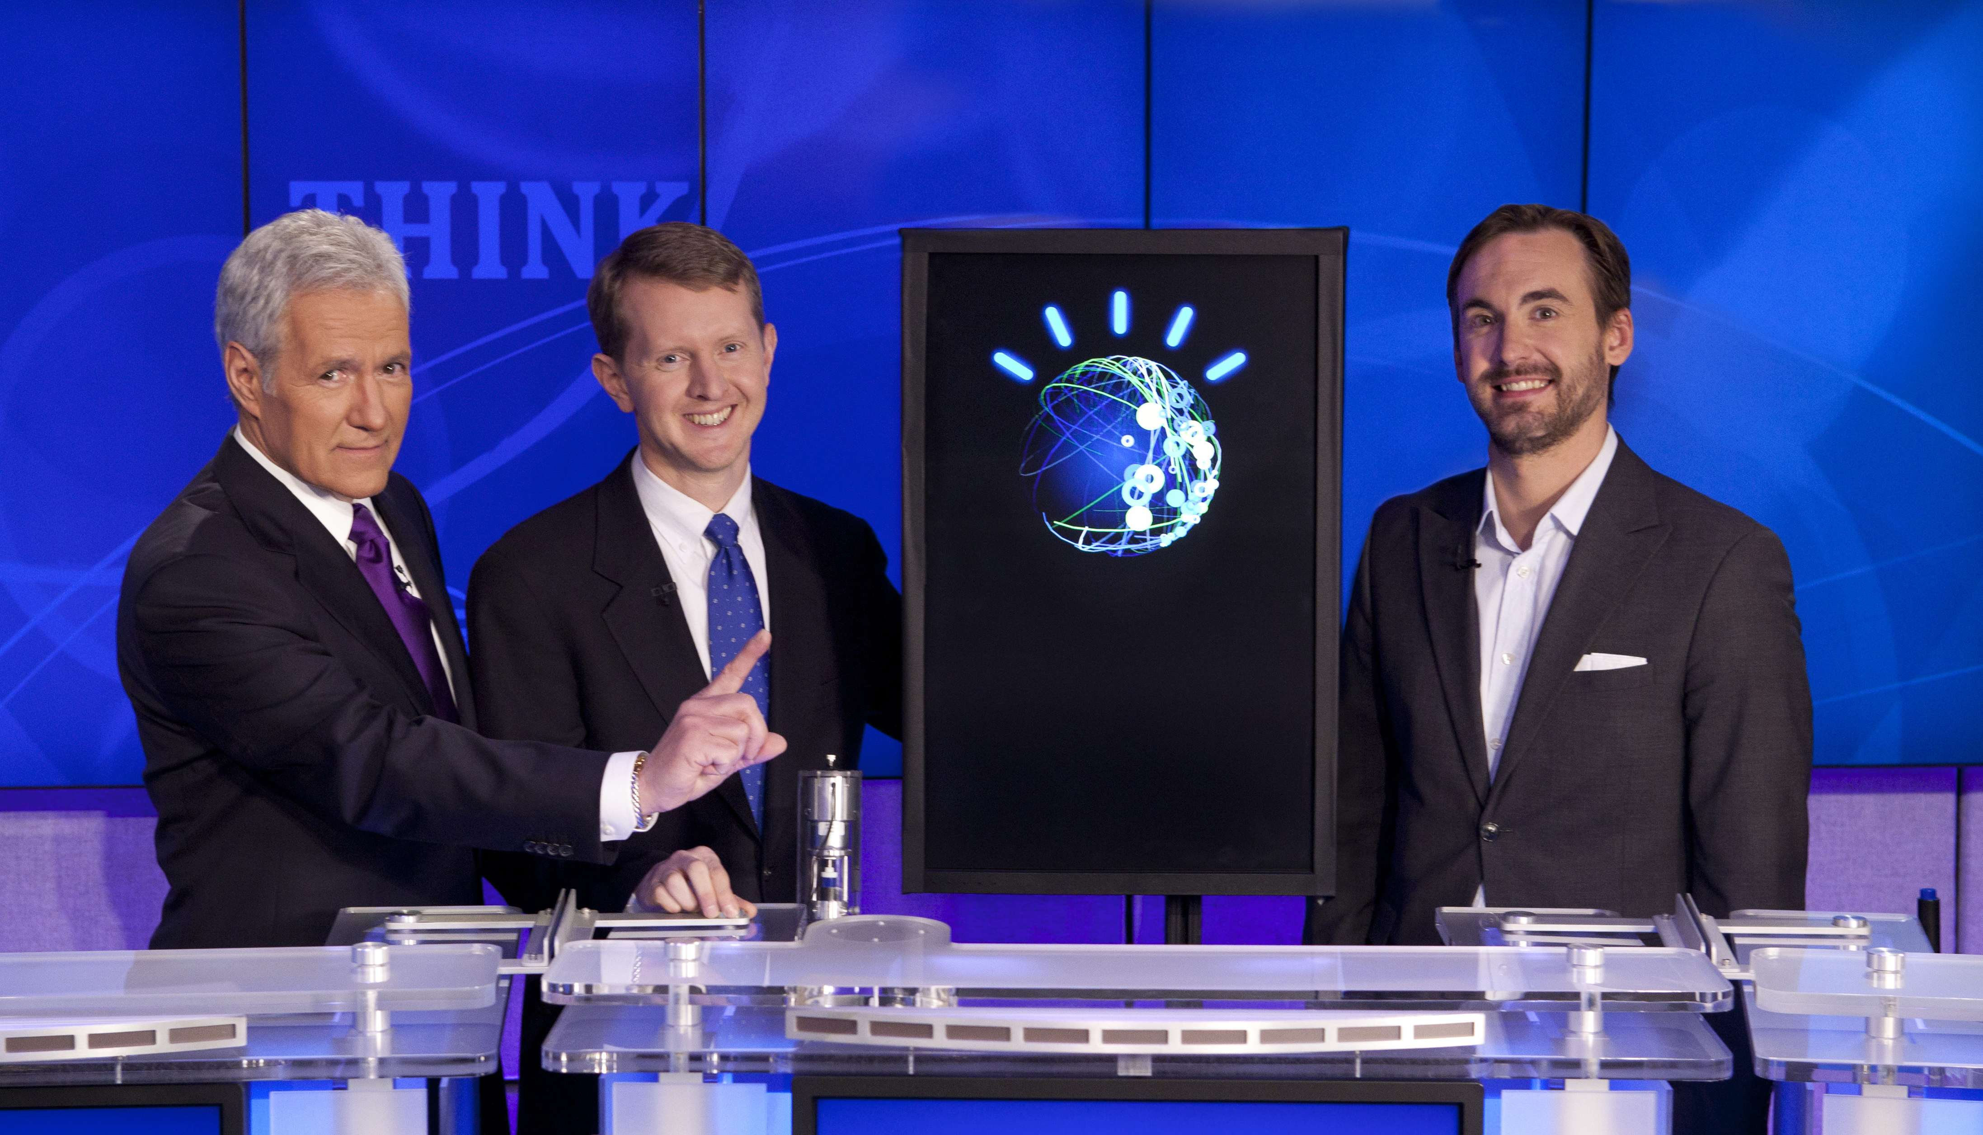
The hardest problems as IBM Grand Challenges
Chess – Deep Blue (1997)
A finite, mathematically well-defined search space
Limited number of moves and states
Grounded in explicit, unambiguous mathematical rules
Human Language – Watson (2011)
Ambiguous, contextual and implicit
Grounded only in human cognition
Seemingly infinite number of ways to express the same meaning

Slide 5

Automatic Learning For “Reading”
Generalization &
Statistical Aggregation
Sentence
Parsing
Volumes of Text
Syntactic Frames
Semantic Frames
subject
verb
object
Inventors patent inventions (.8)
Officials Submit Resignations (.7)
People earn degrees at schools (0.9)
Fluid is a liquid (.6)
Liquid is a fluid (.5)
Vessels Sink (0.7)
People sink 8-balls (0.5) (in pool/0.8)

Slide 6
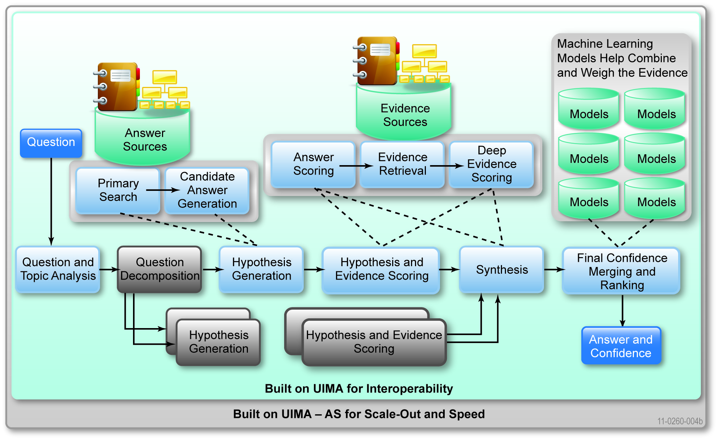
Inside Watson Massively Parallel Probabilistic Evidence-Based Architecture
Notes:
8/15/16
6
Large-scale Hypothesis Generation, Evidence Gathering and Scoring architecture
DeepQA generates and scores many hypotheses using an extensible collection of Natural Language Processing, Machine Learning and Reasoning Algorithms. These gather and weigh evidence over both unstructured and structured content to determine the answer with the best confidence.
1. Question analysis, decomposition, LAT detection, focus
2. Primary search – multiple effective queries
unstructured – document search, TIC passage search, passage search – two search engines: Indri, Lucene
structured – answer lookup, prismatic search
3. Candidate answer generation
unstructured - from document metadata
2 + 3 = hypothesis generation
Watson – the computer system we developed to play Jeopardy! is based on the DeepQA softate archtiecture.Here is a look at the DeepQA architecture. This is like looking inside the brain of the Watson system from about 30,000 feet high.
Remember, the intended meaning of natural language is ambiguous, tacit and highly contextual. The computer needs to consider many possible meanings, attempting to find the evidence and inference paths that are most confidently supported by the data.
So, the primary computational principle supported by the DeepQA architecture is to assume and pursue multiple interpretations of the question, to generate many plausible answers or hypotheses and to collect and evaluate many different competing evidence paths that might support or refute those hypotheses.
Each component in the system adds assumptions about what the question might mean or what the content means or what the answer might be or why it might be correct.
DeepQA is implemented as an extensible architecture and was designed at the outset to support interoperability.
<UIMA Mention>
For this reason it was implemented using UIMA, a framework and OASIS standard for interoperable text and multi-modal analysis contributed by IBM to the open-source community.
Over 100 different algorithms, implemented as UIMA components, were integrated into this architecture to build Watson.
In the first step, Question and Category analysis, parsing algorithms decompose the question into its grammatical components. Other algorithms here will identify and tag specific semantic entities like names, places or dates. In particular the type of thing being asked for, if is indicated at all, will be identified. We call this the LAT or Lexical Answer Type, like this “FISH”, this “CHARACTER” or “COUNTRY”.
In Query Decomposition, different assumptions are made about if and how the question might be decomposed into sub questions. The original and each identified sub part follow parallel paths through the system.
In Hypothesis Generation, DeepQA does a variety of very broad searches for each of several interpretations of the question. Note that Watson, to compete on Jeopardy! is not connected to the internet.
These searches are performed over a combination of unstructured data, natural language documents, and structured data, available data bases and knowledge bases fed to Watson during training.
The goal of this step is to generate possible answers to the question and/or its sub parts. At this point there is very little confidence in these possible answers since little intelligence has been applied to understanding the content that might relate to the question. The focus at this point on generating a broad set of hypotheses, – or for this application what we call them “Candidate Answers”.
To implement this step for Watson we integrated and advanced multiple open-source text and KB search components.
After candidate generation DeepQA also performs Soft Filtering where it makes parameterized judgments about which and how many candidate answers are most likely worth investing more computation given specific constrains on time and available hardware. Based on a trained threshold for optimizing the tradeoff between accuracy and speed, Soft Filtering uses different light-weight algorithms to judge which candidates are worth gathering evidence for and which should get less attention and continue through the computation as-is. In contrast, if this were a hard-filter those candidates falling below the threshold would be eliminated from consideration entirely at this point.
In Hypothesis & Evidence Scoring the candidate answers are first scored independently of any additional evidence by deeper analysis algorithms. This may for example include Typing Algorithms. These are algorithms that produce a score indicating how likely it is that a candidate answer is an instance of the Lexical Answer Type determined in the first step – for example Country, Agent, Character, City, Slogan, Book etc.
Many of these algorithms may fire using different resources and techniques to come up with a score. What is the likelihood that “Washington” for example, refers to a “General” or a “Capital” or a “State” or a “Mountain” or a “Father” or a “Founder”?
For each candidate answer many pieces of additional Evidence are search for. Each of these pieces of evidence are subjected to more algorithms that deeply analyze the evidentiary passages and score the likelihood that the passage supports or refutes the correctness of the candidate answer. These algorithms may consider variations in grammatical structure, word usage, and meaning.
In the Synthesis step, if the question had been decomposed into sub-parts, one or more synthesis algorithms will fire. They will apply methods for inferring a coherent final answer from the constituent elements derived from the questions sub-parts.
Finally, arriving at the last step, Final Merging and Ranking, are many possible answers, each paired with many pieces of evidence and each of these scored by many algorithms to produce hundreds of feature scores. All giving some evidence for the correctness of each candidate answer.
Trained models are applied to weigh the relative importance of these feature scores. These models are trained with ML methods to predict, based on past performance, how best to combine all these scores to produce final, single confidence number for each candidate answer and to produce the final ranking of all candidates.
The answer with the strongest confidence would be Watson’s final answer. And Watson would try to buzz-in provided that top answer’s confidence was above a certain threshold.
----
The DeepQA system defers commitments and carries possibilities through the entire process while searching for increasing broader contextual evidence and more credible inferences to support the most likely candidate answers.
All the algorithms used to interpret questions, generate candidate answers, score answers, collect evidence and score evidence are loosely coupled but work holistically by virtue of DeepQA’s pervasive machine learning infrastructure.
No one component could realize its impact on end-to-end performance without being integrated and trained with the other components AND they are all evolving simultaneously. In fact what had 10% impact on some metric one day, might 1 month later, only contribute 2% to overall performance due to evolving component algorithms and interactions. This is why the system as it develops is regularly trained and retrained.
DeepQA is a complex system architecture designed to extensibly deal with the challenges of natural language processing applications and to adapt to new domains of knowledge.
The Jeopardy! Challenge has greatly inspired its design and implementation for the Watson system.

Slide 7
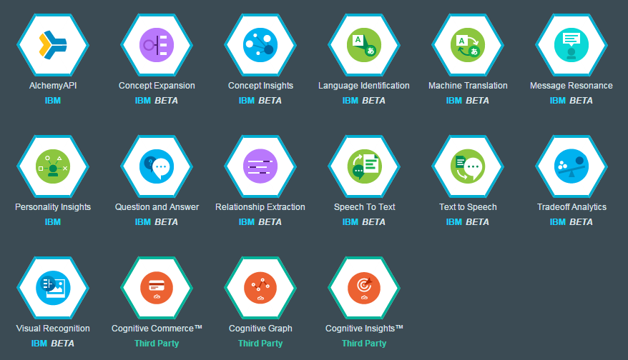
Watson on Bluemix
Notes:
List current as of 2015-04-14.

Slide 8
Relevant Information Discovery: Search vs. Expert Q&A
Decision Maker
Has Question
Search Engine
Distills to 2-3 Keywords
Finds Documents containing Keywords
Reads Documents, Finds Answers
Delivers Documents based on Popularity
Finds & Analyzes Evidence
Expert
Decision Maker
Understands Question
Asks NL Question
Produces Possible Answers & Evidence
Considers Answer & Evidence
Analyzes Evidence, Computes Confidence
Delivers Response, Evidence & Confidence
Notes:
8

Slide 9
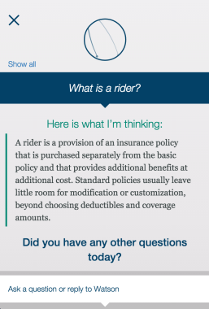
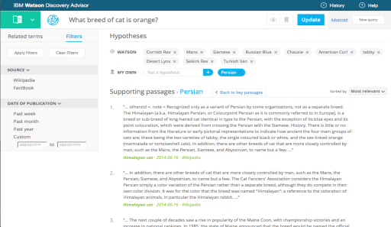
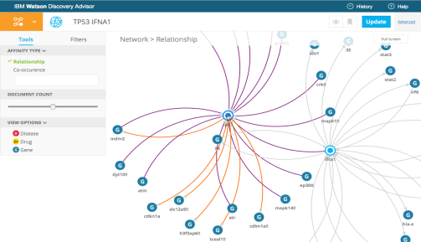
Use Case Patterns
Exploration
Collect the information that you need to explore your problem area better
Engagement
Dialog with end users to answer the questions needed around products and services
Discovery
Help find the questions you’re not thinking to ask and connect the dots that you’re missing that will lead to new inspiration
Decision
Assess the choices that enable you to make better decisions
Policy
Test conformance to a set of written policy conditions

Slide 10
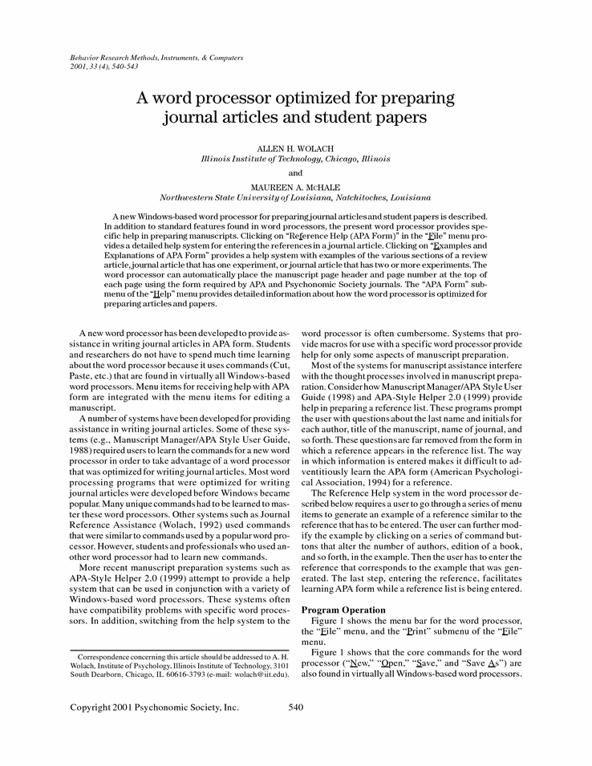
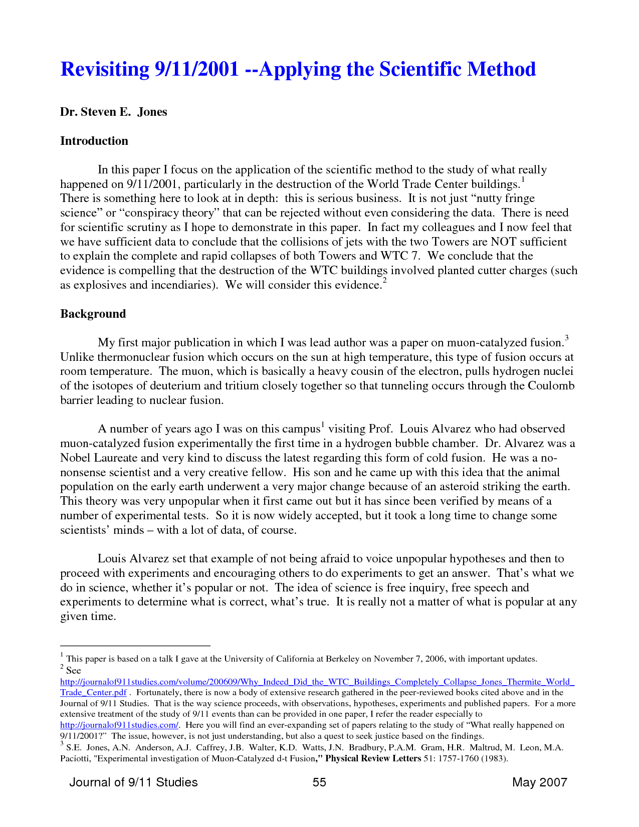
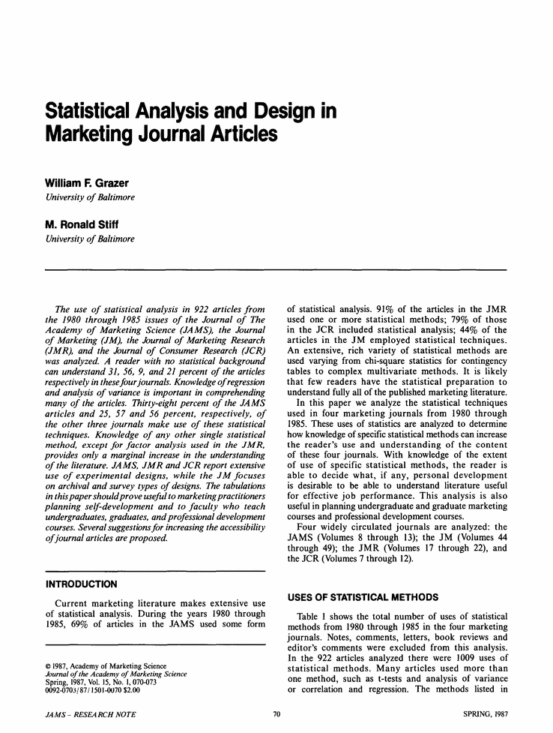




Watson Discovery Advisor
Ingest
Consult
Scientists, Engineers, Planners, Project Management, Attorneys, Scholars, Economists, Legislators, Analysts, …

Slide 11
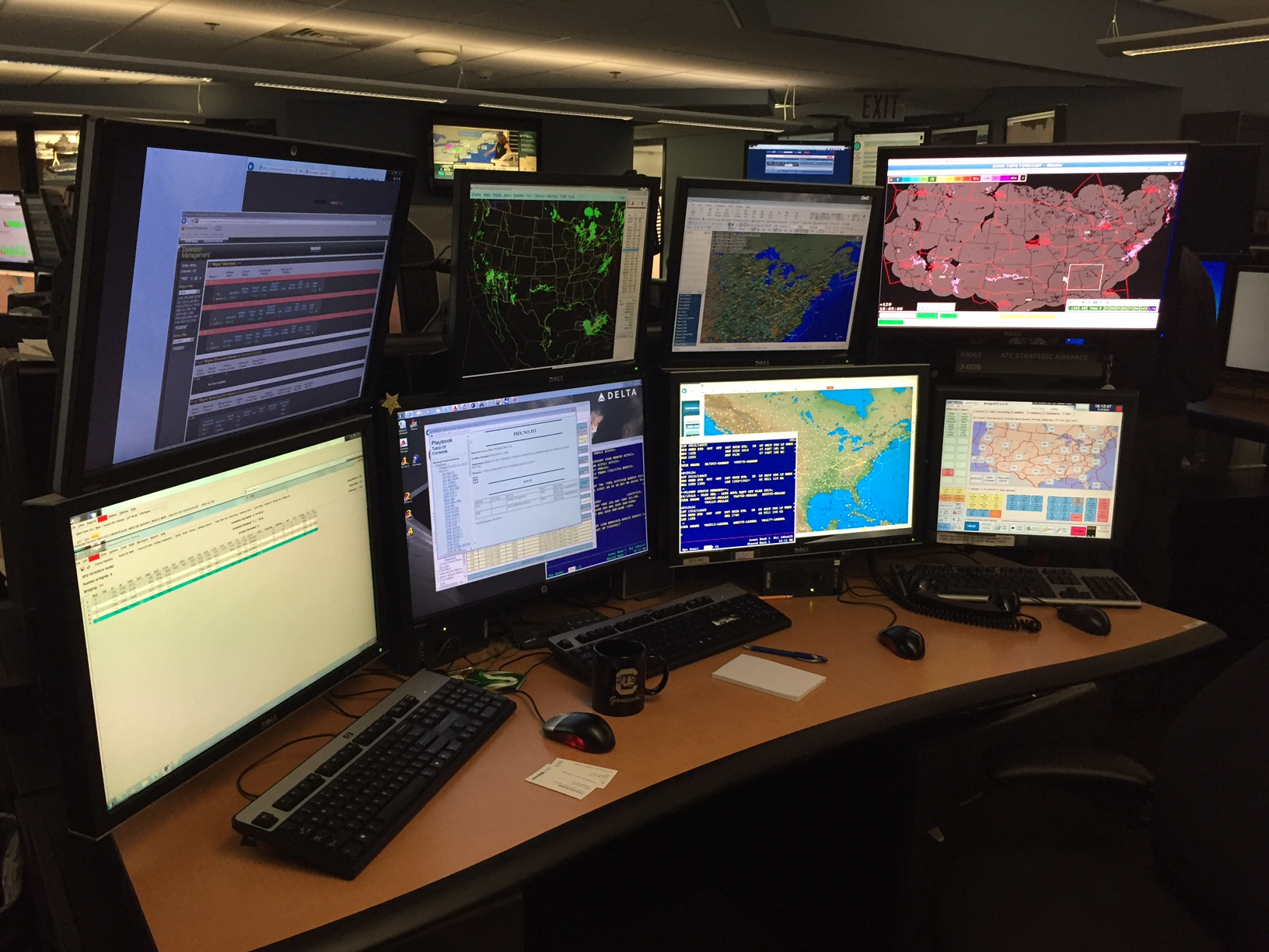
Decision

Slide 12
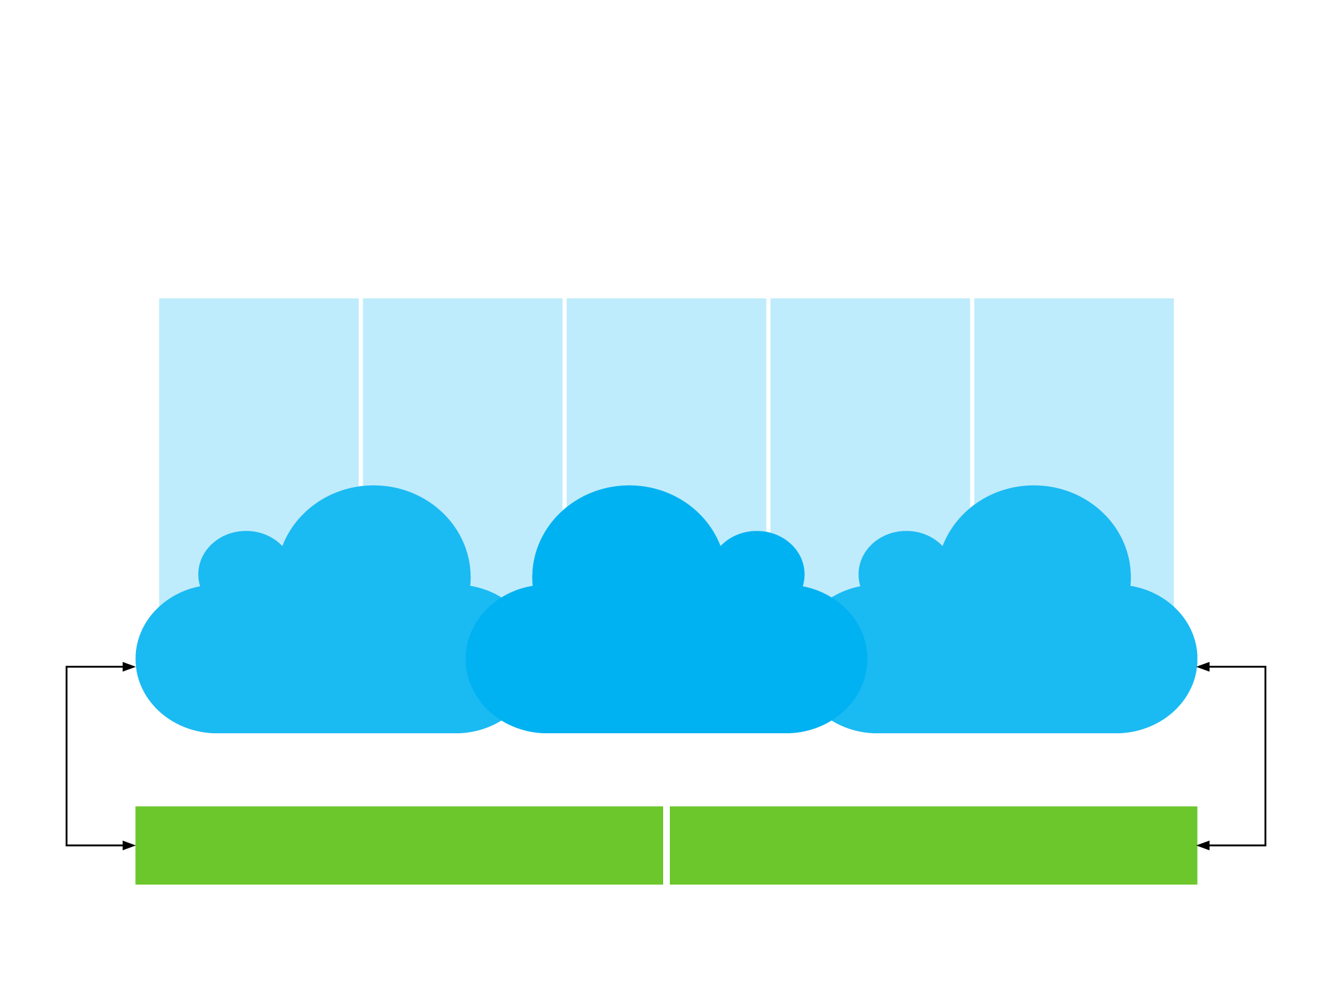
Watson Health Five pillars enabled through a platform that has data, knowledge, analytics and industry specific solutions supported on a secure cloud.
Life Sciences
Oncology/ Genomics
Imaging
Continuum of Care
Payments and Value
Real-world evidence
Discovery advisor
Clinical trials
Oncology advisor
Genomic advisor
EMRA
Radiology
Cardiology
Oncology
Ophthalmology
Chronic diseases
Population health
Care management
Social programs
Wellness
IBM Watson Health Cloud
Analytics/Insights Platform
Image Analytics
Cognitive Knowledge Platform
Data
Knowledge
© 2016 International Business Machines Corporation Why Watson Health?
12

Slide 13
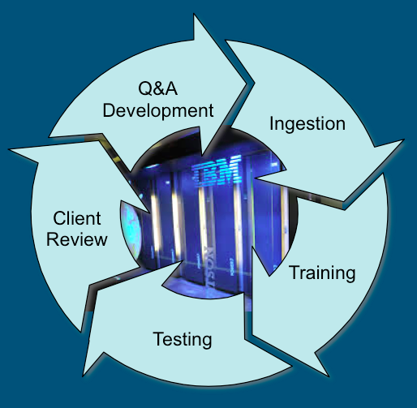
Process for Building a Watson System
Selection and ingestion of documents to build a corpus
Pre-processing conditioning (if necessary)
Watson ingests documents to create its knowledge base
Domain Training
Training sets (Q/A pairs) are created by subject matter experts
Training sets are used to train the machine learning models
Special lexicons are established (if any)
User pilots
System is tested in mission domain by a small set of end users
Modifications are made to enhance effectiveness
Staged deployment to production level
Expanded user base
Expand infrastructure to meet scaling objectives
Periodically expanded corpus
Integrate with existing analytics and other tools

Slide 14

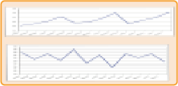

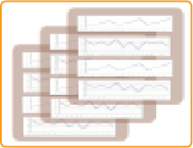



Evolution of Watson in Analysis and Decision Support
Data
Decision point
Possible outcomes
Data instances
Reports and queries on data aggregates
Predictive models
Answers and confidence
Feedback and learning
Historical
Option 1
Option 2
Simulated
Option 3
Text
Video, Images
Audio
Notes:
14
So, we begin by defining analytics extremely broadly as they use of data plus computation to make smart decisions. It is not just examining data to give insight from it. That insight has to be coupled to actually doing something, to taking some action. When we talk about data we mean historical data that may be coming off transactions system, off of sensors -- scraped off the web in some way, or have simulated data that has generated in fact using some sort of model or simulation emulation tool to understand how a system would have performed under different circumstances.
Those are two forms of usually structure data that also comes in is text, as words written by people, as documents as contracts as advertisements et cetera. It may come in this video image. So the things being analyzed may have to be extracted from that and increasingly it may come in as audio, for example, those of you that may only be listening to the sound track of this presentation. At the decision point, one has to decide what data instances to use to support the decision. One has to understand how they want to query this data, summarize this data, represent this data, because it's going to be large. You’re not going to examine every piece of it. You’re going to examine some summary of it or something that's computed on it. You may need to create and use predictive models that say, given that this is is what happened in the past what will happen in the future, what is likely to happen in the future. More and more we're asking not only for a projection going forward but for answers, for recommendations, for answers to questions, along with confidence in those answers. “How likely is this to be right?” “How accurate is this forecast? Is it a a thousand units plus or minus five? Or a thousand plus or minus five hundred? Those are very different levels of confidence in accuracy.
And more and more we are looking for means of incorporating feedback and learning in to the use of analytics. Understanding what data brings value, what methods of modeling and analyzing bring value, and do we have the right underlying representation of the system we’re studying. Can we learn from the decisions that are made and the outcomes that occur as a result of those decisions and feed that back into our system modeling process.
In general, what you want to do is use the analytics to evaluate different options, aiming typically toward a target. You might be looking at things like, “Well, how close is the option to my target?” “How big of a range does it have?” “Would I prefer to take something that's a little off my target, but has more certainty because I’d rather know exactly what the outcome is going to have. Or would I rather take a decision that has a larger possible set of outcomes but has more upside potential as well as more downside potential in that range. These are all ways where the human user can use the analytics to help drive the decision making.
14

Slide 15
In 10 years, cognitive systems will be to computing what transaction processing is today
less than
∧
Amplify human creativity, insight, intuition, and experience
Inspiring us to new alternatives to decisions
Bringing the breadth of human knowledge into view
Learn behavior through formal and informal training processes
Interact with humans on our terms – in the language of humans
Demonstrate expertise through trust and depth of character
Evolve, adapting to ever changing knowledge and understanding
Establish transformative relationships between humans and machines

Slide 16
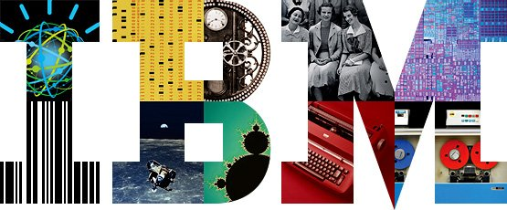
Thank You
Notes:
16

