Slide 1

Dataflow-Centric NASA Enterprise Knowledge Network
Jia Zhang, Roy Shi, Qihao Bao, Weiyi Wang, Shenggu Lu, Yuanchen Bai, Xingyu Chen, Haoyun Wen, Zhenyu Yang
Carnegie Mellon University – Silicon Valley
Rahul Ramachandran, Patrick N. Gatlin
NASA/MSFC
Tsengdar J. Lee
NASA Headquarter

Slide 2
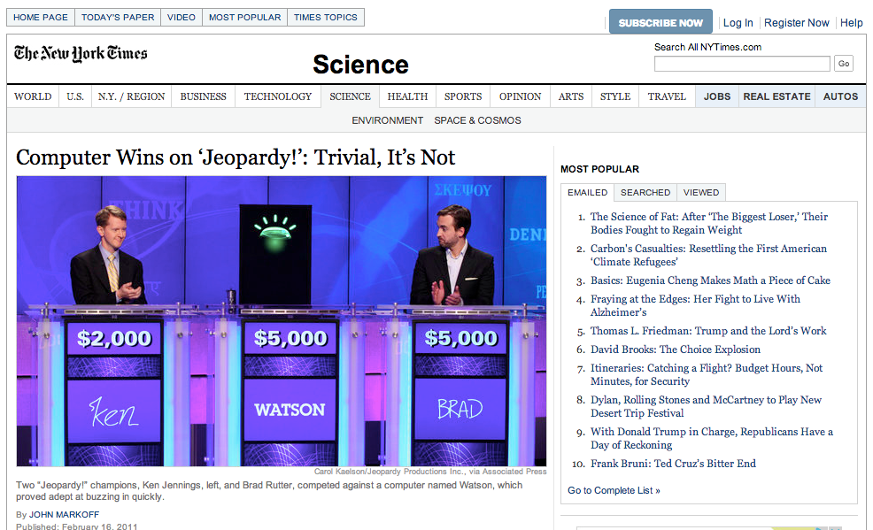
(2011) IBM Watson Wins Jeopardy!

Slide 3
Question to Watson:
This data set is used for predicting crop yields in Nebraska under the future climate scenario RCP8.5.
Watson: What is temperature and precipitation data set in IPCC climate projection archive at http://... By the way, you should really talk to Dr. X who has done a lot of research in this area.

Slide 4
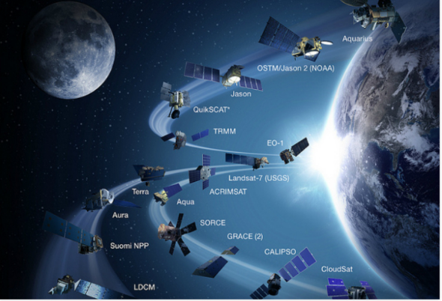
Project Motivation
NASA data centers have by all means BIG DATA
NASA has accumulated over 40 years of data stored at all NASA data centers.
Satellites and sensors have been gathering new data 24X7.
To process the data, scientists have developed various models and tools.
A lot of data projects focusing on promoting data
One question not catching much attention
Can we recommend data usage experience?
Which models and tools have been applied to process data? Any experience and/or lessons?
It is difficult for data processing software to be reused without technical support and experience.
A comprehensive collection of input parameters; comprehensive internal logic
Usage experience usually gets lost

Slide 5
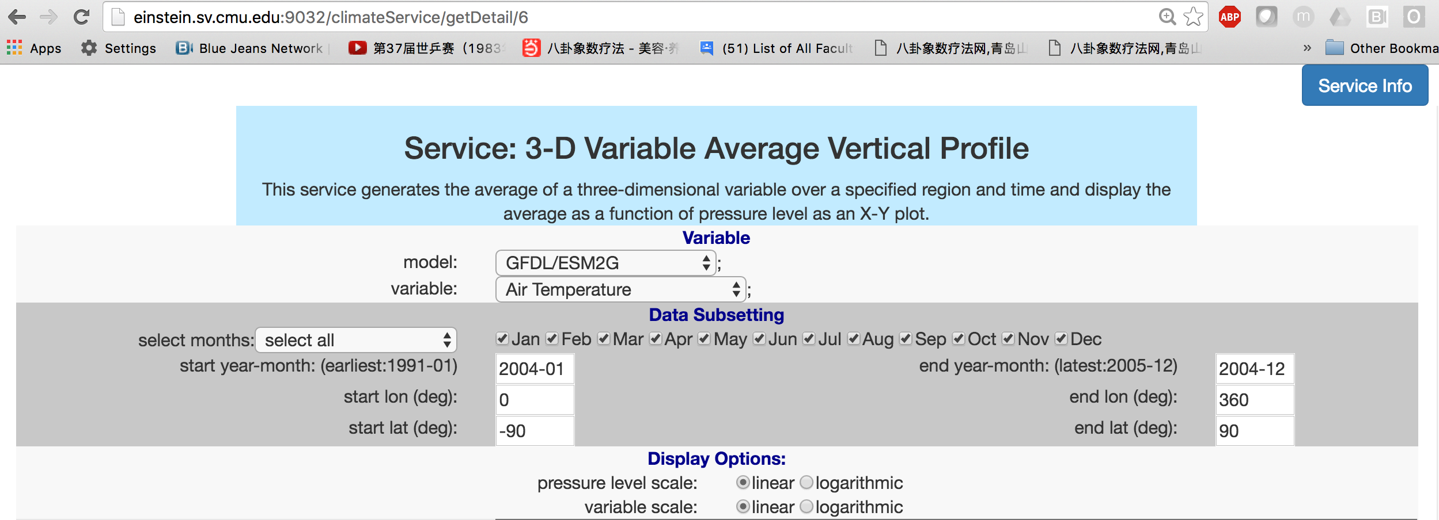
Example: CMDA Service
Climate Model Diagnostic Analyzer
A service requires input of more than a dozen of parameters w/ semantic meanings
(Zhang et al., 2015-a)

Slide 6
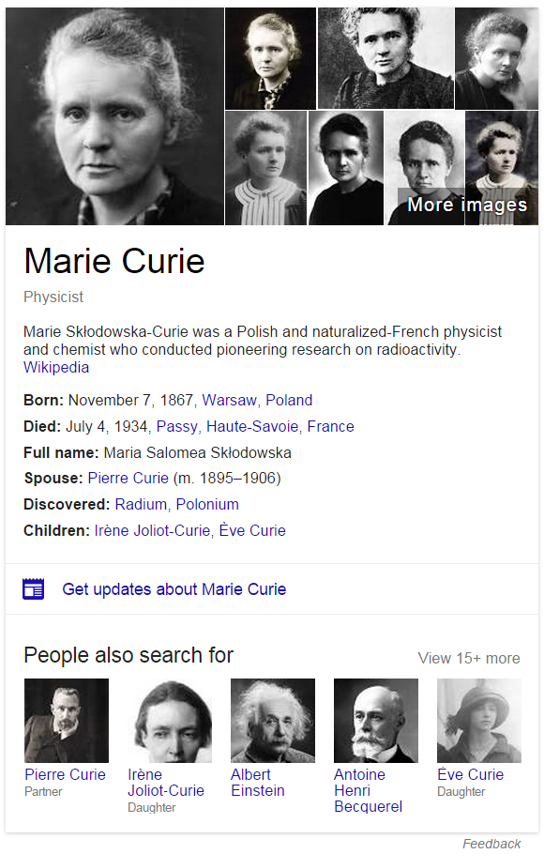
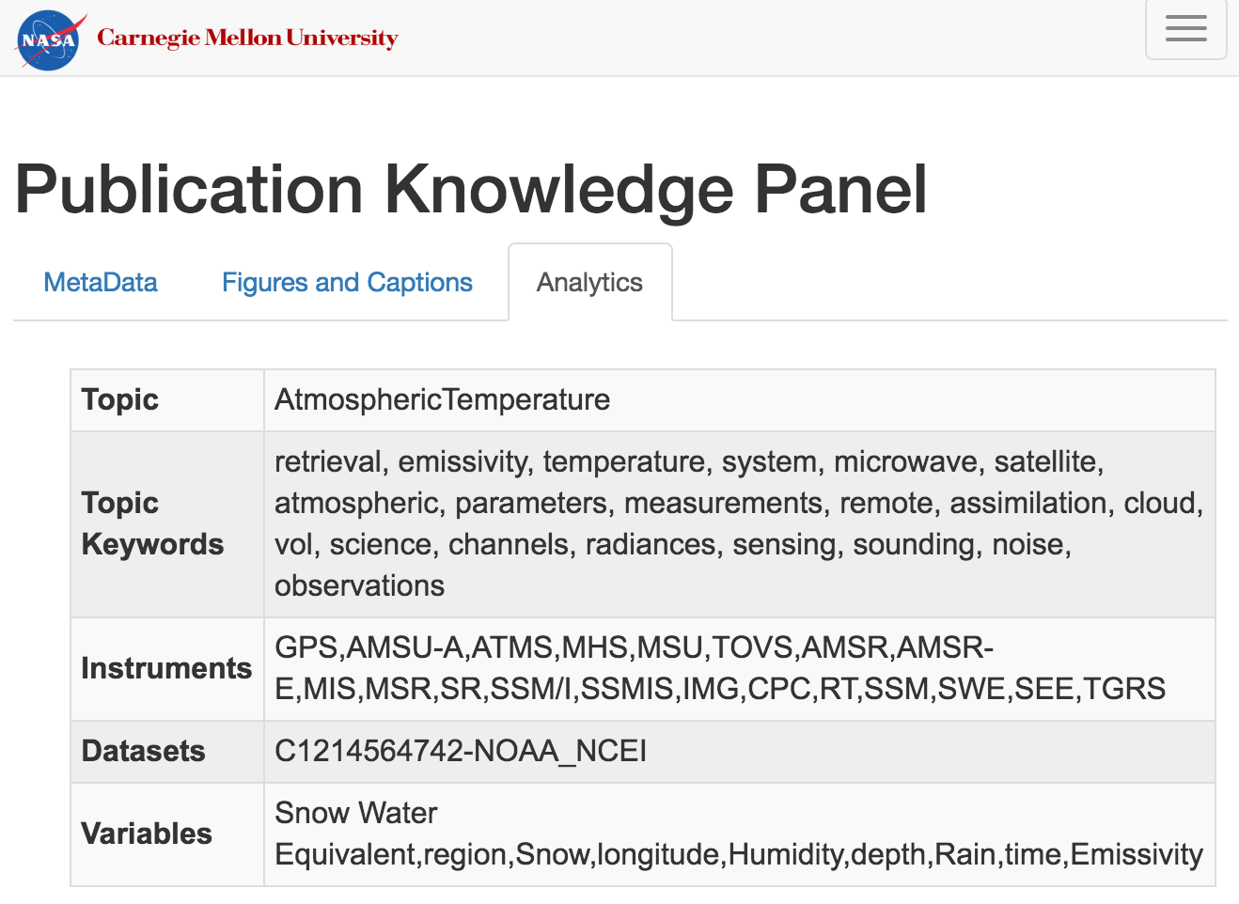
What Should Be Offered?
Triggered by Google Knowledge Graph
Google provides a name card, summarizing things people are commonly interested in
Limited on people, Places, things
What researchers wish to get?
Which dataset should I study?
How to process this dataset?
Any results came from this dataset?
What did others do on this dataset?
Can I repeat their process?
Can I revise their process and rerun?
Help me understand a published work (e.g., topic, data used, technique used, workflow)?
Given a topic, which hypotheses have been studied?
Given a paper, which reviewers should be invited?

Slide 7
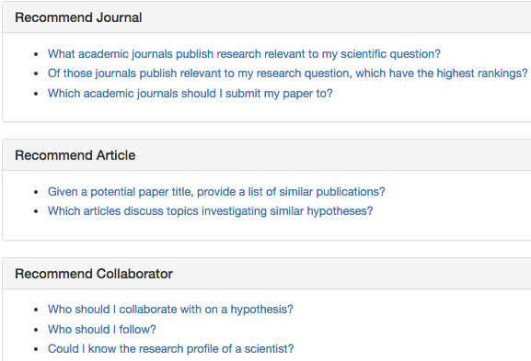
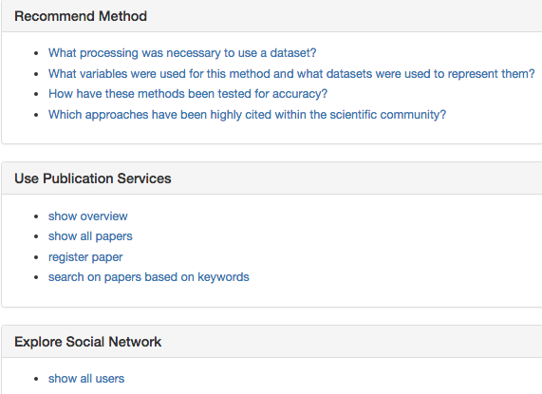
Frequently Requested Queries

Slide 8
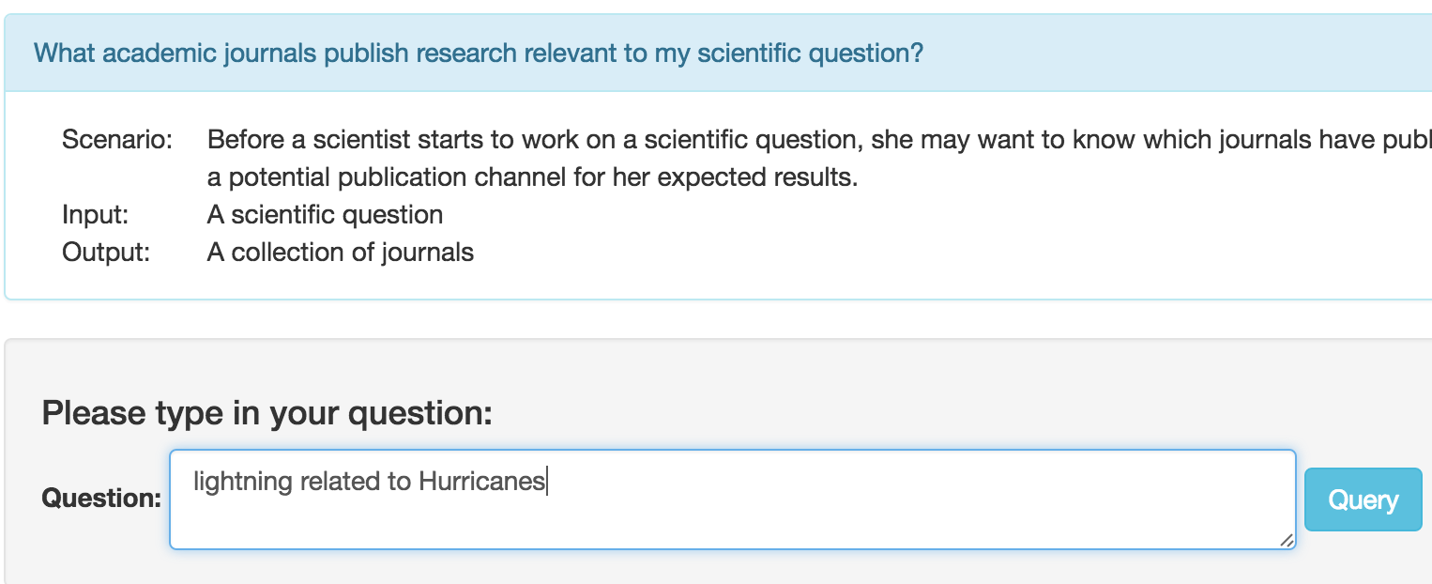
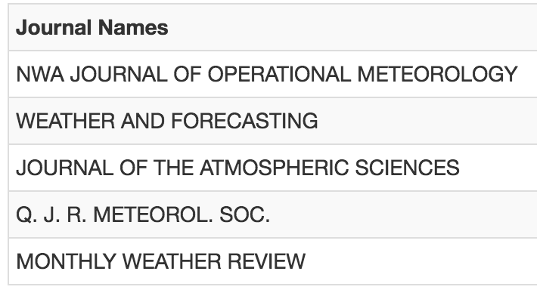

Slide 9
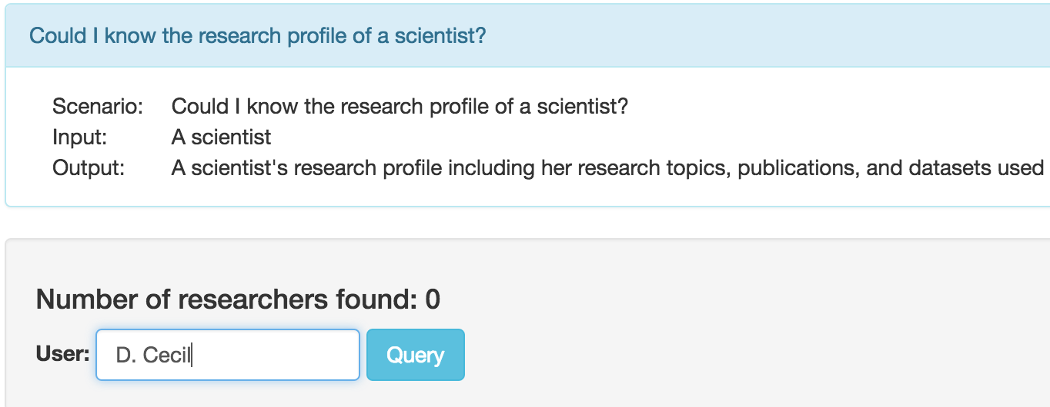
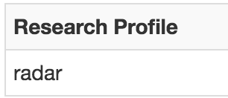

Slide 10
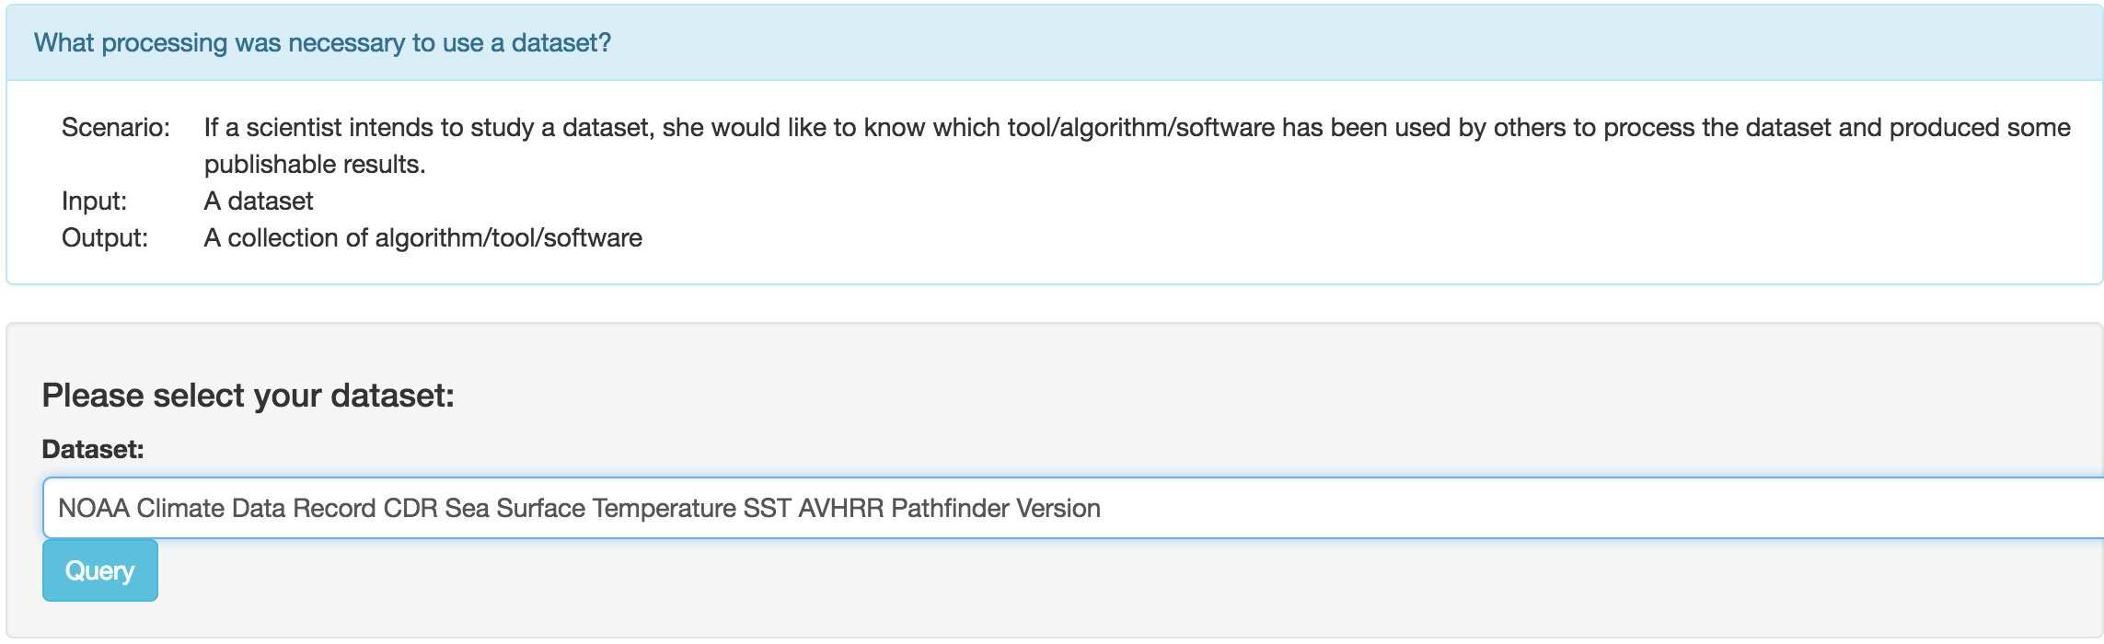
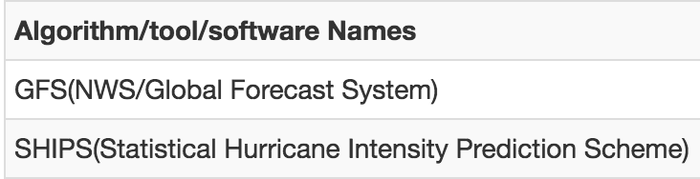

Slide 11
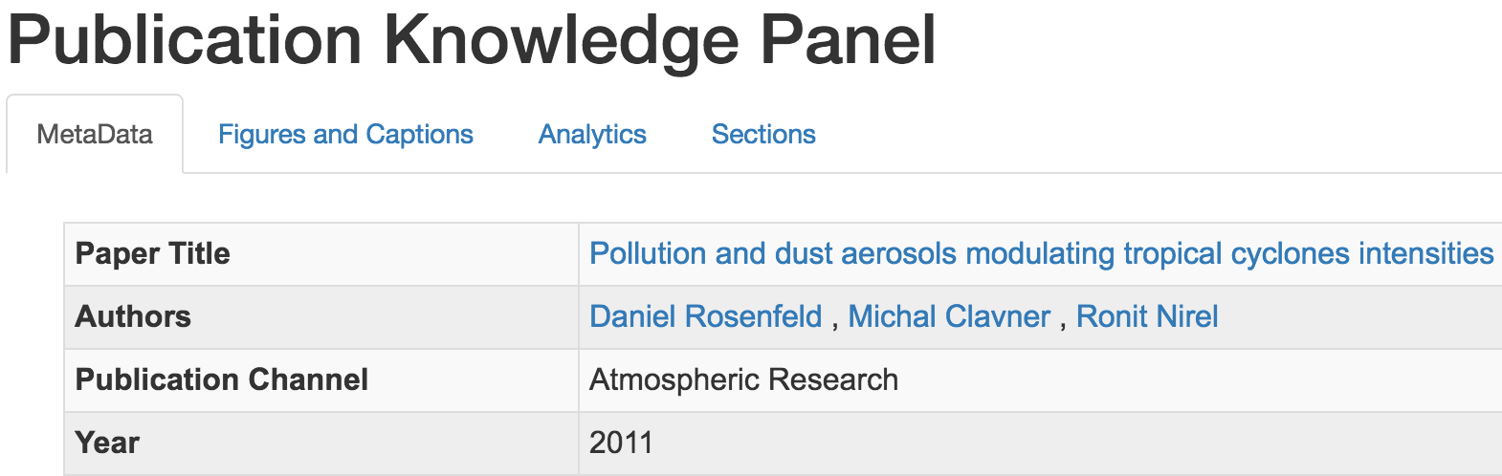
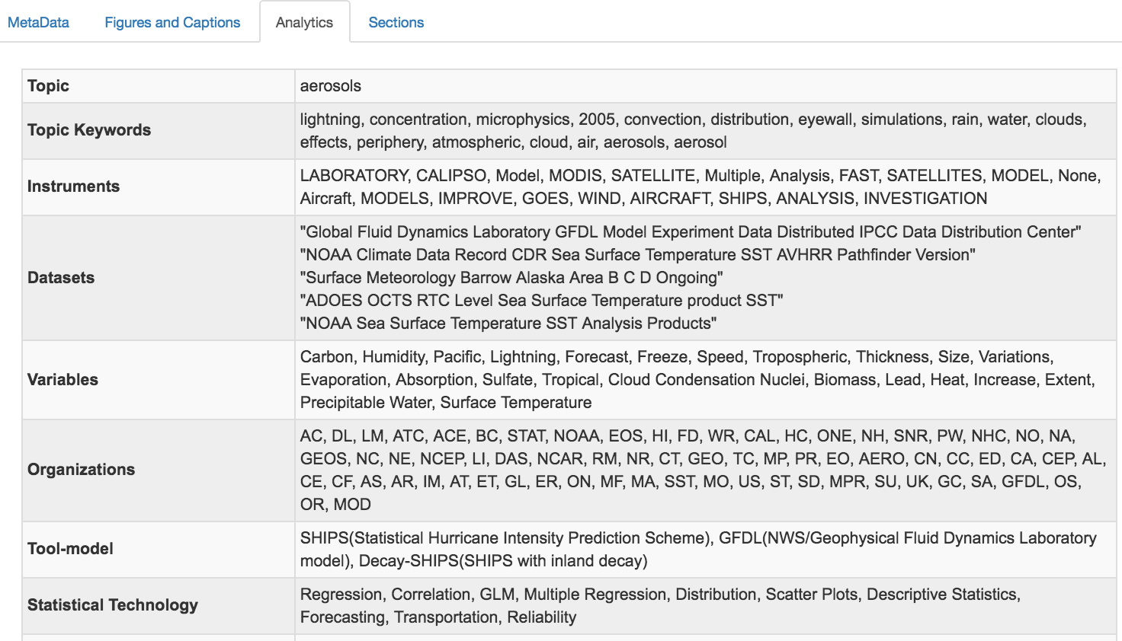
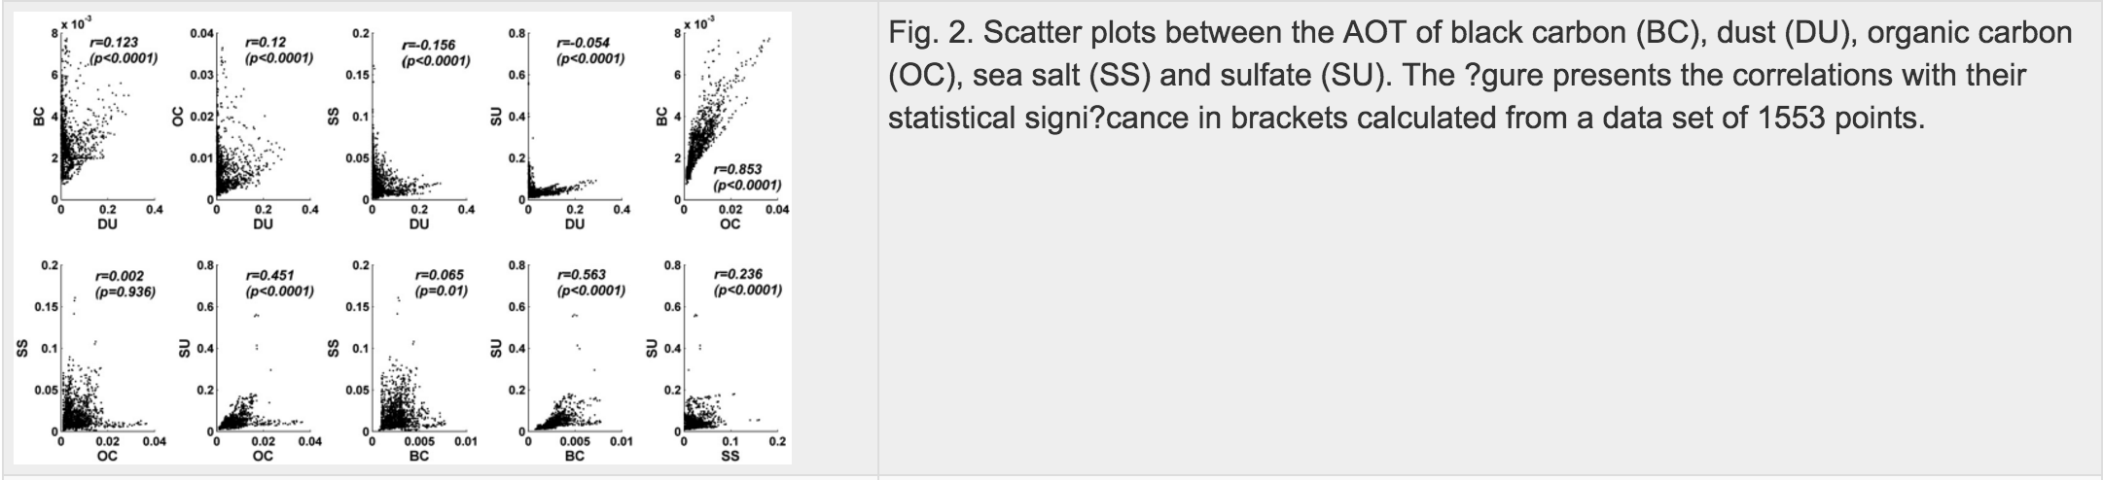

Slide 12
Benefit to NASA Earth Science
Operational Knowledge Base to significantly enhance NASA’s Earth science research
Hypothesis formulation and testing
Automate the search for and compilation of background information
Given a topic, what hypotheses have been tested?
What data/tools are being used to test a hypothesis?
Common paths to knowledge discovery
Mission development/review
What kinds of instruments/parameters are needed to specify science objectives?
Impact of a mission by linking it with publications and dataset distribution

Slide 13
Project Goal
Provide a one-stop gateway able to proactively recommend personalized dataset, tools and algorithms, as well as experience
Different from other data projects
Promote data usage experience (provenance-based and publication-based)
Social network-oriented techniques to enable more powerful queries with scalability and extensibility
Strategies to use
Develop information model to define key information entities and relationships
Apply state of the art information retrieval/text mining techniques to extract and classify information components
Utilize graph database for storing entities and relationships
Apply relational learning algorithms to extract knowledge

Slide 14
Project Progress
Science Knowledge Network construction
People-Data-Workflow-Service (PDWS) network
Understanding from papers
Data processing workflow recommendation
Deep cleaning via attention-based summarization
Knowledge labeling via network analysis
Bloom Filter-powered service discovery
LDA+CF Service recommendation

Slide 15
Project Progress
Science Knowledge Network construction
People-Data-Workflow-Service (PDWS) network
Understanding from papers
Data processing workflow recommendation
Deep cleaning via attention-based summarization
Knowledge labeling via network analysis
Bloom Filter-powered service discovery
LDA+CF Service recommendation

Slide 16
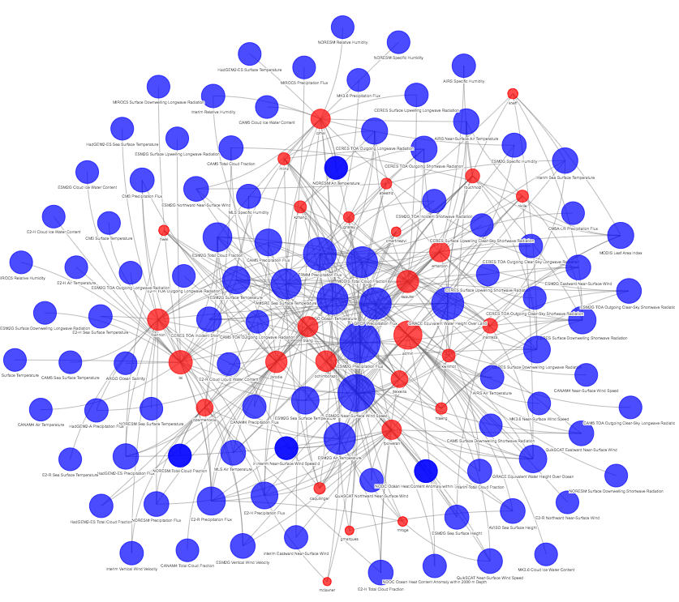
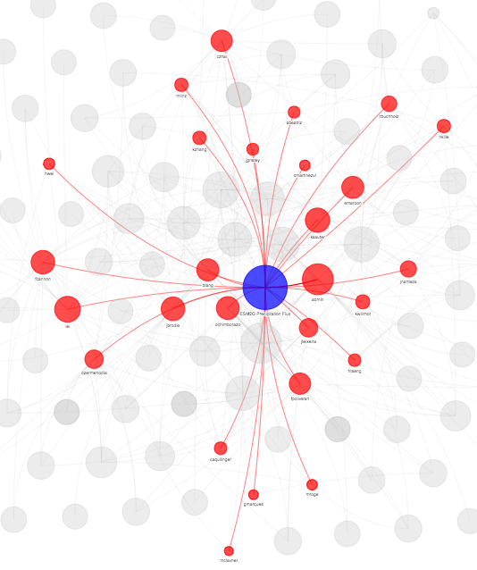
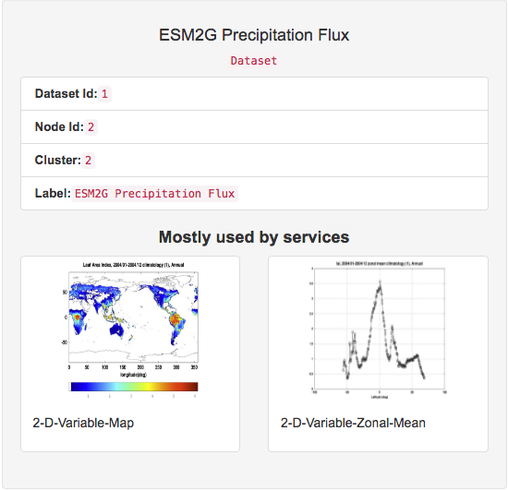
Science Knowledge Network
In need of a science knowledge base
Completeness, accuracy, data quality
Able to catch, store, and retrieve a variety of information
Structured & unstructured
Scalable and ever evolving
Able to constantly learn and derive facts
Predict new facts based on existing facts using statistical relational learning
Information extraction methods to extract “noisy” data from the web
Different from existing knowledge bases
Data analytics service/workflow oriented
Leverage scientific domain knowledge
Proactive recommendation needed

Slide 17

Existing Knowledge Base Construction
Two categories based on whether employ a fixed/open lexicon of entities
Schema-based: entity/relation in globally unique id; relation predefined in fixed vocabulary
Schema-free: Open Information Extraction (OpenIE) technique; normalized but not disambiguated
Four categories based on how triples are created
Curated approach: manually created by a closed group of experts
Collaborative approach: manually created by an open group of volunteers
Automated semi-structured approach: extracted automatically from semi-structured text via hand-crafted rules, learned rules, or regular expressions
Automated unstructured approach: extracted automatically from unstructured text via machine learning and NLP
Schema-based
Schema-free
SKN aims to include data from all categories and more
Published work
Computer-supported provenance mining
Other resources
(Nickel et al., 2016)

Slide 18
Our Earlier Related Work
Social network-powered workflow recommendation
Model software as social entities
Apply social network analysis techniques to study software recommendation
Provenance-driven workflow generation and recommendation
Reverse-engineering of workflow development
Provenance-equipped climate service sharing and execution platform
We built a platform to manage real-time data-service provenance.
In this project we aim to complement our work by exploring published data-service provenance.

Slide 19
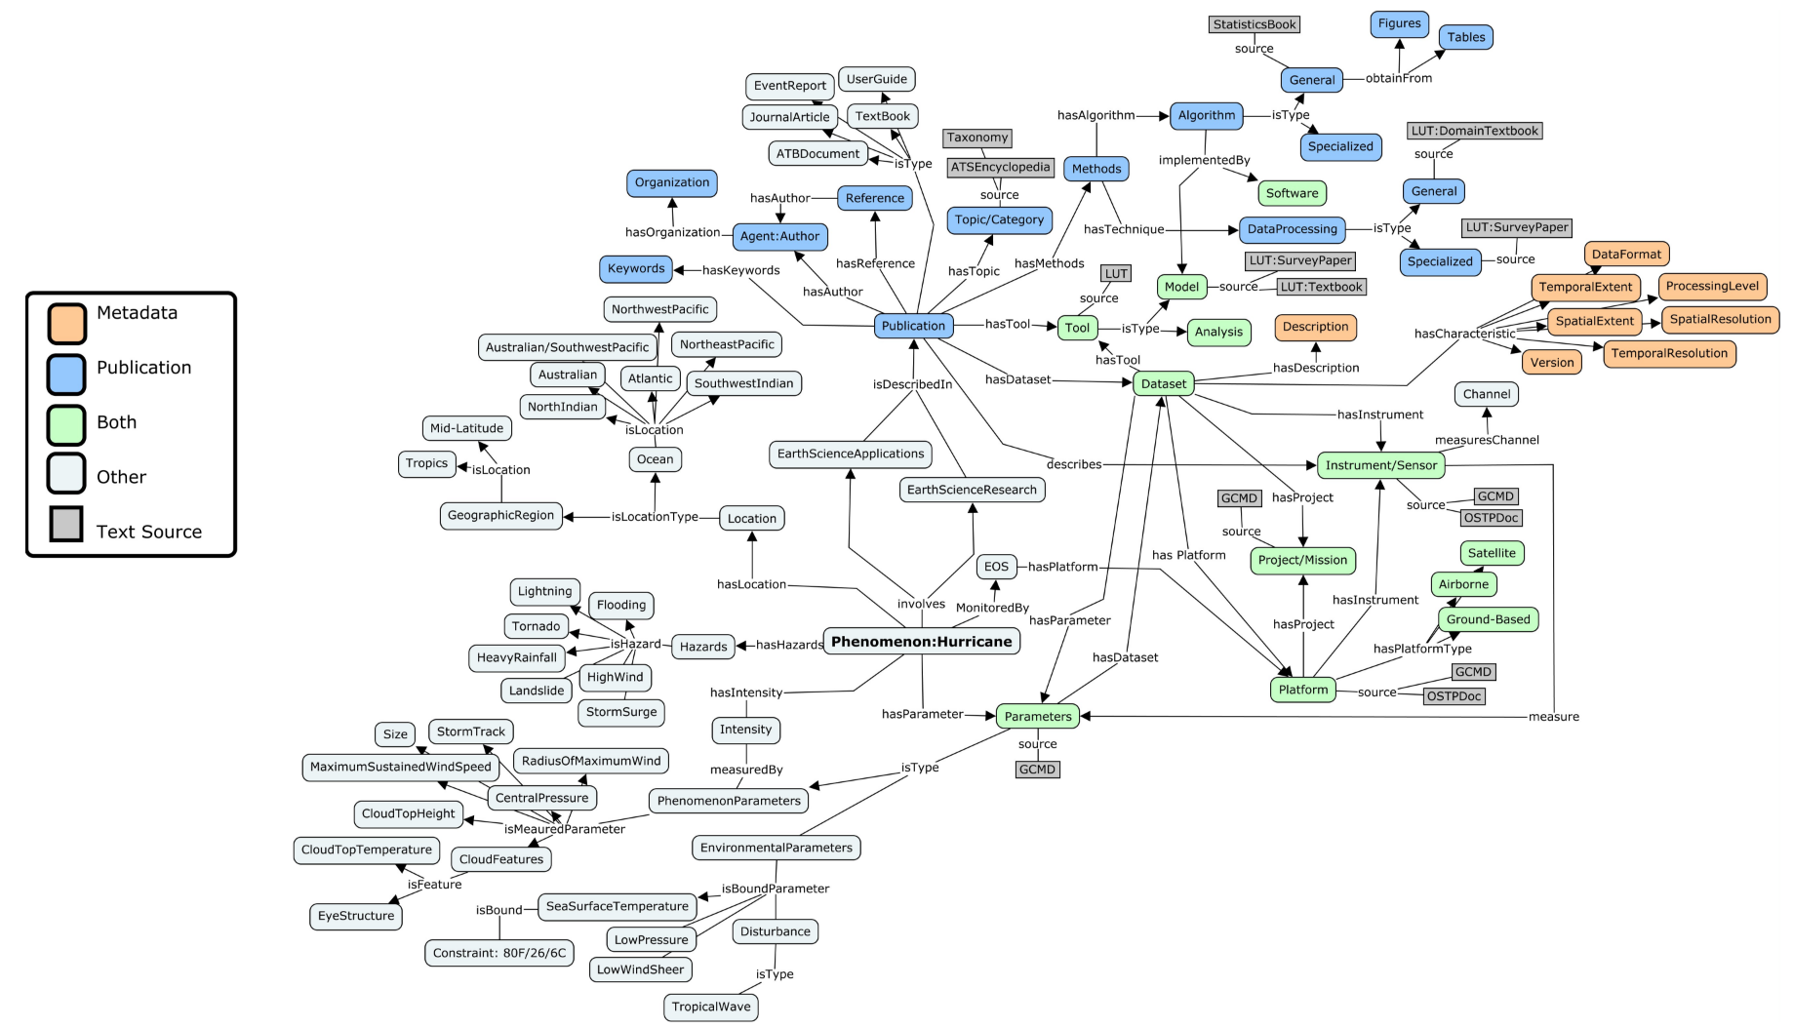
Domain knowledge Driver
Domain knowledge serves as schema to guide automatic information extraction & KB construction
GCMD
Science keywords
Platforms
Instruments
CMR
Datasets
Notes:
Add a page with the initial image, add name, etc.

Slide 20
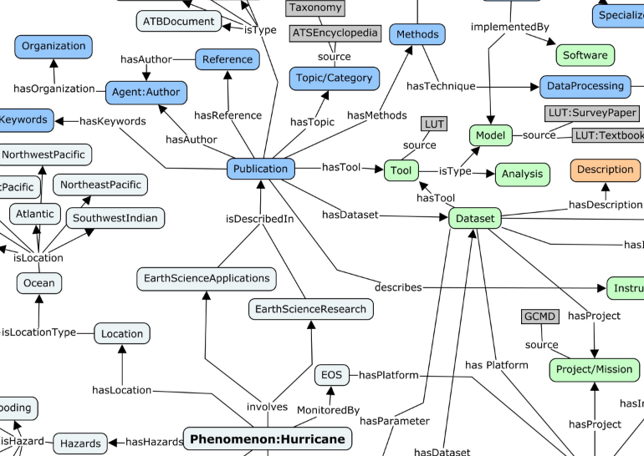
Start from Publication Mining
Notes:
Add a page with the initial image, add name, etc.

Slide 21
Enrich SKN from Published Work
Enrich KG using knowledge extracted from publications
Publications represent knowledge of significant scientific discovery activities
State of the art
NASA GCMD keywords, instruments
CMR datasets
Preliminary work
Extract main parts (datasets, techniques/methods, conclusions) of the papers that are relevant to hurricanes given in the GCMD keyword inventory
Understand the datasets, techniques and conclusions in papers and how those are related to GCMD keywords

Slide 22
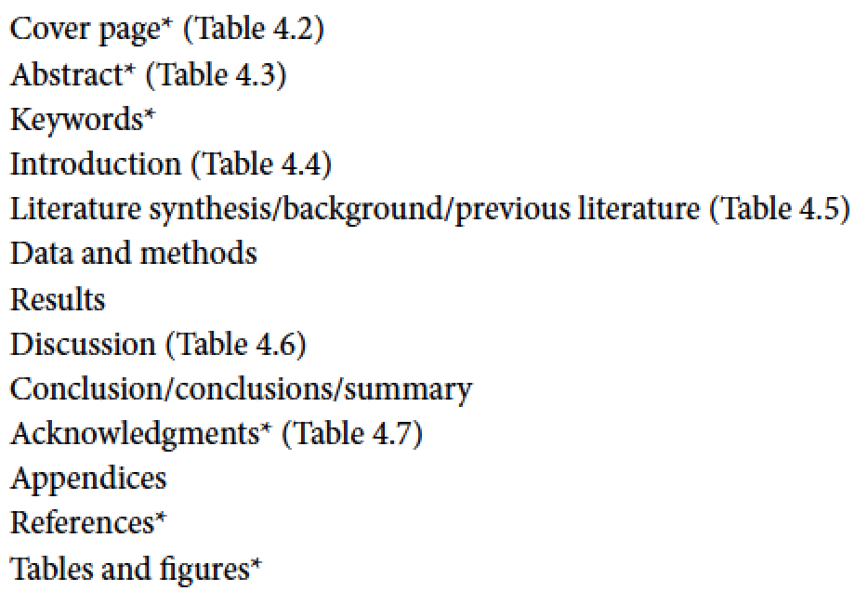
Understanding Publications
Structure of a Earth science paper
“The Structure of a Scientific Paper” in Eloquent Science (D. Schultz)
Work in progress
Paper topic identification
Dataset identification
Figure/table caption extraction
Items extracted

Slide 23
Paper Topic Identification
Automatically categorize papers
Usages: recommend papers; identify research trends
Identify usage of datasets
How datasets have been used to conduct which topics of research?
Refined two-layer topic modeling
Level 1: Latent Dirichlet Allocation
Identify topics and keywords
Level 2: Apriori algorithm
Strengthen topic finding through term association rules

Slide 24
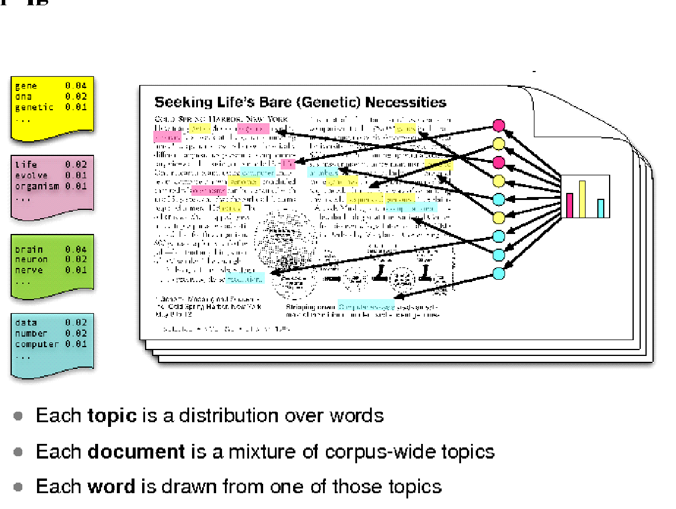
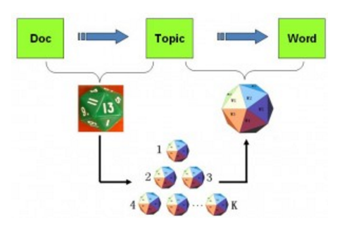
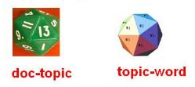
Level 1: Latent Dirichlet Allocation
Latent info
also our target
per-word topic assignments
Statistical model for discovering the abstract "topics" that occur in a collection of documents
Pros: probabilistic model can be extended and embedded in other complicated model
Cons: prone to overfitting
Probabilistic model based on word statistics
Approved in good performance
The topic distribution is assumed to have a Dirichlet prior.
per-document topic distribution
PLSA (Probabilistic Latent Semantic Analysis)
Notes:
What is LDA? Reference
Alternatives: why choose this one.
Break into 2 pages
Parameters into the optimization model
This is akin to the standard bag of words model assumption, and makes the individual words exchangeable.

Slide 25
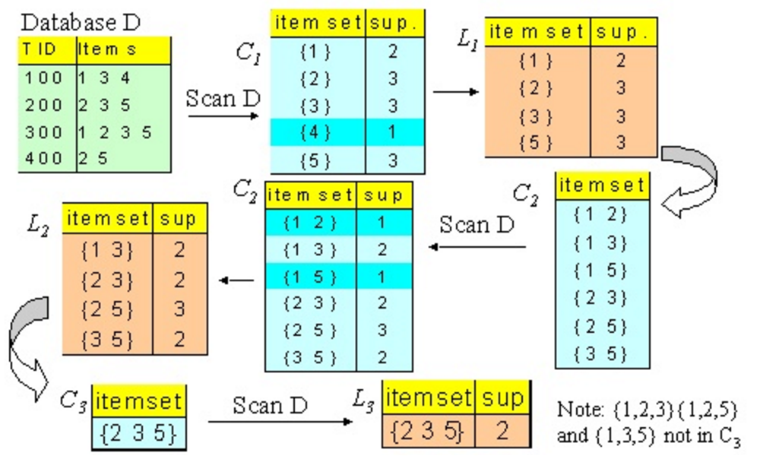
Level 2: Apriori Algorithm
LDA adopts bags of words
Association rules
Statistically, some items usually appear together
Influential algorithm for mining frequent item sets based on association rules
A "bottom up" approach, where frequent subsets are extended one item at a time
Apriori uses breadth-first search and a hash tree structure to count candidate item sets efficiently
We consider each paragraph as a transaction to study association rules.
Terms appeared in the same paragraph
Candidate word sets are generated using the word sets of the database.
The word set of the previous pass is joined with itself to generate all wordsets whose size is higher by 1.
Each generated word set that has a subset which is not large is deleted. The remaining word sets are the candidate ones.
(Agrawal et al., 2016)
Notes:
Apply

Slide 26
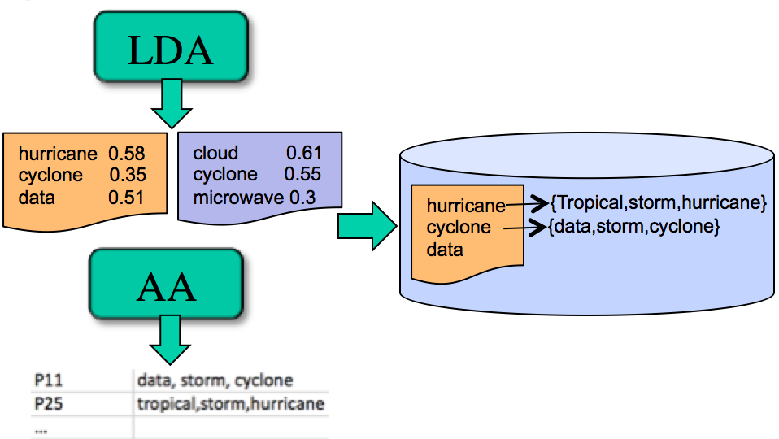
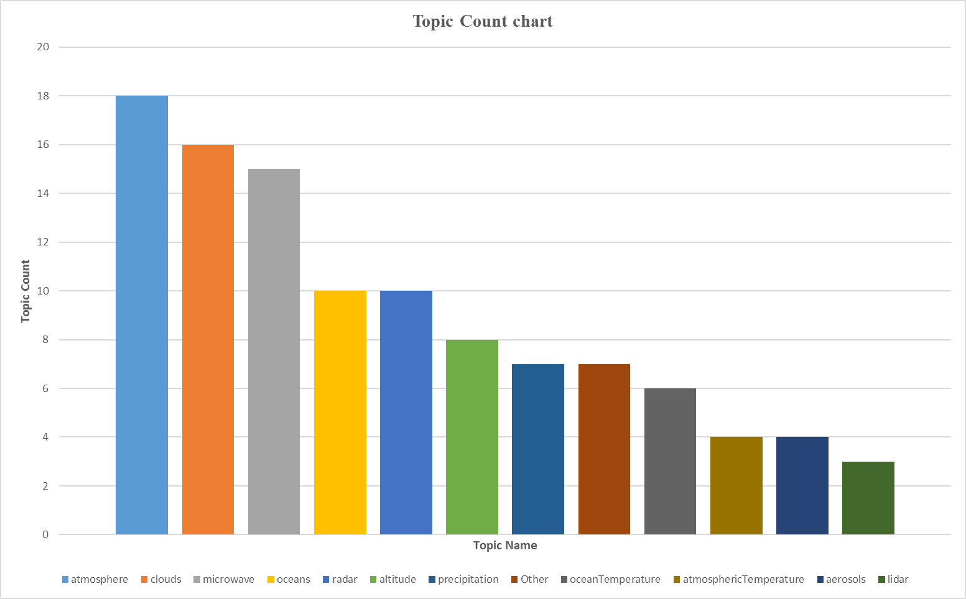
LDA + AA
LDA+AA
LDA finds keywords in latent topics learned
AA finds out keywords frequently used together
LDA+AA finds out not only keywords, but also their usage patterns
Localize terms in the same paragraph
For each keyword identified by LDA, its usage patterns are identified
Enhance new paper topic identification
Paper categorization results using Labeled LDA
(Label papers using Topic+Term (153) selected GCMD science keywords
Notes:
Apply

Slide 27
Dataset Identification
Challenges
Our investigation reveals that Earth scientists typically do not cite datasets directly.
Exhaustive term search with fuzzy search found 0 papers / 110 Hurricane papers
Strategy
We studied how Earth scientists identify in a paper possible datasets used.
Heuristic algorithm
Construct profiles for NASA datasets (instruments+variables)
Locate potential areas where GCMD instruments are physically surrounded by variables
For each potential area, construct a vector profile
Bipartite graph comparison with NASA datasets profiles
Longest Common Subsequence for verification
Apply pattern recognition to identify common dataset reference scenario
Notes:
Add a picture to the top right corner

Slide 28
Dataset Identification Workflow
CMR datasets
paper
Dataset Profile
Build profile
(instrument+variables)
Loop
Locate potential sections
platform
instrument
Dataset profiles
Locate potential dataset areas
(GCMD instruments physically surrounded by CF/GCMD variables)
Dataset
Similarity?
Loop
variable
institute
Pattern recognition
Build vector profile
(instrument+variables)
Extract named entity
LCS clarification
Notes:
Add a picture to the top right corner

Slide 29
Instrument & Variable
Dataset profile mainly contains instrument and variables
Instrument identification
Union of Short_Name and Long_Name of GCMD Instrument list
Match instrument name list with each paper and return top matched
Variable Identification
Decided to adopt CF variables + GCMD variables
Match variable name list with each paper and return top matched
Other methods explored
If nouns & adjectives, too many (over 1,000 in 110 Hurricane papers)
If filtered with non-English words, only a few left

Slide 30
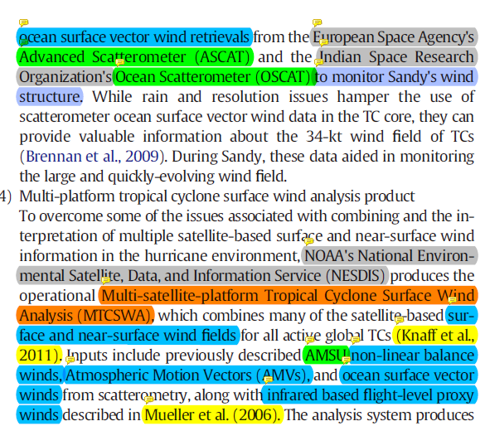
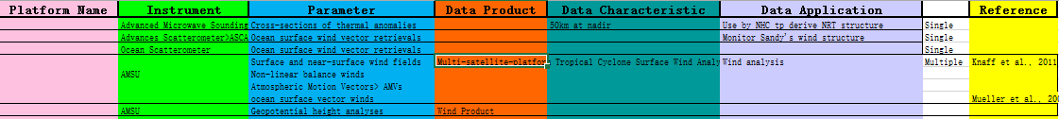
Dataset Profiling
Dataset location identification
Locate potential areas where GCMD instruments are physically surrounded by variables
Dataset reference patterns
Learn the common used dataset reference patterns, e.g.,
“organization name + utilize/use/leverage + successive noun”
“instrument name + produce/create/accumulate + successive noun
“successive noun A + is/are utilized/used/leveraged + successive noun B”
successive noun A will be identified as dataset candidate

Slide 31
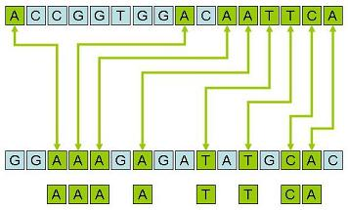
Longest Common Subsequence
Find the longest subsequence common to all sequences in a set of sequences (often two sequences).
What if patterns do not occur in the text?
Unlike substrings, subsequences are not required to occupy consecutive positions within the original sequences.
Originally motivated from DNA sequencing
Dynamic programming solution
Identify potential locations of datasets
Assume that dataset description will not go beyond three sentences.
Assume that at least 3~4 core terms of a dataset should appear as threshold
Or 2 core terms with the same abbreviation
(Meier et al., 1978)
Notes:
Finding the longest subsequence common to all sequences in a set of sequences (often just two sequences). It differs from problems of finding common substrings: unlike substrings, subsequences are not required to occupy consecutive positions within the original sequences.

Slide 32
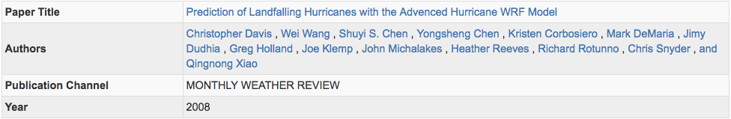
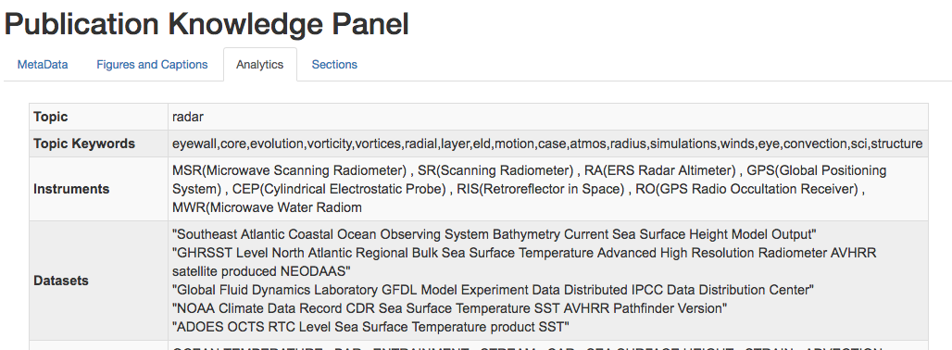
Notes:
Finding the longest subsequence common to all sequences in a set of sequences (often just two sequences). It differs from problems of finding common substrings: unlike substrings, subsequences are not required to occupy consecutive positions within the original sequences.

Slide 33
Figure/Table & Captions
Challenges
Extract various areas of text from a PDF, especially a scholarly article PDF. Inside, PDF might have any number of structures that are difficult to understand and exasperating to get at.
Strategy
Perform structural analysis to determine column bounds, headers, footers, sections, titles, figures, tables, etc.
Algorithm
Overlap between PDFMiner library and PyPDF2 library
Merge, Delete, Split, Slices to create own pdf Metadata
Identify each section by the structural analysis
Notes:
Remove half, add some wording
Copy some from email

Slide 34
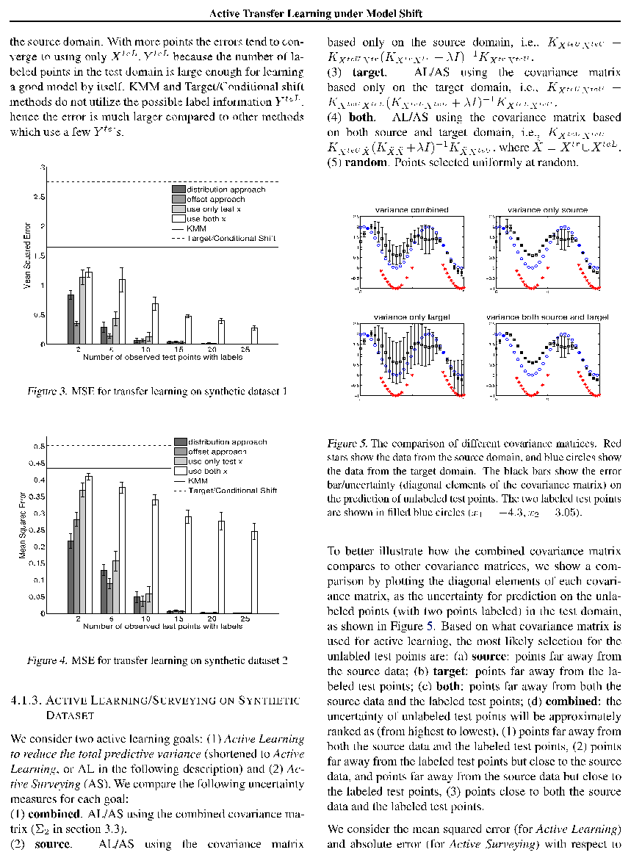
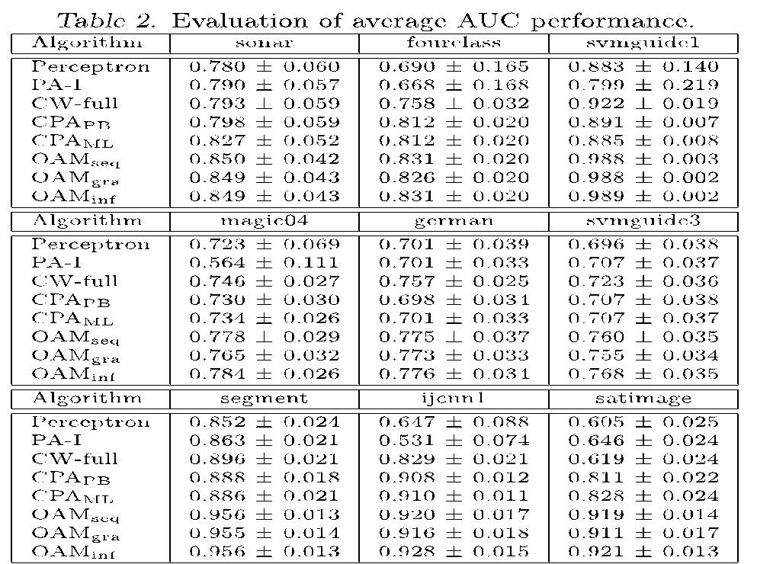
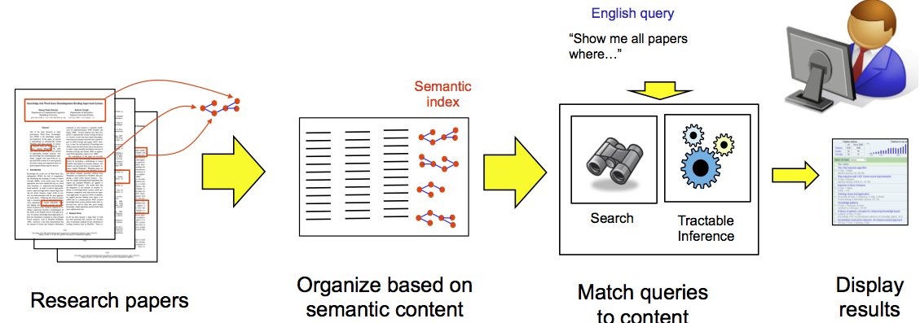
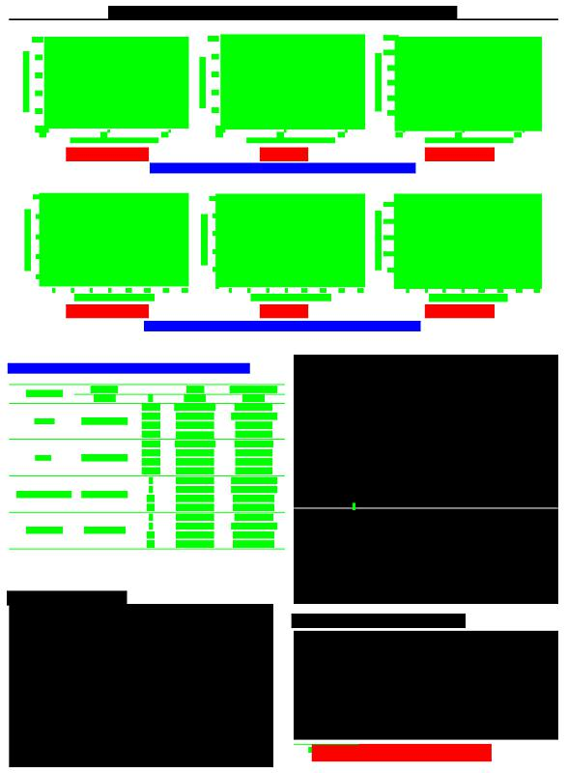
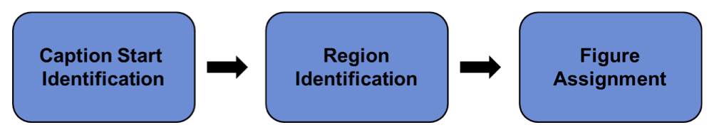
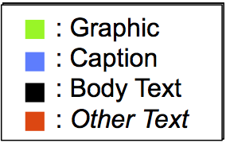
Figure/Table & Captions
Rule-based system
Exploits commonly used formatting styles used in academic domains
(Clark et al., 2015)
Notes:
Remove half, add some wording
Copy some from email

Slide 35
Items Extracted
Extract following key information from journal papers:
Author
Names/Affiliations
Keywords
Topic/Category
(e.g., Hurricane->Intensity, Hurricane->Prediction, Hurricane->Structure, etc.)
Data description
Platform (e.g., satellite, ground, air)
Instrument (e.g., MODIS, TRMM PR, WSR-88D, HIRAD, etc.)
Dataset Name (e.g., TRMM 2A25)
Parameters/variables (e.g., wind, pressure, temperature, etc.)
Tools
Analysis software/utilities (e.g., ArcGIS, Matlab, IDL, Python, GrAds, Gempak, etc.)
Models (e.g., WRF, GFS, SHIPS, etc.)
6. Methodology
1. Algorithm (e.g., Dvorak, Model Parameterization, TRMM 2A25 Algorithm)
2. Data Processing
a. Statistical techniques (e.g., correlation, RMSE, bias, standard deviation, etc.)
b. Filters (e.g., windowing techniques, noise removal, etc.)
c. Projection type, if applicable (e.g., azimuthal, cylindrical, conic, etc.)
3. Visualizations/Plot types (e.g., cross-section, scatter, time series, etc.)
7. Hypothesis (i.e., what will be tested)
8. Conclusions (i.e., key findings)
Shall classify papers based on hypothesis (topics)
Shall perform analysis of extracted information to infer patterns
Notes:
Remove half, add some wording
Copy some from email

Slide 36
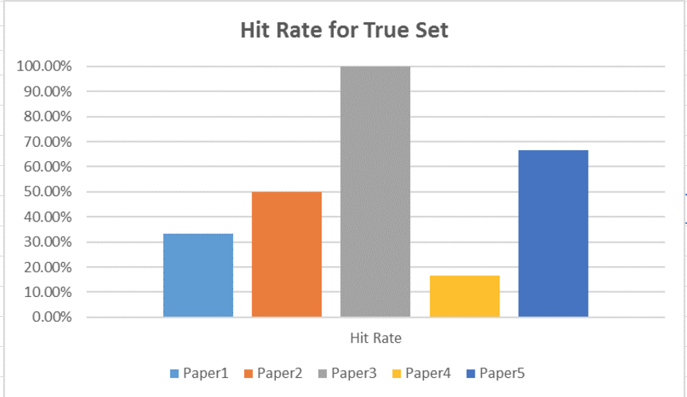
Items Extracted
Author
Keywords
Topic/Category
Data description
Platform
Instrument
Dataset Name
Parameters/variables
Tools
Analysis software/utilities Models
Methodology
1. Algorithm
2. Data Processing
a. Statistical techniques
b. Filters
c. Projection type, if applicable
3. Visualizations/Plot types
Notes:
Remove half, add some wording
Copy some from email

Slide 37
Project Progress
Science Knowledge Network construction
PDWS network
Understanding from papers
Data processing workflow recommendation
Deep cleaning via attention-based summarization
Knowledge labeling via network analysis
Bloom Filter-powered service discovery
LDA+CF Service recommendation

Slide 38
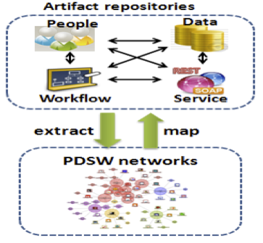
Data Processing Workflow Recommendation
NASA data centers intend to recommend not only datasets, but also dataset processing experience.
Multi-step workflow
Enable and facilitate knowledge sharing and collaboration
PDSW knowledge base
People, Data, Service, Workflow
(Zhang et al., 2015)

Slide 39
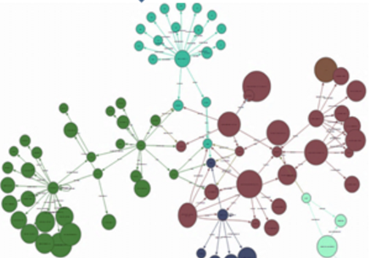
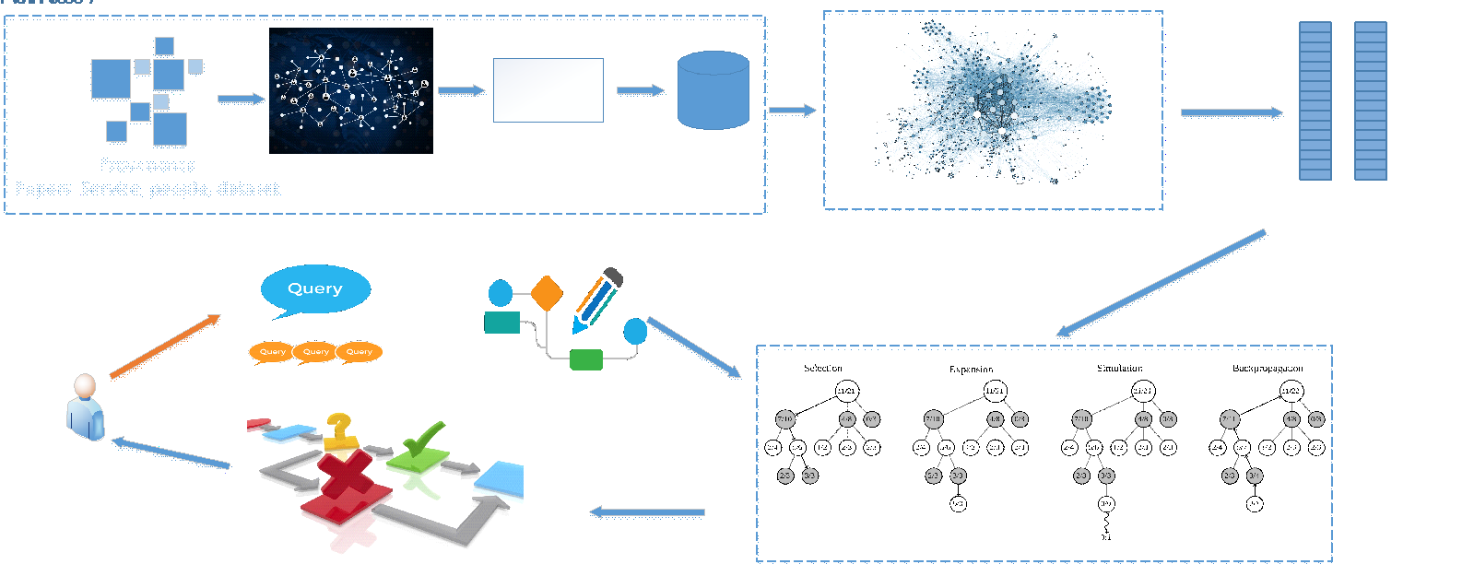
Overall Architecture
Web resources
Deep cleaning via attention-based summarization
Knowledge labeling via network analysis
Function-based service clustering via Deterministic Annealing
Relationship-based service clustering via Path Ranking Algorithm
Bloom Filter-based service routing
Monte Carlo Search-based workflow composition
Publications
Notes:
Cleaning

Slide 40
Data Cleaning – Attention Based Summarization
Summarization remains important in natural language understanding
Aim to produce a condensed representation of an input text to capture the core meaning of the original
Utilize extractive approaches that crop out and stitch together portions of the text to produce a condensed version
Rooted in neural network, Attention-Based Summarization combines a neural language model with a contextual input encoder.
Incorporates less linguistic structure than comparable abstractive summarization approaches
Easily scale to train on a large amount of data
Applied to paper data cleaning, service description data cleaning, and user query summarization for later network address encoding efficiency

Slide 41
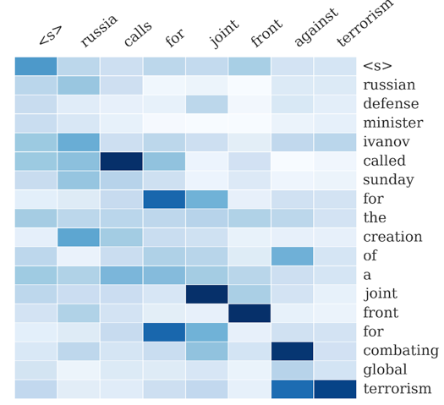
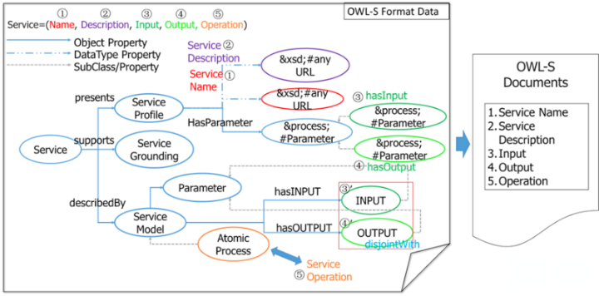
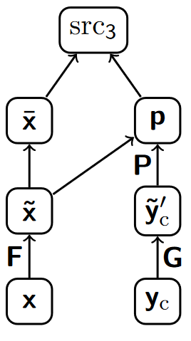
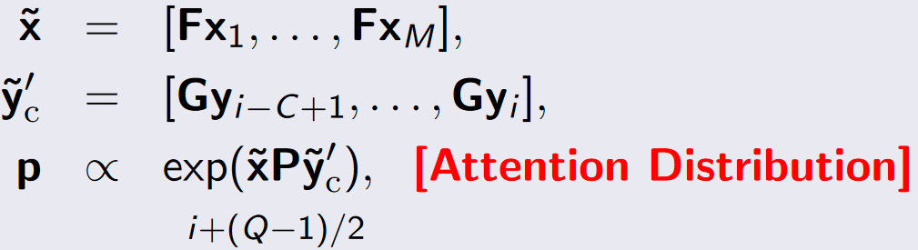
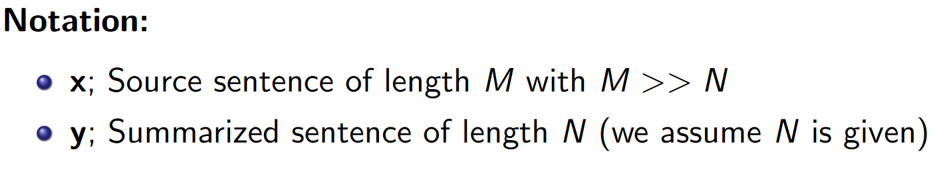
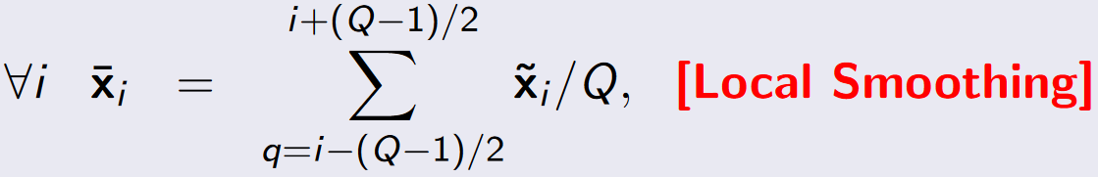
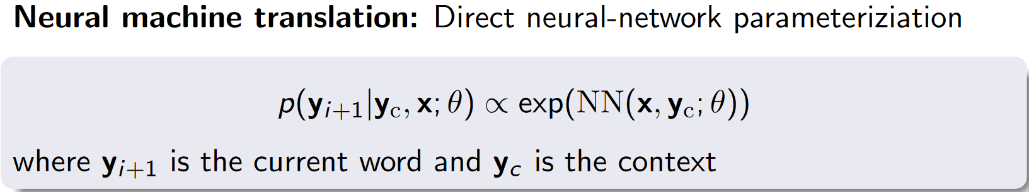

Data Cleaning – Attention Based Summarization
The heatmap represents a soft alignment between the input (right) and the generated summary (top). The columns represent the distribution over the input after generating each word.
(Rush et al., 2015)
feed-forward neural network language model (NNLM) for estimating the contextual probability of the next word, by directly parameterizing the original distribution as a neural network

Slide 42



PDSW Network Analysis
Analyzes the structural properties of PDSW network
Topological properties studied include the degree distributions, reciprocity, clustering coefficient, PageRank, and centrality.
Such information is used to label features of nodes and edges

Slide 43






Service Network & Motivation
Services available form a global service network.
How to help users quickly identify appropriate candidate services has become an increasingly critical challenge.
Syntax and semantics-based match-making
Scalability issue due to computational cost at run time
As Web services become more mainstream, very soon service discovery performance will become a bottleneck
The need to ensure scalable service discovery requires methodologies that are beyond the current state-of-the-art in this field.
Start to explore at present how to model and enhance service discovery
attributes & features selection
service
discovery
If we wait until the time that service discovery scalability becomes an obstacle, some techniques might have to be reexamined and accommodated, which wastes valuable human resources.

Slide 44

Services are organized into clusters, analogous to machines forming local networks.
Root node of a cluster is analogous to the router of a local network.
BF are generated for all service nodes, based on the information carried by the services.
Virtual routers are created based on service clustering to expedite service discovery.
A service discovery request is transformed into a network routing problem aiming for quickly locating semantic service cluster and in turn to candidate services.

Slide 45

Bloom Filter for Service Discovery in Service Networks
Services annotated by OWL-S are organized into a network based on semantic clustering.
Virtual routers are created representing clusters, and BF are generated for service routing.
A service search request is transformed into a network routing problem to quickly locate semantic service cluster and in turn to candidate services.
The deterministic annealing technique is applied to facilitate service classification in the network construction.
Dynamic network adjustment is operated to ensure search performance in the network.

Slide 46
Network Scaling
Performance
Once there are incoming new services, the number of leaf nodes will be increased, which may effect search performance.
Continuum theory
Predict scaling functions and then fit the predictions into connectivity distribution to describe the growth of the service network
Strategy
Once the connectivity is larger than a predefined threshold value, to remain search performance, the BF network will be re-computed to generate a new network with more clusters and less leaf nodes.

Slide 47
LDA+CF for Service Recommendation
Method
Uses the latent topic space to calculate the paper similarity through both the observed paper usage.
Topic modeling is used to give a content-based representation of paper profile.
Collaborative filtering is used to analyze historical behaviors for generating recommendation
Earth Science Paper
Similarity semantic space
Similarity usage space
Hybrid Recommendations
Earth Science
Semantic
Description
Historical
Usage
Paper
Collaborative
filtering
Recommendation
Latent Dirichlet
Allocation
Paper

Slide 48

Collaborative Filtering
Collaborative filtering methods are based on collecting and analyzing a large amount of information on users' behaviors, activities or preferences and predicting what users will like based on their similarity to other users.
If a person A has the same opinion as a person B on an issue, A is more likely to have B's opinion on a different issue x than to have the opinion on x of a person chosen randomly.

Slide 49




LDA + CF Recommendation System for Earth Science

Slide 50
To Be Continued…

