Slide 1
Toward Human-Level
(and Beyond) Artificial Intelligence
Prof. Lyle N. Long
Distinguished Professor of
Aerospace Engineering, Mathematics, and Computational Science
The Pennsylvania State University
Presented at NASA Langley Workshop on
Machine Learning Technologies and Their Applications to Scientific and Engineering Domains Workshop
Aug., 2016

Slide 2
Outline
Recently there has been interest in (and fear of) super-intelligence (e.g. Bostrom’s book)
While AI has been over-sold for about 60 years, there are now computers with memory and speed of roughly human level
Once it is developed, it can be readily copied and possibly beyond our control
Self-aware (conscious) systems will most likely also be possible
Massively parallel supercomputers now exceed human computing power

Slide 3
Nick Bostrom
“Superintelligence would be the last invention biological man would ever need to make, since, by definition, it would be much better at inventing than we are.”
Bostrom, N., Superintelligence: Paths, Dangers, Strategies, 2014.

Slide 4
Alan M. Turing
“Instead of trying to produce a programme to simulate the adult mind, why not rather try to produce one which simulates the child’s?”
Turing, A.M. (1950). Computing machinery and intelligence. Mind, 59, 433-460.

Slide 5
Pedro Domingos
“The Master Algorithm is to machine learning what the Standard Model is to particle physics…”
Domingos, N., The Master Algorithm: How the Quest for the Ultimate Learning Machine Will Remake Our World, 2015.

Slide 6
Martin Ford
“…A 2013 study … concluded that occupations amounting to nearly half of US total employment may be vulnerable to automation within roughly the next two decades.”
Ford, M., Rise of the Robots: Technology and the Threat of a Jobless Future, 2016.

Slide 7
Hans Moravec
“… a robot that understands human behavior can be programmed to act as if it is conscious, and can also claim to be conscious. If it says it's conscious, and it seems conscious, how can we prove that it isn't conscious.”
Moravec, H., Robot: Mere Machine to Transcendent Mind, 2000.

Slide 8
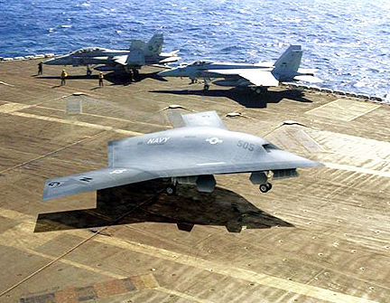
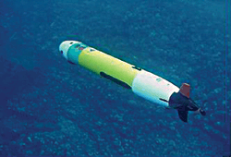
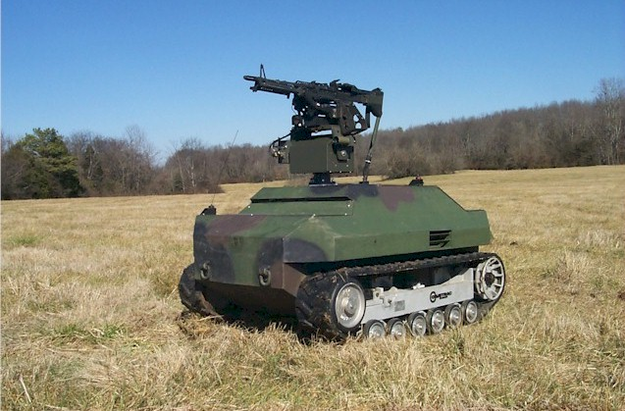
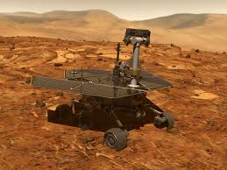

Intelligent Systems for UAV, UUV, UGV, UPV, HAL, …

Slide 9
Two Common Approaches
Intelligent Systems
Connectionism
(e.g. neural networks)
Symbolic
(e.g. Cognitive Architectures: SOAR, ACT-R, SS-RICS, …)
Kelley, Troy D., (2006), “Developing a psychologically inspired cognitive architecture for robotic control: The Symbolic and Subsymbolic Robotic Intelligence Control System (SS-RICS)," Int. J. Adv. Robotic Syst. Vol. 3, No. 3, pp. 219-222.

Slide 10
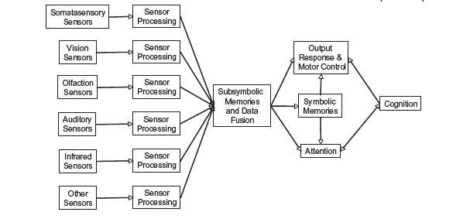
Proposed Robot Architecture
Emotions
Lyle N. Long and Troy D. Kelley, " A Review of Consciousness and the Possibility of Conscious Robots," Journal of Aerospace Computing, Information, and Communication (JACIC), Vol. 7, No. 2, Feb., 2010.

Slide 11
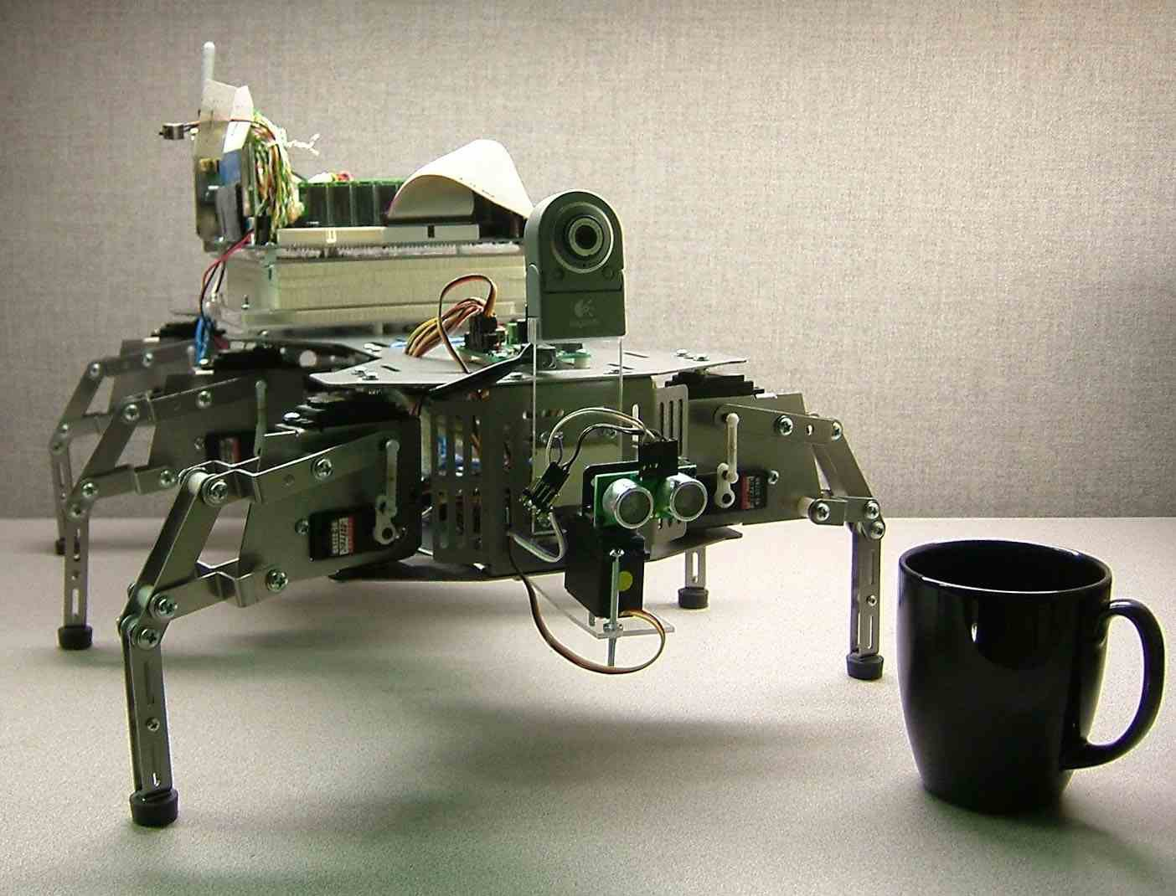
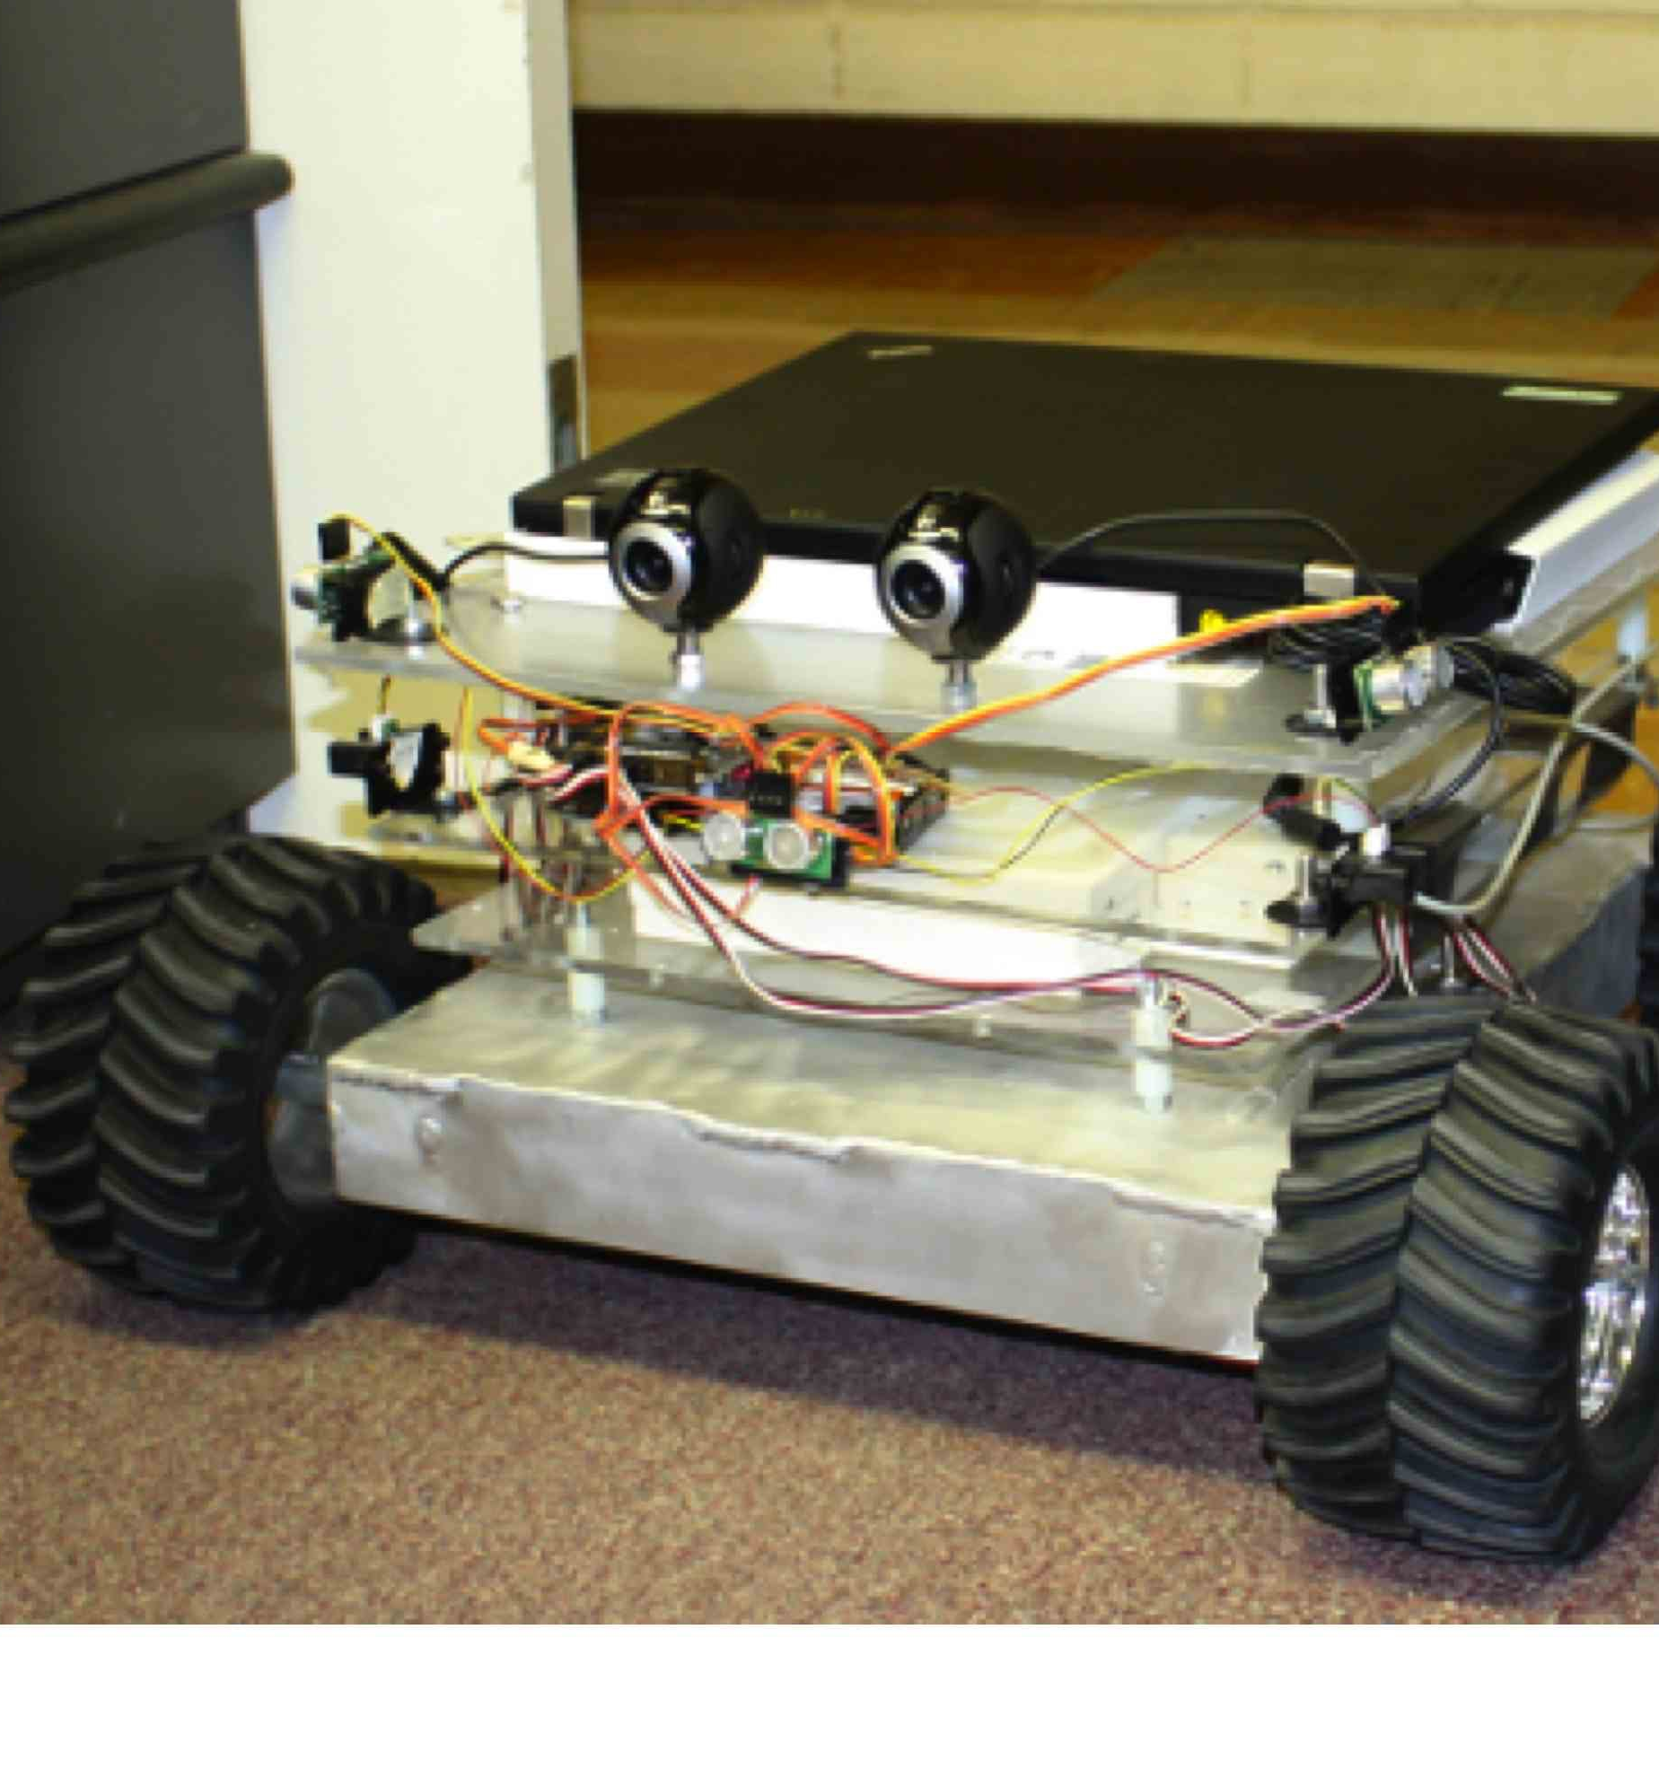
Symbolic Approach to Intelligent Systems
Cognitive Architectures
  SOAR
  ACT-R (CMU: ACT-R, NRL: jACT-R, Army: SS-RICS)
  EPIC
  …
Rule-based or production systems
  Can have working memory and long-term memory
  Some learning, but it is difficult
Learning curve for users is steep…
Difficult to scale to human-level
Hand writing rules is not scalable, need learning

Slide 12
Emotions and Temperament on
Cognitive Mobile Robots
Emotions and temperament help animals (including humans) survive
Groups of animals (including humans) with a diverse set of temperaments are more effective
Robots that vary their behavior based on their emotions should be very useful
Robots with emotions and temperament might be better at interacting with humans also
Long, Kelley, and Avery, “An Emotion and Temperament Model for Cognitive Mobile Robots," 24th Conference on Behavior Representation in Modeling and Simulation (BRIMS), 2015, Washington, DC

Slide 13
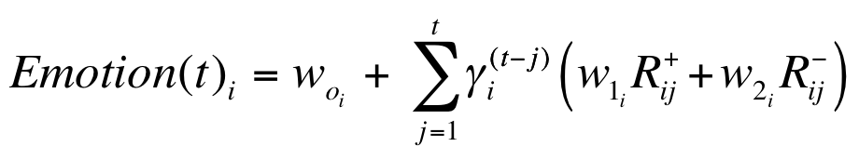
Model Created for Emotions
Eight emotions
that vary with time
Fixed coefficients that define temperament
Rewards &
Punishments
Long, Kelley, and Avery, 24th Conference on Behavior Representation in Modeling and Simulation (BRIMS), 2015, Washington, DC.

Slide 14
Human Brain
The human brain is the most complex system in the known universe and consists of neurons, synapses, and massive sensor inputs and motor outputs
We are interested in mimicking biological systems to use on mobile robots and elsewhere
It also might lead to better understanding of neuroscience since the networks mimic biological neural networks
The most detailed neuron model are the Hodgkin-Huxley equations, which I use

Slide 15
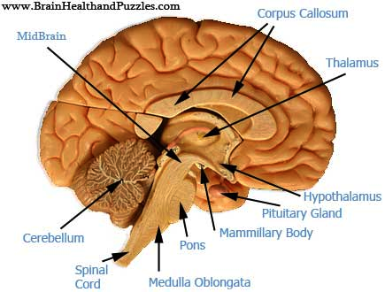
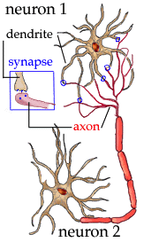
Human Brain
10¹¹ Neurons
10¹⁴ Synapses
Only 25 watts
~25% used for vision

Slide 16
Fastest Computer in World
China’s Sunway Computer:
  10,649,600 processing cores
  93 petaflops (93*10^15 ops/sec)
  1 petabyte of memory (10^15 bytes)
  15 MegaWatts required
  About a million times larger and less efficient than brain
Largest (known) U.S. supercomputer has 1,600,00 processing cores and achieves 17 petaflops

Slide 17
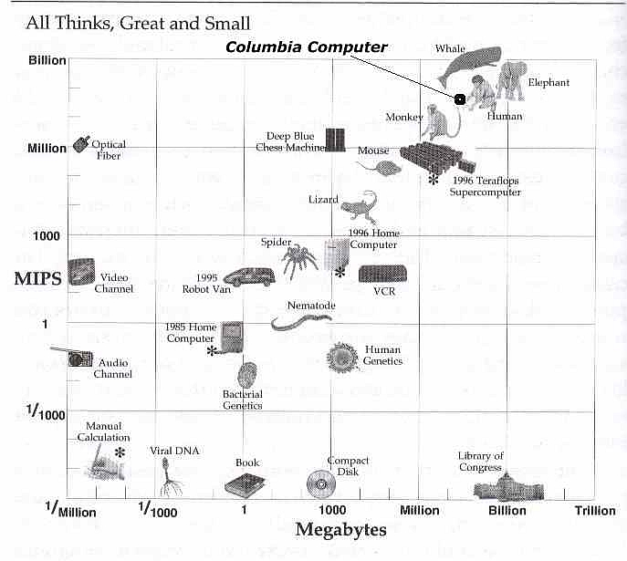
Biology & Computers
Slowest computer on top500.org
China’s Sunway Supercomputer
But ... bytes and MIPS
aren’t enough to make a machine with human-level intelligence.
Many other issues:
- wiring diagrams
- software
- algorithms
- learning
- sensory input
- motor-control output
- power
- volume
- etc.
Macbook Pro Laptop (2016)
Moravec, 1998

Slide 18
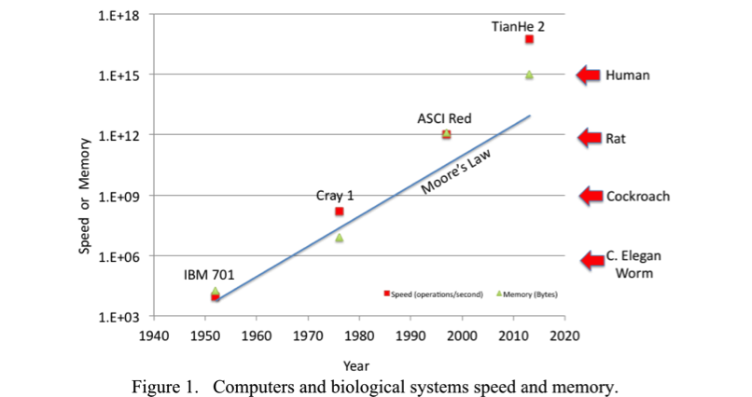
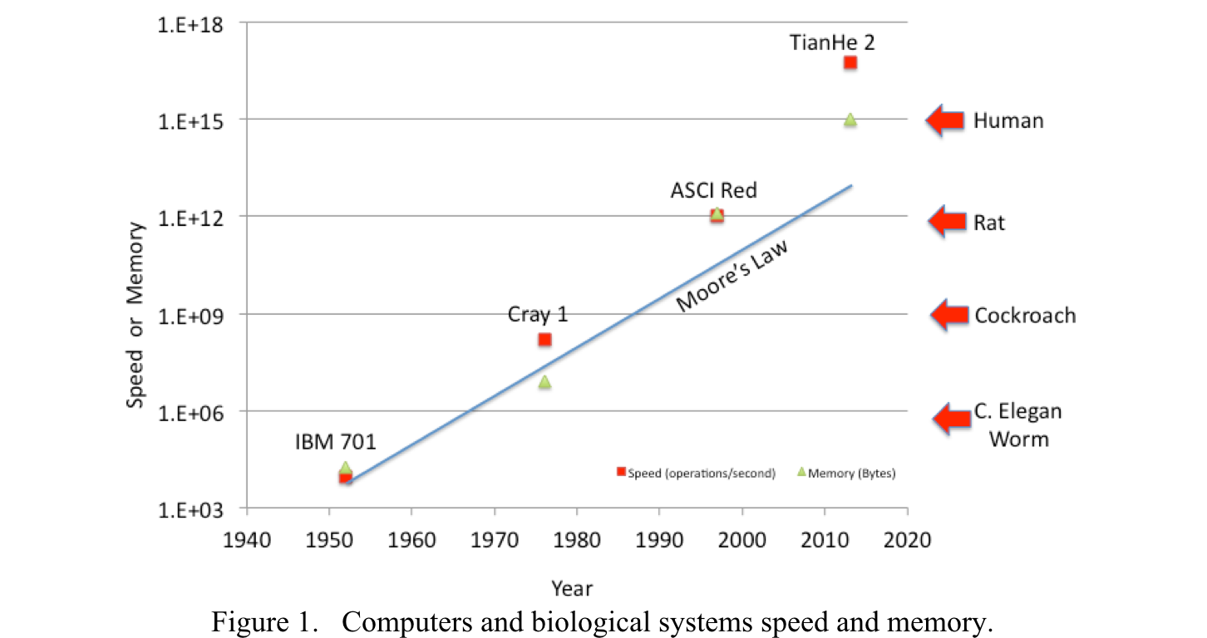
Speed and Memory of Computers and Biological Systems
Long, Lyle N., " Toward Human Level Massively Parallel Neural Networks with Hodgkin-Huxley Neurons," to be presented at 16th Conference on Artificial General Intellience, New York, NY, July 16-19, 2016.

Slide 19
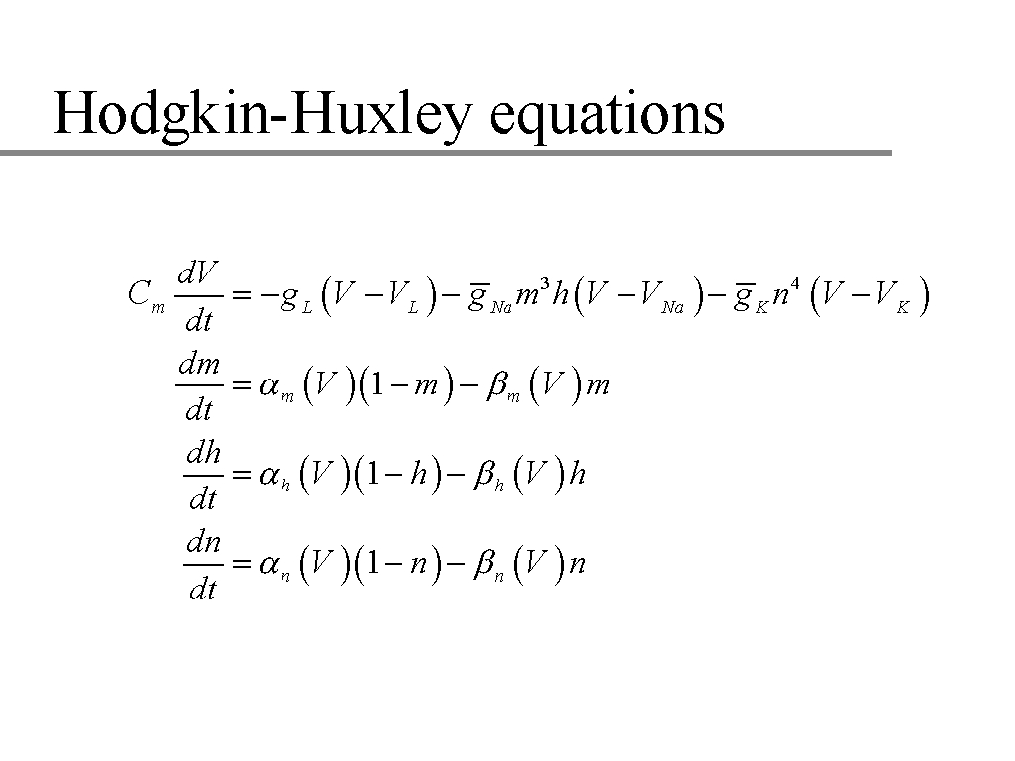
Hodgkin-Huxley Neuron Model
(squid giant axon, Nobel prize 1963)
To model human brain would require 400 billion ODE’s and each one is coupled to ~1000 other ODE’s
A nonlinear, coupled set of four ordinary differential equations for each neuron.
(spatial term has been left out)

Slide 20
Coefficients and Constants in H-H equations
g_{L} = 0.3
g_{Na} = 120
g_{K} = 36
V_{L} = 10.6
V_{Na} = 115
V_{K} = -12

Slide 21
H-H Coefficient Calculations
The coefficients are the most expensive part of the computation. They all involved exponentials and cost roughly 10 – 14 floating point operations each. That’s 60-84 ops/neuron/timestep (just for coefs).
However, these can be efficiently computed using table lookups, i.e. precompute them and then look them up in a table – very fast.
Many publications state that the H-H equations are too difficult and expensive to solve, this is simply not true.
See paper:
Skocik, M.J. and Long, L.N., "On The Capabilities and Computational Costs of Neuron Models," IEEE Trans. on Neural Networks and Learning, Vol. 25, No. 8, Aug., 2014.

Slide 22
Efficient Object Oriented Code for Computing Massively Parallel Neural Networks with H-H equations
C++ with MPI for massively parallel computers
Neuron Objects
  69 fl.pt. ops/neuron/step
  (23 + num_synapse_connections)*4 Bytes/neuron
Synapse Objects
  5 bytes/synapse
  ~15 microSec. per send
  Use MPI_ACCUMULATE

Slide 23
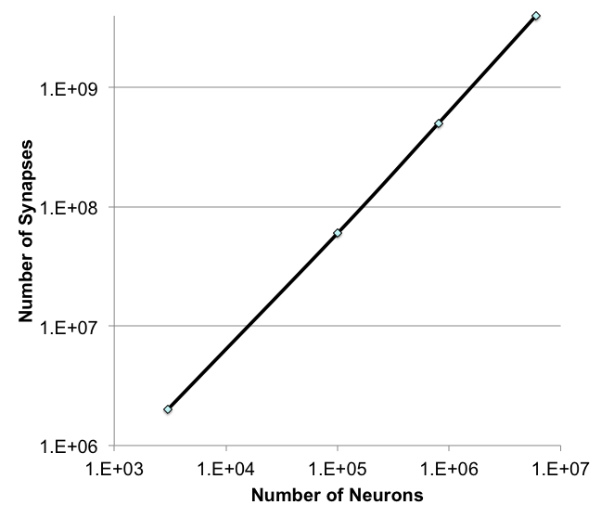
Synapses per Neuron for range of biological systems
Synapses =
3.7 * Neurons^{1.32}
Long, Lyle N., "Efficient Neural Network Simulations using the Hodgkin-Huxley Equations," Conference on 60 Years of Hodgkin and Huxley, Trinity College, Cambridge, UK, July 12 - 13, 2012.

Slide 24
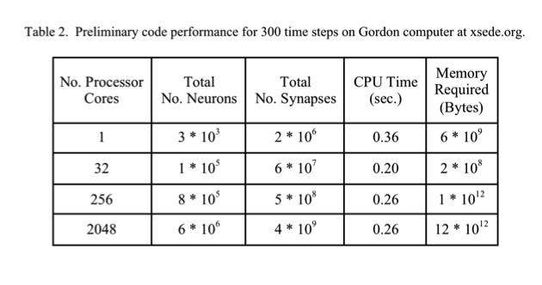
Code Performance

Slide 25
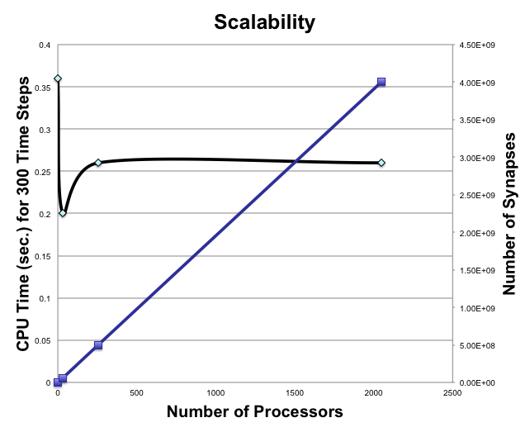
Code Scalability

Slide 26
Computer Code
Computer code is very flexible
Uses pointers and the network can have any connectivity
It also has synapto- and neuro-genesis, so it can automatically add or remove synapses or neurons
Goal is to build a “baby” network and have it grow into “adult” network
Must also address “catastrophic forgetting problem”

Slide 27
Learning
How do we adjust 10¹⁴ synapses?
It takes about 18 years for humans to fully develop (some people longer :)
EACH human takes this long, but for machines once we get one machine trained we can replicate it easily
Refs: Long, 2008 and Long and Gupta, 2008

Slide 28
Learning Approaches for Neural Networks
Backpropagation
Supervised
Unsupervised
Bayesian
Reinforcement
Spike timing dependent plasticity (STDP)
…

Slide 29
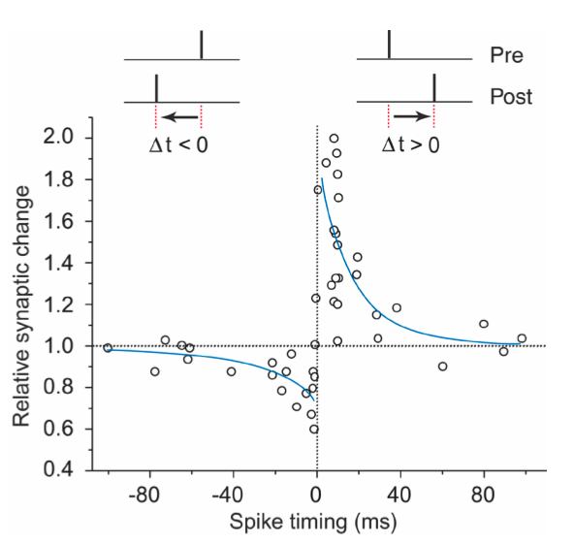
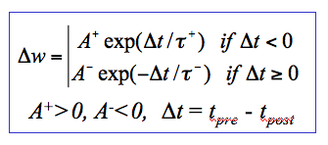

Spike Time Dependent Plasticity (STDP)
Experimentally observed
Bi and Poo, Journal of Neuroscience, 18(24), 1998
Long and Gupta, AIAA Paper No. 2008-0885, 2008.

Slide 30
Conclusions
There are now hundreds of supercomputers, each with more power than a human brain
Code described here uses biologically realistic neurons and is scalable on these machines
Still need efficient large-scale learning algorithms
Human level (or beyond) machine intelligence is certainly possible

Slide 31
References
Bostrom, N., Superintelligence: Paths, Dangers, Strategies, 2014.
Domingos, N., The Master Algorithm: How the Quest for the Ultimate Learning Machine Will Remake Our World, 2015.
Ford, M., Rise of the Robots: Technology and the Threat of a Jobless Future, 2016.
Brynjolfsson, E. and McAfee, A., The Second Machine Age: Work, Progress, and Prosperity in a Time of Brilliant Technologies, 2016
Moravec, H., Robot: Mere Machine to Transcendent Mind, 2000.
Moravec, H., Mind Children: The Future of Robot and Human Intelligence, 1990.
Kelley, Troy D., (2006), “Developing a psychologically inspired cognitive architecture for robotic control: The Symbolic and Subsymbolic Robotic Intelligence Control System (SS-RICS)," Int. J. Adv. Robotic Syst. Vol. 3, No. 3, pp. 219-222.
Long, L.N. and Kelley, T.D., “A Review of Consciousness and the Possibility of Conscious Robots," Journal of Aerospace Computing, Information, and Communication (JACIC), Vol. 7, No. 2, Feb., 2010.
Long, L.N., Kelley, T.D., and Avery, E. “An Emotion and Temperament Model for Cognitive Mobile Robots," 24th Conference on Behavior Representation in Modeling and Simulation (BRIMS), 2015, Washington, DC
www.top500.org
Long, L. N., " Toward Human Level Massively Parallel Neural Networks with Hodgkin-Huxley Neurons,” 16th Conference on Artificial General Intelligence, New York, NY, July 16-19, 2016.
Long, Lyle N., "Efficient Neural Network Simulations using the Hodgkin-Huxley Equations," Conference on 60 Years of Hodgkin and Huxley, Trinity College, Cambridge, UK, July 12 - 13, 2012.
Long, L.N. and Gupta, A., "Scalable Massively Parallel Artifical Neural Networks", Journal of Aerospace Computing, Information, and Communication (JACIC), Vol. 5, No. 1, Jan., 2008.

Slide 32
Thank You. Questions?
Lyle N. Long
LNL@psu.edu
http://www.personal.psu.edu/lnl

