Slide 1
Machine Learning Applications in Aerospace System Design
Prof. Dimitri Mavris
Director, Aerospace Systems Design Laboratory (ASDL)
Langley Distinguished Regents Professor
Boeing Regents Professor for Advanced Aerospace Systems Analysis
School of Aerospace Engineering
Georgia Institute of Technology

Slide 2
Presentation Outline
Introduction
The Aerospace Applications landscape
Our ‘machine learning’ perspective
Enablers for Aerospace Systems Engineering, Integration, Analysis and Design
Leveraging metamodeling to enable Design Space Exploration and Parametric Interactive Decision Making
Representative Case Studies

Slide 3


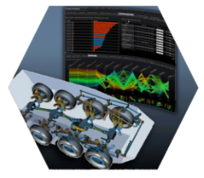


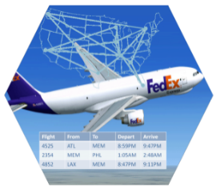
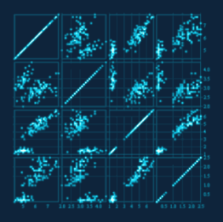
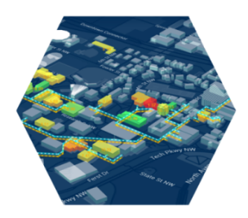


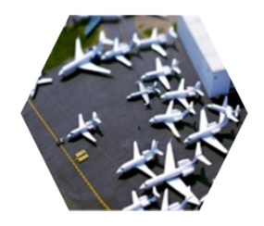
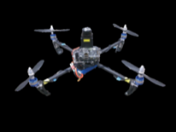
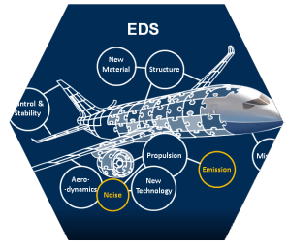
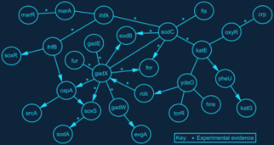

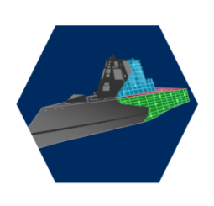
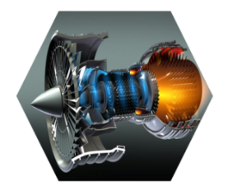


Aerospace Applications Landscape
Uncertainty Quantification & Management
Data and Visual Analytics for Ultra-High Dimensional Space Exploration
“Digital Thread”
Operation-Centric, Larger-Scale SoS
Robust Design under Uncertainties
System of Systems Engineering
Disciplinary Analysis
Time Dependent Data and Model- driven Analysis of Cyber-physical Systems
Computational
Engineering
Rapid Prototyping
with 3D Printing
MDA/O enabled by Surrogate Modeling, Adjoint Method, and Variable Fidelity Strategies

Slide 4
What is needed to enable these activities?
Transition from a single-discipline to a multi-disciplinary analysis, design and optimization perspective
Integration and Automation of the resultant design processes
Transition from a reliance on historical data to physics-based, variable fidelity formulations, especially true for unconventional concepts
Means to perform requirements exploration, technology infusion trade-offs and concept down selections during the early design phases (conceptual design) using these physics-based methods
Methods which will allow us to move from deterministic, serial, single-point designs to dynamic parametric trade environments
Incorporation of probabilistic methods to quantify, assess risk
Transition from single-objective to multi-objective optimization
Need to speed up computation to allow for the inclusion of variable fidelity tools so as to improve accuracy
Incorporation of advances in HPC, IT, M&S, machine learning and visual analytics (NASA CDT initiative) to support technology development, uncertainty burn down and decision making

Slide 5
Aerospace Systems Engineering, Integration, Analysis & Design
Aircraft Design Methods
Design Trade-off Analysis
Technology Assessment, Selection and Forecasting
Multi-Physics Analysis
Unconventional Design Concepts
Vehicle Modeling & Calibration
…
Enabled by the advancement in
Computational power
Modeling & Simulation techniques
Machine learning
Aerospace Engineering
Bayesian Inference
Probabilistic Design
Uncertainty Quantification & Management (UQ&M)
Artificial Neural Networks
Deep Learning
Kernel-Based Methods
Reasoning under Uncertainties
Dimensionality Reduction
Visual Recognition
Data Clustering
…
Advanced System Analysis
Modeling & Simulation
Analysis of Alternatives
Concept Space Exploration
Optimization Techniques
Multidisciplinary Design Analysis & Optimization (MDAO)
Risk & Uncertainty Mitigation
Reliability Analysis
Requirement Analysis
Decision Making
…
Machine
Learning
System Engineering

Slide 6
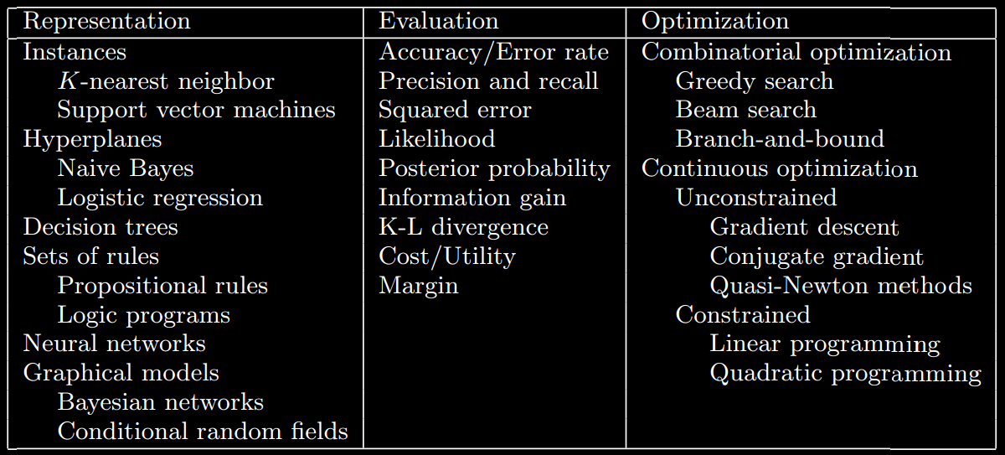

What is Machine Learning?
“Civilization advances by extending the number of important operations we can perform without thinking about them.” Alfred North Whitehead
Five major schools of thoughts in machine learning
Symbolism: Inversed Deduction, Decision Trees
Connectionism: Neural Networks, Deep Learning
Evolutionism: Genetic Algorithm, Genetic Programming
Bayesianism: Bayesian Networks
Analogism: Kernel-Based Methods, Support Vector Machines
“Machine learning” is a field of computer science that uses statistical methods to create programs that detect patterns in massive amounts of data that humans would be unlikely to find. It is the study of algorithms that infer the function they compute from example data
“Big Data” is it’s own world of tools, technologies, and solutions to accommodate large volume, high velocity and great variety in big data
“Data Mining” is related to any tool involved in excavating useful insights from data, big or small. While machine learning is focused on solving specific tasks, data mining is more exploratory term
[Pedro Domingos, 2012]
Source:

Slide 7
Machine Learning Techniques
ANOMALY DETECTION
CLUSTERING
Finding unusual
data points
Discovering structure
START
TWO-CLASS CLASSIFICATION
Two
Predicting
categories
Predicting values
Linear and non-Linear Multivariate Regressions
Three
or more
MULTI-CLASS CLASSIFICATION
Adapted from Microsoft Azure Machine Learning: Algorithm Cheat Sheet

Slide 8
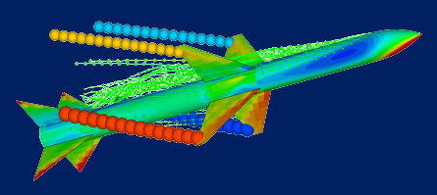
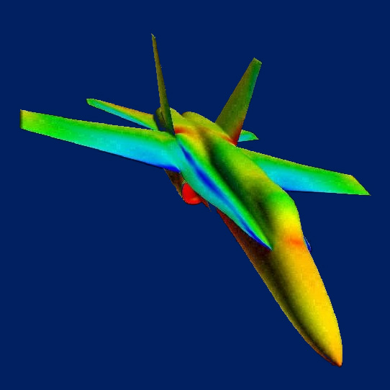
Metamodeling for Design Space Exploration and Parametric Interactive Decision Making
A Big Picture
Surrogate Modeling
Pareto Frontier of Computational
M&S Capability
Topological Exploration
the use of statistical techniques to build approximations (meta-models) of expensive computer analysis codes to facilitate multidisciplinary, multi-objective optimization and concept exploration [Simpson et al., 2001]
MDO with Reduced Order Models
High-Fidelity
Design Optimization
Scope of Design Space
Variable Fidelity Approach*
Adjoint Methods*
High-Fidelity Analysis within Restricted Design Space
Potential strategies to meet the computational challenges in MDO*
Surrogate Modeling
Variable Fidelity Approach
Adjoint Methods
(These are not necessarily mutually exclusive)
Parametric Exploration near Baseline Design
Reduced-Order Model
Model
Fidelity
High-Fidelity M&S Tools
* National Research Council, “Decadal Study for Civil Aeronautics: Foundation for the Future,” 2006
** Missile picture from Nielsen Engineering and F-18 from AIAA

Slide 9
Evolution of Adaptive Regression Techniques
Non-parametric Techniques
Support Vector Machine
Defining basis functions centered on the training data points, then, select a subset of them
“In 1990s, many researchers immigrated to SVM from MLP due to better performance.” [Hinton, 2007]
Add basis function for each of whole or partial training data
Originated from weight-kernel duality
Fast to train but slow prediction in general
Kernel Based Method (such as Kriging / Gaussian Process)
Memory-based methods which store training data for prediction phase
Use similarity metrics for training vectors
Fast to train but slow at making prediction
Parametric Techniques
Relevance Vector Machine
Use parametric forms for basis functions whose parameter values are adapted during training
Originally inspired by biological neural network
Hard to train but predicts fast
Curse of Dimensionality
Linear Regression Methods (such as RSM)
Boltzmann Machine
Linear combinations of fixed basis functions
Linear parametric model
Perceptron
Hopfield Net
Deep Belief Net
Used a layer of hand-coded features and tried to recognize objects by learning how to weight these features
Fundamentally limited in what they can learn to do
“The Next Generation Neural Network” [Hinton, 2007]
Based on Restricted Boltzmann Machine
Synthesis between neural net and Bayesian net
Applied to the most challenging machine learning tasks today
Multilayer Perceptron
Nonlinear parametric model
Consists of multiple layers
Compare outputs with correct answer to get error signal
Back-propagate error signal to get derivatives for learning

Slide 10
Machine Learning/Surrogate Modeling
Key enabler that has allowed us to:
speed up processes,
protect proprietary nature of codes used,
overcome organizational barriers (protectionism of tools and data),
allow for the frameworks to be tool independent (no need for direct integrations of codes; also enables our desire for variable tool fidelity formulations),
allow the designer to perform requirements exploration, technology infusion trade-offs, and concept down selections during the early design phases (conceptual design) using physics-based methods
Surrogate models can also be used at the integrated system level to determine responses at that level. This will allow us to move from deterministic, serial, single-point designs to dynamic parametric trade environments.

Slide 11
Representative case studies

Slide 12
Representative Case Studies
Metamodeling for Technology-Driven Design Space Exploration - Environmentally Responsible Aviation
Parametric, Physics Based Modeling - Kriging and Neural Net Metamodeling for Multi-Fidelity Aerodynamic Prediction (back up)
Probabilistic Design - Uncertainty Quantification using Bayesian Belief Net for Structural Optimization (back up)
Health Monitoring of Cyber-Physical Systems -Dynamic Data and Model-Driven Case Study
Manufacturing Influenced Design - Digital Factory of the Future: Data-Driven Production Planning & Control

Slide 13
Metamodeling for Technology-Driven Design Space Exploration - ERA

Slide 14
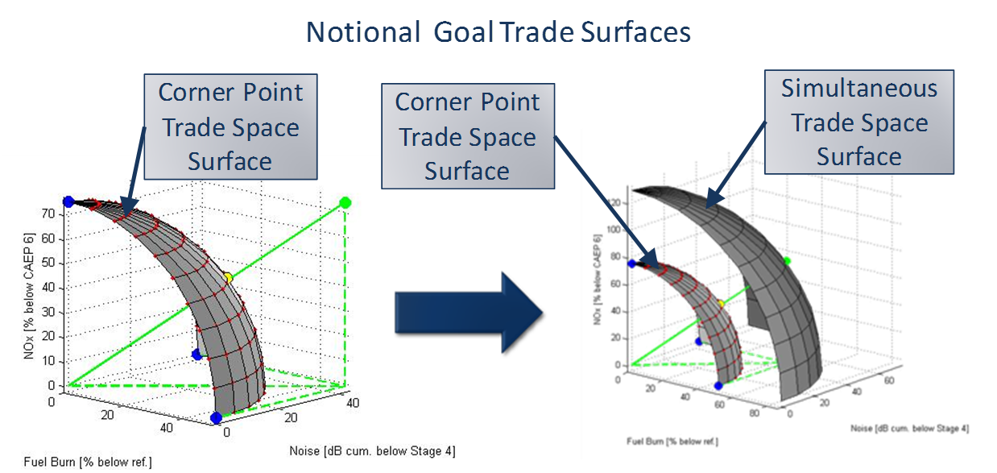
Environmentally Responsible Aviation (ERA) Program
NASA launched the ERA program to identify and mature technologies in the N+2 time frame that could impact a set of aspirational environmental goals
The objective was to not just meet the three goals separately, but simultaneously
Identifying appealing technology portfolios that could potentially simultaneously meet the goals required a design space exploration conducted on a physics-based M&S environment
GT-ASDL was tasked to aid NASA and its industry partners with this technology exploration
CORNERS OF THE
TRADE SPACE
N+1 = 2015***
Technology Benefits Relative
To a Single Aisle Reference
Configuration
N+2 = 2020***
Technology Benefits Relative
To a Large Twin Aisle
Reference Configuration
N+3 = 2025***
Technology Benefits
Noise
(cum below Stage 4)
-32 dB
-42 dB
-71 dB
LTO NO_{x} Emissions
(below CAEP 6)
-60%
-75%
better than -75%
Performance:
Aircraft Fuel Burn
-33%
-50%**
better than -70%
Performance:
Field Length
-33%
-50%
exploit metro-plex* concepts

Slide 15
Metamodeling for Environmentally Responsible Aviation
NASA ERA Dashboard
Technology Evaluation Process:
Goal: Dynamically (interactive, parametrically) evaluate technology implementation scenarios at the vehicle and fleet levels in a cohesive tradeoff environment
Features:
Provide users with fast and visual feedback on aircraft and system-level metrics
Ability to perform rapid trades and ‘what if’ scenarios in a manageable time
High computation speed at both vehicle and system-level
High combinatorial space (e.g. 40 technologies correspond to 1.1 trillion combinations)
Three hierarchical levels at which technologies are evaluated were incorporated in the ERA strategic planning and prioritization dashboard

Slide 16
Modeling and Simulation Environment
Environmental Design Space (EDS)
An M&S environment developed with support by the FAA/AEE to model existing aircraft as well as advanced technologies and concepts
EDS integrates continuously updated NASA design tools with industry vetted design logic to provide a parametric aircraft design capability
Consistent engine to airframe match
Creates output links to connect with fleet assessment tools
Takes advantage of years of development and validation by NASA
EDS provides integrated analysis capability to estimate:
Source noise
Exhaust emissions
Engine and vehicle performance

Slide 17
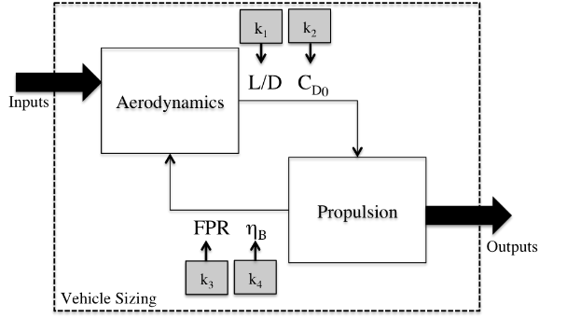
Analysis Procedure
“k-factor” Approach
Quantitative forecasting requires quantitative representation of technologies
Technologies, or potential impacts of technologies, can be defined as delta's with respect to a current system baseline
``k-factors'’ directly modify computed metrics during the analysis process, which in turn simulate technology benefits and penalties
Vehicle assessment method combines technology impact modeling with vehicle modeling, sizing and synthesis to evaluate performance metrics
Technology impacts are modeled at component level
Allowed to propagate through EDS in order to determine the system level benefits
Utilizes surrogate modeling to evaluate technology trade space for multiple vehicle configurations and classes

Slide 18
EDS Vehicle Calibration
EDS Vehicle model classes
EDS vehicle models have been developed, calibrated, and validated to existing vehicle in the fleet. Rigorous vetting process with industry SMEs
EDS captures existing aircraft models from Regional Jets, RJs through Very Large Aircraft, VLA aircraft
Existing aircraft models serve as departure point for modeling new technology engines and aircraft

Slide 19

Metamodeling for Environmentally Responsible Aviation
Metamodel Generation
Metamodels are used to enable the dashboard to rapidly evaluate metrics at each of the assessment levels
Metamodels are generated for each level:
Vehicle performance from EDS (Vehicle)
Noise contour surrogates (Airport)
Fleet fuel burn and NOx surrogates (Fleet Level)
Each level of surrogates are consistent with the previous allowing for trade-off and understanding of interdependencies
Vehicle surrogates are a function of technologies
Airport surrogates are a function of technologies, airport properties and flight schedule
Fleet level surrogates are a function of technologies, fleet mix, replacement schedule and operations

Slide 20
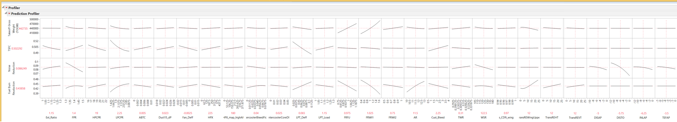
Visual Analytics- Parametric, Interactive Sensitivity Derivatives

Slide 21
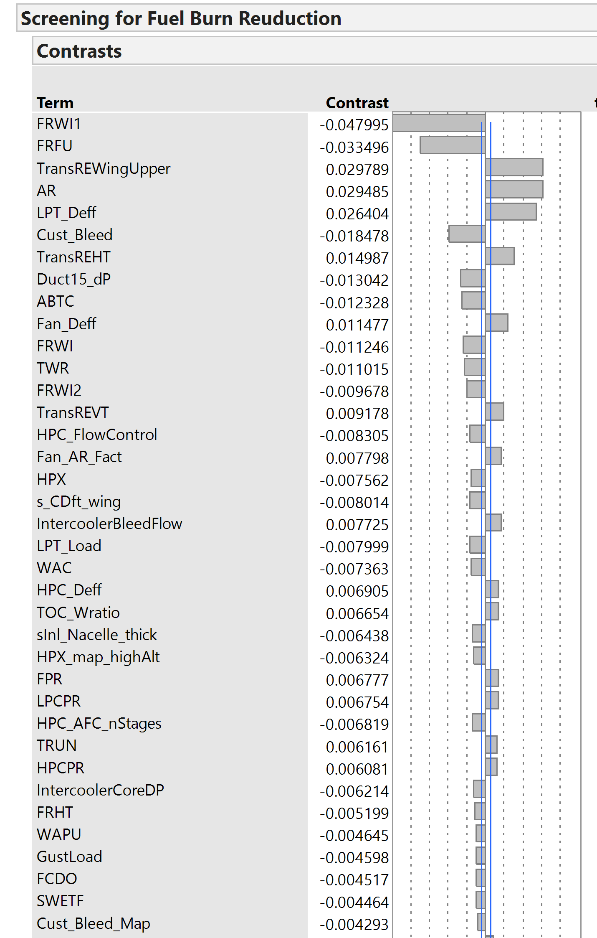
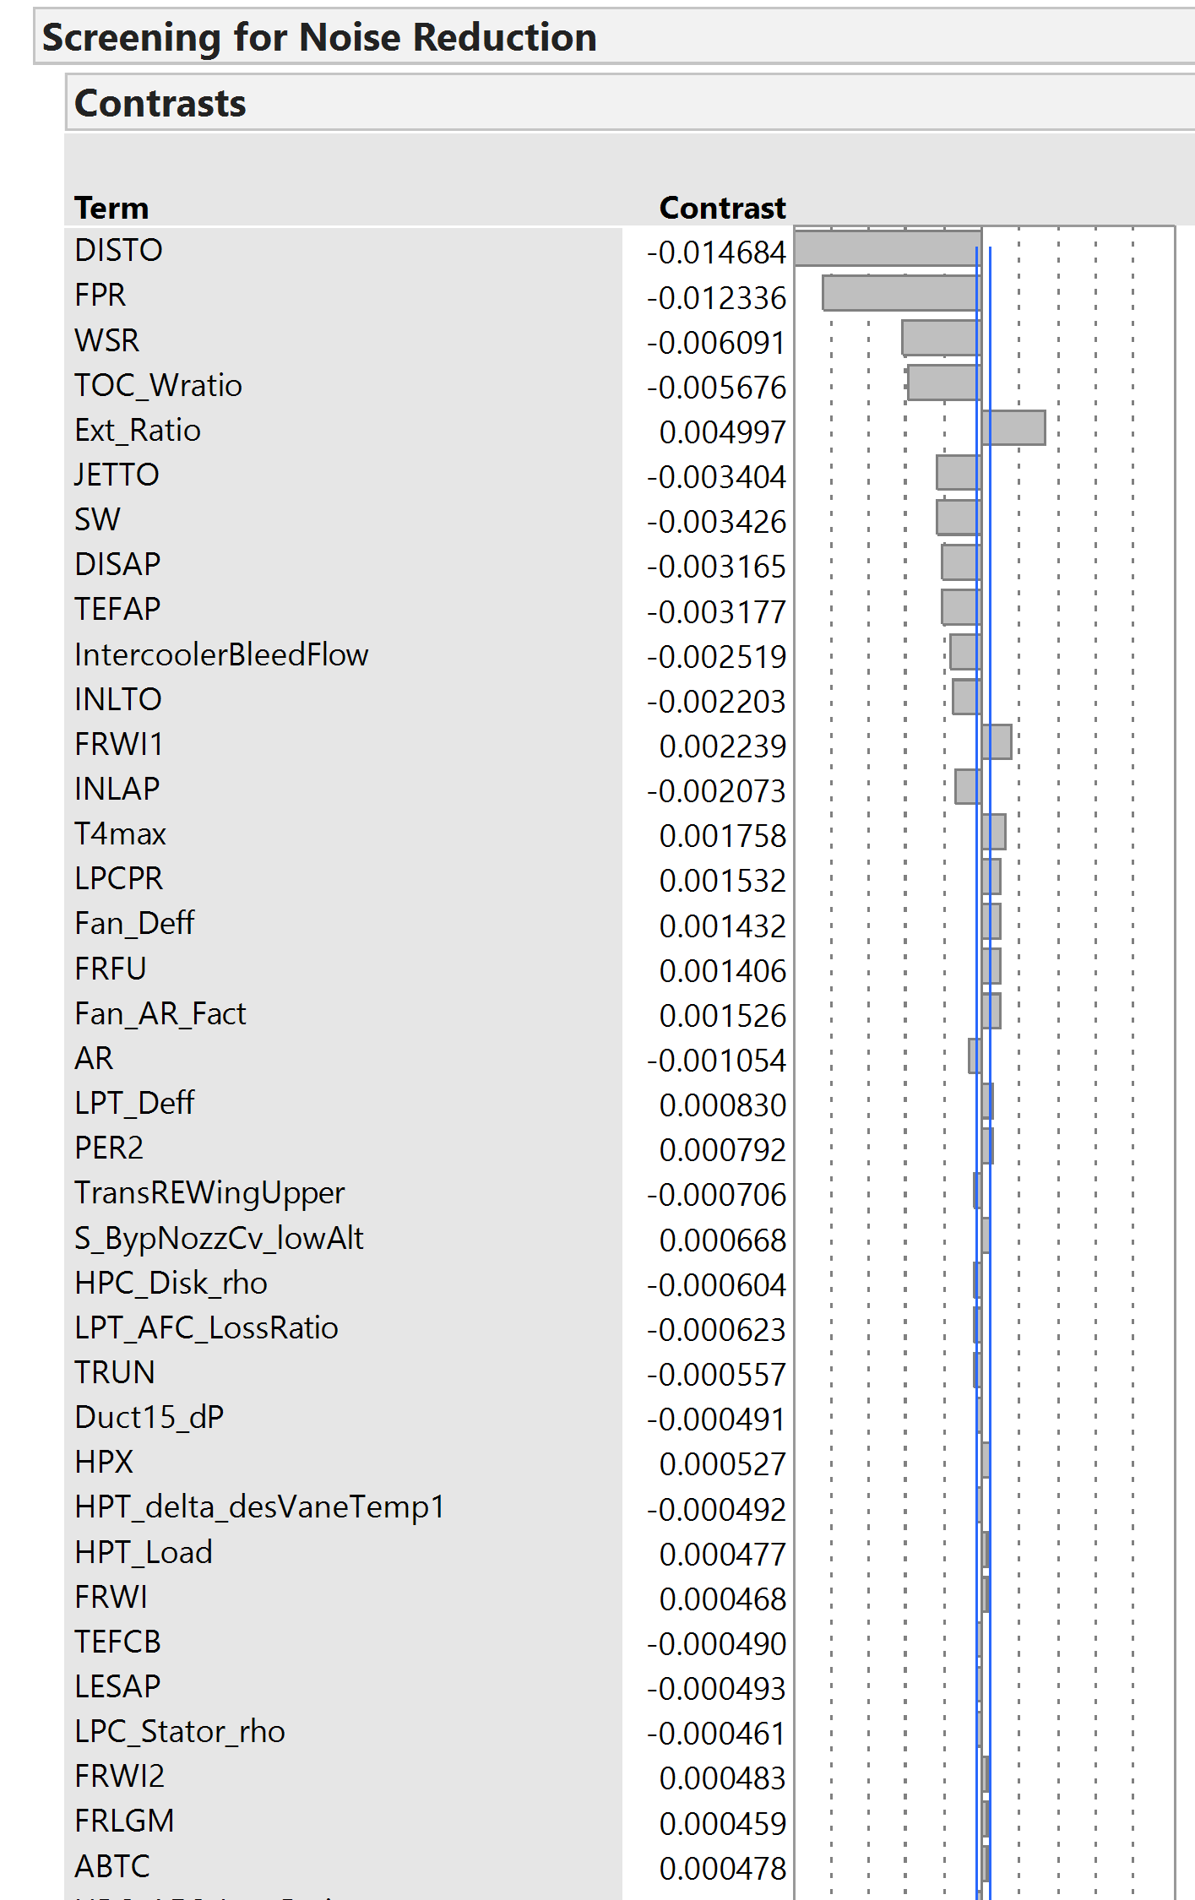
Analysis of Variance – Relative Contribution Significance

Slide 22
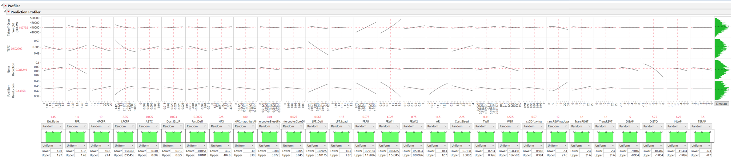
Global Space Exploration- Monte Carlo Analysis

Slide 23
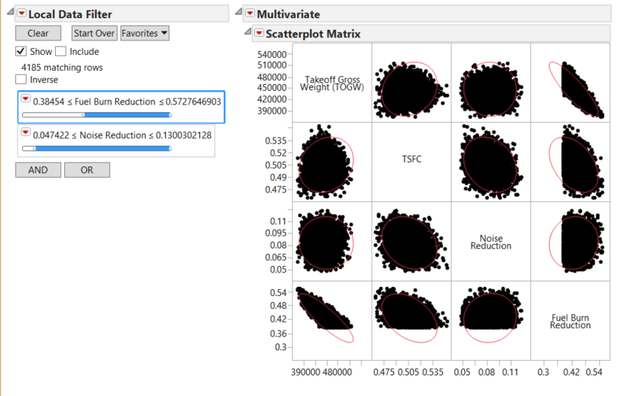
Visual Analytics- Multivariate Analysis- Filtered Monte Carlo

Slide 24
Propagation of Vehicle Impact and Uncertainties to Fleet Level
AEDT: Aviation Environmental Design Tool
GREAT: Global and Regional Environmental Analysis Trade-off

Slide 25
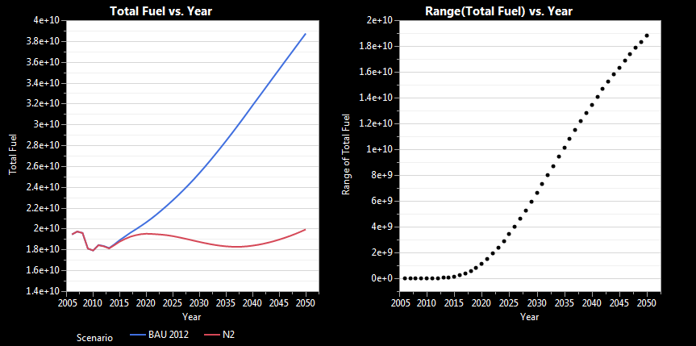
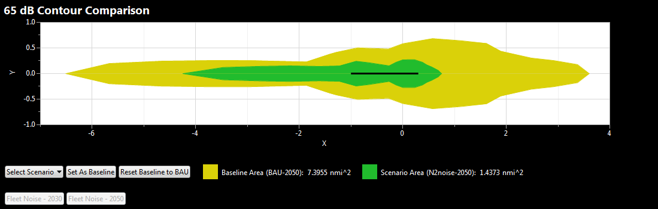
Example Fleet Results- Fuel Burn and Noise Contours
Provides user with ability to manipulate fleet composition to observe effects on fuel burn and emissions
Output and results are visualized at both the vehicle system level and at a fleet-wide impact level
Provides insight on which technologies and configurations should be pursued in order to meet system level goals – whether it be fuel burn, emissions, noise, or a compromise between all three
Compares impacts on airport noise contours for a generic runway configuration to give insight on how technologies reduce and reshape contours

Slide 26
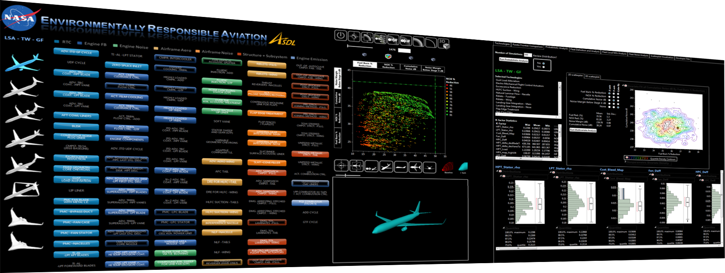

Visual Analytics and Decision Making for ERA
Metamodeling enables instant queries for noise and emission performance in vast combinatorial design space
Instant Visualization of Design Space
Probabilistic Analysis Supporting Decision Making Process
Highly Interactive ‘Control Panel’ for ‘Virtual Experiments’
Multi-Objective Combinatorial Optimization
Visual Analytics with 3D Vehicle Rendering

Slide 27
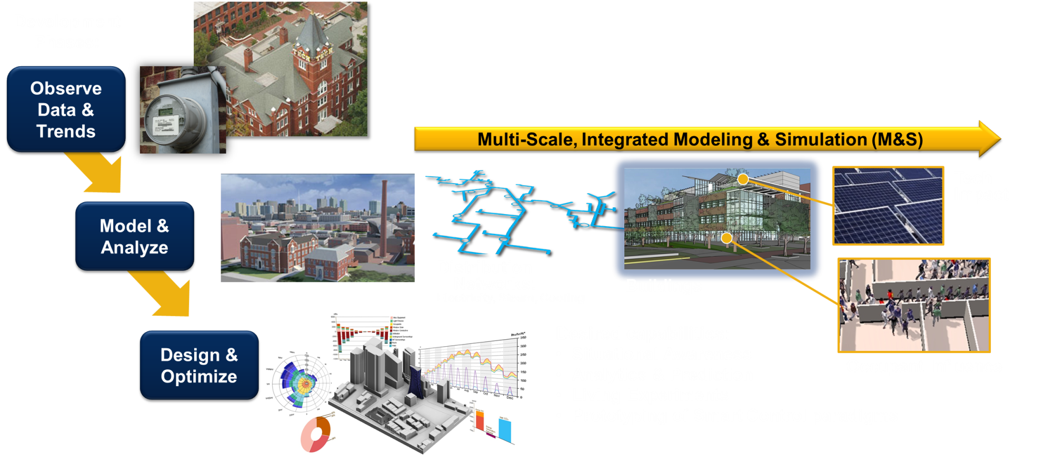
Dynamic Data and Model-Driven Application
Goal: a virtual M&S testbed for future campus energy technologies that
Use existing meter data & expertise of GT Facilities
Address GT Administration energy goals & planning needs
Facilitate “what if?” gaming, scenario evaluation, & trade studies

Slide 28
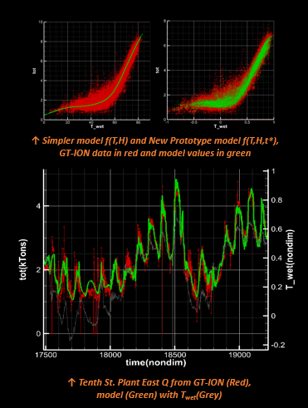
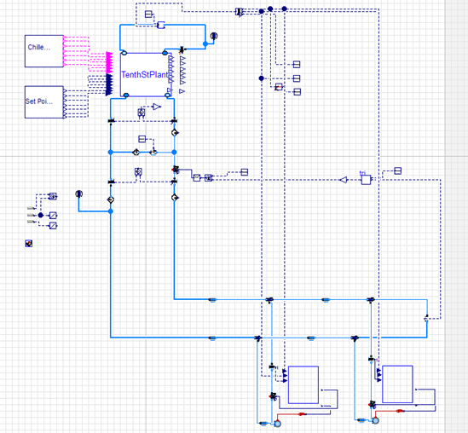
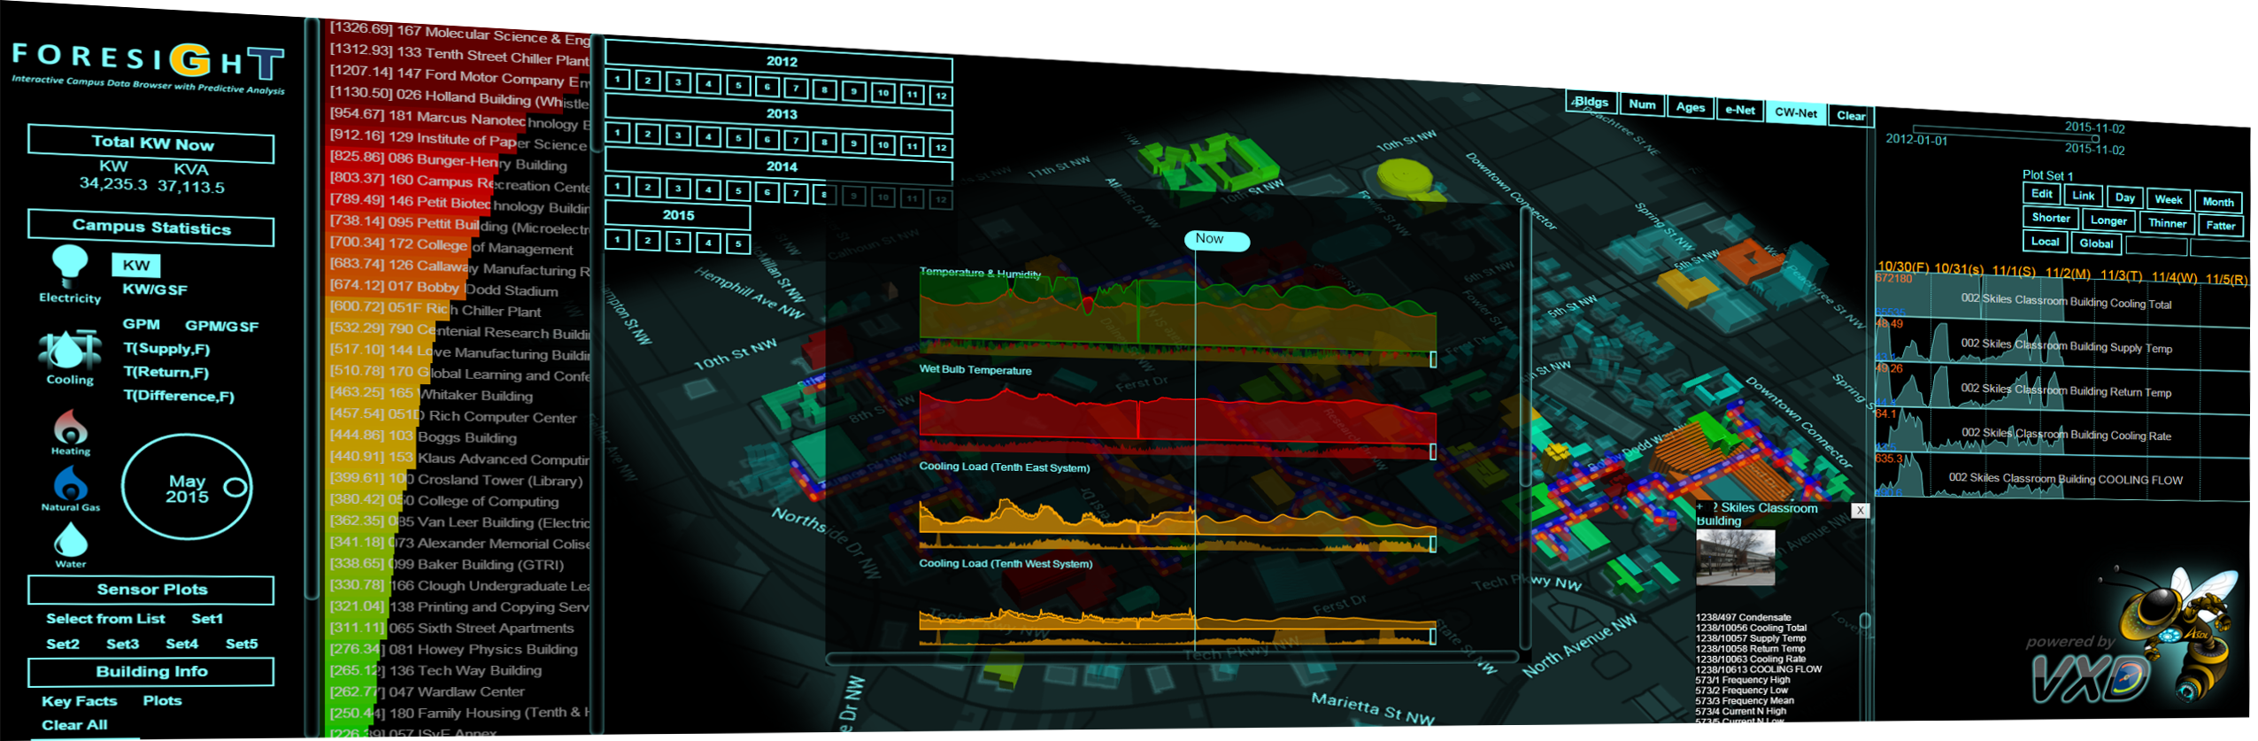
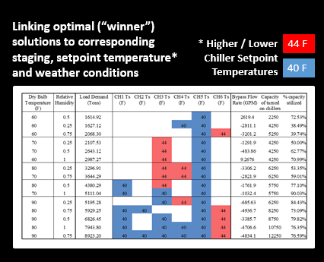
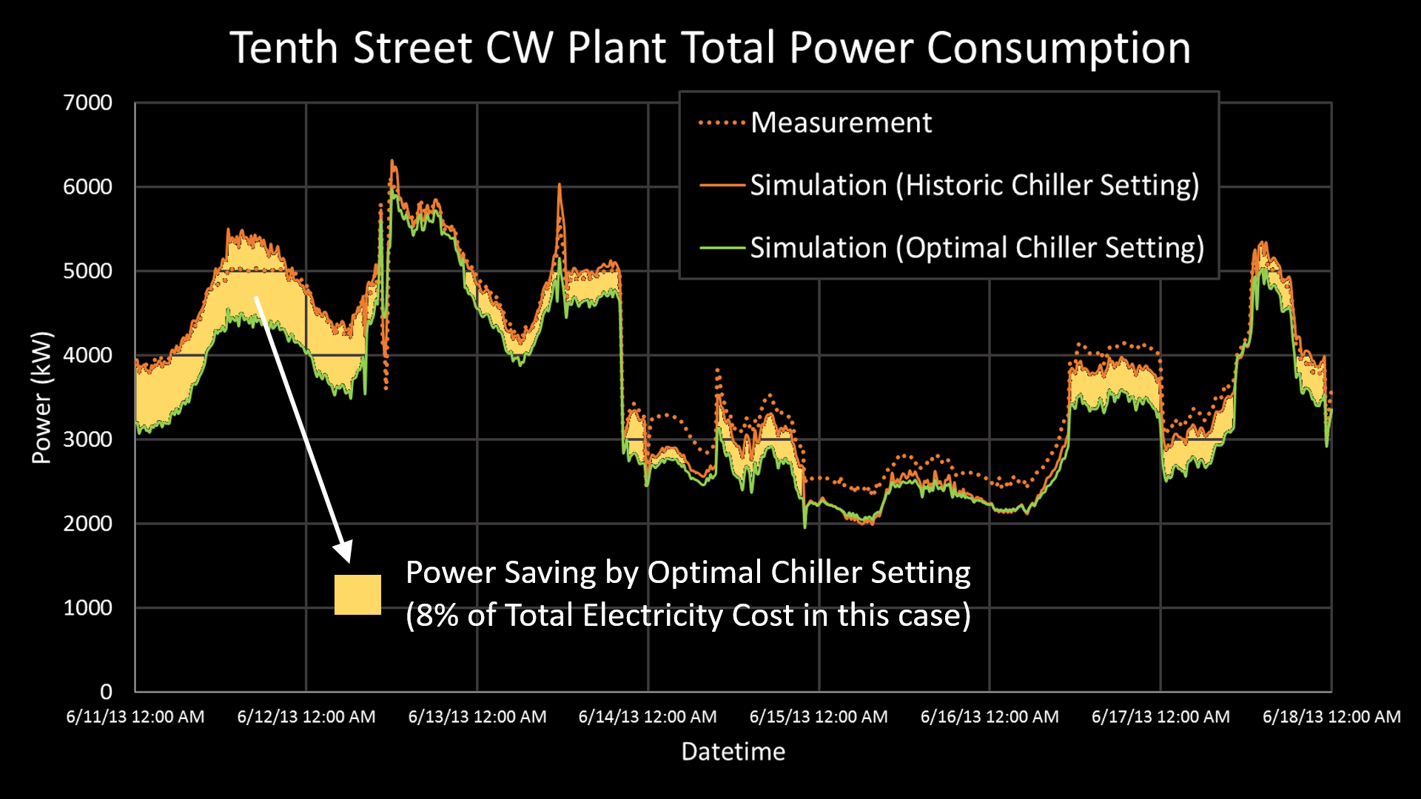
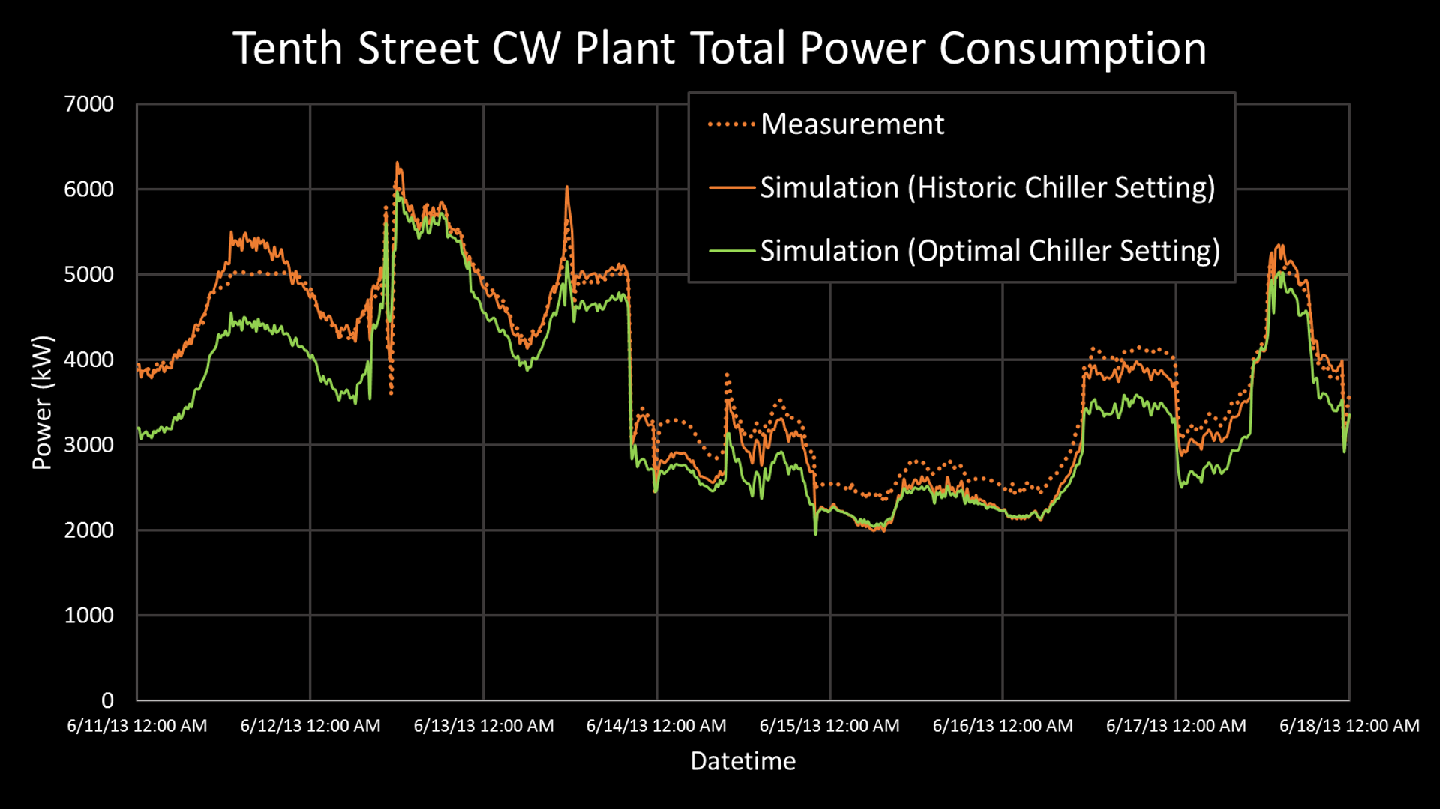
Dynamic Data and Model-Driven Application
Basic model construction for various load items using up-to-date machine learning algorithms
Construction of integrated M&S environment and validation of it using historic operation data
Execution of Design of Experiments to identify optimal plant setting parameters
Validation of optimal plant setting parameters against historic data
Application of data-driven models on M&S environment to perform Virtual Experimentation and to improve plant operation
1
2
3
4
5
Dymola Model for GT CW System
GT FORESIGHT as a testbed for Data-driven Campus Utility Operation Research
Table of weather condition and corresponding optimal setting*
Potential Energy-Saving using the previously identified optimal setting
Neural Net Model for Cooling Load versus Historic Data
Dymola versus Historic Data
28

Slide 29
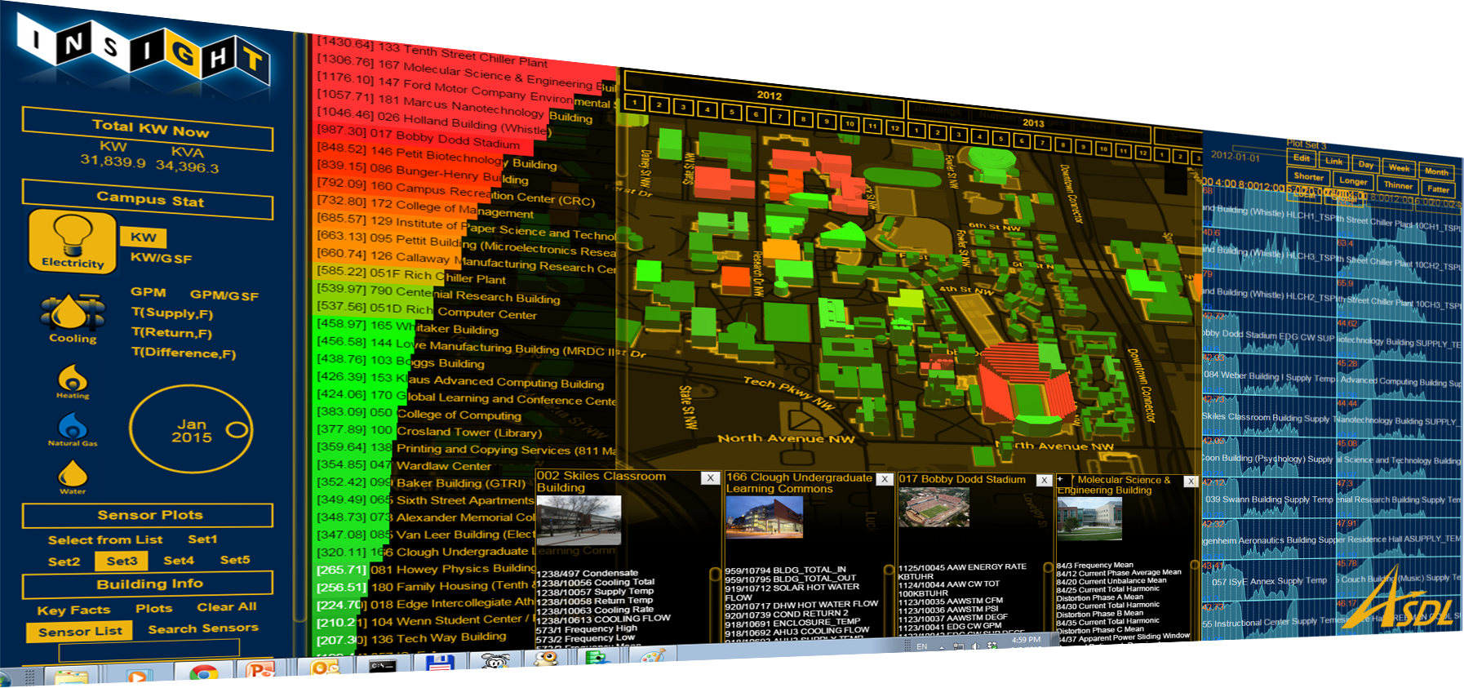
Dynamic Data and Model-Driven Application

Slide 30
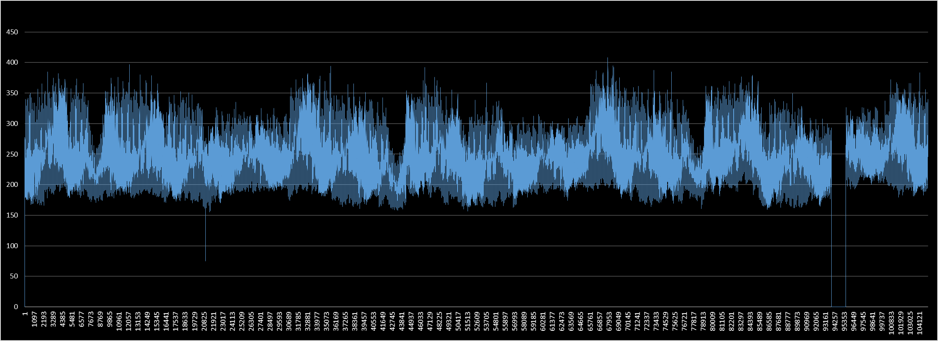
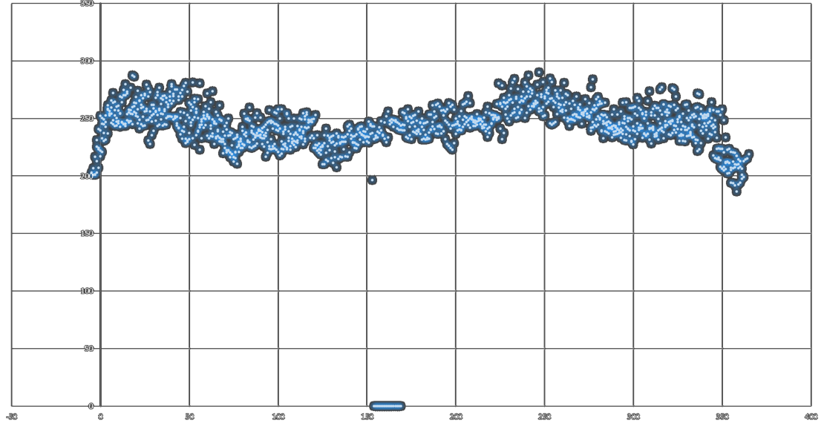
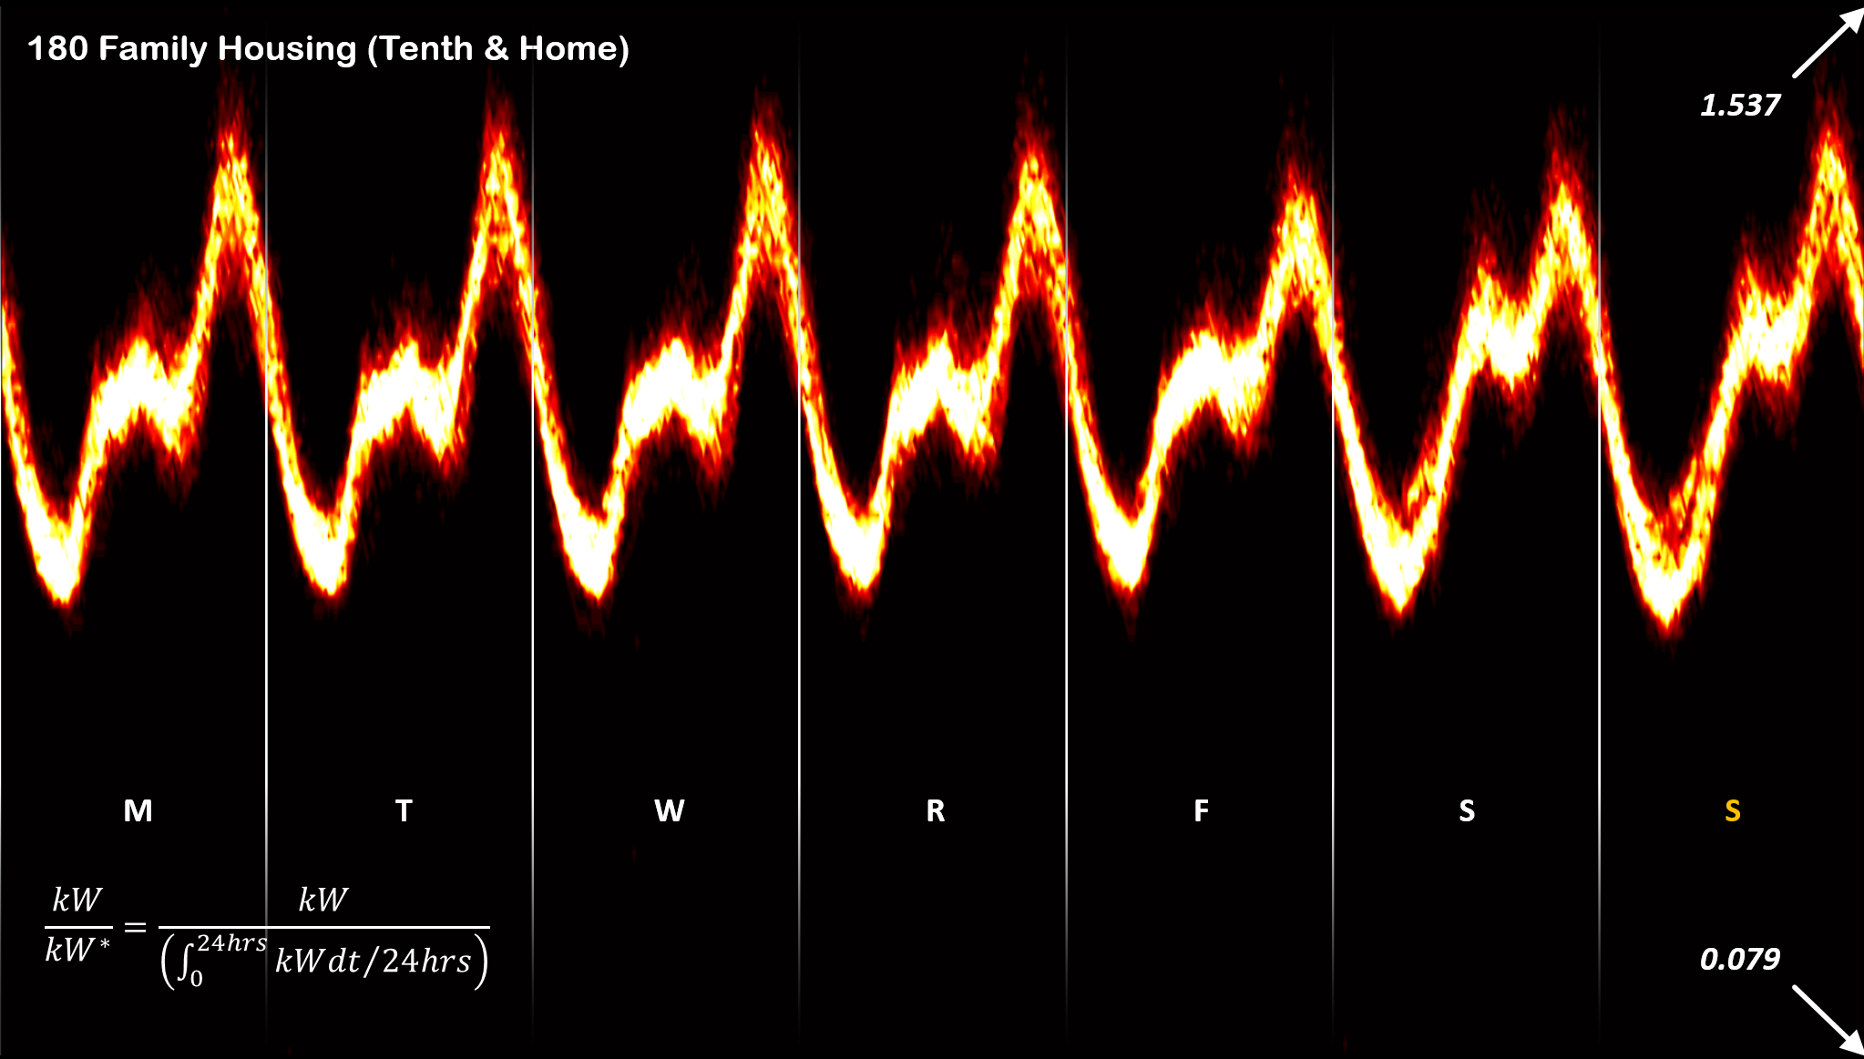
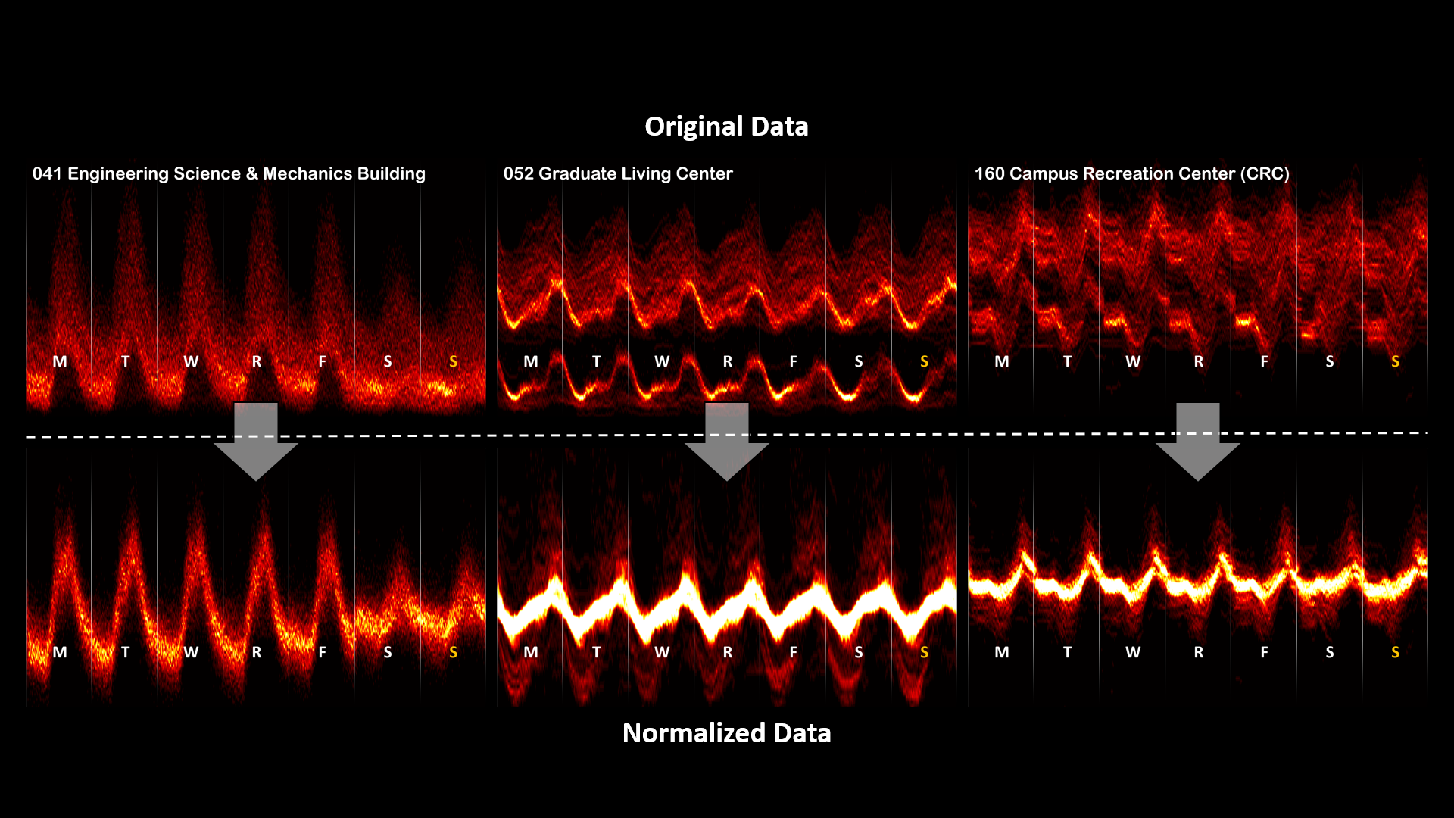
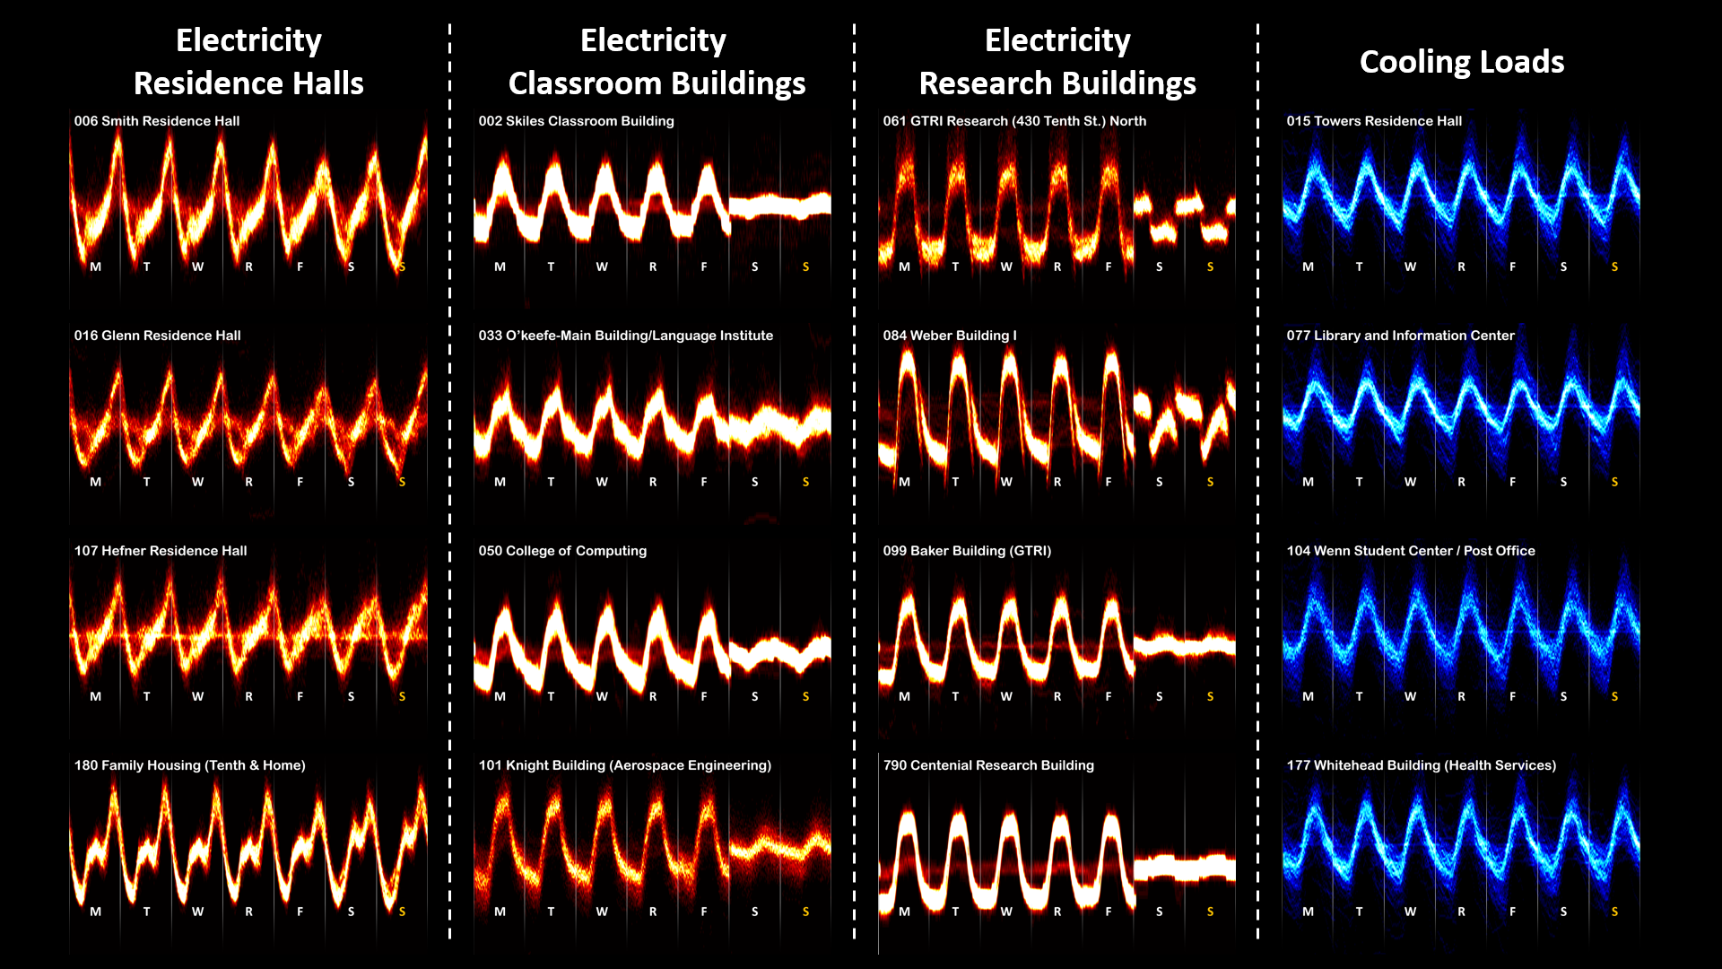
Deep Learning for Building Energy Consumption
1. Raw Data
2. Annual Trend Extraction
3. Daily Usage Pattern Identification
ION Database
Decoupled Modeling for Usage Pattern and Quantities
Useful Preprocessing Logic Developed
Each building has a unique signature energy usage pattern

Slide 31
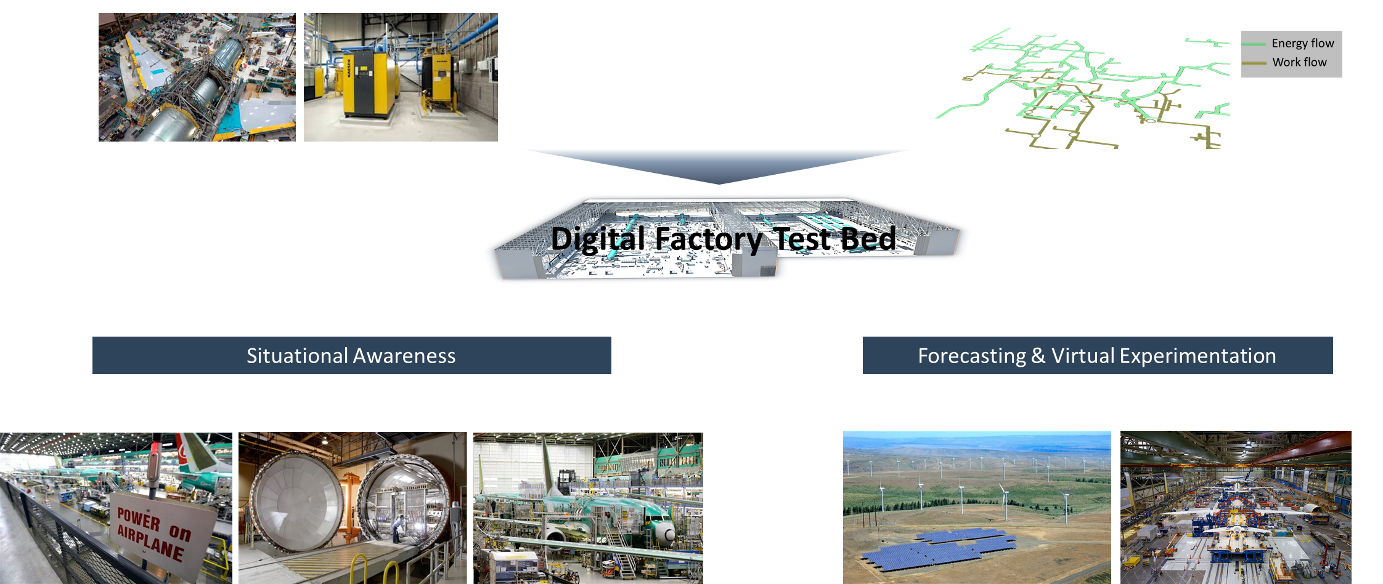
Production Planning & Control towards Smart Factory
Research objective: Support schedule recovery by identifying reactive scheduling strategies that mitigate the impact of delays and disruptions
Requires to
Generate a more realistic predictive schedule (include disruptions)
Identify the system-wide impact of selecting a specific plan, encountering a disruption, and/or implementing a mitigation strategy
Drilling System
Simulation at System (cell) and System of Systems (building) Levels
Cycle time prediction
Analyze data to further identify relevant parameters driving cycle time
Identify appropriate sample size and samples
Apply a variety of nonlinear/adaptive models to fit cycle time
Conduct a comprehensive trade study to finalize prediction model and procedure
Improve reliability and accuracy in 'cycle time' prediction
Disruptions prediction
Identify where issues in the automated drilling sequence lead to increases in cycle time
Develop disruption prediction model
Develop a physics-based model that integrates the data-driven model generated for the drilling operations
Calibrate, verify, and validate model(s) using historical data
Forecasting & Impact Assessment
Provide the user with a set of recovery scheduling strategies that minimize the impact on metrics of interest (Flow time, etc.) and risk (schedule variation)

Slide 32
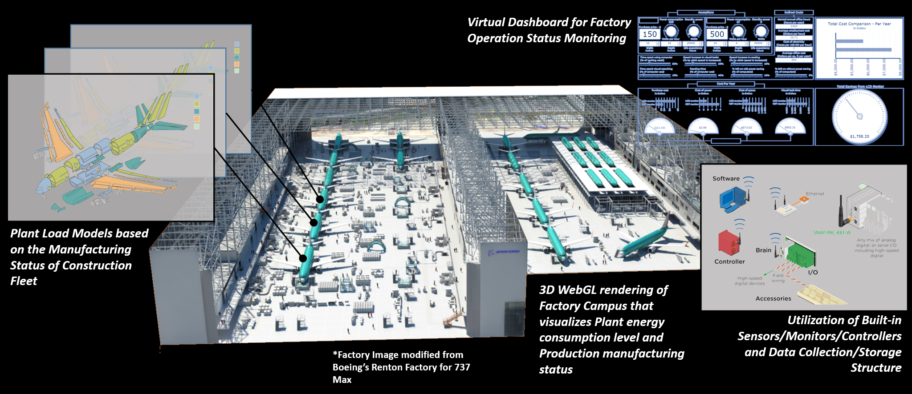
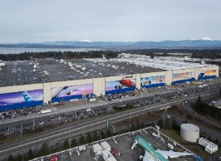
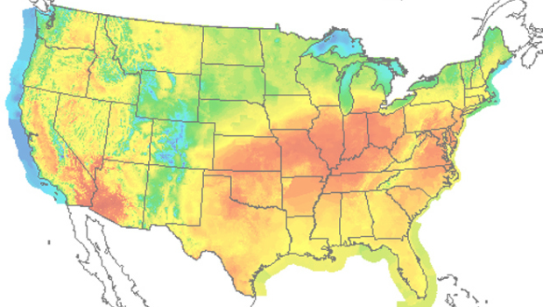
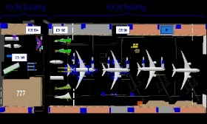

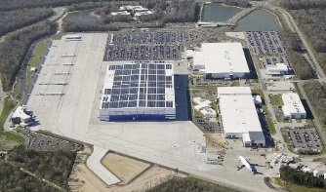
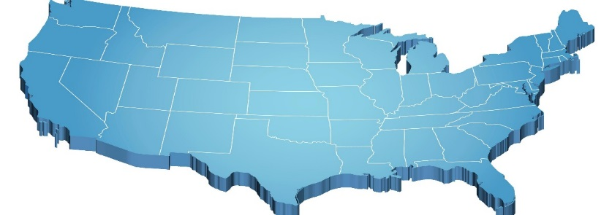
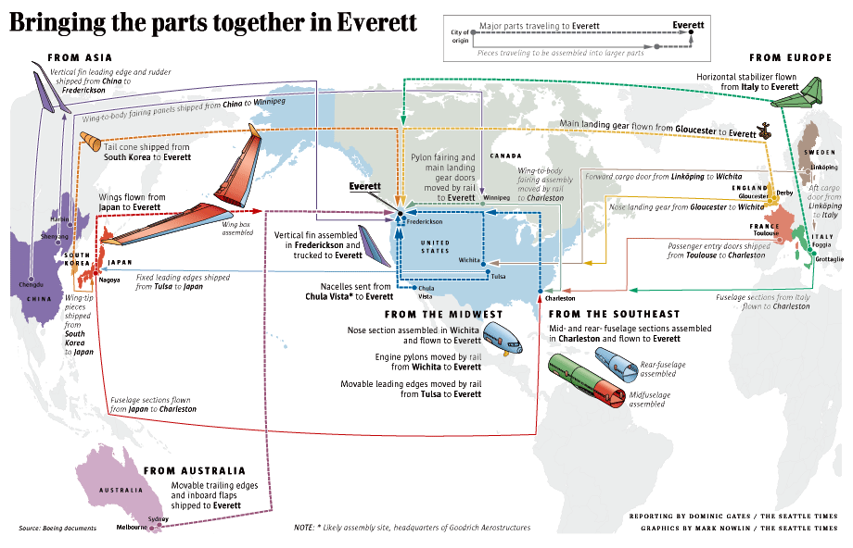
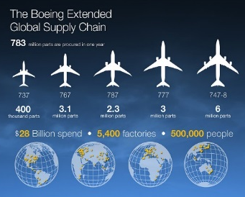
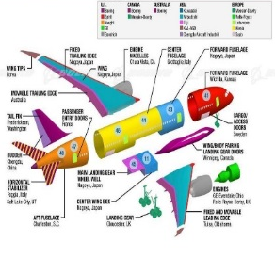
Production Planning & Control towards Digital Factory of the Future
Potential Applications of Data Analytics Towards Implementation of the Digital Factory
Sequential Flow Analysis
Anomaly Detection
Decision Support
Process Layer
Process Feature Analysis
Process Monitoring
Manufacturing Scheduling
Energy Layer
Demand Modeling
Energy Usage Monitoring
Consumption Minimization
Logistics / Supply Chain Layer
Agent-Based Supply Chain Modeling
Delay Analysis
Material Control System
*All task elements are interrelated.

Slide 33
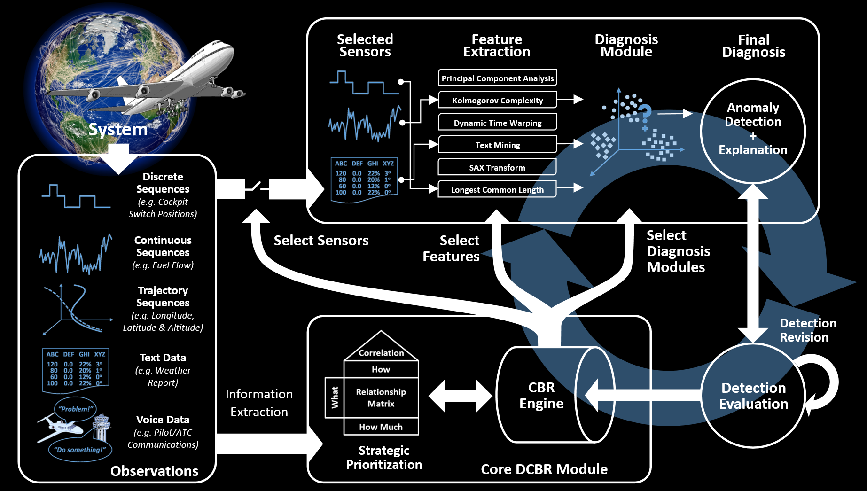
Vision of Data-Driven Airspace Operation
Dynamic Case-Based Reasoning system for integrated diagnosis of the National Airspace System

Slide 34

Closing Remarks: The Vision for the Future -Virtual Experimentation
A game-changing, cyber-physical initiative that will enable the capability to seamlessly integrate and deploy
technologies into the analysis, design, testing, validation, discovery, and manufacturing processes

Slide 35
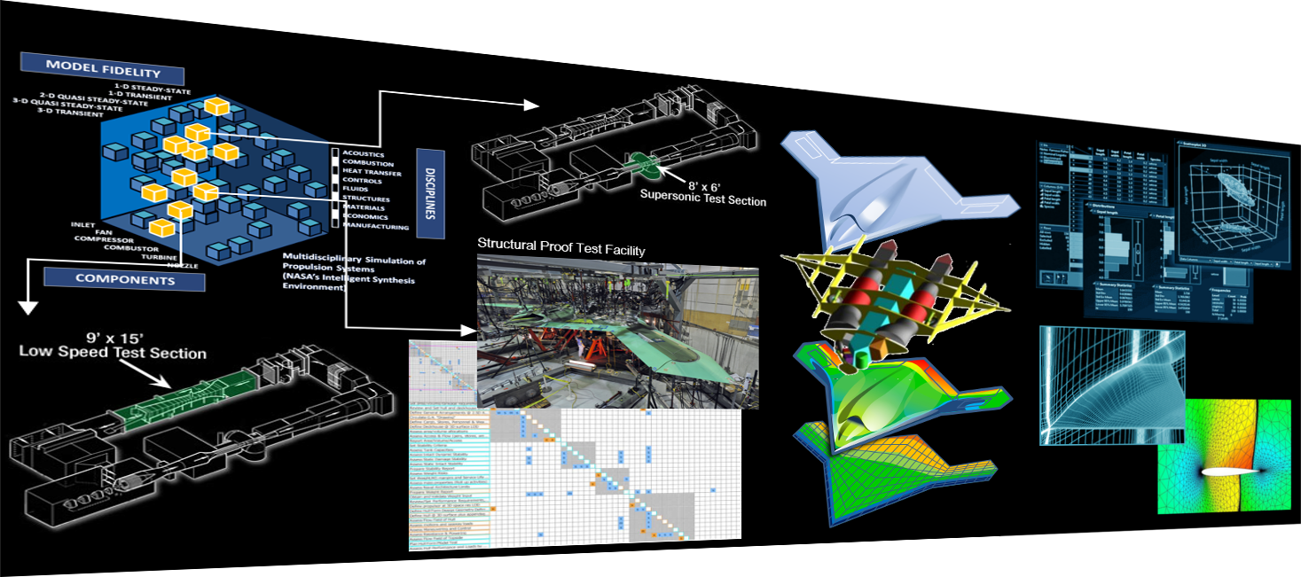
Depiction of an Integrated Virtual Experimentation Environment
‘Selection’ of suitable Codes & Tools
Interactive Control for Every Detail of ‘Virtual Instruments’
Adaptive Simulation Runs over Multiple Disciplines
Data Analytics to Monitor ‘Virtual Experiments’
Advanced Integration based on ‘Virtual Machines’
Visual Analytics as ‘Experiment Reports’
Parametric Task Designer
Instant Construction of ‘Virtual Facilities’

Slide 36
Back up Slides

Slide 37

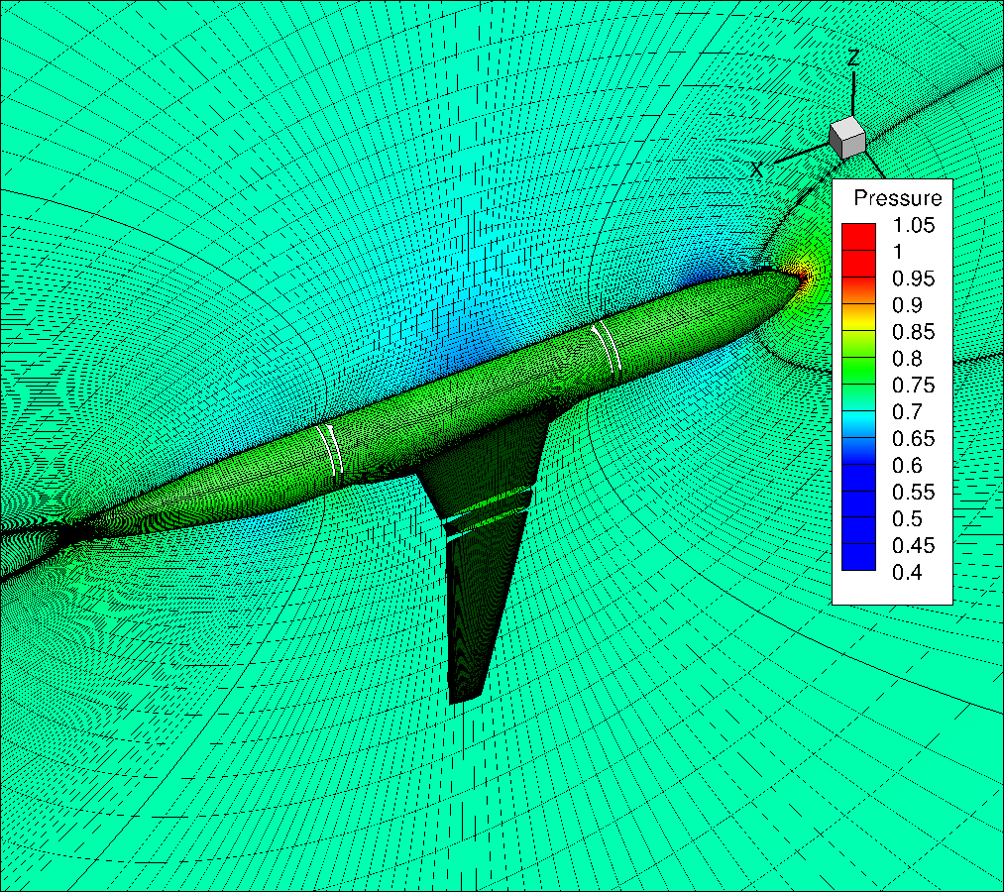
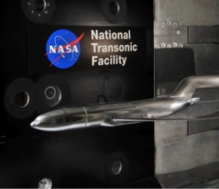

Probabilistic Aero-Structural Analysis
Aircraft designers must set design (target) loads for structural optimization
Challenges
Large number of flight conditions ~ 10⁶
High degrees of Uncertainties (from design immaturity, sparseness in data, biases in analysis codes, etc.)
Goal
Perform Uncertainty Quantification (UQ) by focusing to important flight conditions while properly considering dependencies among sources of uncertainties
Enablers
Bayesian Adaptive Sampling for efficient sampling
Bayesian Belief Network for dependency/covariance quantification
ε₂ = Uncertainties in analysis results (CFD*) are properly updated by BBN as evidence (Wind Tunnel Test) is successively provided.
Design
ε₁ = Uncertainties in payload and fuel weight, etc.
?
Loads
Overestimation ➔ excess weight
Underestimation ➔ costly re-design
ε₁
Weight
ε₂
Aero
ε₃
Structure
Probability
ε₃ = Uncertainties in material properties such as stiffness
Stresses

Slide 38





Probabilistic Aero-Structural Analysis
Bayesian Network
A probabilistic graphical model (a type of statistical model) that represents a set of random variables and their conditional dependencies via a directed acyclic graph (DAG)
Integrate data from different sources
Accounts for dependencies
Probabilistic surrogate modeling
Uncertainty quantification & propagation
Uncertainty management & reduction
Bayesian Network using UNINET
Support non-parametric continuous, discrete distribution variables and functional nodes
Network Building
User defined model
Automatic network generation from data
Pruning process
Dependency modeled through rank correlation and realized using Gaussian Copula
Sampling
Analytic real time sampling for probabilistic nodes
Use vine copula and Gaussian copula dependence
Sample based conditioning: For Network with functional nodes
Additional features
Sculpting
Visualization: UNIGRAPH
Sensitivity analysis: UNISENS
Continuous/Discrete variable nodes & Functional nodes in UNINET
Networks before & after pruning
Posterior distribution after conditioning on ‘V7’

Slide 39




Probabilistic Aero-Structural Analysis
Bayesian adaptive sampling for deterministic scenario
Bayesian adaptive sampling for non-deterministic scenario
Adaptive sampling for 99% percentile load
Optimized weight at different reliability level
Goal achieved

Slide 40




Metamodeling for Aerodynamic Shape Optimization
Finding a needle in haystack
Creation of Metamodels of Euler-level aerodynamics for a parametric vehicle outer model line (OML) for rapid design space exploration
Massively parallel 580,000 runs by computational nodes in the multiple DoD HPC Centers
Fully parametric OML design variables
Total 48 Flight Conditions with various Mach numbers (0.3~4.0), Angles of Attack (0/15/40), and Sideslip Angles (0/5/15)
An inviscid CFD package, Cart3D
1.5M~2.5M Computational Grid Cells for each case
RSM, polynomial NN, ANN, RBFN techniques tested
Neural Networks used as final metamodels for three Force and three Moment Coefficients
Three Force Prediction used as input when training for moment coefficients
Design Variables for Fully-Parametric Outer Mold Line
Example of CFD Result
Example of NN Fit Result
Summary of Metamodeling Results

Slide 41




Metamodeling for Multi-Fidelity Analysis
Bringing-Down Computational Cost Even More by Adaptive Sampling
Multiplicity in Data Sources
Readily obtainable, but lower-accuracy sources (e.g., reduced-order analysis)
Higher-accuracy, but computationally expensive sources (e.g., wind tunnel experiment results, high-fidelity analysis)
Universal Kriging has advantages
For multi-fidelity modeling, lower-accuracy (cheap) data source can be used to identify general trends, while the higher-accuracy (expensive) source to correct the metamodel
For adaptive sampling, it is straightforward to estimate potential reduction in the prediction variance for candidate sample points
Ghoreyshi Co-Kriging for Multi-Fidelity Metamodeling
Additional to training data for single Kriging, y_{cheap} data serve as an extra input parameter
The objective is to accurately predict y_{expensive} for unseen cases
Adaptive Sampling
Efficient estimation of prediction variances based on Schur’s complement formula for candidate samples
Demonstration on Pitching Behavior Prediction for Reusable Winged First-Stage Boosters
Design Requirement: Maintaining sufficient control authority for a wide range of flight condition
Conceptual design fully accounting for control characteristics is extremely challenging due to the need for high-fidelity analyses that, in general, are computationally prohibitive for vast parameter space in early design phase
Multi-Fidelity Metamodeling with Adaptive Sampling brought down computational cost significantly serving the goal

