Slide 1

Role of Materials and Manufacturing in the NNI
Michael A. Meador
Director
U.S. National Nanotechnology Coordination Office
mmeador@nnco.nano.gov
www.Nano.gov

Slide 2
Overview
NNI Overview
Clinton Challenges
Nanotechnology Signature Initiatives
Intersection Between the NNI and Manufacturing Institutes
Nanotechnology Inspired Grand Challenges
Summary

Slide 3
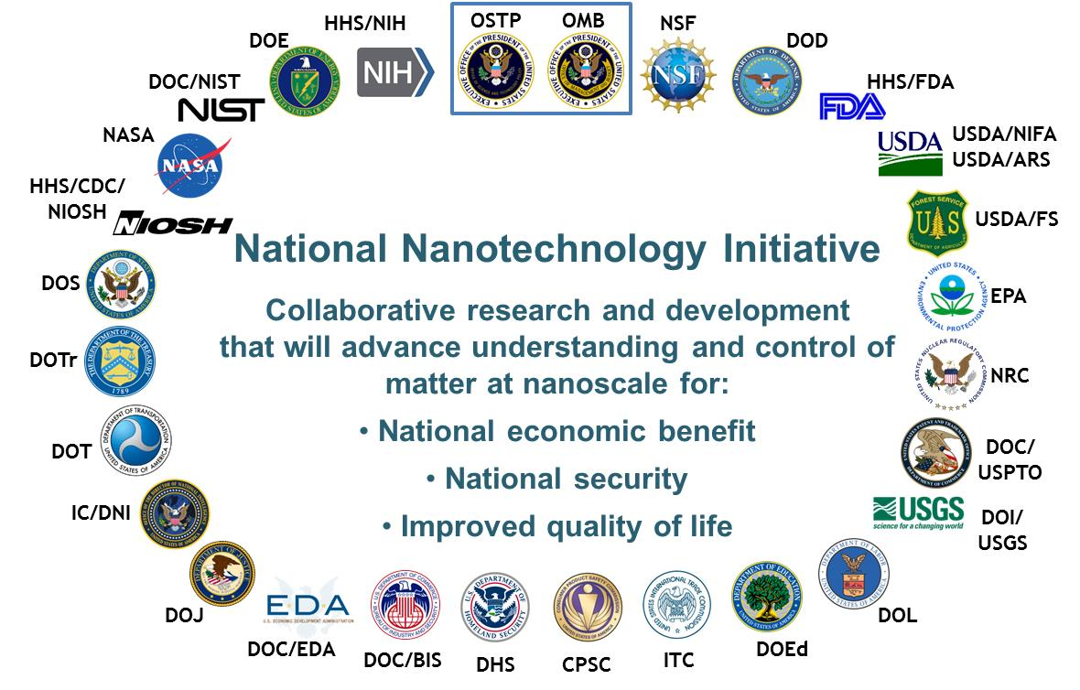
The National Nanotechnology Initiative (NNI)
Established in 2000 by President Bill Clinton
Intent of the NNI is to provide a framework for member agencies to work together to:
Advance world-class nanotechnology research
Foster the transfer of technologies into products for commercial and public benefit
Develop and sustain educational resources, a skilled workforce and the supporting infrastructure and tools to advance nanotechnology
Support the responsible development of nanotechnology
The NNI is a coordinated initiative not a distinct funding program
Signature Initiatives
Nanoelectronics for 2020 and Beyond
Water Sustainability Through Nanotechnology
Sustainable
Nanomanufacturing
Nanotechnology for Sensing
Nanotechnology Knowledge Infrastructure
Notes:
(No need to reiterate if already captured in risk)

Slide 4
The US Government Has Invested Over $22B in Nanotechnology R&D Since 2001
USDA/ARS
DOJ
DOT
DOC/NIST
CPSC
DOD
USDA/FS
DHS
$ Millions
NSF
USDA/NIFA
DHHS/FDA
DHHS/NIOSH
DHHS/NIH
EPA
NASA
DOE
† 2009 figures do not include American Recovery and Reinvestment Act funds for DOE ($293 million), NSF ($101 million), NIST ($43 million), and NIH ($73 million).
†† 2015 estimated based on 2015 enacted levels and may shift as operating plans are finalized.
††† 2016 Budget.

Slide 5
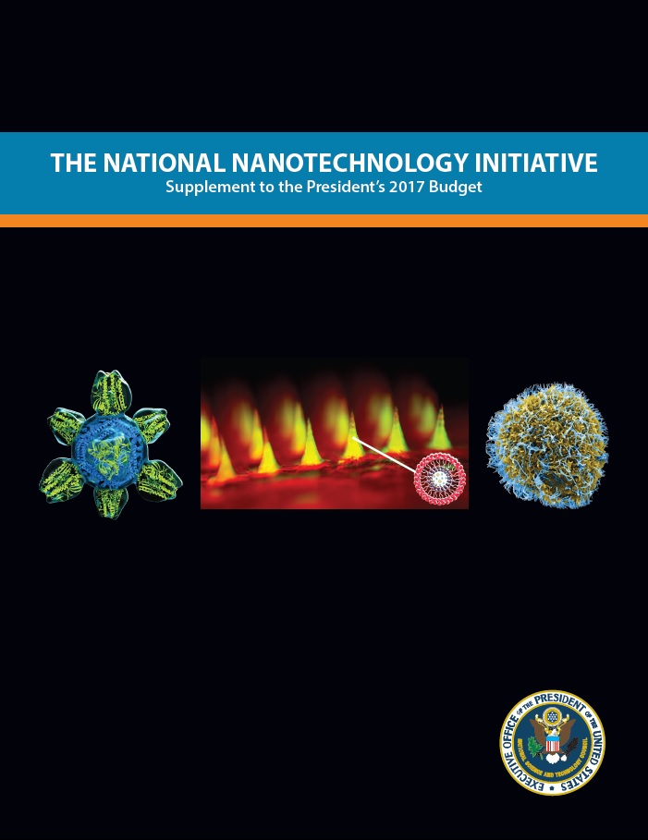
NNI Reporting
The NNI Supplement to the President’s Budget:
Funding information by agency/department and PCA for prior, current FY and requested amount for budget year
Accomplishments from prior FY
Plans for current FY and budget year
Available on www.nano.gov

Slide 6
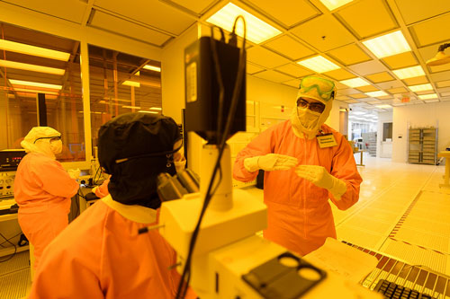
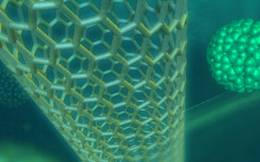

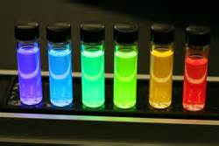
Some Nano-Factoids Lux Research, February 2016
Worldwide governments, corporations and VCs invested $18.1 billion in 2014 (8% increase over 2010)
The U.S. contributed 33% of this amount – leads in government and corporate spending
Corporate spending in the US in 2014 was $4.0 billion, government spending was $1.67 billion
Global value of nano-enabled products is predicted to reach $3.7 trillion by 2018.
The revenue from nano-enabled products globally grew from $339 billion in 2010 to $1.6 trillion in 2014.
US revenues grew form $109M to $370M
The revenue from nanomaterials increased 35% over 2012 to $2.12 billion in 2014

Slide 7
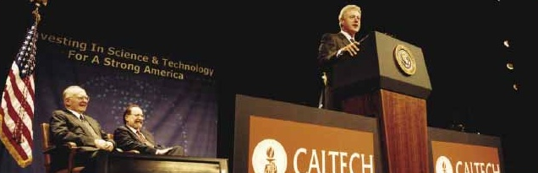
The National Nanotechnology Initiative (NNI)
“ Just imagine, materials with 10 times the strength of steel and only a fraction of the weight; shrinking all the information at the Library of Congress into a device the size of a sugar cube; detecting cancerous tumors that are only a few cells in size. Some of these research goals will take 20 or more years to achieve. But that is why—precisely why there is such a critical role for the Federal Government.”
President Clinton, California Institute of Technology, January 21, 2000

Slide 8
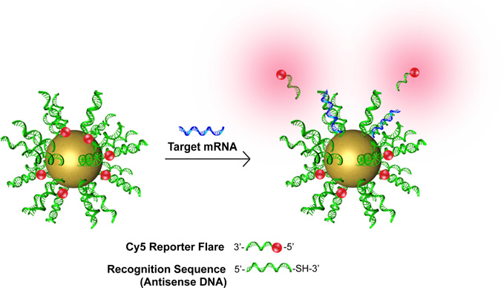
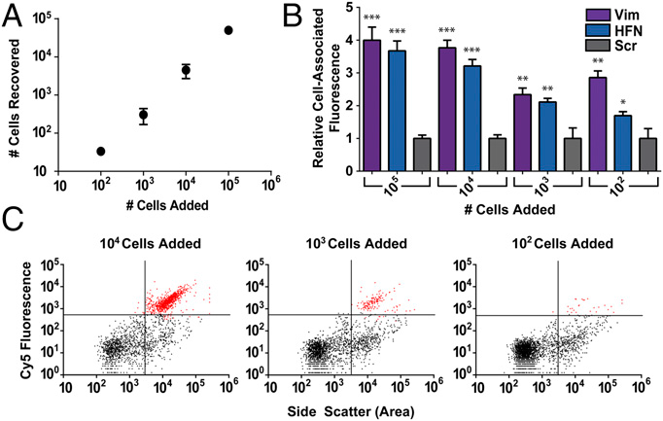
NanoFlares Can Detect as Few as 100 Cancer Cells per mL of Blood
Gold NPs decorated with a monlayer of antisense DNA and fluorophore containing reporter flare
Binding of target mRNA releases fluorophore
T.L. Halo et al PNAS 2014, 111, 17104-17106

Slide 9
The National Nanotechnology Initiative (NNI)
“ Just imagine, materials with 10 times the strength of steel and only a fraction of the weight; shrinking all the information at the Library of Congress into a device the size of a sugar cube; detecting cancerous tumors that are only a few cells in size. Some of these research goals will take 20 or more years to achieve. But that is why—precisely why there is such a critical role for the Federal Government.”
President Clinton, California Institute of Technology, January 21, 2000

Slide 10
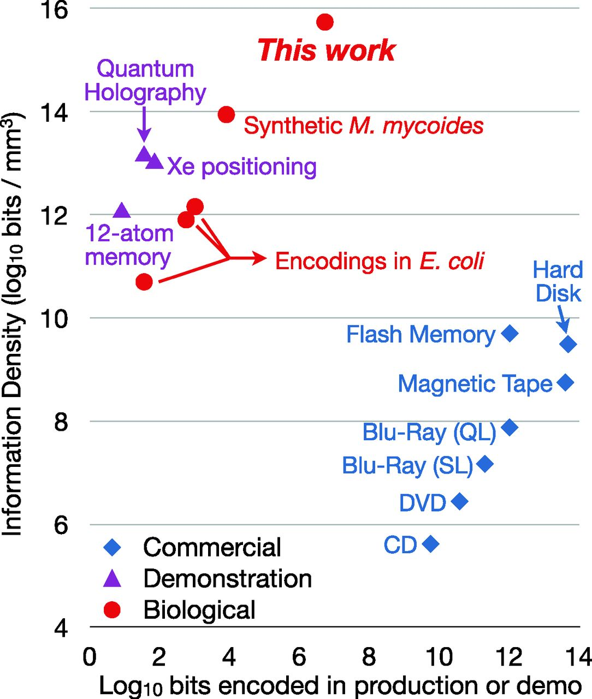
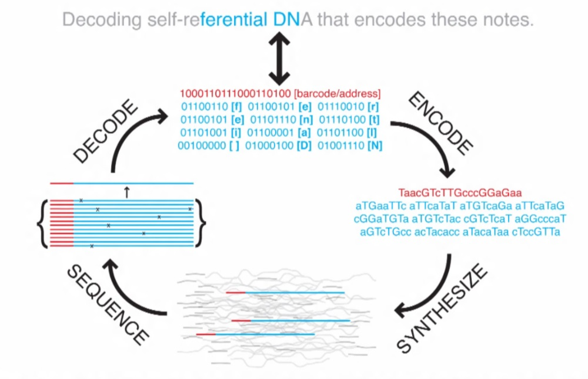
DNA Encoding Provides a Route to High Density Data Storage
G.M. Church, Y. Gao, S. Kosuri Science 2012, 337, 1628

Slide 11
The National Nanotechnology Initiative (NNI)
“ Just imagine, materials with 10 times the strength of steel and only a fraction of the weight; shrinking all the information at the Library of Congress into a device the size of a sugar cube; detecting cancerous tumors that are only a few cells in size. Some of these research goals will take 20 or more years to achieve. But that is why—precisely why there is such a critical role for the Federal Government.”
President Clinton, California Institute of Technology, January 21, 2000

Slide 12
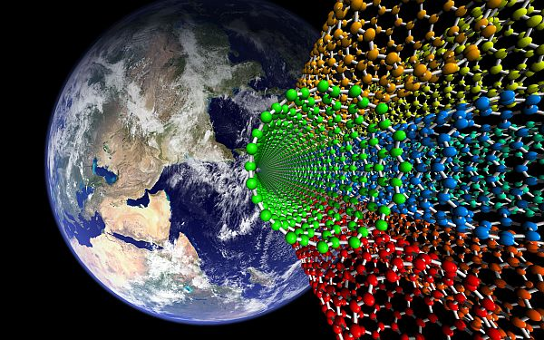
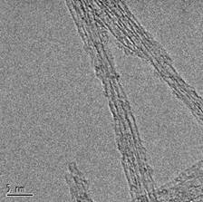
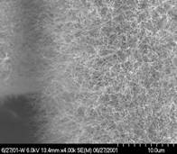
Carbon Nanotube Based Materials
Carbon Nanotube Space Elevator
Purified Single Wall Carbon Nanotubes
Nanotubes have remarkable properties-
Specific strength 150X that of conventional carbon fibers, 100X aluminum
Elongation 10X that of conventional carbon fibers
Electrical and thermal conductivities ~10X that of high conductivity carbon fibers
Because of these properties, carbon nanotubes have been proposed for disruptive applications such as a space elevator cable
Nanotube Modified Substrates

Slide 13
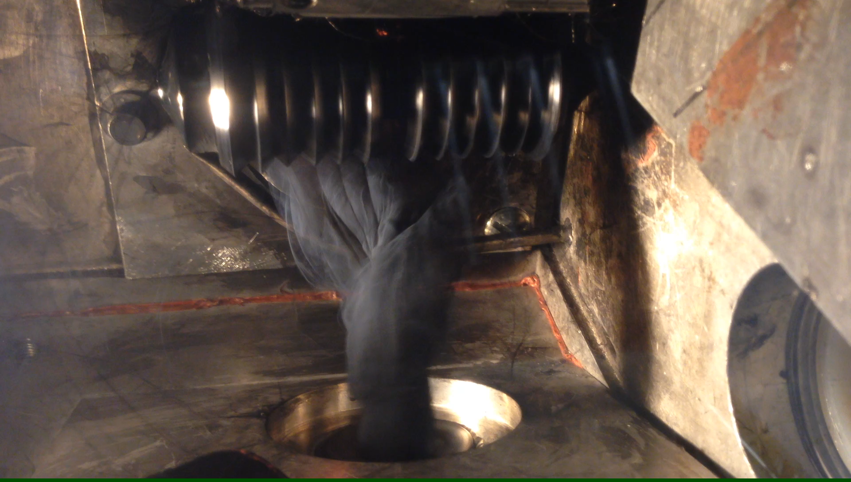
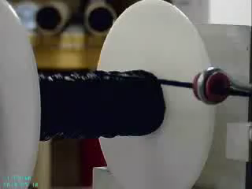
Carbon Nanotube Yarns in Production

Slide 14
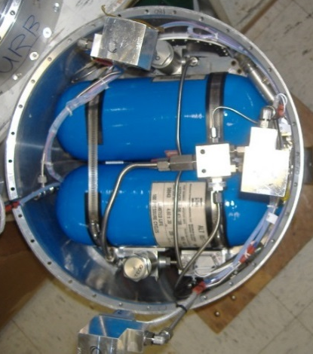
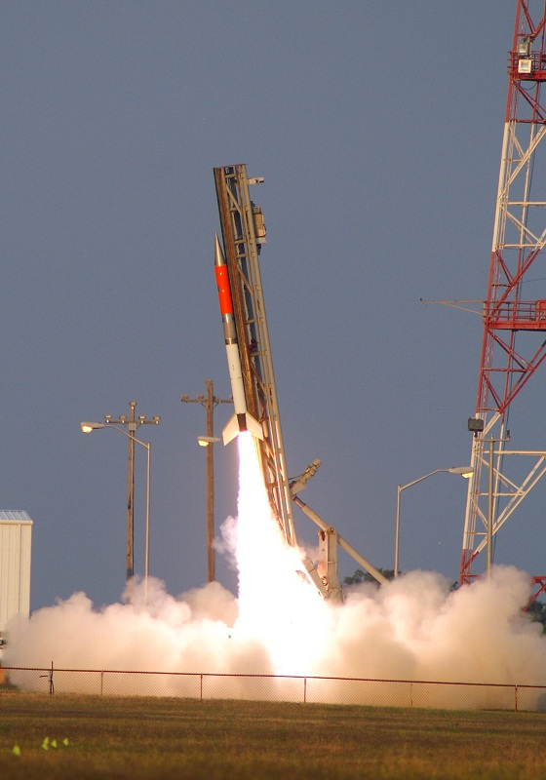
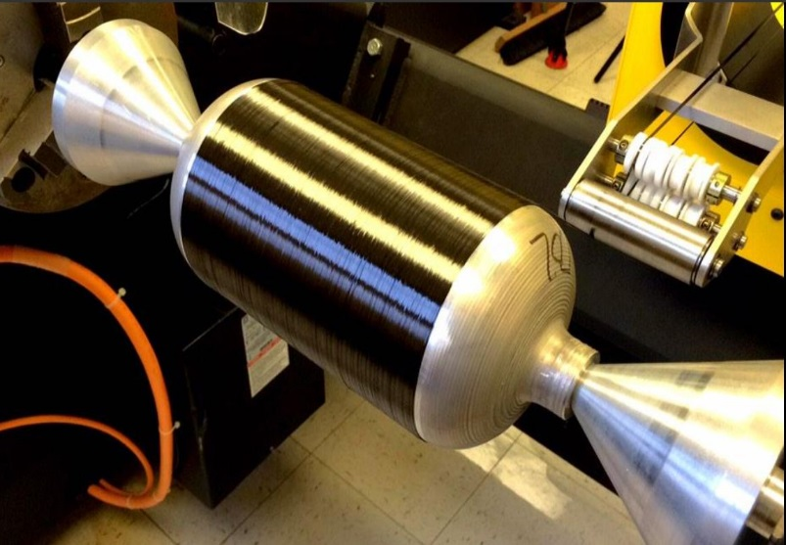
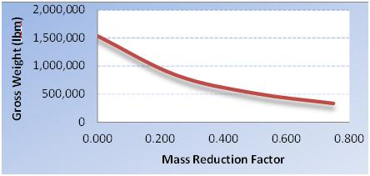


CNT Reinforced Composites to be Demonstrated in a Structural Component
30% Reduction in Vehicle Weight!
Flight Test 2016

Slide 15
The National Nanotechnology Initiative (NNI)
Established in 2000 by President Bill Clinton
Intent of the NNI is to provide a framework for member agencies to work together to:
Advance world-class nanotechnology research
Foster the transfer of technologies into products for commercial and public benefit
Develop and sustain educational resources, a skilled workforce and the supporting infrastructure and tools to advance nanotechnology
Support the responsible development of nanotechnology
The NNI is a coordinated initiative not a distinct funding program
Signature Initiatives
Nanoelectronics for 2020 and Beyond
Water Sustainability Through Nanotechnology
Sustainable
Nanomanufacturing
Nanotechnology for Sensing
Nanotechnology Knowledge Infrastructure
Notes:
(No need to reiterate if already captured in risk)

Slide 16
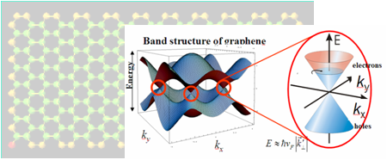






Nanoelectronics for 2020 and Beyond
Agencies involved: DOD, DOE, IC/DNI, NASA, NIST, NSF
Goal: Accelerate the discovery and use of novel nanoscale fabrication processes and innovative concepts to produce revolutionary materials, devices, systems, and architectures to advance the field of nanoelectronics.
Thrust areas:
Exploring new or alternative “state variables” for computing
Merging nanophotonics with nanoelectronics
Exploring carbon-based nanoelectronics
Exploiting nanoscale processes and phenomena for quantum information science
Expanding the national nanoelectronics research and manufacturing infrastructure network (university-based infrastructure)

Slide 17






Nanotechnology Knowledge Infrastructure: Enabling National Leadership in Sustainable Design
Agencies involved: CPSC, DOD, EPA, FDA, NASA, NIH, NIOSH, NIST, NSF, OSHA
Goal: Provide a community-based, solutions-oriented knowledge infrastructure to accelerate nanotechnology discovery and innovation.
Thrust Areas:
A diverse collaborative community of scientists, engineers, and technical staff to support research, development, and applications of nanotechnology to meet national challenges
An agile modeling network for multidisciplinary intellectual collaboration that effectively couples experimental basic research, modeling, and applications development
A sustainable cyber-toolbox to enable effective application of models and knowledge to nanomaterials design
A robust digital nanotechnology data and information infrastructure to support effective data sharing, collaboration, and innovation across disciplines and applications

Slide 18
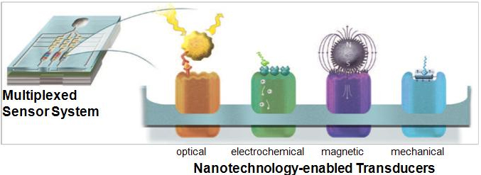

Nanotechnology for Sensors and Sensors for Nanotechnology: Improving and Protecting Health, Safety, and the Environment
Agencies involved: CPSC, DOD/DTRA, EPA, FDA, NASA, NIH, NIOSH, NIST, NSF, USDA/NIFA
Goals: Support research on nanomaterial properties and development of supporting technologies that enable next-generation sensing of biological, chemical, and nanoscale materials.
Thrust Areas:
Using nanotechnology and nanoscale materials to build more sensitive, specific, and adaptable sensors in order to overcome the technical barriers associated with conventional sensors
Developing new sensors to detect engineered nanomaterials across their life cycles, in order to assess the potential impact on health, safety, and the environment

Slide 19
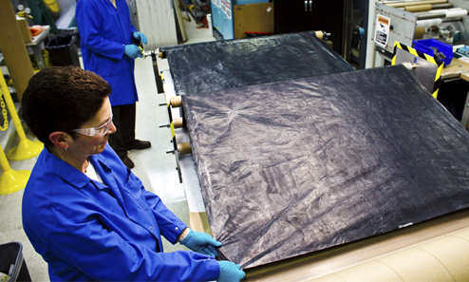

Sustainable Nanomanufacturing: Creating the Industries of the Future
Agencies involved: DOD, DOE, EPA, IC/DNI, NASA, NIH, NIOSH, NIST, NSF, OSHA, USDA/FS
Goal: Establish manufacturing technologies for economical and sustainable integration of nanoscale building blocks into complex, large scale systems.
Thrust Areas:
Design of scalable and sustainable nanomaterials, components, devices, and processes
Nanomanufacturing measurement technologies
Photo Courtesy of Nanocomp Technologies

Slide 20
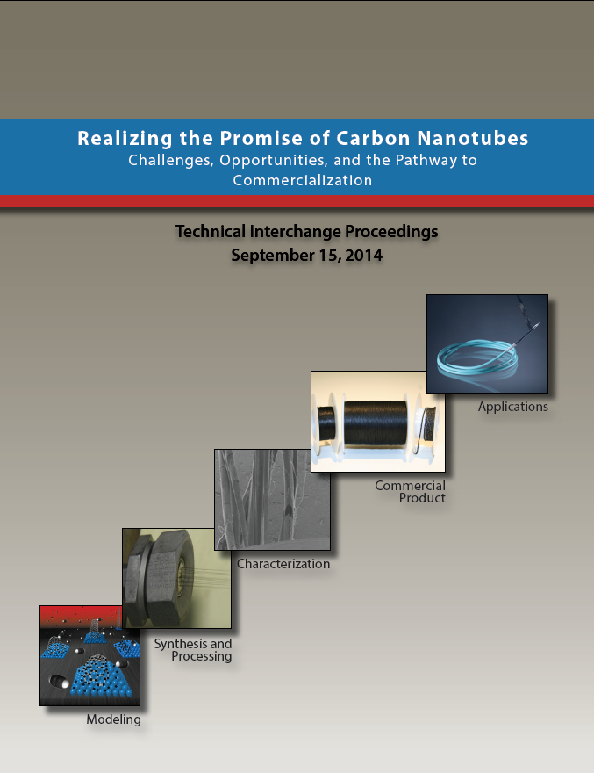
Realizing the Promise of Carbon Nanotubes: Challenges, Opportunities, and the Pathway to Commercialization
September 15, 2014
National Aeronautics and Space Administration (NASA) Headquarters, Washington, DC

Slide 21

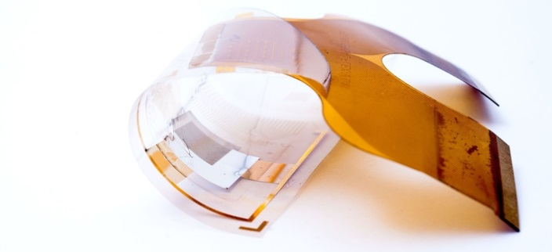
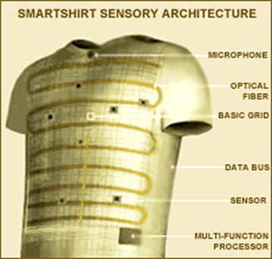
Nanotechnology and Innovative Manufacturing Institutes
Flexible Hybrid Electronics
Integrated Photonics Institute for Manufacturing Innovation
Revolutionary Fibers and Textiles

Slide 22
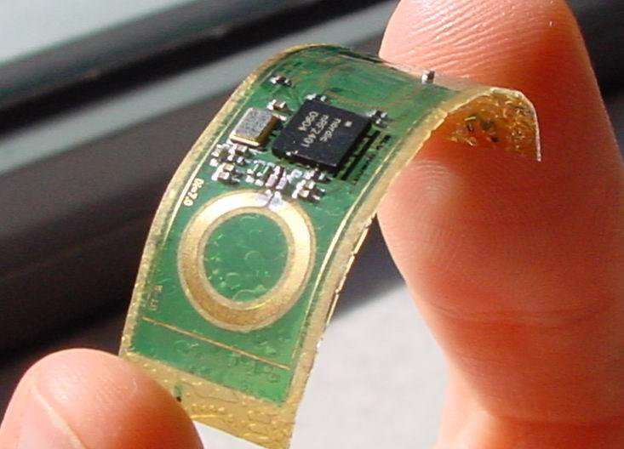
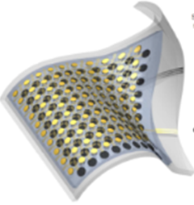


Flexible Hybrid Electronics
Manufacturing Innovation Institute
Lead: FlexTech Alliance
Hub location: San Jose, CA
Federal Funding: $75 M
Flexible Hybrid Electronics: Highly tailorable devices on flexible, stretchable substrates that combine thinned CMOS components with components that are added via “printing” processes. This technology is identified as flexible-hybrid due to integration of flexible components such as circuits, communications, sensors, and power with more sophisticated Silicon based processors.
Comm
Power
Logic
Sense A, B…
Commercial | DOD Applications
Wearable Technologies | Warfighter information devices and sensors
Internet of Things | Unattended sensors, vehicle borne sensors
Medical prosthetics, medical sensing | Warfighter Training and performance monitoring. Soldier medical care
Government POC: Dr. Eric Forsythe,
eric.w.forsythe.civ@mail.mil
Website: http://manufacturing.gov/fhe-mii.html
Announced August 28, 2015

Slide 23
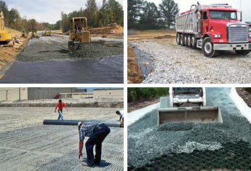
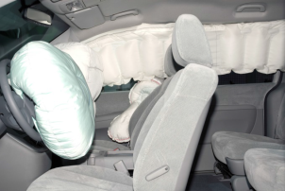
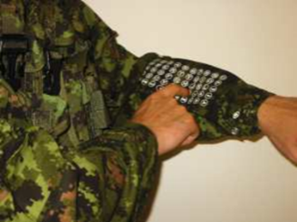

Revolutionary Fibers and Textiles
Manufacturing Innovation Institute
$75M federal investment over five years
Revolutionary Fibers and Textiles
Advances in fiber science have created fibers with extraordinary properties of strength, flame resistance, and electrical conductivity. These ‘revolutionary’ fibers are composed of specialty fabrics, industrial fabrics, e-textiles, and advanced textiles. They are built upon a foundation of synthetic and/or multi-material fibers that have a wide-range of applications in both the defense and commercial sector that go beyond traditional wearable fabrics
Transportation – Covers and Airbags
Geosynthetics – Construction
Objective:
Serve as a public-private partnership between government, academia and industry to address manufacturing challenges from design to end products
Support an end-to-end innovation ‘ecosystem’ in the U.S. for revolutionary fibers and textiles manufacturing and leverage domestic manufacturing facilities to develop and scale-up manufacturing processes
Provide rapid product realization opportunities, based on robust design and simulation tools, pilot production facilities, a collaborative infrastructure with suppliers, and workforce development opportunities through targeted training and curriculum programs
Military and Commercial Shelters
Military and Commercial Smart Clothing
Government POC: Steve Luckowski,
stephen.l.luckowski.civ@mail.mil
Website: http://manufacturing.gov/rft-mii.html
Announcement Expected – Dec 2015

Slide 24
NNI 2.0
Pivotal year for the NNI
NNI celebrated it’s 15th anniversary last year – what should the NNI look like in the future?
NNI Strategic Plan Update
Election Year
Some issues:
Nanotechnology as a focus area vs. as an enabling technology
Transition of nanotechnology discoveries from lab to market
Role of nanoEHS
Elements Necessary for Continued Vitality and Growth of the NNI
Bold and compelling vision for the future
Grand Challenges
NNI Strategic Plan
Impactful accounting of the accomplishments – telling the NNI story
Education and Outreach
Broad community support for continuation
Nanotechnology business community
Technical and professional societies

Slide 25
Grand Challenges
Recommended by PCAST in their 2014 review of the NNI
Definition derived from Administration's Innovation Policy
Attributes of Grand Challenges are:
Require advances in fundamental scientific knowledge, tools, and infrastructure for successful completion.
Drive the need for collaboration between multiple disciplines, some of which do not normally interact, to come together, collaborate and share resources and information to solve the challenge .
Span efforts from discovery and fundamental science to engineering demonstration and commercialization, i.e., catalyze the transition of technologies from lab to market.
Be too big to be undertaken by one or even a few organizations.
Be exciting enough to motivate decision makers to provide funding and resources and multiple organizations to collaborate, share resources, and information to solve the challenge.
Have a measurable end-point and clear intermediate milestones that are measurable and valuable in their own right
RFI released in June 2015 to solicit public input on potential Nanotechnology Inspired Grand Challenges – over 100 responses
First nanotechnology inspired Grand Challenge (future computing) announced in October 2015

Slide 26
1st Nanotechnology Grand Challenge
Create a new type of computer that can proactively interpret and learn from data, solve unfamiliar problems using what it has learned, and operate with the energy efficiency of the human brain
Announced on 10-20-2015 by the WH Office of Science and Technology Policy
Moving beyond conventional (von Neumann) computing architectures to make computers that can solve problems faster than conventional computers and require much less energy
Other Grand Challenge topics are under consideration

Slide 27
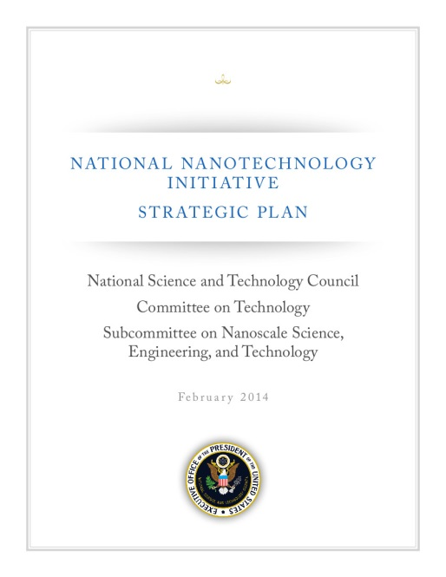
NNI Strategic Plan
Describes vision and goals, strategies to achieve the goals, and investment strategy
Identifies specific objectives toward collectively achieving the vision
Currently undergoing an update (every 3 years)
Input from NNI member agencies and broader nanotechnology community
NNI Strategic Plan Stakeholders’ Workshop held in Washington on May 19 and 20
Very worthwhile discussion that will help shape the new Plan
Workshop summary as an appendix to the Plan

Slide 28
Summary
The NNI has been a highly successful initiative
16 + years of US leadership in nanotechnology R&D
Enabled the development of unique nanofabrication and characterization facilities
Facilitated the commercialization of nanotechnology products – US accounted for 23% of global revenues in nanotechnology-enabled products
Promoted the responsible development of nanotechnology based products
It’s time to start talking about the next era of the NNI – NNI 2.0
We want your input
Where is nanotechnology headed in the next 10-15 years? What are the challenges and opportunites?
What should the NNI do to ensure that the US capitalizes on these opportunities?
What would a Grand Challenge look like in structural materials?
How can government be an early adopter of nanomaterials technologies?

Slide 29
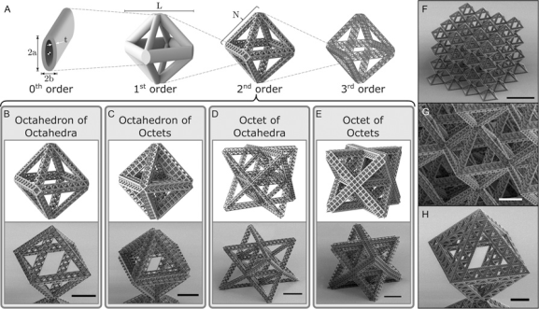
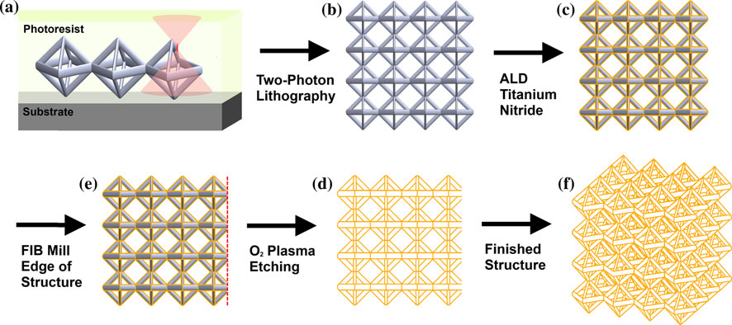
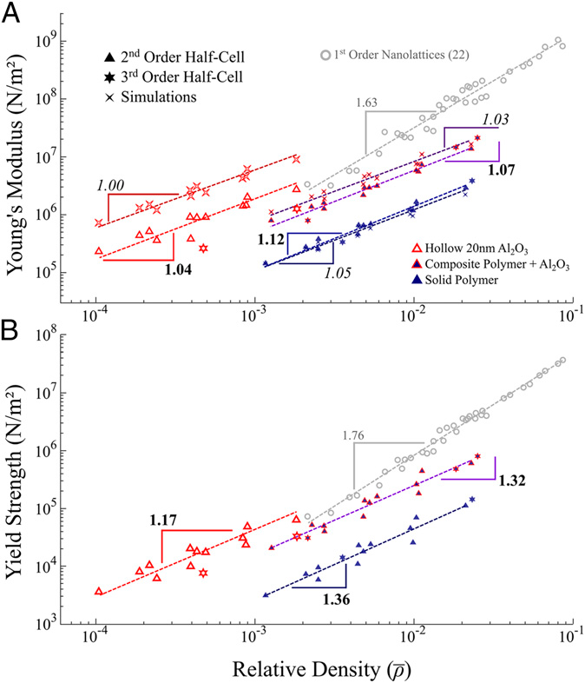
Hierarchical Structures
L.R. Meza and J.R. Greer J. Mater. Sci. 2014, 49, 2496
L.R. Meza, et al PNAS 2015, 112, 11502

Slide 30
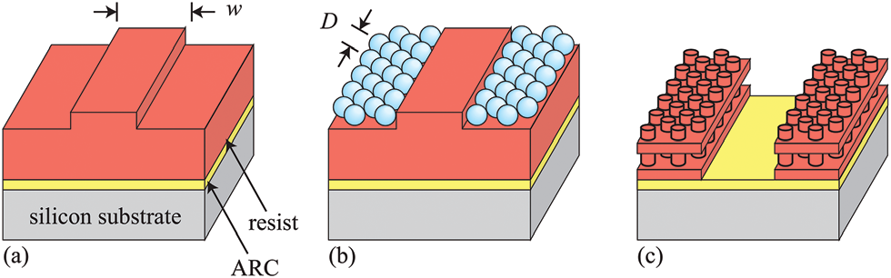
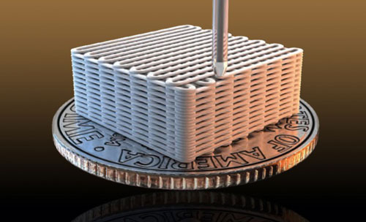
Other Approaches to Hierarchical Structures
Source: Lawrence Livermore National Laboratory
Zhu, et al Nature Comm. 2015, DOI:10.1038
J.E. Elek, et al Nanoscale 2015, 7, 4406-10

