Slide 1
Emerging Materials Technologies for Aerospace Power and Propulsion
Ajay Misra
Glenn Research Center
Presented at Advanced Aerospace Materials: “Beyond The Next” Workshop
June 21-22, 2016

Slide 2
Focus of This Presentation
Aerospace power system
Electric propulsion
Not Covered:
Airbreathing and chemical propulsion (e.g., gas turbine engines, hypersonic propulsion, and rocket engines)
Ceramic matrix composites (CMCs) with higher temperature capability required for future missions

Slide 3
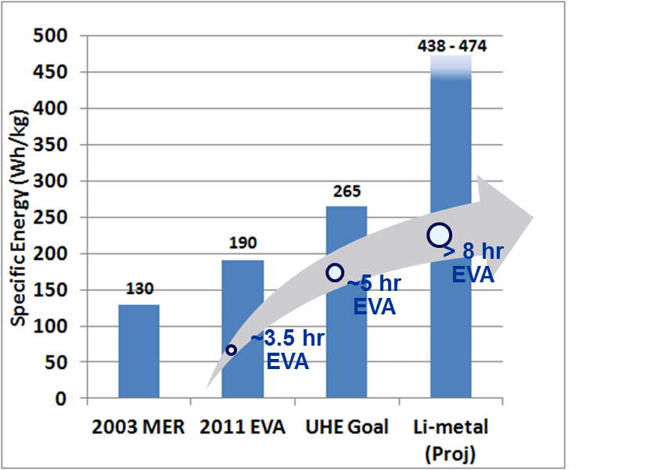
Mass Reduction of Future Space power System
Notional Mass Distribution in Spacecraft
Energy Storage Needs for Future EVA
Mass Reduction Strategy for Space Power System:
High energy density energy storage system
Increasing power density of power processing units (power electronics)
Lightweight electrical cables
Lightweight thermal management
High voltage
Multifunctional structures/components

Slide 4
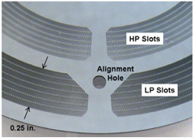
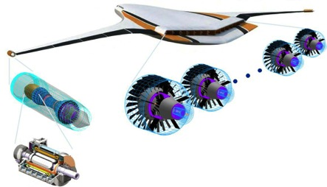
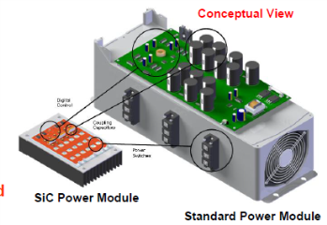
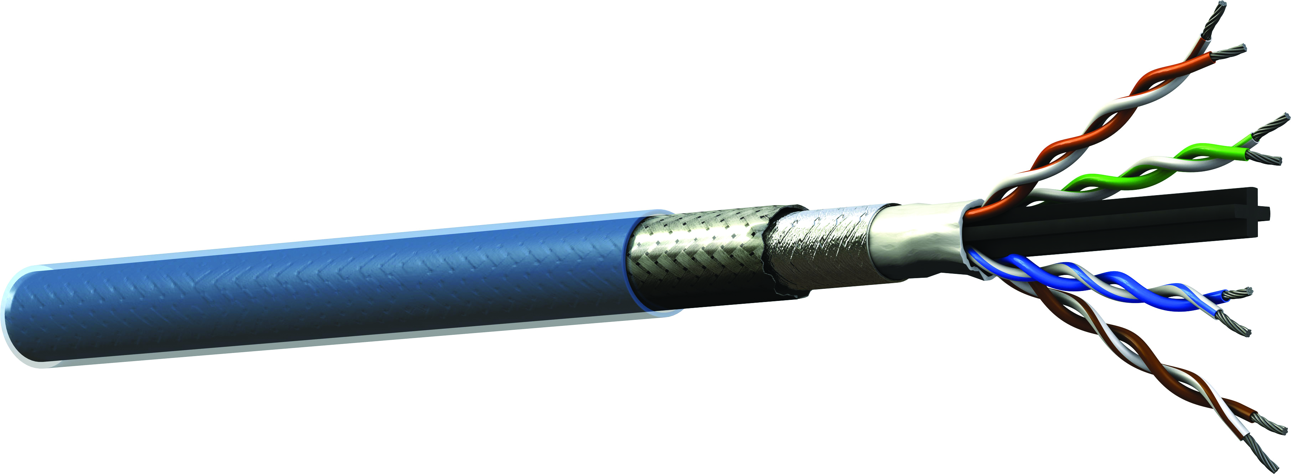
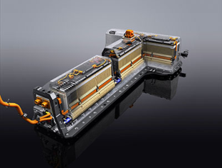
Component Requirements for Hybrid Electric/All Electric Aircraft
Lightweight Thermal Management System
High Power Density Power Electronics
Lightweight Power Transmission Cable
Energy Storage System with High Energy Density
Need:
3-5 X improvement in power density, energy density of various components
3-5 X decrease in mass of thermal management system and power transmission cables
High Power Density Electric Motors

Slide 5
In-Space Propulsion Technology Needs
Solar Electric Propulsion Incorporating Ion/Hall Thrusters
Need:
Long life (order of increase in life) enabled by lower operating temperatures for emitters, new materials resistant to erosion by ionic species
High power density and efficiency enabled by higher temperature capability of electromagnetic coils and magnetic systems
Increase in power density of power processing unit (or the power electronics system)

Slide 6
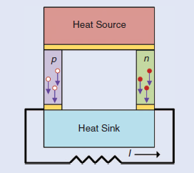
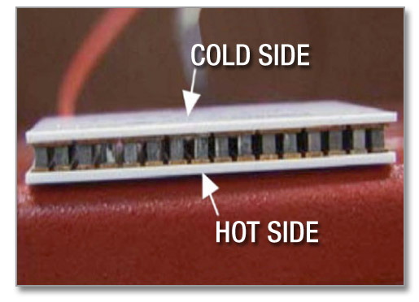
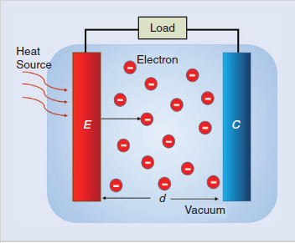
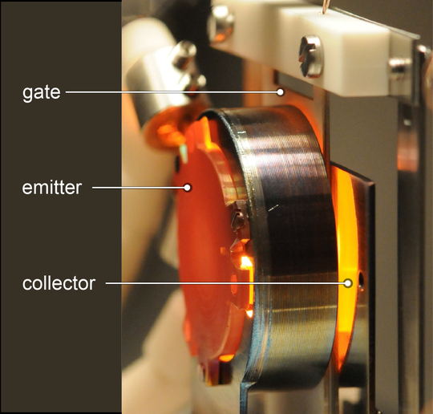
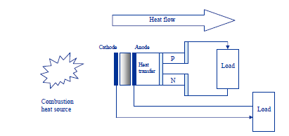
Solid State Energy Conversion/Energy Harvesting
Thermoelectric
Need:
High thermal-to-electric conversion efficiency
Temperatures compatible with heat source
Durability
Thermionic
Thermionic
+
Thermoelectric

Slide 7
Materials for Power and Electric Propulsion Related to Aerospace Applications
High Power Density Electrical Motor
High Power Density Power Electronics
Lightweight Power Transmission Cable
Energy Storage With High Energy Density
Solid State Energy Conversion
In-Space Propulsion
Advanced permanent magnet materials
Advanced soft magnet materials
High temperature magnet materials
Advanced Capacitors
Materials with high electrical conductivity
Advanced energy storage materials
Advanced thermoelectric materials
Advanced thermionic materials
Wide bandgap semiconductor materials
7

Slide 8
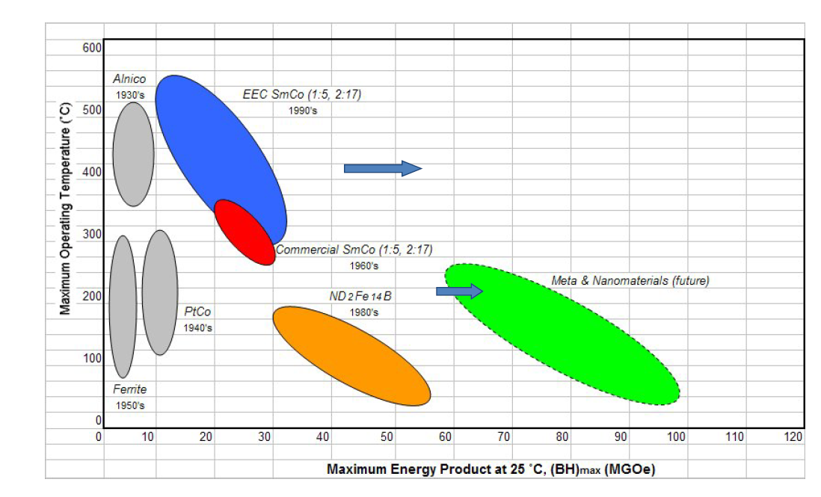
Advanced Permanent Magnet Materials
Breakthrough needed to significantly increase maximum energy product of magnets

Slide 9
Potential of Nanocomposite Permanent Magnets
From Univ. of Delaware presentation
Higher (BH)_{max} achieved for thin films, but significant fabrication challenges for bulk nanocomposite magnets

Slide 10
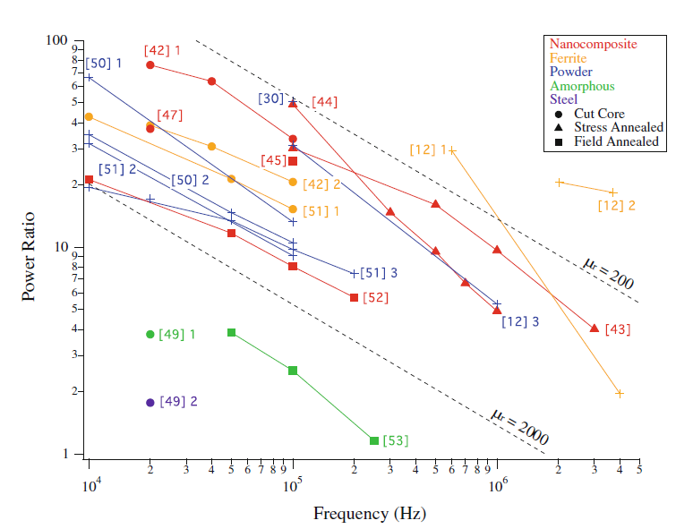
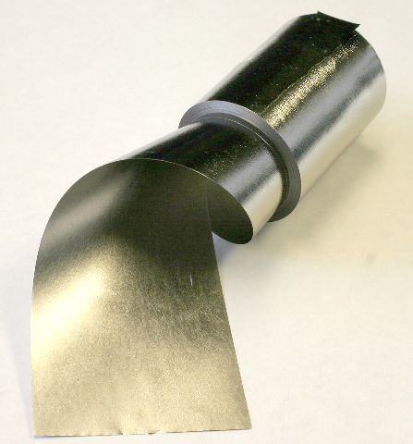
Advanced Soft Magnetic Materials
Power Ratio (stored inductive power/power loss) as a Function of Frequency
Power Factor/Power Loss
Nano-crystalline Alloys
Amorphous Alloys
Si Steels
Frequency (Hz)
Ohodnicki, 2015
Opportunity for new nanocrystalline alloys

Slide 11
High Temperature Magnetic Materials
No major advances over last two decades
New material chemistries and fabrication approaches needed

Slide 12
Advanced Electrically Conductive Materials
Subraminium et. al. (Nature Comm)
Rice University (Science)
Subraminium et. al. (Nature Comm)
High conductivity of metallic CNT not achieved in CNT fibers/yarns, although specific conductivity of fiber/yarn higher than Cu or Al
CNT fibers/yarns offer potential for 1000 X increase in current carrying capacity

Slide 13
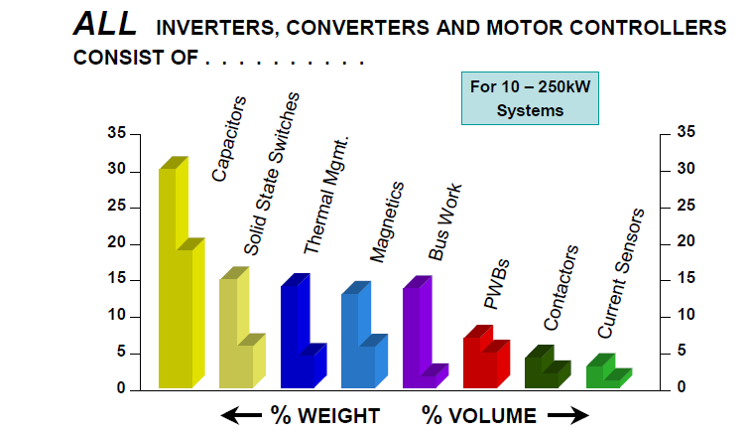
Capacitors for Power Electronics
From AFRL
Capacitors with higher energy density and higher temperature capability are required for increasing power density of power electronics

Slide 14
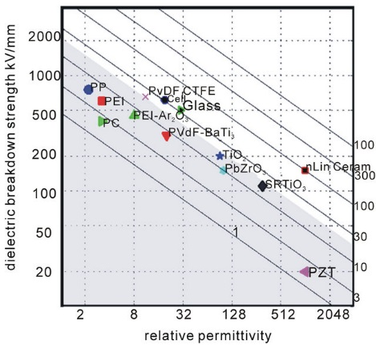
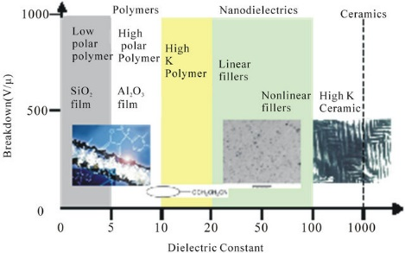
Advanced Capacitors With High Energy Density
Nanodielectric Materials Offer Significant Potential
Irwin (GE)
Irwin (GE)
Challenges for Nanodielectric Capacitors::
Higher dielectric permittivity polymers
Higher dielectric permittivity ceramics
Proper dispersion
Good interfacial adhesion between ceramic filler and polymer
Higher temperature capability ( > 200ºC

Slide 15
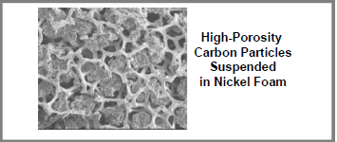
High Energy Density Batteries Require Significant Advances in Materials
Dendrite growth on Li anode
Needed:
New electrolyte chemistries (include solid electrolytes)
New cathode chemistries with high voltage capability
Hierarchically ordered porous structure
Requirements for hybrid electric aircraft
Energy Density, watt-hr/kg
30
yr
30
yr
15
yr
30
yr
15
yr
15
yr
Current
Engineered porous cathode structure
IBM

Slide 16
Big Data Analytics Approach for Discovery of New Battery Materials
Persson et. al. (Comp. Mat. Sci, 2015)

Slide 17
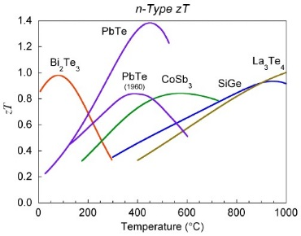
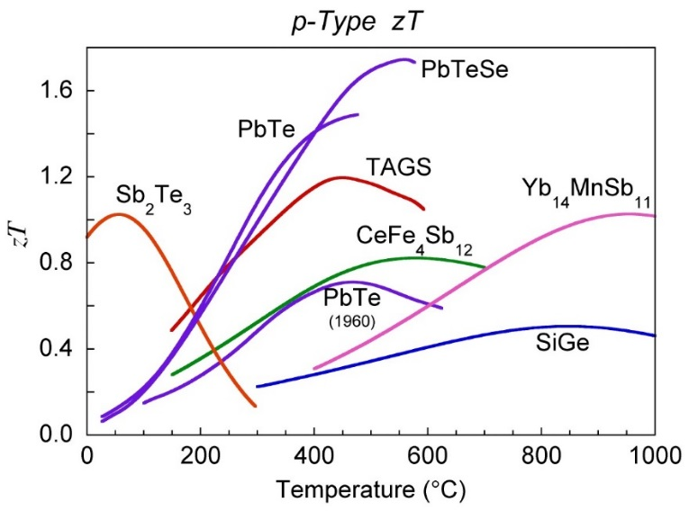
Advanced Thermoelectric Materials
Creating the next generation will require a fundamental
understanding of carrier transport in these complex
materials which is presently lacking

Slide 18
Data Driven Discovery of New Thermoelectric Materials
Gaultois et. al., Chemistry of Materials, 2013)

Slide 19
Low Work function Thermionic Materials
Original thermionic converters based on refractory metals (e.g., W) with work function of 4.5eV (required very high temperature of operation, 1300ºC +
New materials with low work function
LaB₆ – 2.66 eV
BaO/SrO coated CNT – 1.9eV
Potassium intercalated CNT – 3.3 eV
Cessium intercalated CNT – 2.4 eV
AlGaN – 2.3 eV
Cessiated 3C-SiC – 1.65 eV
Single layer graphene – although high workfunction, emission proportional to T³ compared to T² for other materials
Nanostructured geometry engineering of surface (Aizat et.al, 2016)
Significant opportunity for development of new low work function materials based on computational modeling tools

Slide 20
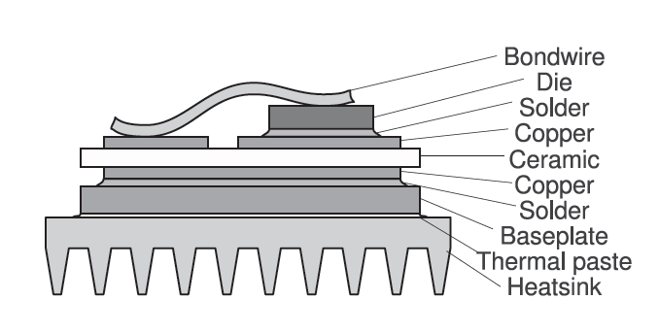
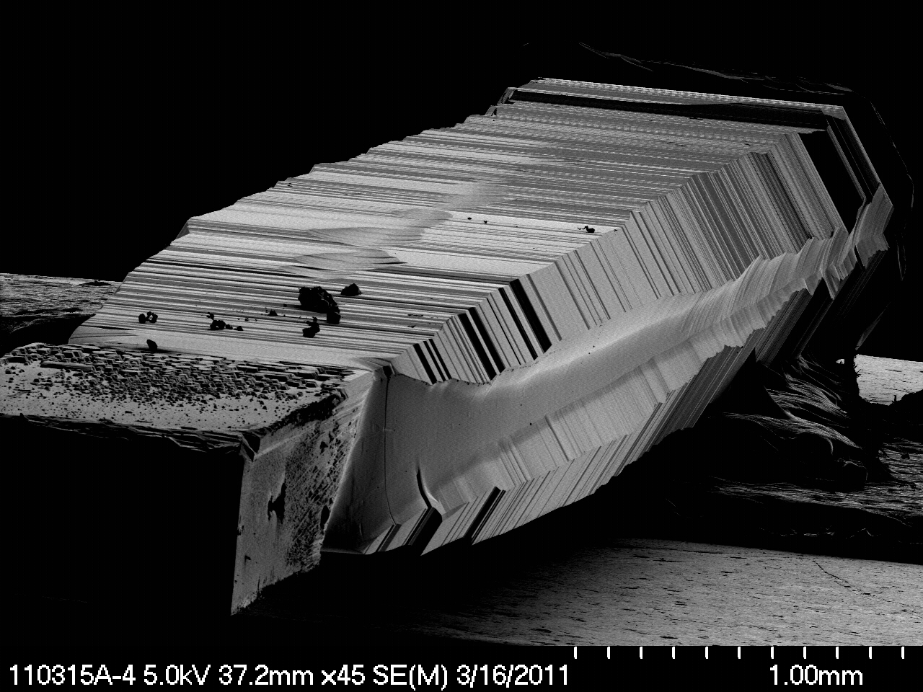
Power Electronics with Wide Bandgap Semiconductor
Increase in power density by increasing temperature capability of semiconductor
High temperature packaging is a major barrier
~ 15 mm Long Crystal
SiC theoretical
~ 600ºC
m-face
SOA SiC
~ 250ºC
a-face
c-face
[1100]
Si
~ 150ºC
[1120]
[0001]
Defect-free SiC for large wafers is a technical challenge
Need temperature capability beyond the current state-of-the-art (SOA)

Slide 21
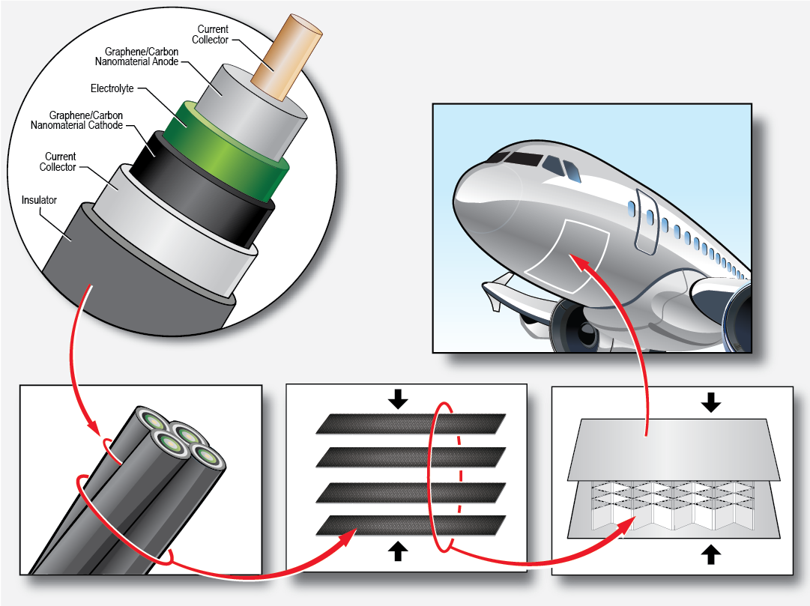
Multifunctional Materials and Structures
Multifunctional Materials:
Magnetic materials with high thermal conductivity
Capacitors with high thermal conductivity
Electrical insulation materials with high thermal conductivity
Multifunctional Structures With Energy Storage
Research Needs:
Material modeling to determine multifunctional properties for various materials
Material database with multifunctional properties
Design tools for multifunctional structures using multifunctional materials
21

Slide 22
Concluding Thoughts
Advanced materials enabling for future aerospace power and electric propulsion systems
Nanomaterials will be critical for achieving desired properties in many material systems
Deep understanding of material behavior and factors affecting material properties required
Robust fabrication process for bulk nanocomposites required
Big-data analytics tools will lead to new material discovery
Ab-initio calculations coupled with machine learning
Multifunctional materials and structures will enable designs with reduced mass

