Slide 1

Materials Genome Initiative
Dr. Harry Partridge
Chief Technologist
NASA Ames Research Center
Moffett Field, CA, USA
June 21, 2016
Notes:
1
The US Materials Genome Initiative (MGI) has emphasized the need to accelerate the discovery and development of materials to maintain industry competitiveness in new and existing markets. While largely interpreted as an initiative arising from the materials community, it is important to address the coupling of materials with manufacturing and all other relevant aspects of product development in order to maximize its impact. The dual thrusts of Integrated Computational Materials Engineering and the MGI represent a long-term vision of industry, academic, and government stakeholders. The goal is to build a new kind of coupled experimental, computational, and data sciences infrastructure. The emphasis is on high-throughput methods to accelerate historical sequential processes of serendipitous materials discovery and largely empirical materials development by leveraging computation and modern data sciences and analytics. The notion of a materials innovation ecosystem is introduced as the framework in which to pursue acceleration of discovery and development of materials consisting of various elements of data sciences, design optimization, manufacturing scale-up and automation, multiscale modeling, and uncertainty quantification with verification and validation.
U.S. Materials Genome Initiative (https://
www.mgi.gov ), which has placed a spotlight on the challenges
and opportunities for the creation of novel materials for 21st
century applications. “ Genomics” here refers indirectly to the
role of biological genomes, in the sense that functional
materials are made by the information-rich assembly of building
blocks, and in the hope that the correlation of function with
composition can eventually be made and predicted with
biological-level richness and precision. Materials genomics
therefore comprises methods of synthesis, analysis, optimization,
and computational prediction.

Slide 2
MGI
Strategic Plan
Programs/funding
NASA roles
Data

Slide 3



To help businesses discover, develop, and deploy new materials twice as fast, we’re launching what we call the Materials Genome Initiative. The invention of silicon circuits and lithium ion batteries made computers and iPods and iPads possible, but it took years to get those technologies from the drawing board to the market place. We can do it faster.
-President Obama
Carnegie Mellon University, June 2011
Notes:
A genome is a set of information encoded in the language of DNA that serves as a blueprint for an organism’s growth and development. The word genome, when applied in non-biological contexts, connotes a fundamental building block toward a larger purpose.

Slide 4
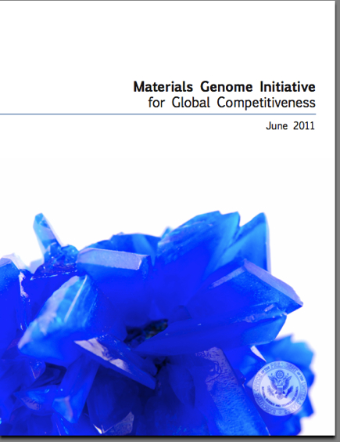
The Materials Genome Initiative
Goal: to decrease the cost and time-to-market by 50%
Develop a Materials Innovation Infrastructure
Achieve National goals in energy, security, and human welfare with advanced materials
Equip the next generation materials workforce
http://www.whitehouse.gov/sites/default/files/microsites/ostp/materials_genome_initiative-final.pdf
http://www.wtec.org/sbes-vision/RDW-color-FINAL-04.22.10.pdf
http://www.wtec.org/sbes/SBES-GlobalFinalReport.pdf
National Research Council. (2008). Integrated Computational Materials Engineering. Washington, DC: The National Academies Press.
http://nvlpubs.nist.gov/nistpubs/ir/2012/NIST.IR.7898.pdf

Slide 5
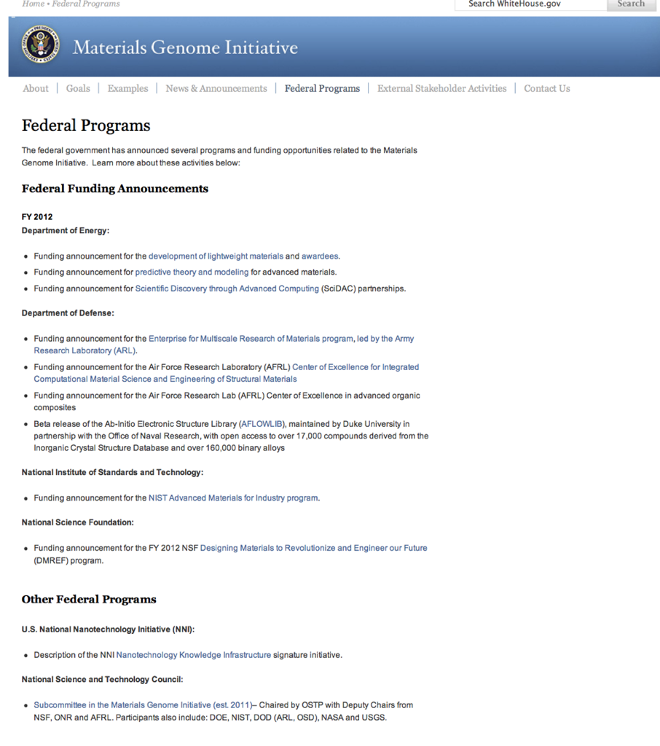

Slide 9

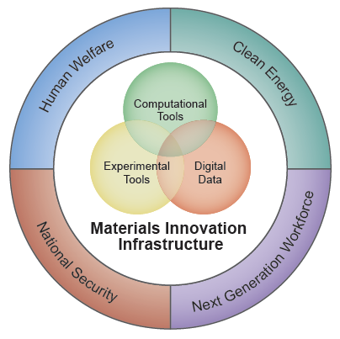
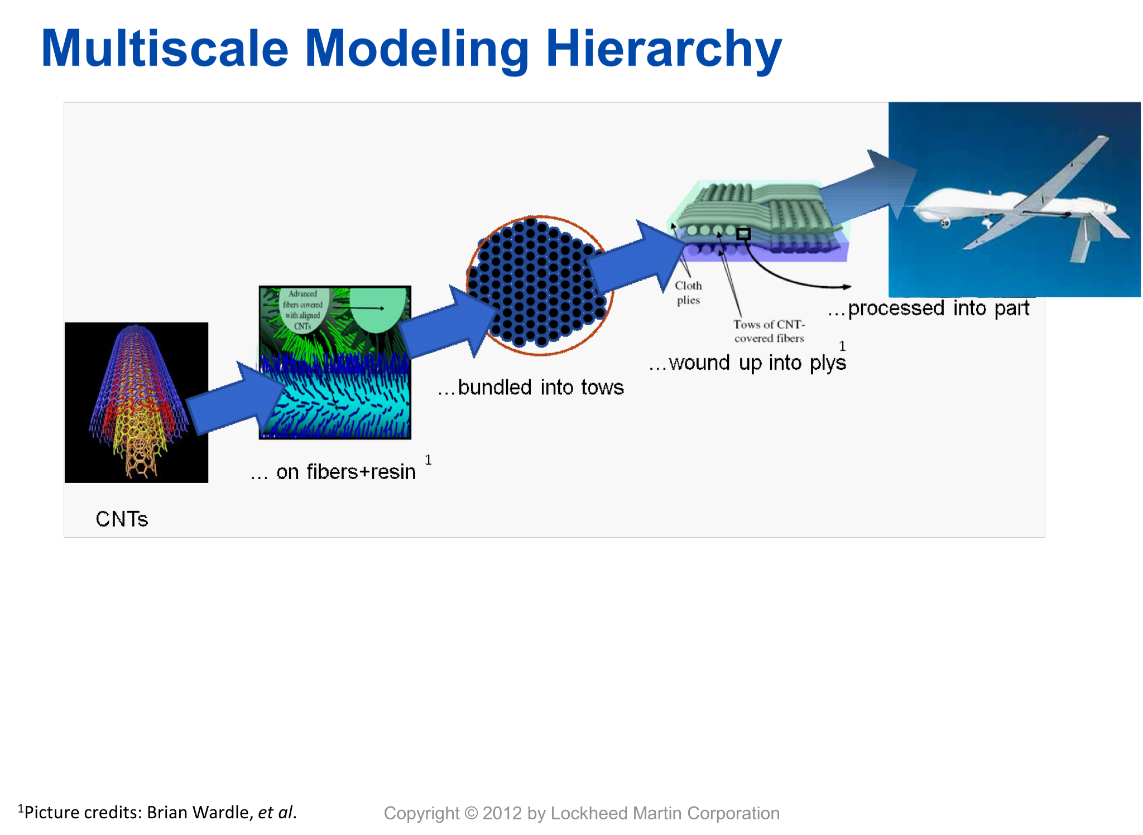

Multiple Components to the MGI!
Courtesy: BASF
Material “Informatics”
National Infrastructure for Data Sharing and Analysis
Multiscale Modeling
Atoms to Component Description of Materials
9
Notes:
The MGI effort can be rightly be thought of as Materials “Informatics” effort, inspired by previous efforts in Biology and Chemistry, represented by the image shown here on the left, where an integrated network of computational tools, experimental tools, and digital data form a Materials Innovation Infrastructure.
It is clear that companies are already doing this at least to some extent, so the questions become, 1) What are the gaps? 2) What do we need as part of a national infrastructure? 3) How efficient is it?

Slide 10


Slide 11
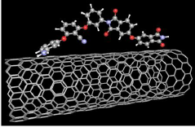

Materials Genome Initiative (MGI)
Current materials development based on empirical design approaches results in incremental material improvements and long maturation and insertion time. For example, carbon fibers were invented in 1958 yet significant use of carbon fiber composites in aerospace applications has required 50 years of development.
Existing material certification approach inhibits the utilization of new processing methodology.
PROBLEM / NEED BEING ADDRESSED
Reduce time between discovery and technology insertion by at least half relative to current practice.
Shorter maturation and insertion period can translate to lower costs, greater affordability and lower risk of failure.
Integration of materials certification within a comprehensive computational approach will reduce time and cost to certify new flight hardware.
Accelerated insertion of processing methods and emerging materials systems are required for aerospace applications
QUANTITATIVE IMPACT
STATUS QUO
PROJECT DESCRIPTION:
Develop integrated computational / experimental / processing methodologies for accelerating discovery and insertion of materials to satisfy NASA’s unique mission demands.
The challenges:
Requires validated multi-physics design tools that incorporate materials properties, processing and design requirements
Materials process control and characterization
Approach:
Atomistic modeling to guide material design e.g. matrix composition, crosslinking between CNTs, grain size and texture
Multiscale modeling influence of materials design on mechanical properties and durability
Process modeling to determine processing parameters required to produce as-designed material nano-/micro-structures and enable advanced manufacturing methods utilization
Utilize material data management to support robust material design methodology
Multi-scale and multi-physics models for the characterization of materials processing and structure-property relationships are maturing.
Cross-center effort including computational, experimental and processing expertise to develop emerging material systems including multifunctional materials.
Define path for compressed materials maturation and insertion through multiscale modeling to reduce materials testing and shorten iterative cycle for materials optimization.
Capability for materials “designers” to assess the trade-off between various material properties of interest and enable rapid prototyping.
Synergistic efforts in multiscale modeling, information management,
NEW INSIGHTS
PROGRAM GOAL
experimental characterization and materials processing will accelerate design, development and
sustainment of ultra-durable material systems.
Computational material design is enabling to NASA’s aerospace needs.

Slide 12
Space technology Research Institutes
Computationally Accelerated Materials Development for
Ultra High Strength Lightweight Structures
https://www.fbo.gov/notices/1da1168bb868634d0b8104b014fb34dc
University led Institute
$15M: $3M/yr for 5 years
Develop high strength structural materials using an MGI inspired approach-
Using advanced modeling throughout the entire materials development lifecycle.

Slide 13
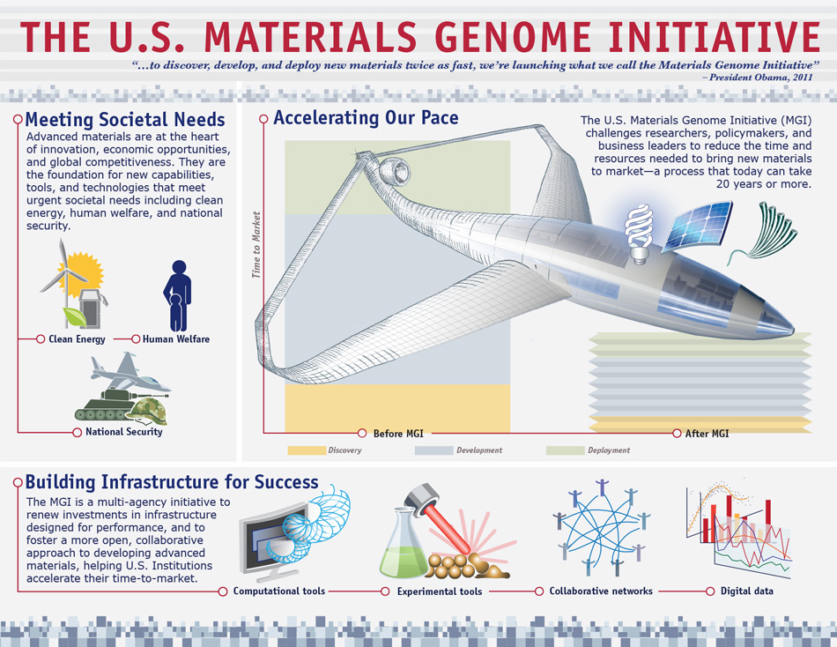

Slide 14
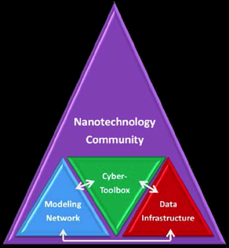
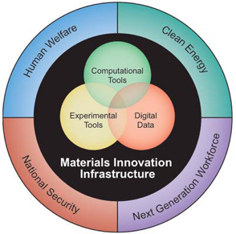
Nanoinformatics, the NKI-NSI and the MGI
“The Nanotechnology Knowledge Infrastructure developed by ten agencies will stimulate the development of models, simulation tools, and databases that enable the prediction of specific properties and characteristics of nanoscale materials.
Also approaches, protocols, and standards developed through MGI activities may be initially explored, tested, or evaluated specifically for nanomaterials under NKI efforts.
The cross fertilization between NNI and MGI will yield broader knowledge dissemination and can be facilitated by the NKI effort.”
Fact Sheet on Progress on the Materials Genome Initiative
Executive Office of the President, May 14, 2012

Slide 15

NIST and MGI
2010
2011
2012
2013
NIST, DOE, NSF, and DOD work with OSTP to prepare MGI Whitepaper
NIST develops Initiative, $4M (now 9M/yr) allocated for internal programs
04/12: NSTC Subcommittee (CoT) on the Materials Genome Initiative formed (NIST, DOE, DOD, NSF, NASA, NIH, USGS, NNSA, DARPA, NSA, OMB)
2/13:
Subcommittee co-chairs announced -L. Locascio (NIST), H. Kung (DOE)
Strategic planning kicked off
Focus teams formed: Data, Code Curation, Industry Outreach, Transformational Challenges
5/12: MGI White House Kickoff Event
www.whitehouse.gov/mgi
www.nist.gov/mgi
Notes:
A genome is a set of information encoded in the language of DNA that serves as a blueprint for an organism’s growth and development. The word genome, when applied in non-biological contexts, connotes a fundamental building block toward a larger purpose.

Slide 16

We have a Problem and Opportunity
What is the MGI?
The Materials community will be well served by answering this question consistently

