Slide 1
Future Opportunities for Ultralight Materials and Structures
Lattice-based materials and structures
Haydn Wadley
University of Virginia
Charlottesville, Va

Slide 2
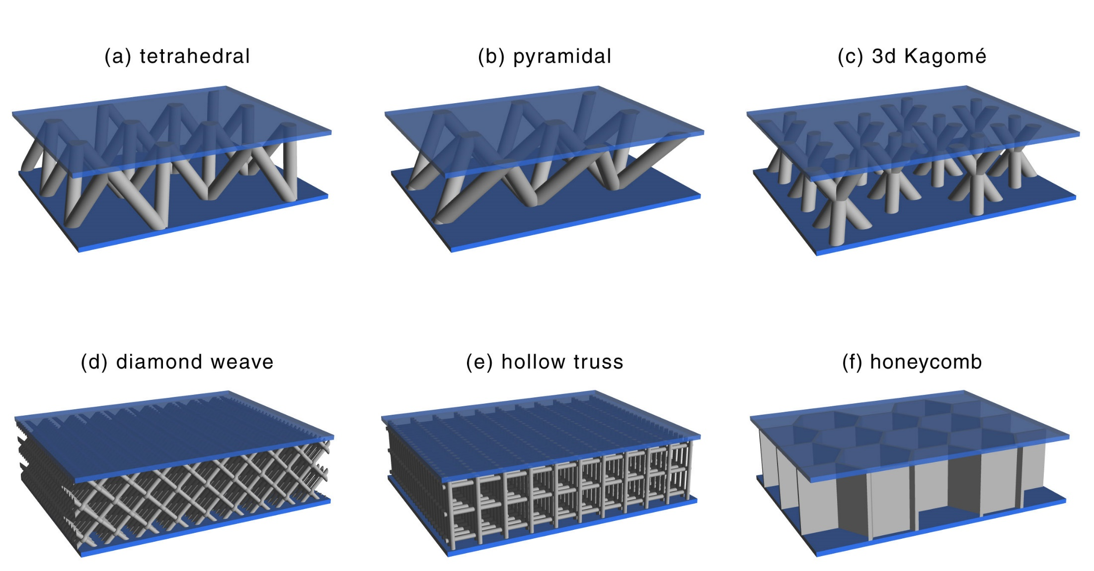
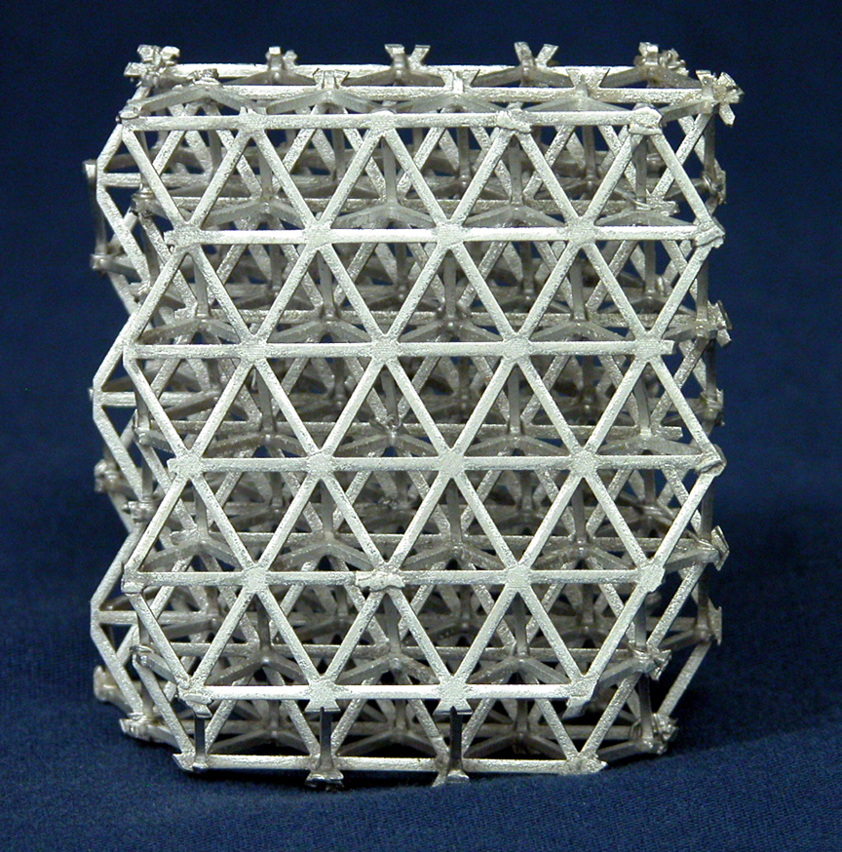
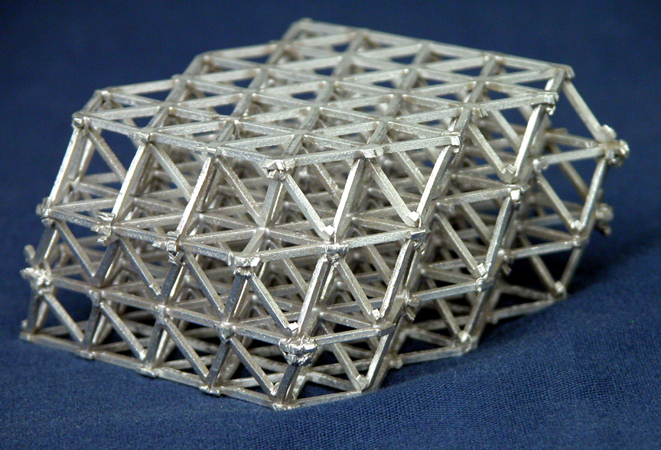
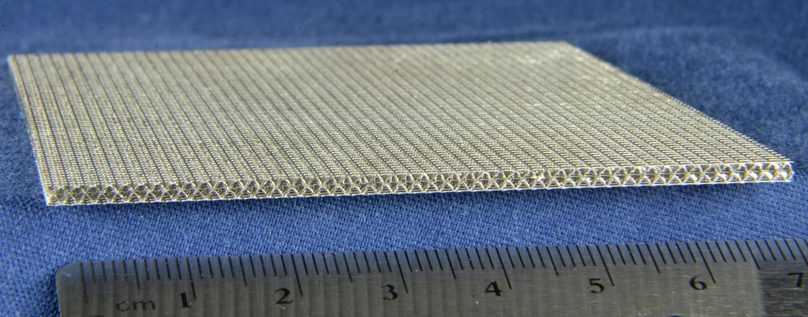

10mm
10mm
Examples of metallic lattices
Examples of cellular structures

Slide 3
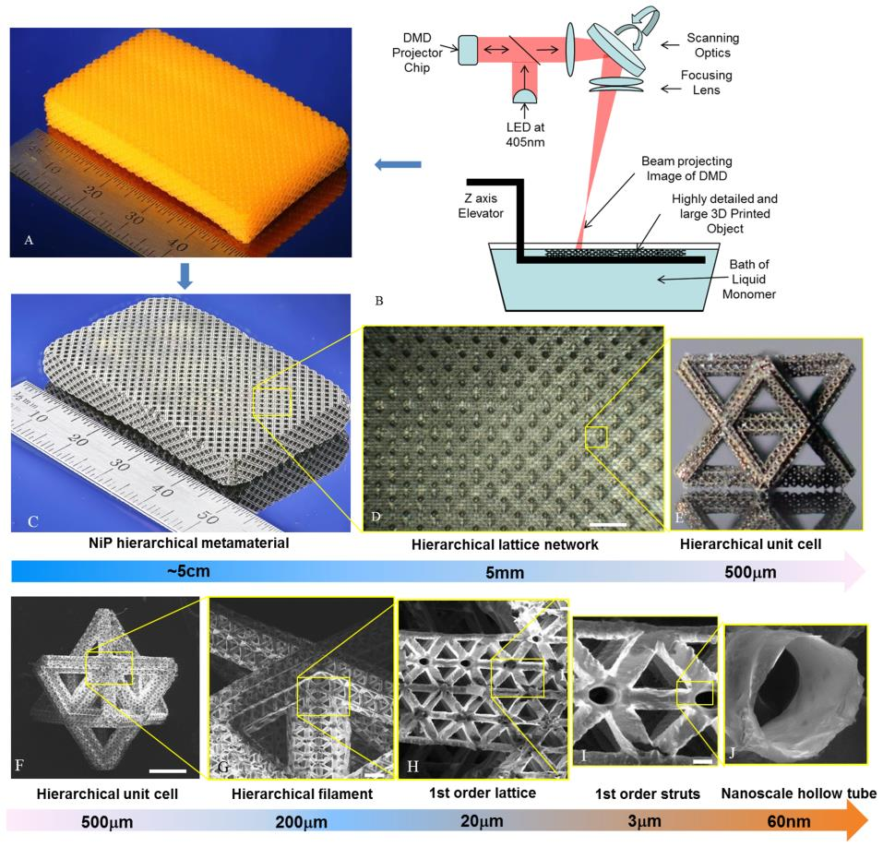
Multiscale metallic metamaterials --- across over 7 orders of magnitude in length-scale
LED Projection Micro Stereo-lithography
Zheng et al., Nature Materials, 2016 In Press

Slide 4
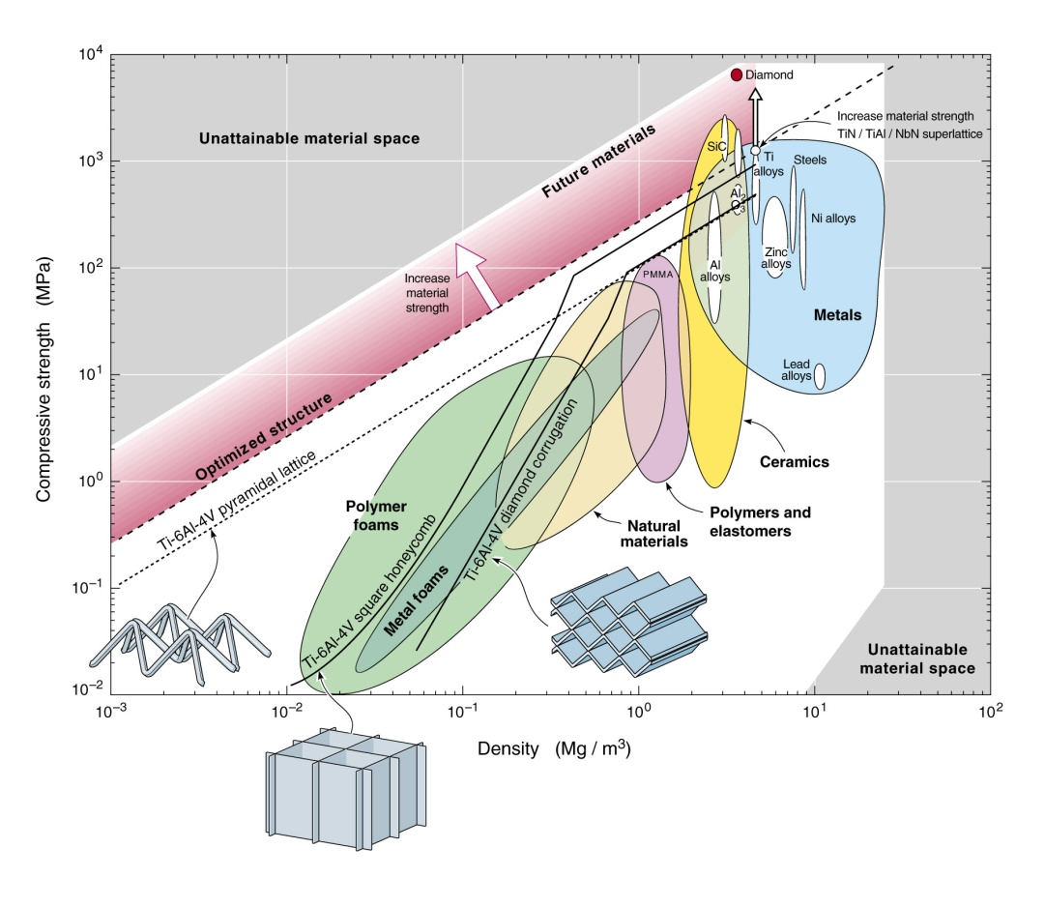
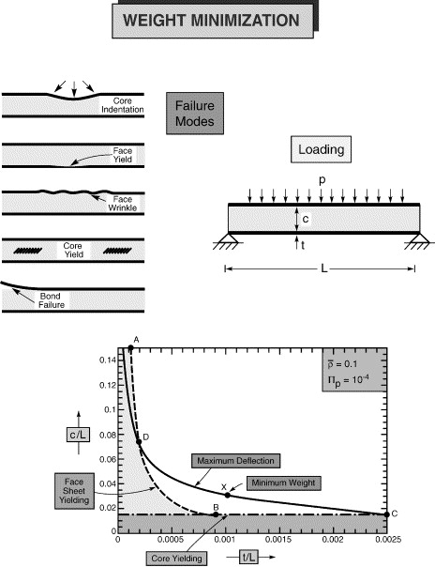
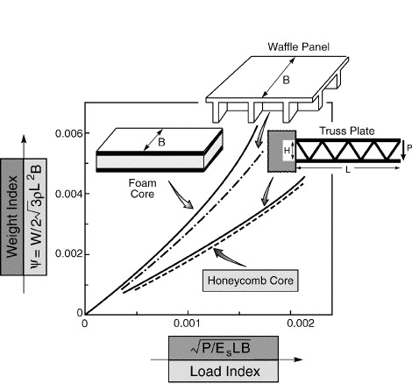
Sandwich Panel Weight Minimization Concepts
Foam core weight
minimization
Core comparisons during panel bending
Transverse shear (per unit width)
Load index
Bending moment
(per unit width)
Weight(per unit width)
Weight index
Failure loci
Density
Characteristic length = M/V
(related to L)
Maximize core moduli, and strength, minimize core density and optimize topology
A.G. Evans, J.W. Hutchinson, N.A. Fleck, M.F. Ashby, H.N.G. Wadley, The topological design of multifunctional cellular metals, Progress in Materials Science, Volume 46, Issues 3–4, 2001, 309–327
Haydn N.G. Wadley, Norman A. Fleck, Anthony G. Evans, Fabrication and structural performance of periodic cellular metal sandwich structures, Composites Science and Technology, Volume 63, Issue 16, 2003, 2331–2343
,

Slide 5
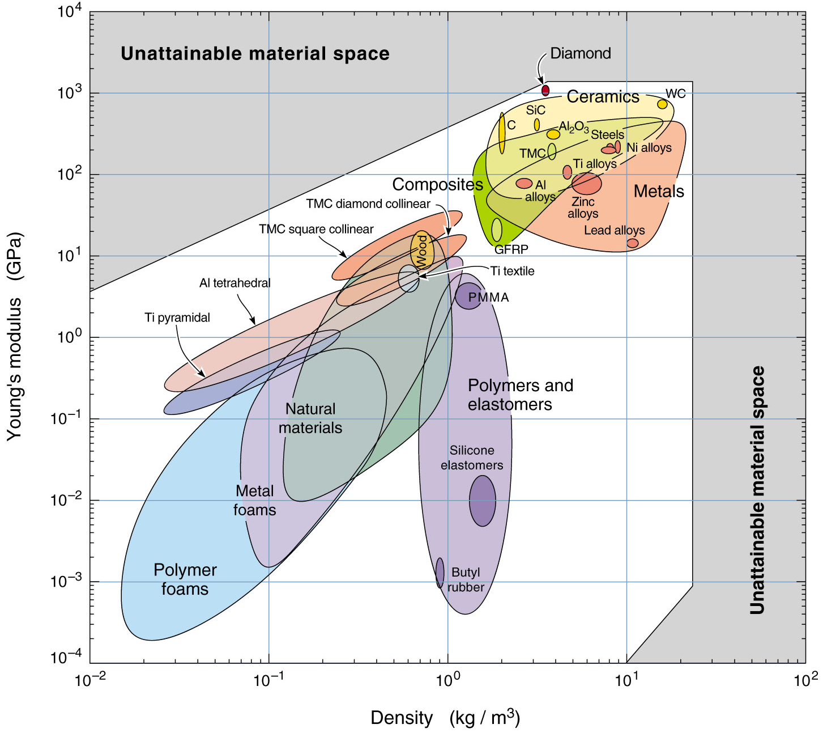

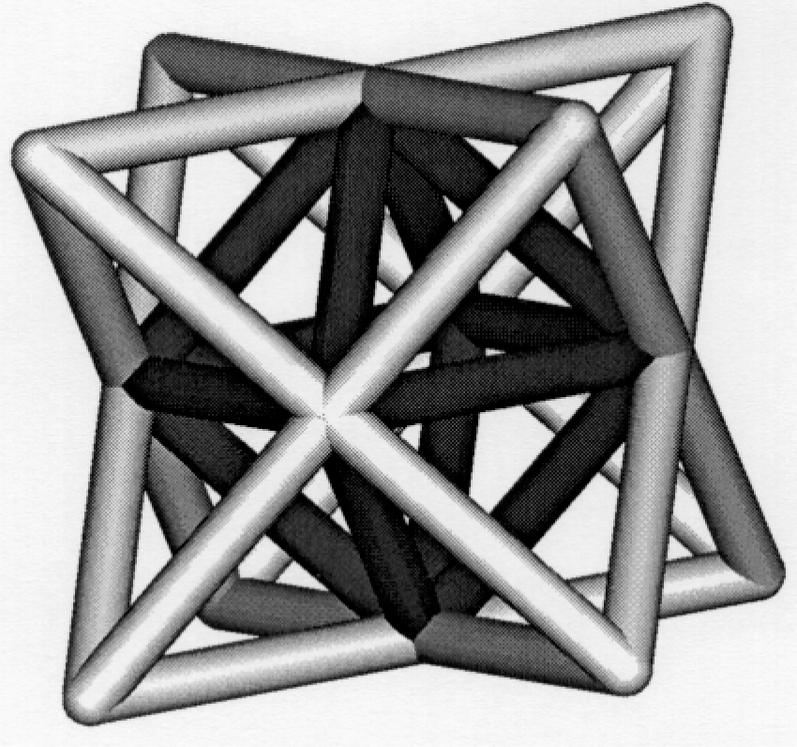
Elastic Modulus –Density Space White Space
Highest possible bound was calculated by Voigt for anisotropic materials/structures (honeycomb).
Hashin and Shtrikman investigated bounds for elastic materials. For 3D isotropic systems these are below the Voigt (iso-strain) bound.
Lattices we are interested in (e.g. octet truss) are almost isotropic and provide multifunctionality.
Voigt (anisotropic) bound
H-S upper bound
Octet truss
Stretching structures
Bend-dominated structures
V.S. Deshpande, N.A. Fleck, M.F. Ashby, Effective properties of the octet-truss lattice material, Journal of the Mechanics and Physics of Solids, Volume 49, Issue 8, 2001, 1747–1769

Slide 6
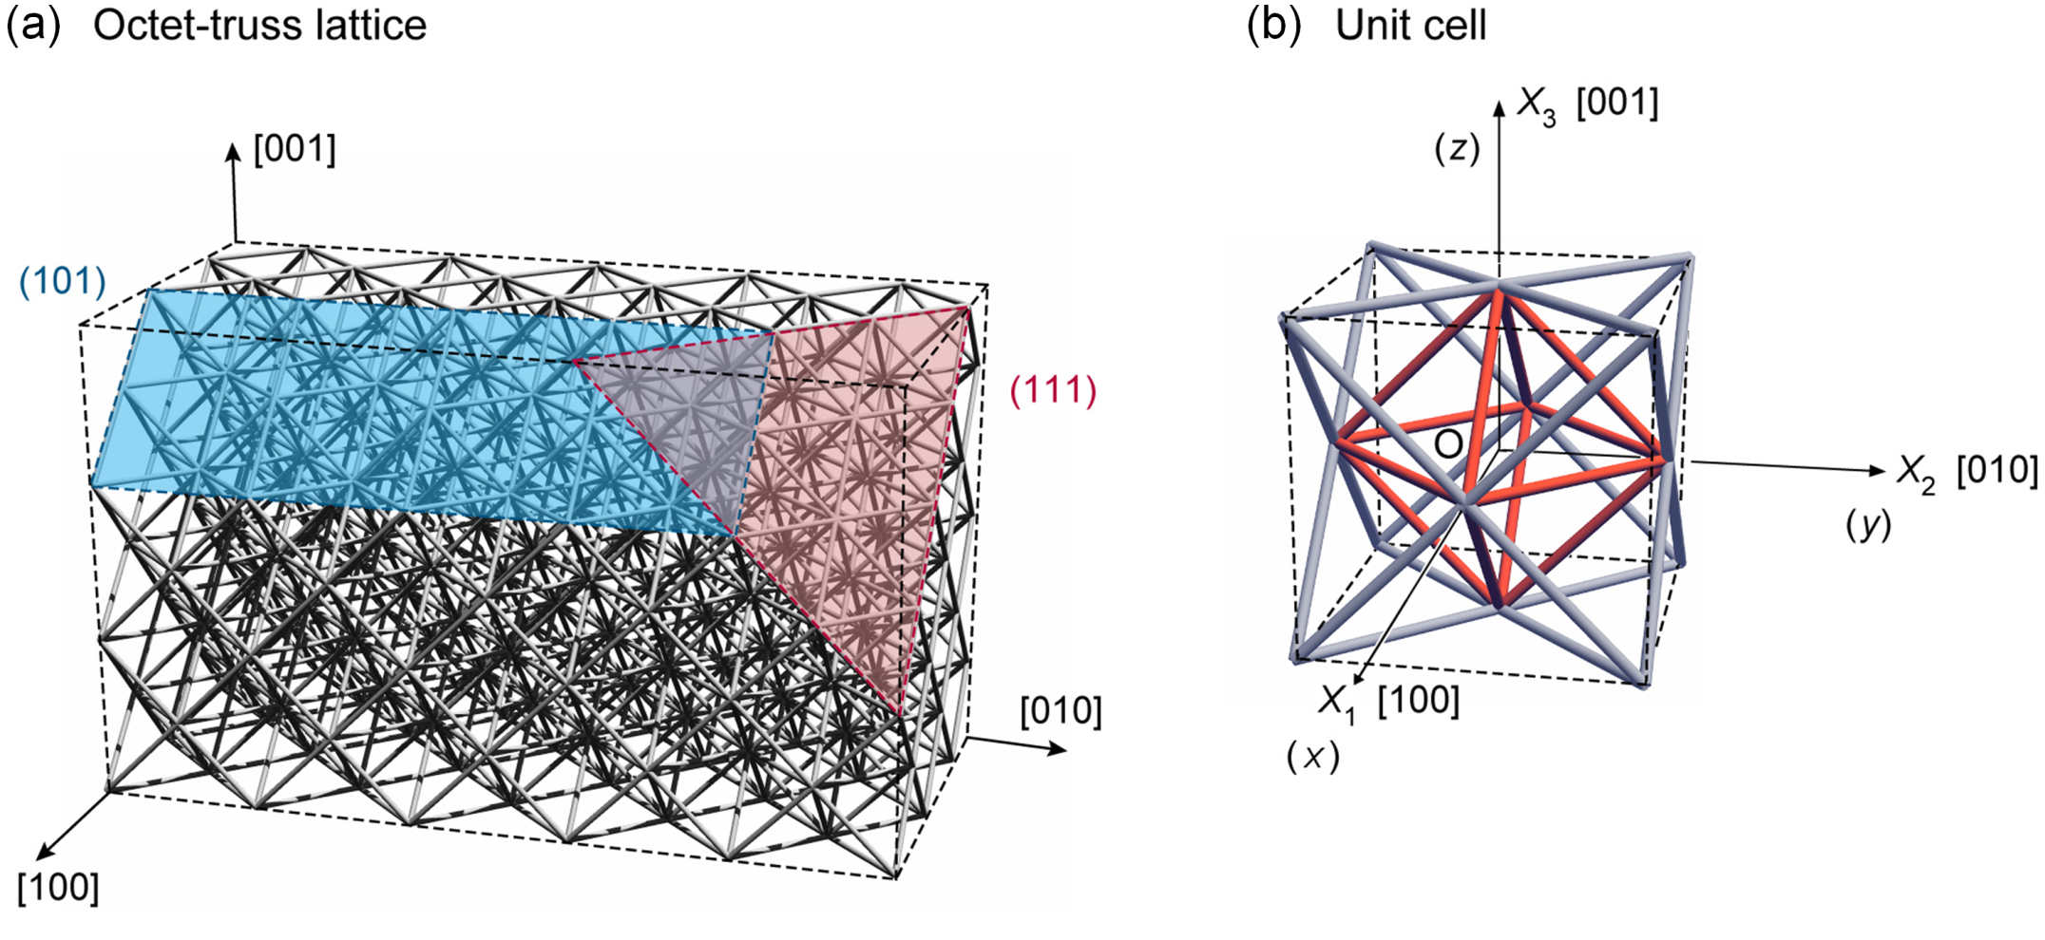
The octet truss lattice
A stretch dominated structure
An octet-truss lattice constructed by the 3D packing of unit cells.
Each node within the octet lattice lies at the intersection of 12 struts.
A unit cell of the face centered cubic crystal symmetry octet-truss lattice.
A central octahedral cell (with 12 struts) bounded by 8 edge tetrahedrons.
Almost isotropic

Slide 7
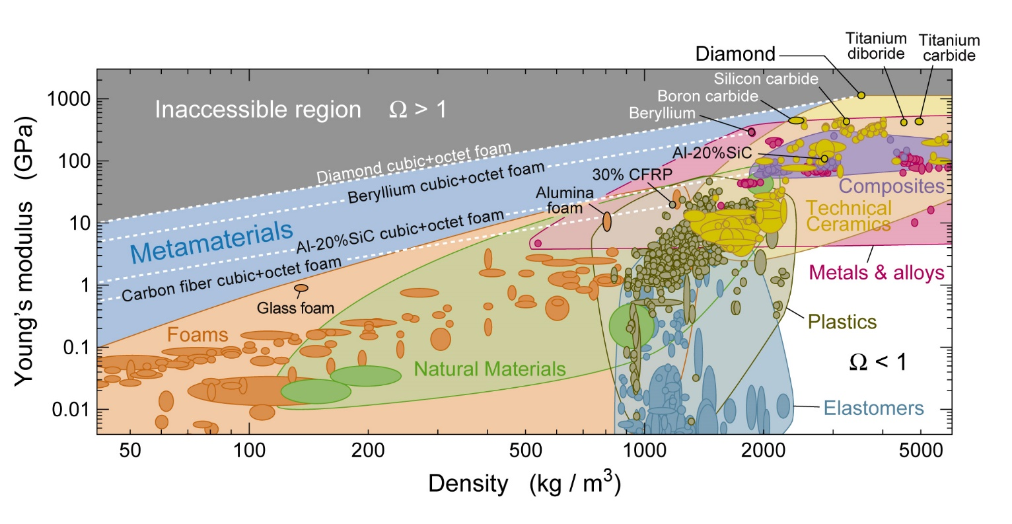
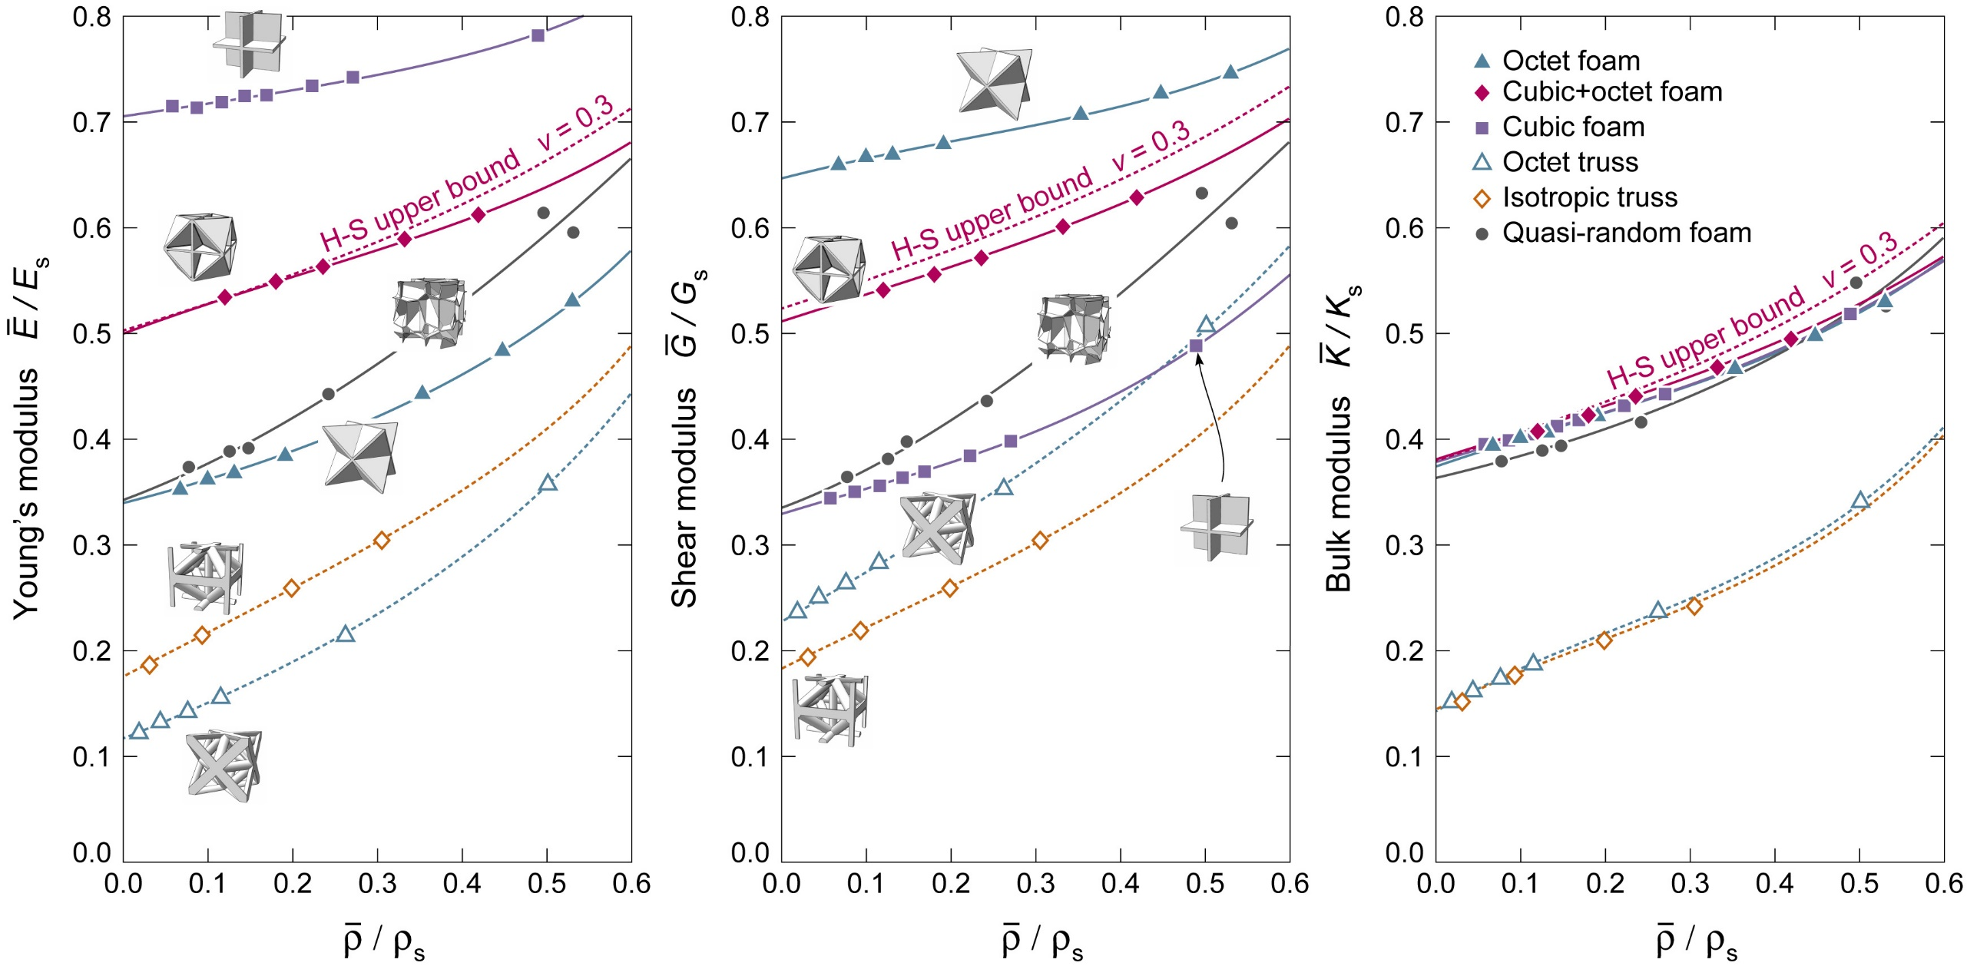
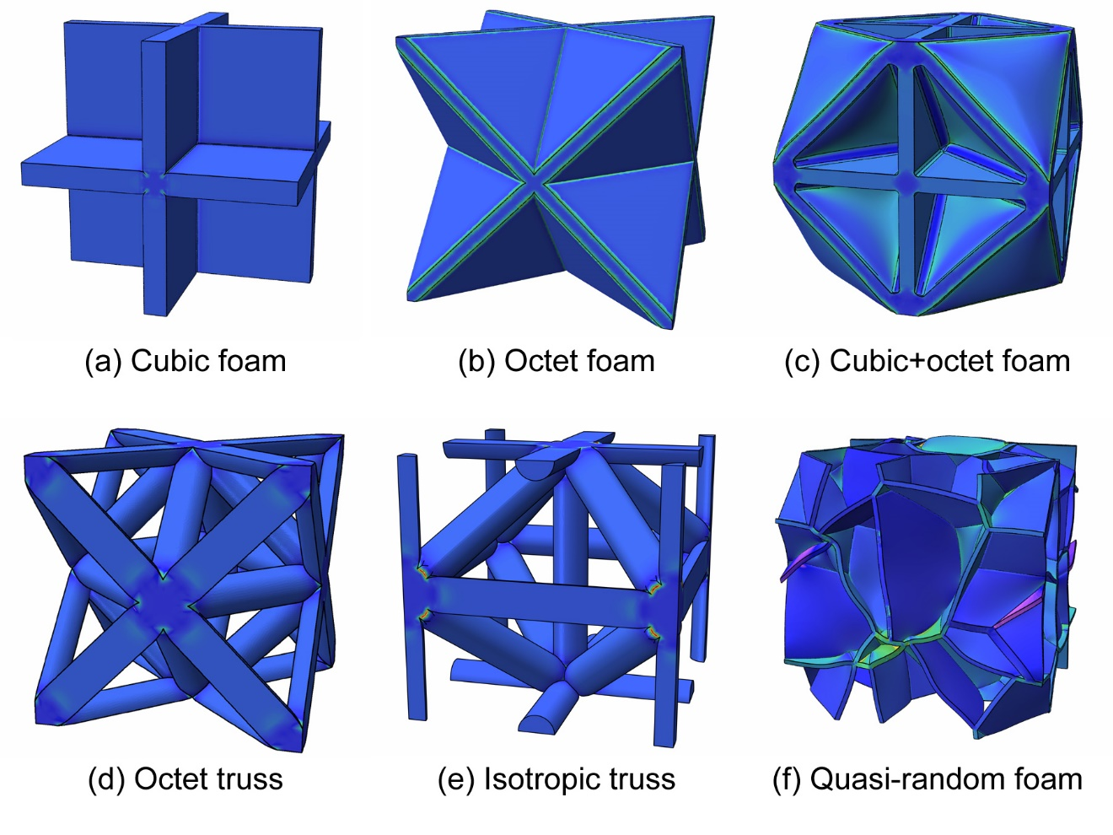
Topology Design and Material Selection Enables Bound Limited Stiffness
Jonathan Burger, Robert McMeeking, Haydn Wadley (submitted, 2016)

Slide 8
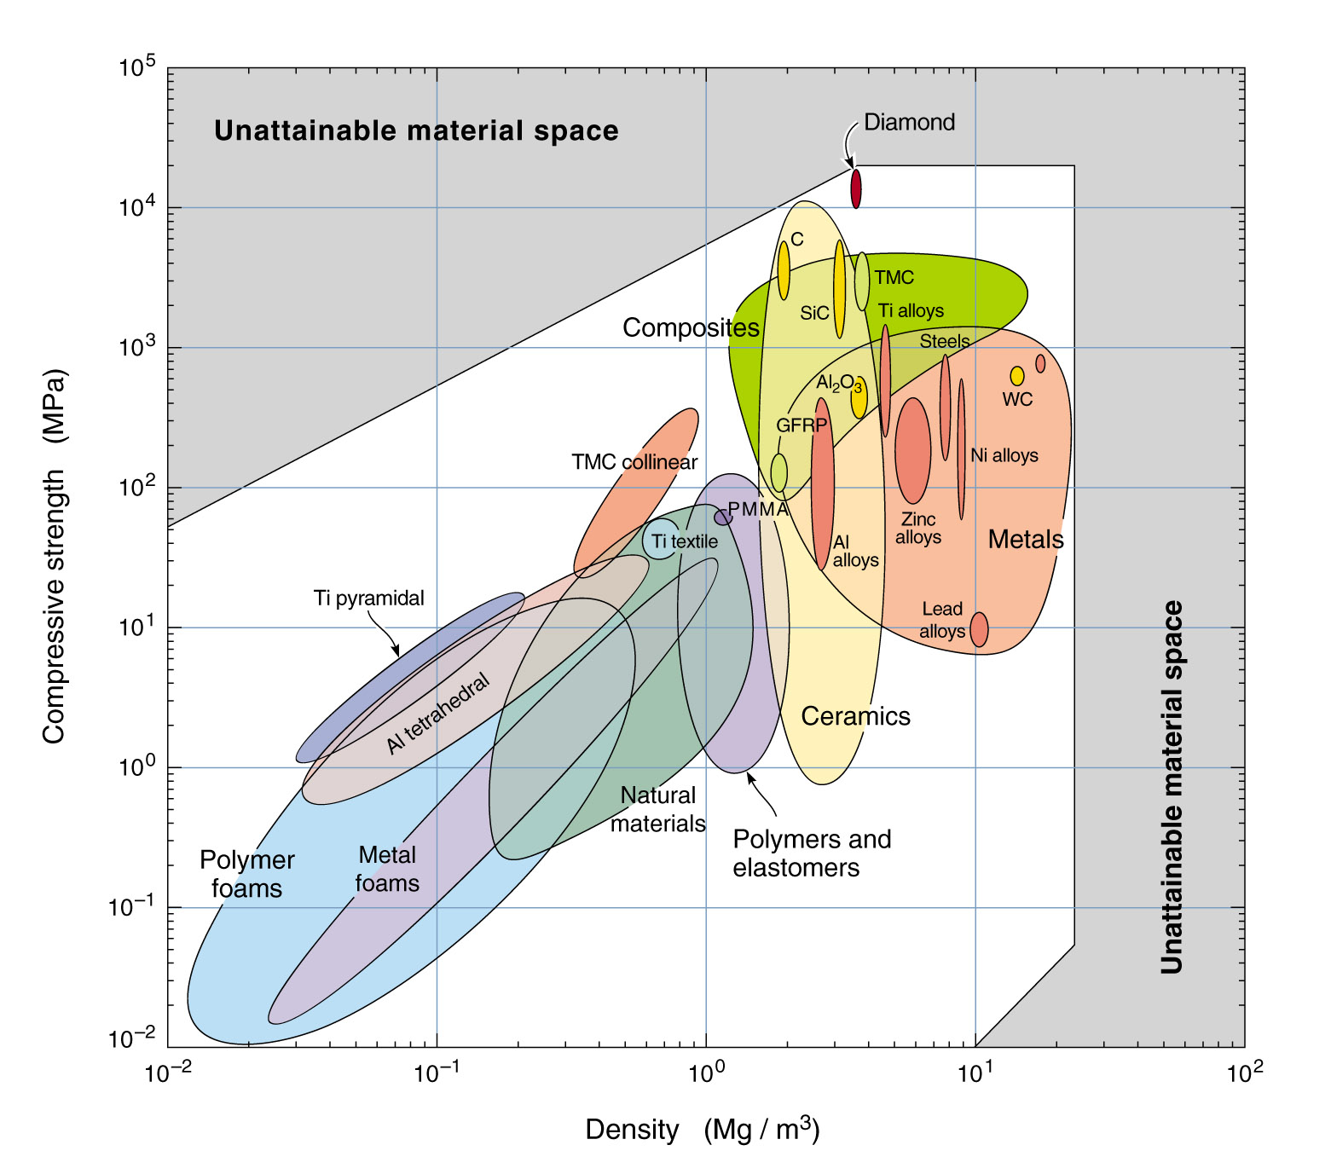
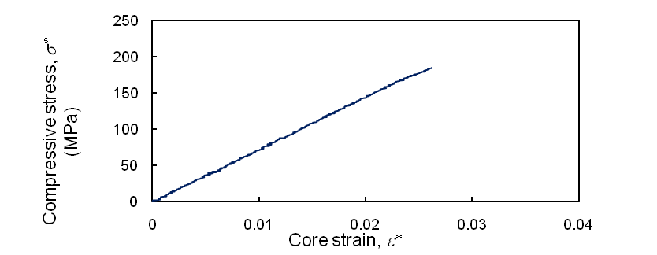
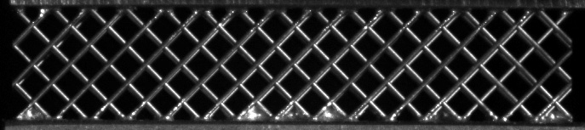
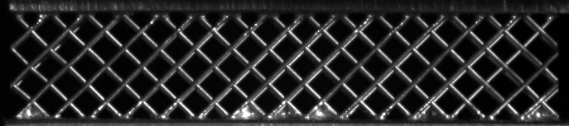
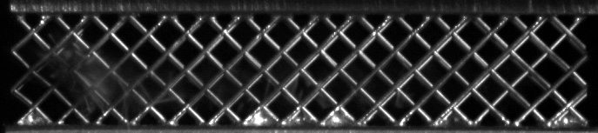
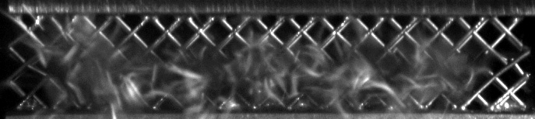
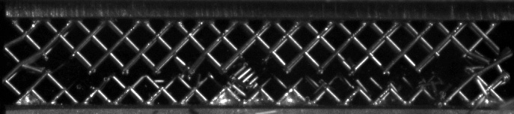
Opportunities in Strength –Density Space
TMC Compression
250
200
IV
III
Compressive stress, σ_{c} (MPa)
II
150
100
50
I
0
Octet truss bound
0.00
0.01
0.02
0.03
0.04
Core strain, ε_{c}
But beware of fracture as we take away plasticity
5 mm
I
t = 0.00000 s
II
t = 450.00002 s
III
t = 450.00014 s
IV
t = 450.00028 s
final
t = 450.07576 s
Perhaps a >10X opportunity if we can make lattices from ultra-high strength, low density materials?
The failure initiating at III and ending at IV propagates in about 140 microseconds (~ 200 m/s).

Slide 9
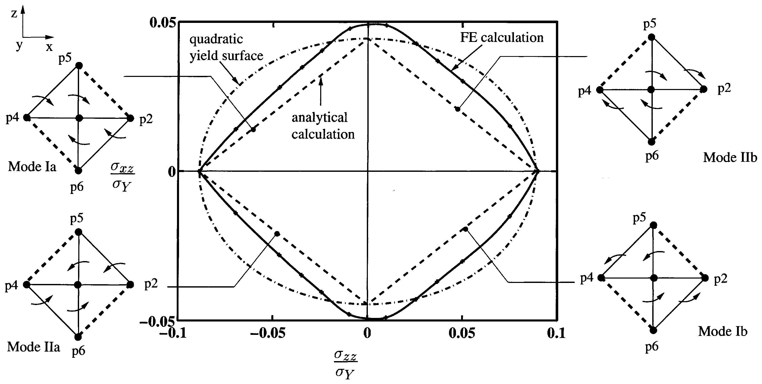
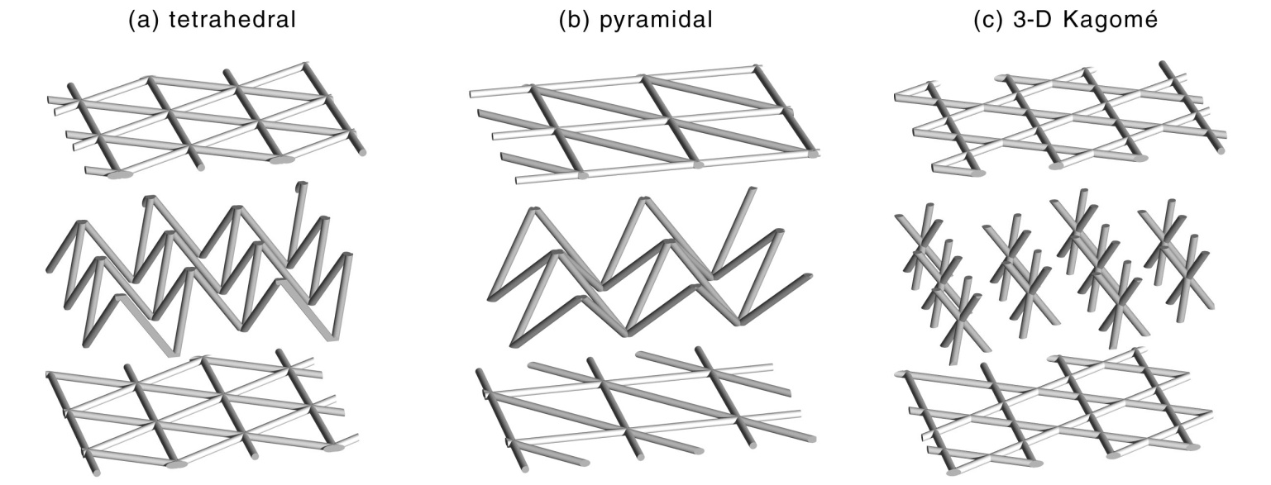

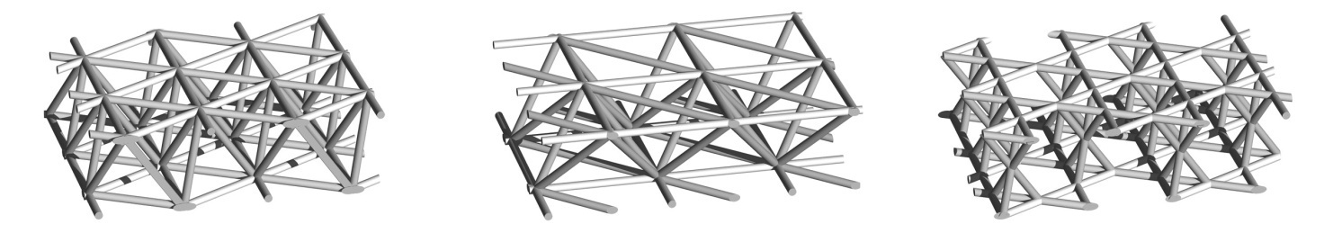
Design of stretch dominated octet lattice structures
ω
Deshpande, Fleck, Ashby JMPS 2001
At lower density, compressed trusses buckle
Strength of a single layered pyramidal lattice
elastic
plastic yield control
Substitute σ_{cr}, for σ_{y} in Eq (1)
inelastic
Strength of an octet lattice
Eq (1)
To maximize compressive strength
2/3: since only out of plane trusses directly support out of plane load
maximize σ_{y}, E_{s}, E_{t}, k and I

Slide 10
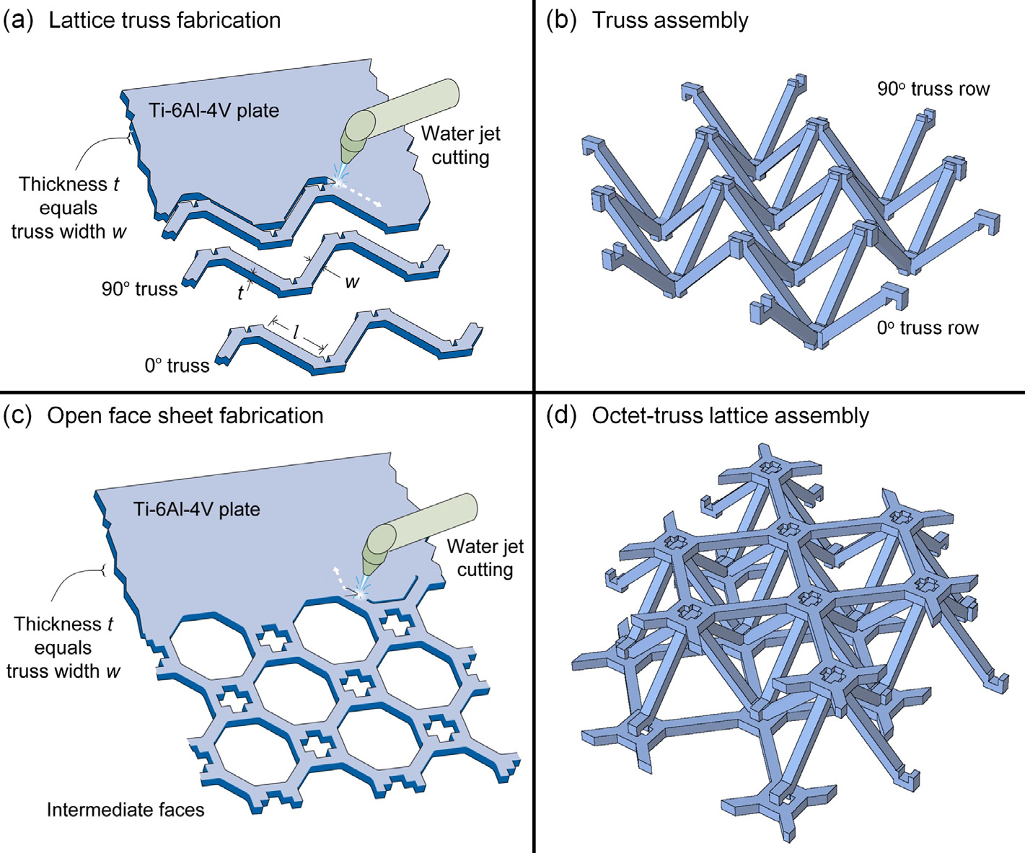
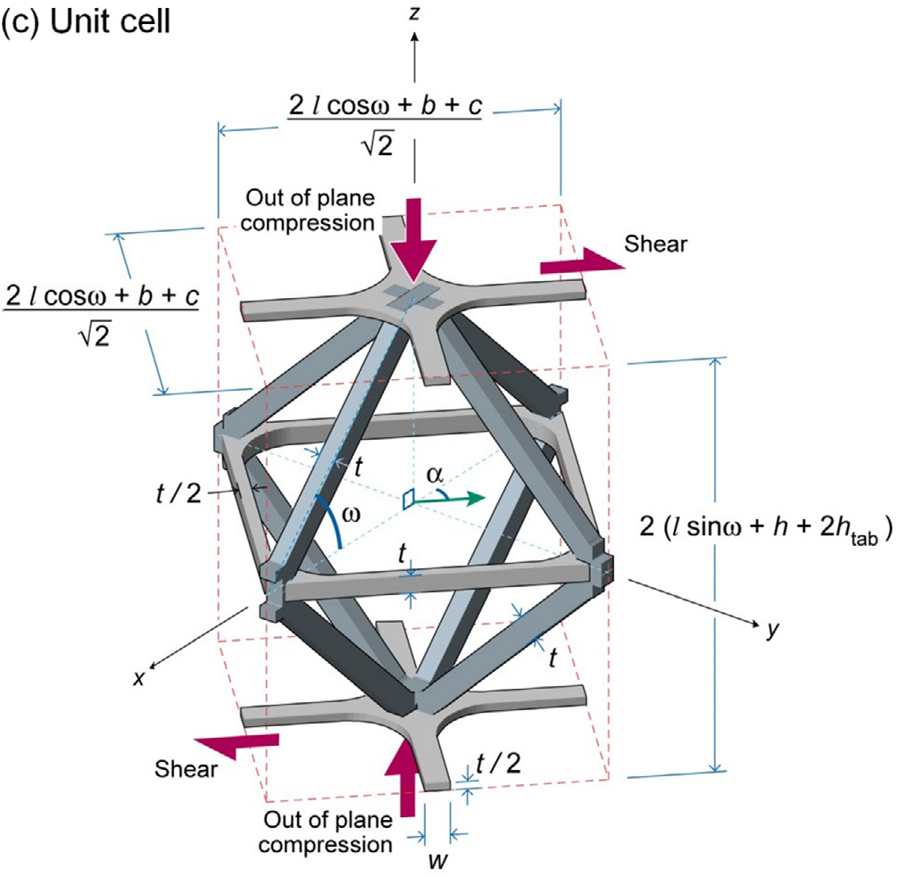

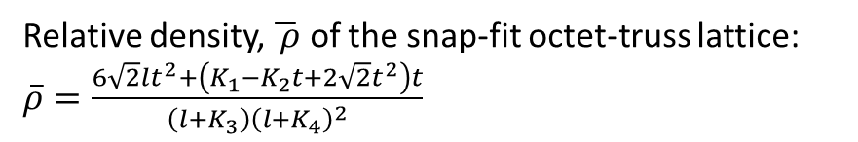
“Snap-fit” octet lattices from high specific strength materials
The "snap-fit" truss fabrication and assembly method for making Ti-6Al-4V octet-truss lattice
l
Relative density, $\overline{ ρ}$ of the snap-fit octet-truss lattice:
$\overline{ρ}=\frac{6\sqrt{2}lt^{2}+\left(K_{1}−K_{2}t+2\sqrt{2}t^{2}\right)t}{\left(l+K_{3}\right){\left(l+K_{4}\right)}^{2}}$
$\overline{ρ}=$6$\sqrt{2}$(t/l)² “ideal” octet as node volume→0
Retains α/β high specific strength microstructure, scalable.
Used for metal alloys, composites and extendable to ceramics

Slide 11
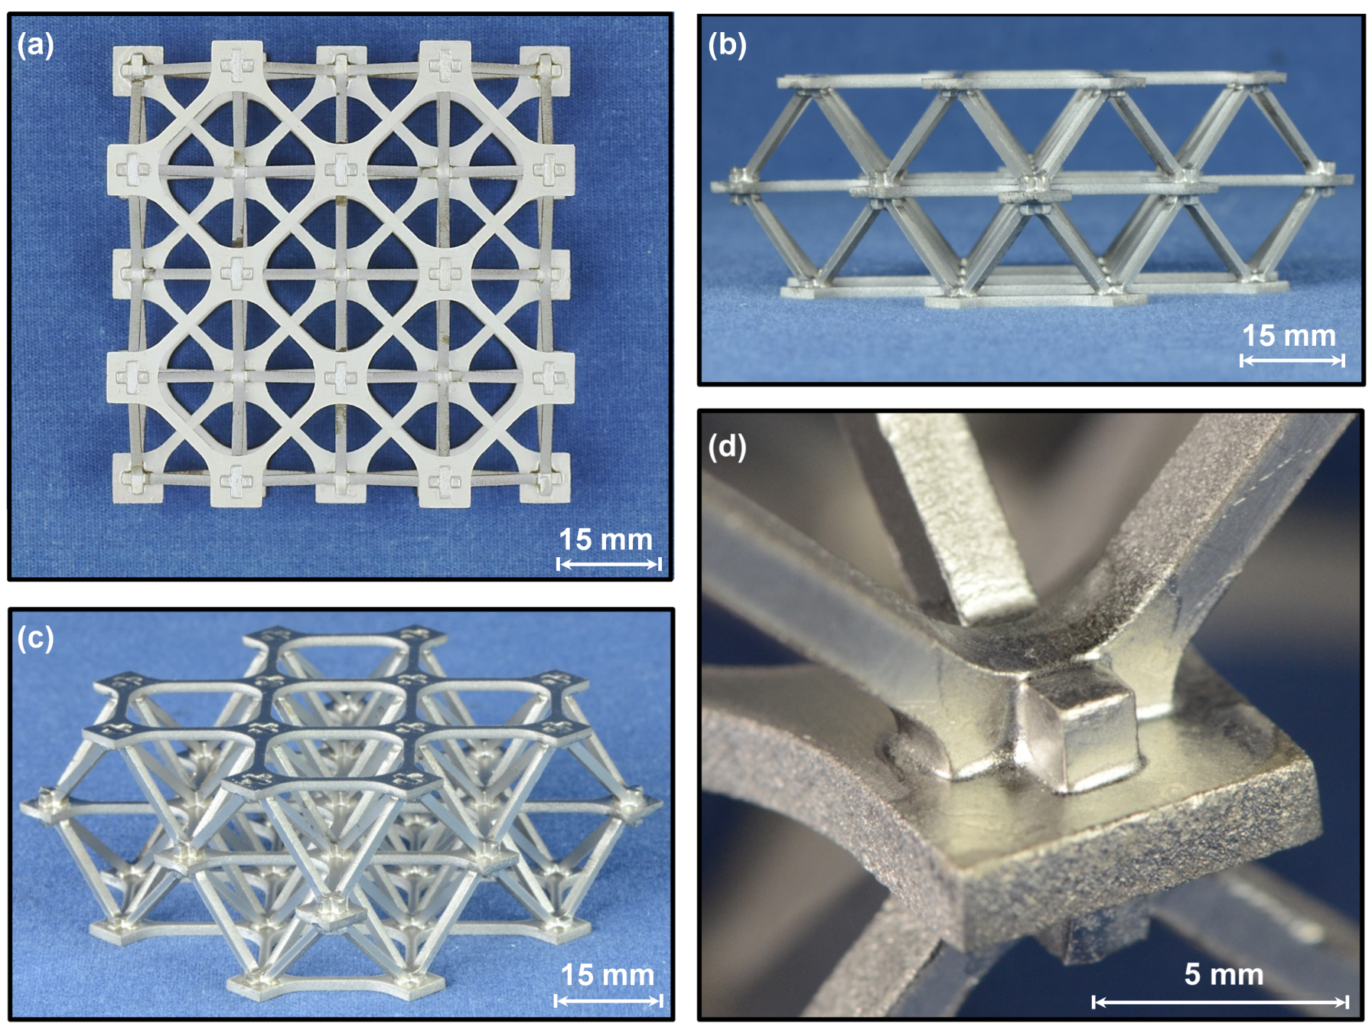
A Ti-6Al-4V octet-truss lattice compression specimen with a relative density of 4.6%.
40Ti-20Cu-20Ni-20Zr (wt.%) braze alloy (900ºC, 30min)

Slide 12
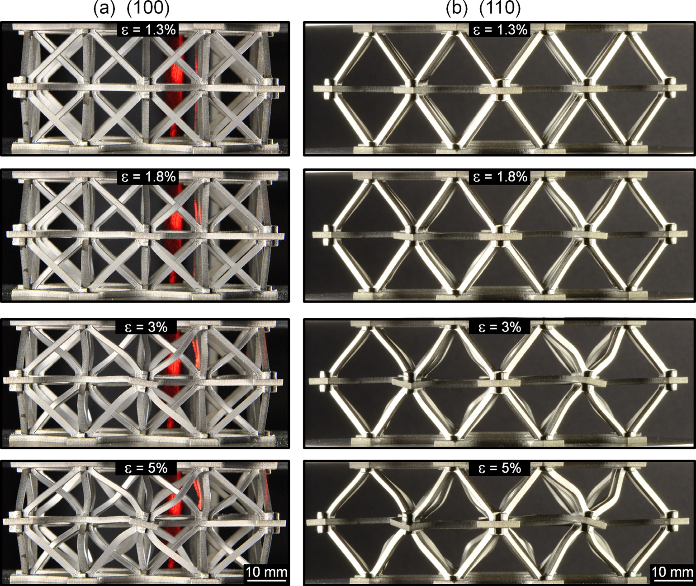
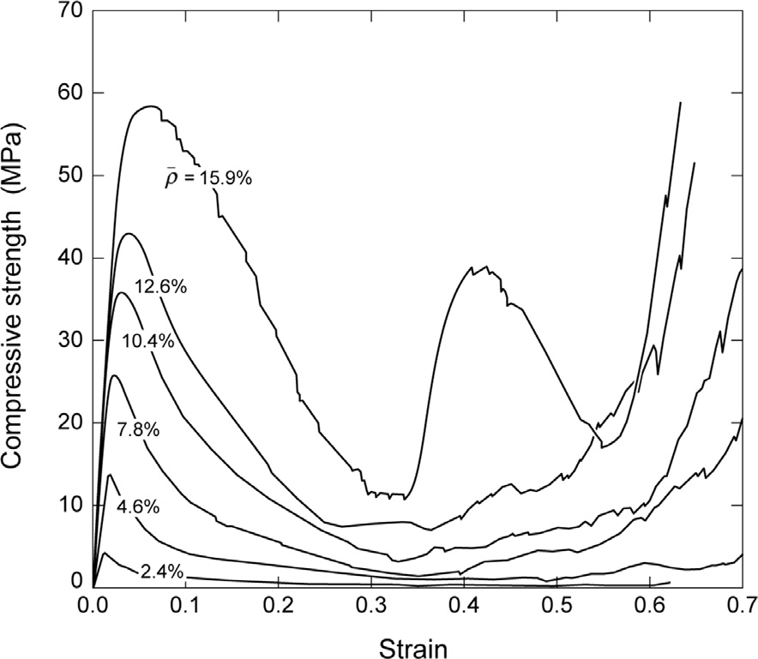
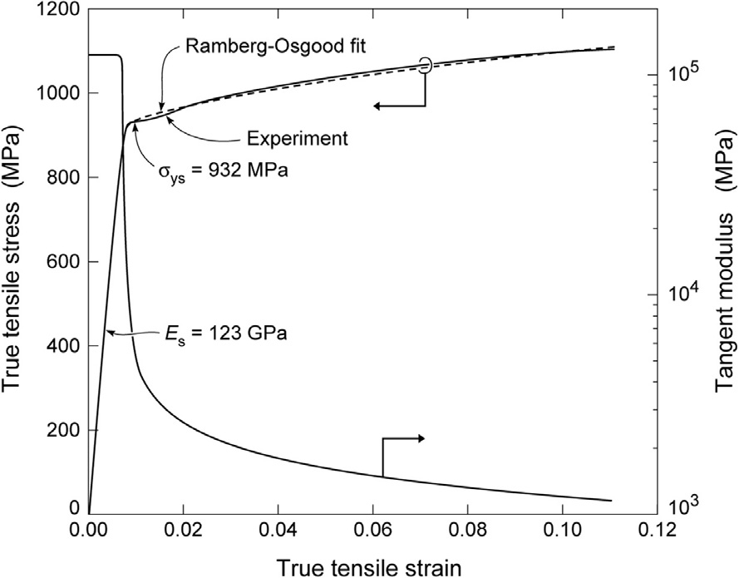
Failure mechanism of a compressed lattice with $\overline{ρ}$ = 4.6%
Mechanical responses
Compressive stress strain response of octet lattices
Cauchy stress- strain response of
Ti-6Al-4V alloy
Tangent modulus (MPa)
Inelastic truss buckling develops as the total strain, ε, increased

Slide 13
Material property charts for the snap-fit Ti-6Al-4V octet lattices

Slide 14
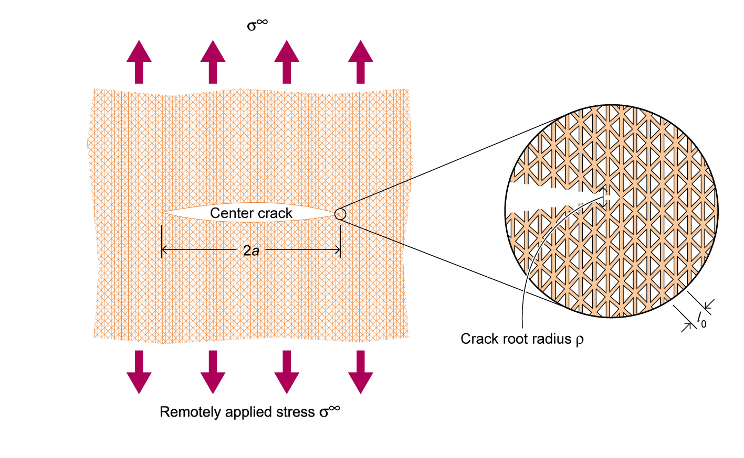
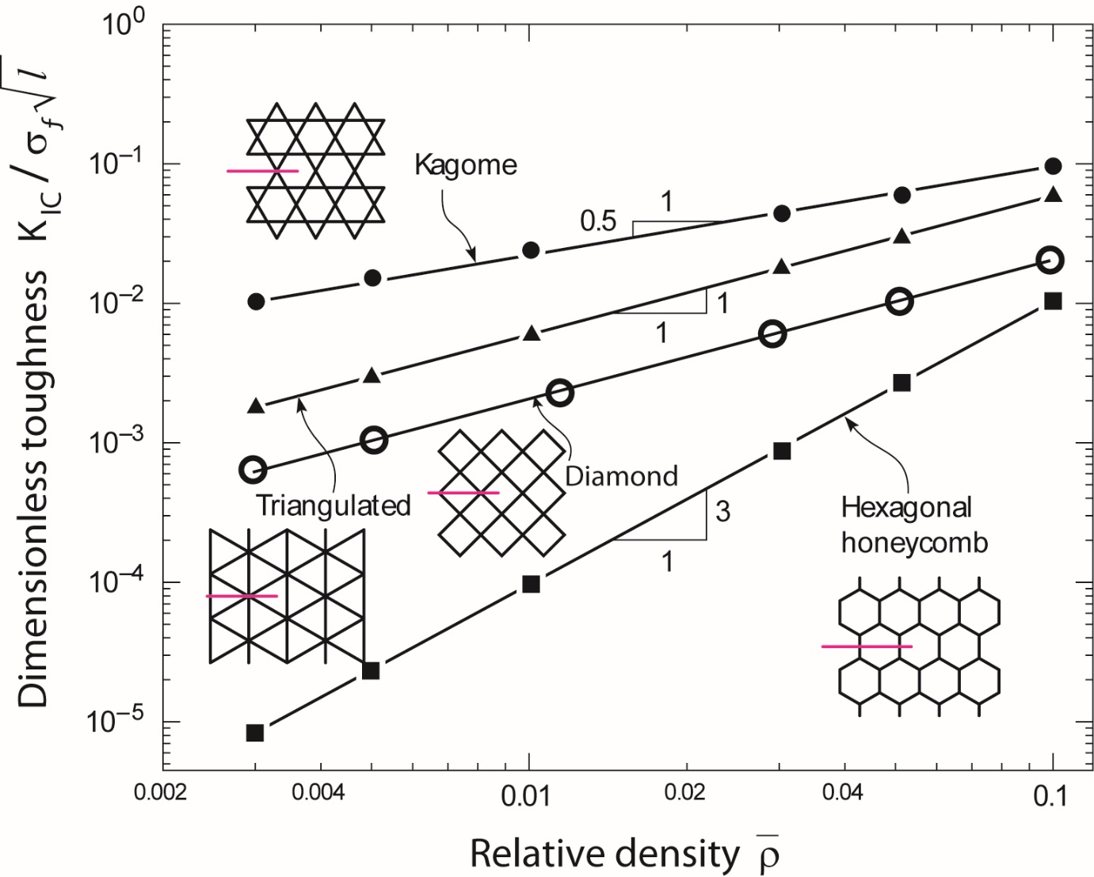


FDA predictions of the fracture toughness of brittle 2D lattices
$$K_{Ic}=α{\overline{ρ}}^{d}σ_{f}\sqrt{l}$$
d= ½ (Kagome), 1 (triangulated) or 2 (hexagonal honeycomb)
strut
2
$$K_{Ic}=\frac{1}{2}\overline{ρ}σ_{f}\sqrt{l}$$
Micro-architectured materials: past, present and future, Fleck, Deshpande, Ashby, Proc Roy Soc 2010.

Slide 15
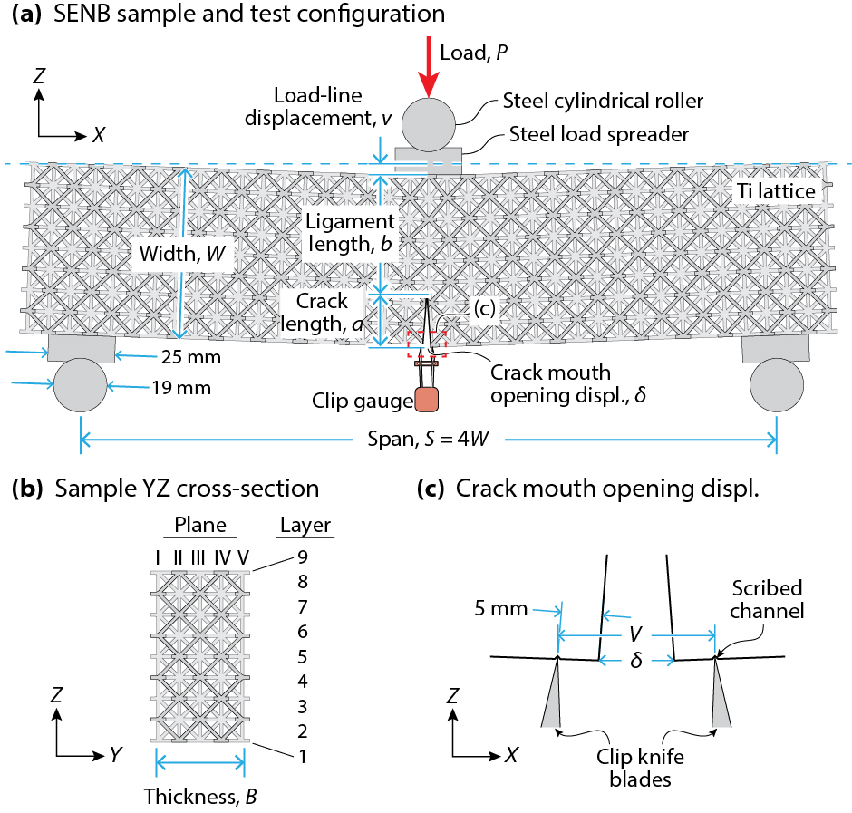
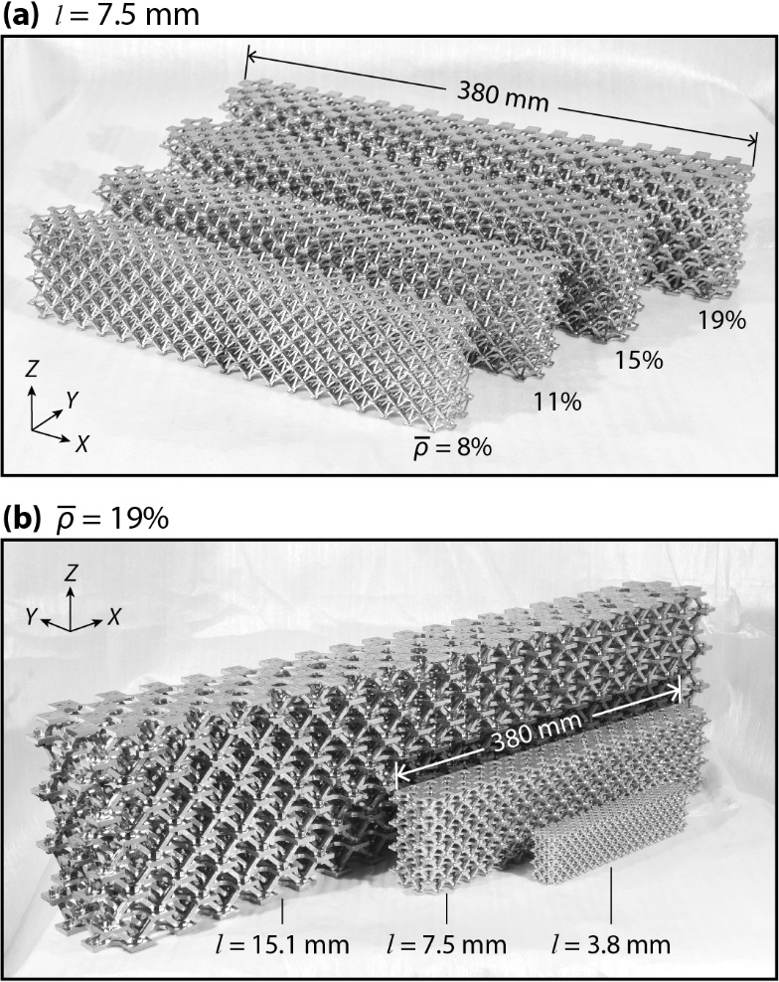
Fracture toughness of octet lattice structures
Effect of relative density
Effect of strut length
ASTM E1820 − 13
Measure J.

Slide 16
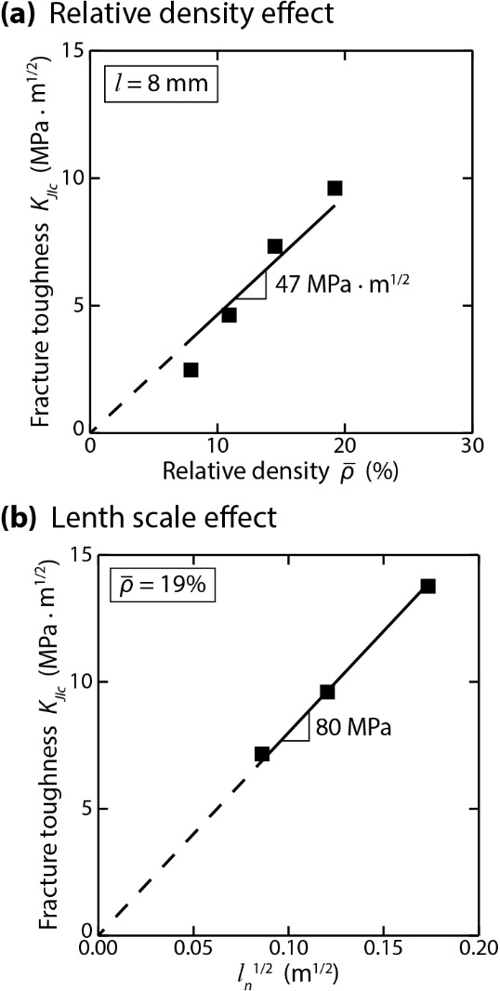
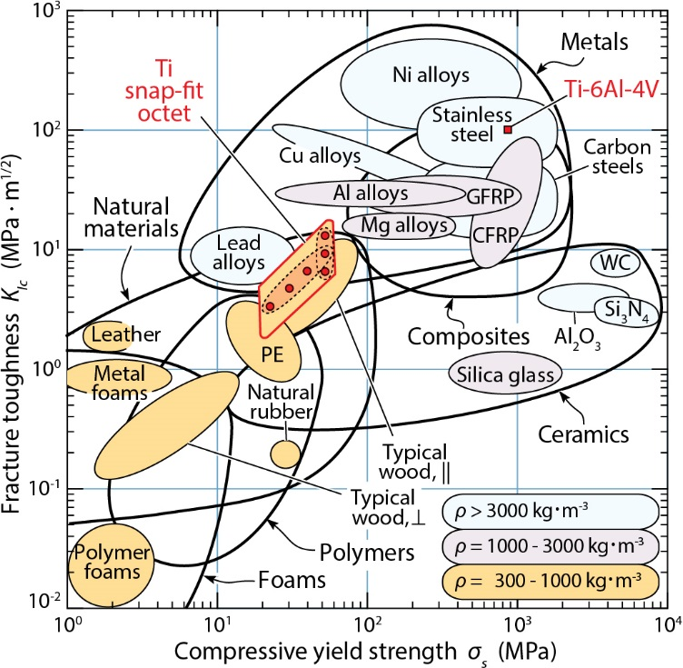


Fracture toughness and compressive strength map for materials of similar density
$$K_{Ic}=α{\overline{ρ}}^{d}σ_{f}\sqrt{l}$$
Metal bonded ceramics
How can we further increase the specific strength of lattices ?
α =0.5
d= unity
$K_{Ic}=\frac{1}{2}\overline{ρ}σ_{f}\sqrt{l}$.

Slide 17
Some thoughts for discussion

Slide 18
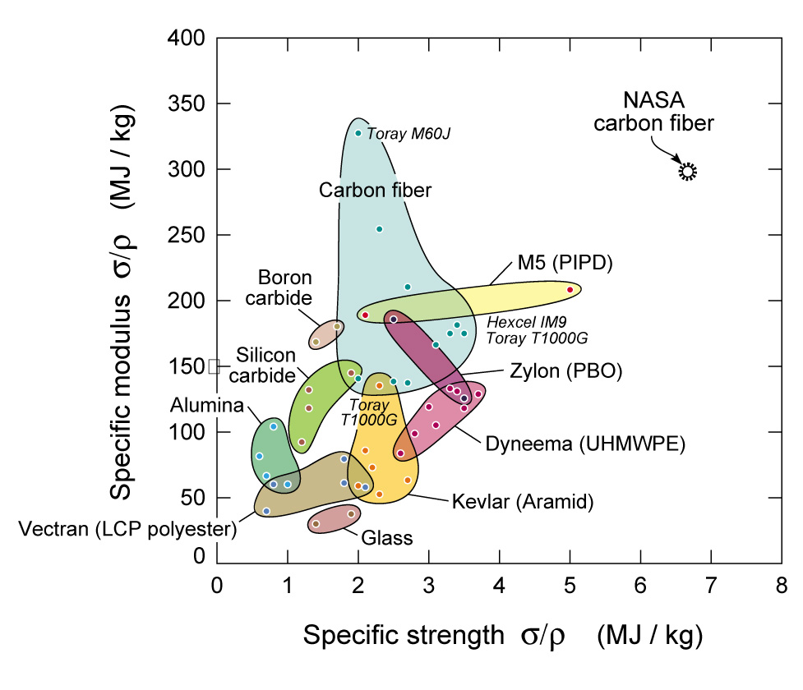
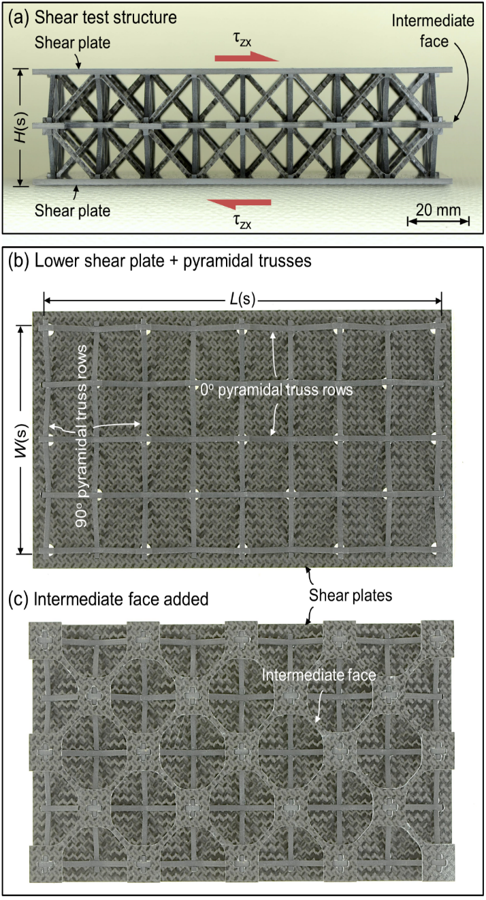
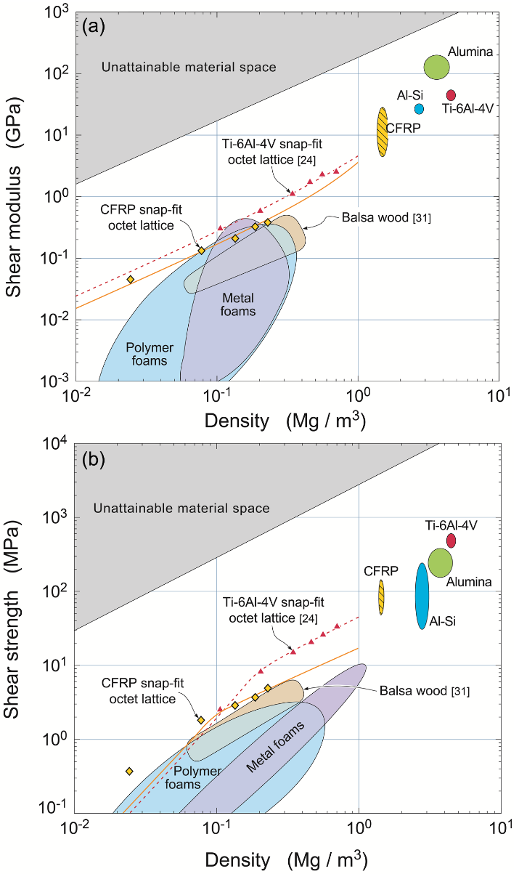
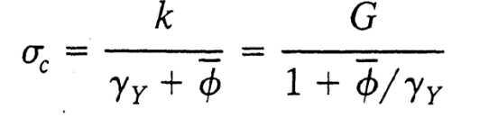
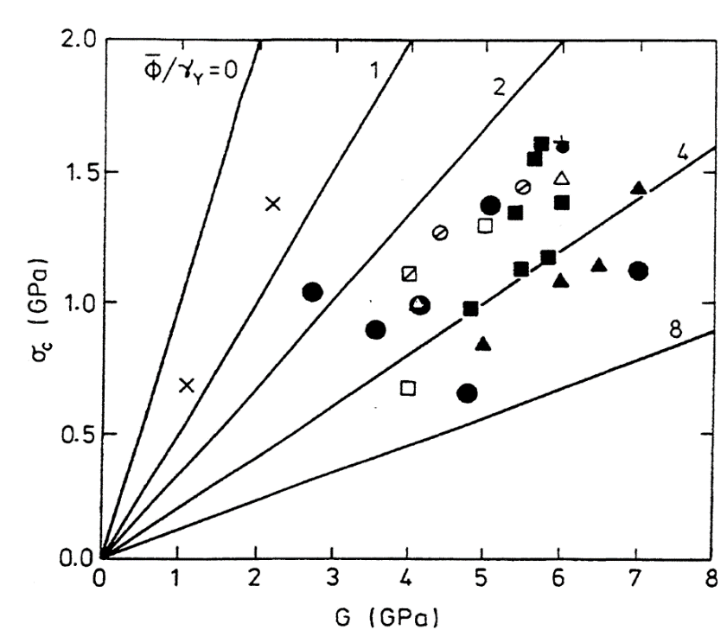
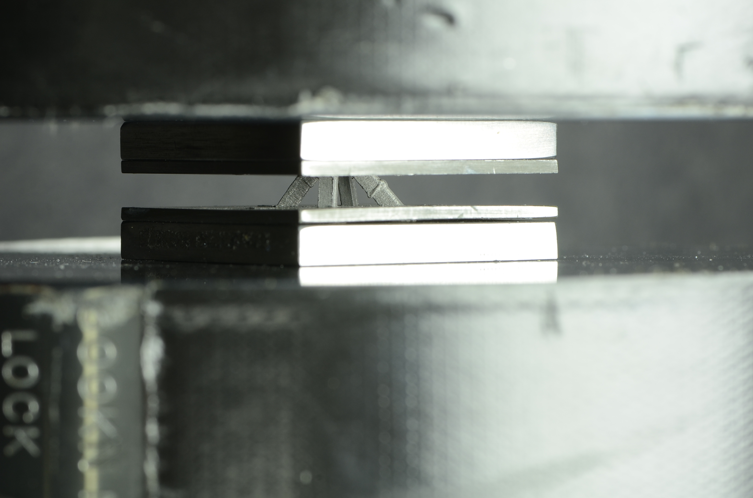
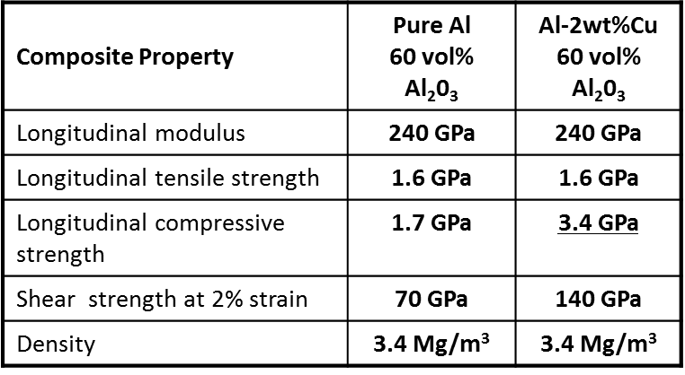
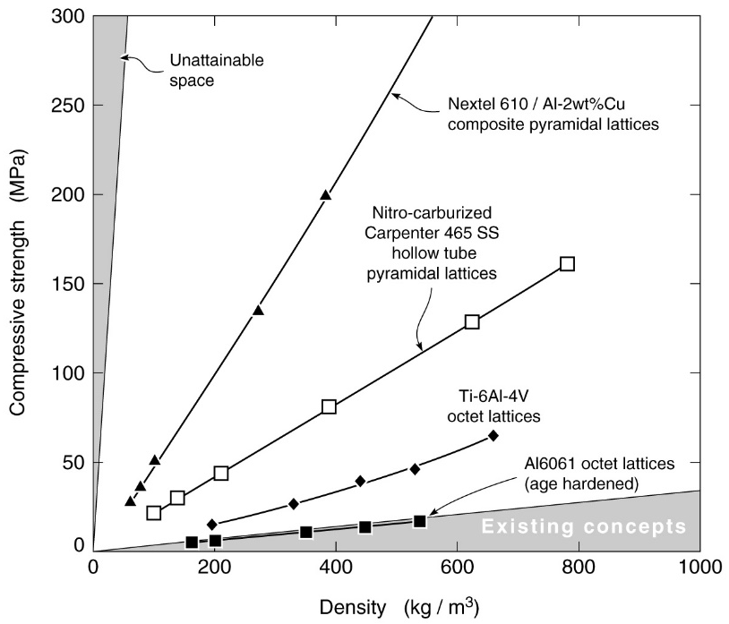
Composite (CFRP) octet truss lattices
(vinyl ester matrix: shear strength = 20 MPa)
“Stubby” composite struts fail in compression by plastic fiber micro-buckling (Budiansky/Fleck).
tension
compression
Future carbon fiber
γ _{Y} is the shear strain and k shear strength of rigid-ideally plastic matrix ϕ is the fiber misalignment angle (~2º) and G the shear modulus.
Microbuckling of Nextel⁶¹⁰ fiber-Al2Cu lattice
Matrix | Shear strength (MPa) | Compressive strength (GPa)
Al 7074 T6 | 350 | 9.5
Ti-6Al-4V | 550 | 15

Slide 19
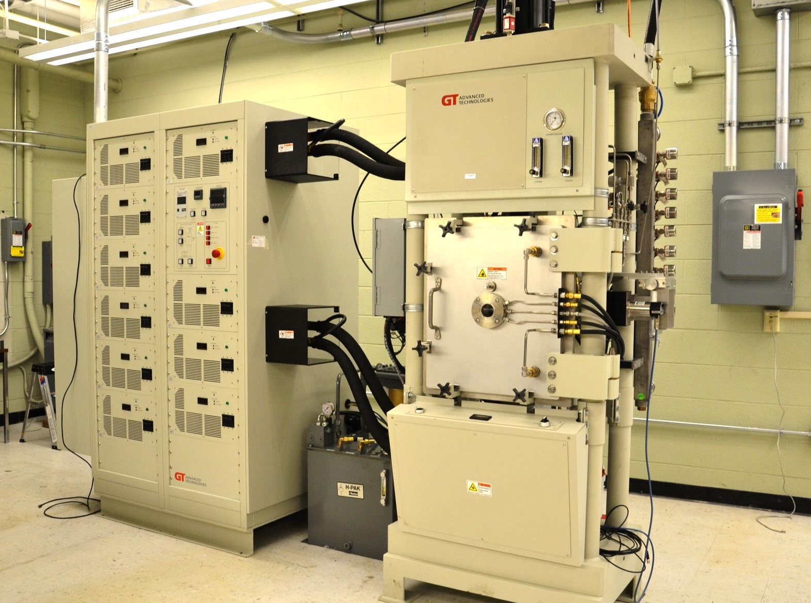
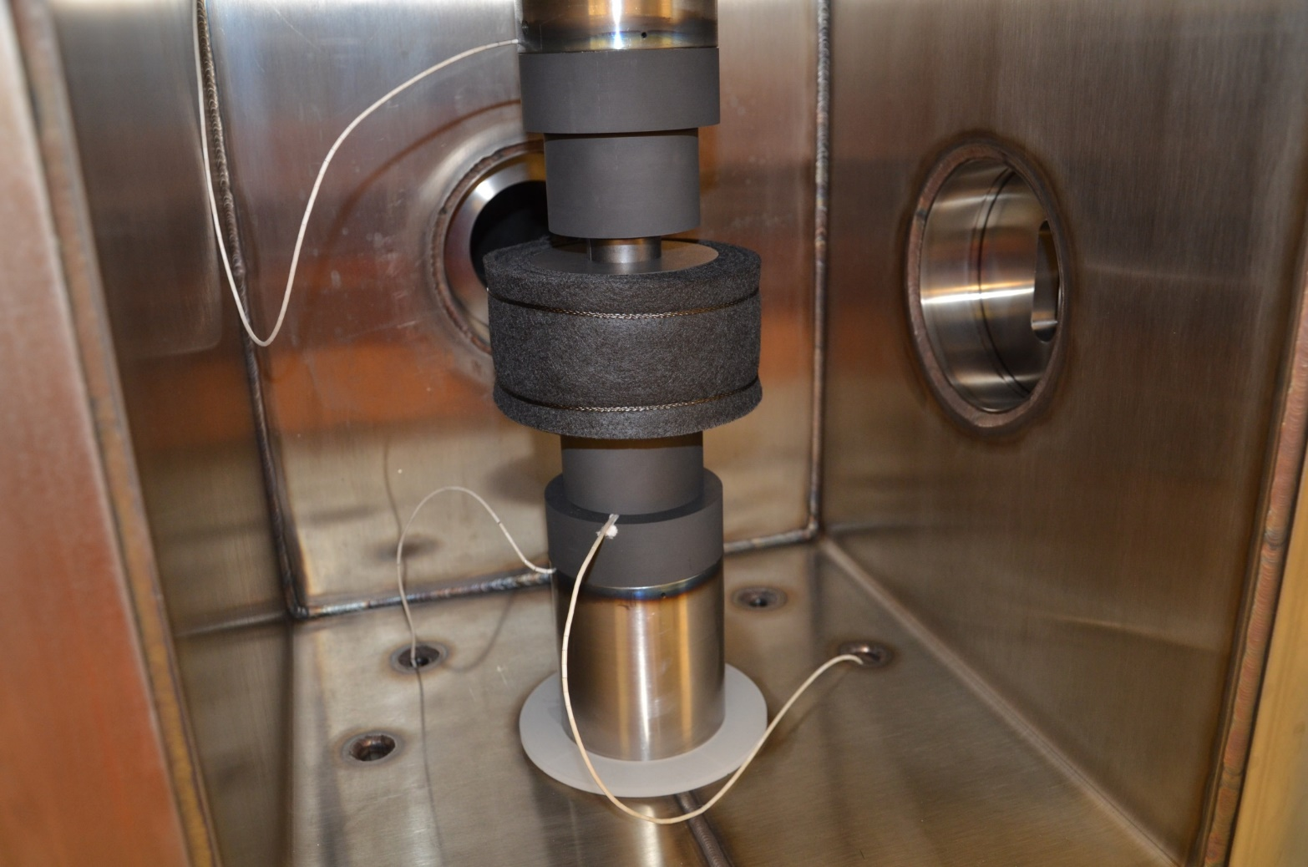
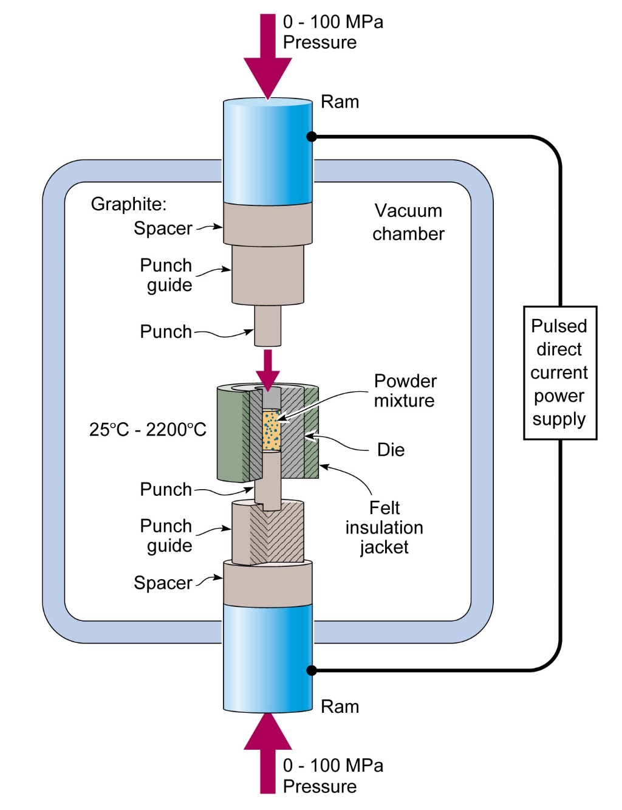
SPS system (10 kA pulses, 10 ton pressure, 10 minutes)
New Processes for Rapid Composite Synthesis and Consolidation

Slide 20
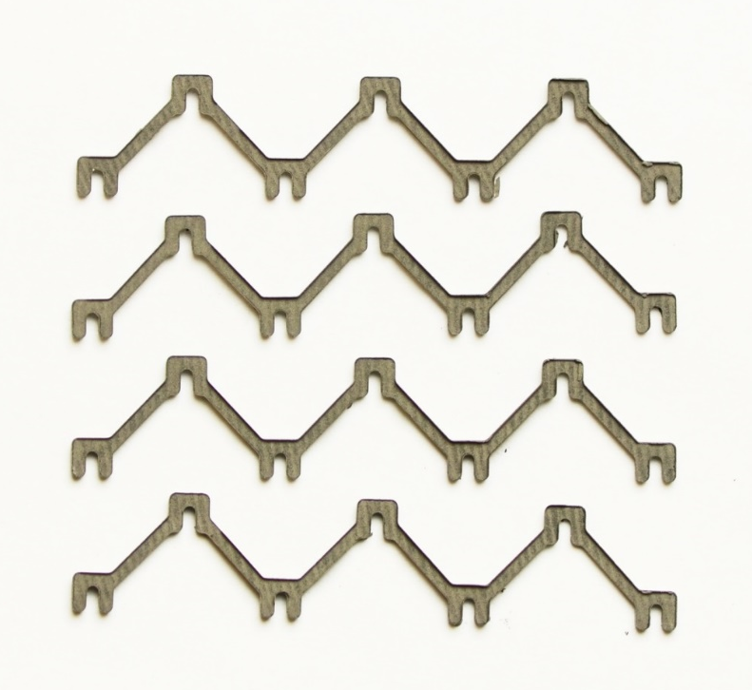

New Process Technologies for Rapid Synthesis and Consolidation
15 mm

Slide 21


Microstructure and mechanical properties of SHS 85 vol %TiC + 15 vol% NiMo
Property | Symbol | As-received value | Post HIP value
Elastic modulus | E | 383 GPa | 378 GPa
Shear modulus | G | 155 GPa | 154 GPa
Poisson’s ratio | υ | 0.23 | 0.22
Vickers microhardness | HV | 1120±170 HV | 1570 ± 230 HV
Compressive Yield Strength (.2%) | σ­­_{YS} | 2250 ± 210 MPa | 2220 ± 170 MPa
Compressive strength | σ­­_{UTS} | 2670 ±139 MPa | 2620 ± 200 MPa
Flexural Strength | σ­­_{b} | 610 ± 130 MPa | 600 ± 78 MPa
Fracture Toughness* | K_{IC} | 15.2 ± 1.1 MPa·m^{1/2} | 17.3 ± 2.2 MPa·m^{1/2}
Residual Stress (TiC phase) |  | 148 MPa ± 35 MPa (compressive) | 285 MPa (compressive)
Core rim structure of TiC arises from diffusion of Mo into surface of the carbide
Density = 5,500 kg/m³
Much higher specific modulus and strength c.f. titanium alloys

Slide 22


Comparisons

Slide 23





Ultra-strong (hard) materials
SHS -TiC-Ni cermet (15vol% Ni)
Ti-TiB density =4,400 kgm⁻³
Hardness = 13.3 GPa: σ_{YS} ~2.7 GPa
SPS - TiB₂ +15vol%Ti
NiMo
TiC
TiB
α Ti
SPS - TiC-Ni cermet (15vol% Ni)
Hardness = 16.5 GPa: σ_{YS} ~3.4 GPa
TiC
NiMo
1650ºC 10min 50MPa
Hardness = 25.2 GPa
Adapted from Compton and Zok

Slide 24


Carbon nanotube composites
CNT/BMI
CNT/BMI
Wang et al Mater. Res. Lett 2013
Other ways to play the nano card?

Slide 25




The Theoretical Strength of Nanoscopic Materials
FCC metals
Covalent solids
Nickel inverse opal with 20 nm width ligaments
a-SiC Syntatic foam
Silicon carbide
Shin et al 2012
Relative density=10%
Density=0.1x3,200 kgm⁻³ = 320 kgm⁻³
Opportunity to create metallic nanolattice that is 10X stronger than SOA at 5 nm.
But ceramics offer transformational opportunities at 0.5 μm strut diameter.

Slide 26
High strength at sub-micron scale results from initiation of <110>{111} slip
3C SiC (zinc blend structure)
Yield stress = 12-15 GPa
Increased strength of pillars as pillar diameter decreased due to reduction in sample volume (reduced probability of grain boundary flaws).

Slide 27





Lattices Assembled From Nanoscopic Materials That Reach Their Theoretical Strength
Theoretical strength limit reached at small size
Nano-octet lattice strength
Examples of other size dependent properties
Catalytic properties –nano-materials have enhanced chemical reaction rates (endothermic reactions with jet fuel)
Electrochemical properties – nano-materials rapidly transfer ions (Li+ ion rechargeable batteries)
Melting properties – nano-materials have lower transition temperatures from solid to liquid (thermal batteries)
Magnetic properties – nano allows control of the electron spin interactions (magnetic flow control)
Optical properties – nanomaterials enable novel uses of light (transparency, electrochromics)
Wetting –radius of curvature changes liquid surface contact angle (super hydrophobicity- novel heat transfer)
FCC Example: Copper
Covalent Example : SiC
Struts approach
the strength limit size
t
Example of a hierarchical lattice
Copper
http://www.nanoscribe.de/en/
Julia Greer (Caltech)

Slide 28




Scaling laws for the strength and toughness of a stretch dominated lattice
density of lattice
Yield strength
of lattice
Yield strength
of parent solid
density of parent solid
Failure strain
Fracture toughness
of lattice
Cell size
yield strain
Fleck et al 2010
The Ti-6Al-4V alloy example
$σ_{YS}$=1000 MPa
$ρ_{S}$= 4.5 Mgm⁻³
$ρ$ = 0.45 Mgm⁻³
Hence,
$σ_{Y}$=100 MPa
for = 1-10mm

Slide 29




There may be a solution,.. consider crack propagation in hierarchical lattices
Consider the propagation of a crack through a lattice itself made of a nano-lattice (or foam) of a single small cell size.
Octet lattice made from an
inverse opal
Say 20 nm
Say 5 mm
When the crack tip is in a large cell
When the crack tip is in a small cell
For L_{o} >> l_{o} , and the crack arrests between the large cell size struts, resulting in high fracture toughness.

Slide 30
Hierarchical Light Lattices (Half Density of Water)
Octet lattice made from an
inverse opal
Inverse opal
Inverse opal
IO from IO
Octet from inverse opal

Slide 31




Hierarchical SiC Lattices: Inverse opal nanolattice vs 3D printed lattice
Assume 30% relative density for the large cell octet lattice
0.3 x 3,200 kgm⁻³ = 960 kgm⁻³
Octet from inverse opal
10 μm
5 mm
Strength of Octet-Octet 3D printed lattice:
Strength of Inverse Opal-Octet hierarchical lattice:

Slide 32

The Strength and Toughness Predictions for Lattices with a Density a Half Density of Water
Only tan colored bubbles have density < water
Integrated Computational Materials Engineering
(exploits MGI)
Silicon carbide
Inverse opal
Computational modeling of functional properties can be used to discover/invent new hierarchical hybrids with revolutionary combinations of materials functionalities.
Inverse opal
+
IO from IO
Simulation/control of microstructure evolution (material states) during synthesis and processing
Octet from inverse opal
Ceramic options have high strength/toughness at low density + multifunctionality
New opportunity?

Slide 33

The Emerging Hierarchical Lattices Opportunity
Combine newly developed capabilities with manufacturing, materials (genomic) modelling, multiscale topology optimization that create new states of matter with compelling multifunctionalities for NASA applications
Applications
Example functionalities
Mechanical structure + energy storage (thermal via phase change, endothermic reactions, ion diffusion)
+ Heat transfer (two phase, magnetic control)
+ Signature control (acoustic, E/M damping, IR frequency control, electrochromic displays)
nano and macro lattice lengths scales + materials selection + novel integration strategies = new design paradigm

Slide 34
Concluding Remarks
Stretching governed (high nodal connectivity) lattices have moduli approaching material limits. Modulus is topology dependent and proportional to that of the solid and relative density.
Their strength is well predicted by models but today’s materials remains are well below theoretical limits.
The strength of octet lattices can be increased using lightweight materials:
Metal bonded ceramics
Nanoscopic (defect starved) struts (nanolattices/inverse opals)
CFRP struts with very high matrix shear strength (CNT or BNCT – eventually graphene reinforced)
But their toughness is predicted to be (very) low.
Hierarchical lattices look promising for combining strength and toughness, and may exhibit numerous other functionalities (heat transfer, catalysis, energy storage).

Slide 35





Fracture toughness predictions for 15wt%Ti-TiB₂ octet truss lattice
Fracture toughness of octet truss lattice
$$K_{Ic}=0.45\overline{ρ}σ_{s}\sqrt{l}$$
Note, fracture toughness of a lattice structure is also given by
$$K_{Ic}=∑σ_{lattice}\sqrt{\frac{ε_{f}}{ε_{Y}}}\sqrt{l}$$
For an octet truss lattice, it is
$$K_{Ic}=∑0.33\overline{ρ}σ_{s}\sqrt{\frac{ε_{f}}{ε_{Y}}}\sqrt{l}$$
Topology parameter Σ$=$0.136
For Ti-6Al-4V octet truss lattice, $\sqrt{\frac{ε_{f}}{ε_{Y}}}$~ 10; for Ti-TiB₂ cermet, $\sqrt{\frac{ε_{f}}{ε_{Y}}}$~1

Slide 36
BUT,… crack propagation is easy in single cell size nano-lattices (or foams)
Consider a cellular lattice (or foam) structure with a single cell size characterized by a strut length l_{o}.
Suppose it contains a flaw of length 2a
When the structure is loaded by applying a stress, at the sample boundaries,
the stress at the tip of the crack rises (intensifies) by a factor that increases with crack length and with decrease in the radius of curvature at the crack tip:
The crack tip radius of curvature is approximately the cell strut length. Thus the stress at the crack tip increases as the cell size decreases.
The resistance to crack extension decreases as cells get small – is very small for nanoscopic struts!

Slide 37


Representative responses of SENB samples
c
d
b
Crack extension occurs by strut failure at low density and nodal fracture at higher density

Slide 38

SiC inverse opal with ligaments <1 μm width
Density of SiC =3,200 kgm⁻³
Unpublished work of James Pikul (from his University Illinois web site)
Relative density=50%

Slide 39





Silicon Carbide Hierarchical Lattices with Light Metal Toughness and Nickel Alloy Strength
Octet lattice
Hierarchical lattices
Program has developed a titanium octet lattice “super wood” that 3x stronger and 3-30x tougher than isotropic wood.
Multi-kg scale fabrication demonstrated.
Micromechanical analysis indicates that if the Ti struts of the lattice are replaced by microlattice made from high elastic modulus struts (whose strength approaches material theoretical limits) a hierarchical lattice can be made.
HL’s would be tougher than light metals, stronger than many steels But have a density less than water!
Ti octet lattice
Tougher than light metals
Ti lattice is 3x stronger and tougher than isotropic woods
Strong as steel
Lattices also exhibit multifunctionality
Hierarchical octet lattice
Efficient cross flow heat exchange
Acoustic metamaterials (stop bands)
Controllable μ-wave reflectivity
Shape morphing structures
Novel batteries
Many processing routes
+
Multifunctionality

Slide 40

Predictions for lattices with a density = 500 kg m⁻³
Upper bound toughness predictions
Materials in blue have a density >500 kgm⁻³
Only tan and pink have required density
Natural woods are highly anisotropic.
Isotropic wood*
Can a titanium octet lattice really do better than “isotropic” (MDF) wood?
*Medium density fiber board (MDF)

Slide 41


Slide 42


SPS 15wt%Ti-TiB₂: Hot pressed 1650C 15min 50MPa
Hardness
H = 25GPa
Compressive strength
σc = 3248 MPa± 313MPa
Flexural strength
σf = 262 MPa ± 22MPa
Fracture surface after 4 points bending

Slide 43


A simple “snap-fit” fabrication approach and σ_{zz} pyramidal lattice compression results
FEM results use σ_{c}= 2600 and 3300 MPa material models for FEM min and max predictions.

Slide 44


Predictions and measurements of compressive modulus and strength
A conservative compressive strength of 2600MPa was used for the analytical model predictions. $σ_{c}=$ 2600 and 3300 MPa material’s models were used for the minimum and maximum FE predictions

Slide 45



Slide 46


Slide 47


Microlattice with microscale octet unit cells
Z =12
Zheng et al., Science, June 2014, Vol. 344, 6190

Slide 48

Ultralight lattices with an array of material constituents across large density range can be constructed
Lattice materials with density range across five orders of magnitude have been created
Notes:
We fabricated the octet lattice materials into standard face centered cubic lattices of the same sizes to characterize this materials
material constituent ranging from polymer, to metal and ceramic.
two configurations, solid and hollow, with densities ranging across five orders of magnitude from as large as hundreds of kg.cm-3 as light as 1 kg.cm-3

Slide 49
Multiscale metallic metamaterials --- across over 7 orders of magnitude in length-scale
Zheng et al., Nature Materials, 2016 In Press

Slide 50



Net Shape TiB₂Ti Trusses
1
3
2
50 MPa

Slide 51
Fracture toughness predictions for 15wt%Ti-TiB₂ octet truss lattice
Fracture toughness of octet truss lattice
$$K_{Ic}=0.45\overline{ρ}σ_{s}\sqrt{l}$$
Note, fracture toughness of a lattice structure is also given by
$$K_{Ic}=∑σ_{lattice}\sqrt{\frac{ε_{f}}{ε_{Y}}}\sqrt{l}$$
For an octet truss lattice, it is
$$K_{Ic}=∑0.33\overline{ρ}σ_{s}\sqrt{\frac{ε_{f}}{ε_{Y}}}\sqrt{l}$$
Topology parameter Σ$=$0.136
For Ti-6Al-4V octet truss lattice, $\sqrt{\frac{ε_{f}}{ε_{Y}}}$~ 10; for Ti-TiB₂ cermet, $\sqrt{\frac{ε_{f}}{ε_{Y}}}$~1

