Slide 1
Space Exploration: Needs and Challenges
Phillip A. Williams, Ph.D.
HEOMD System Maturation Team (SMT) Lead for
Structures, Mechanisms, Materials, & Processes Discipline Team
SMT Integration Team
21 June 2016

Slide 2
Outline
HEOMD EMC Overview
Guiding Principles
Exploration Architecture
Analysis Trade Space
Pioneering Challenges/ Common Challenges & Capabilities
Capability Driven Framework/ System Maturation Teams
Materials Capability Gaps

Slide 3
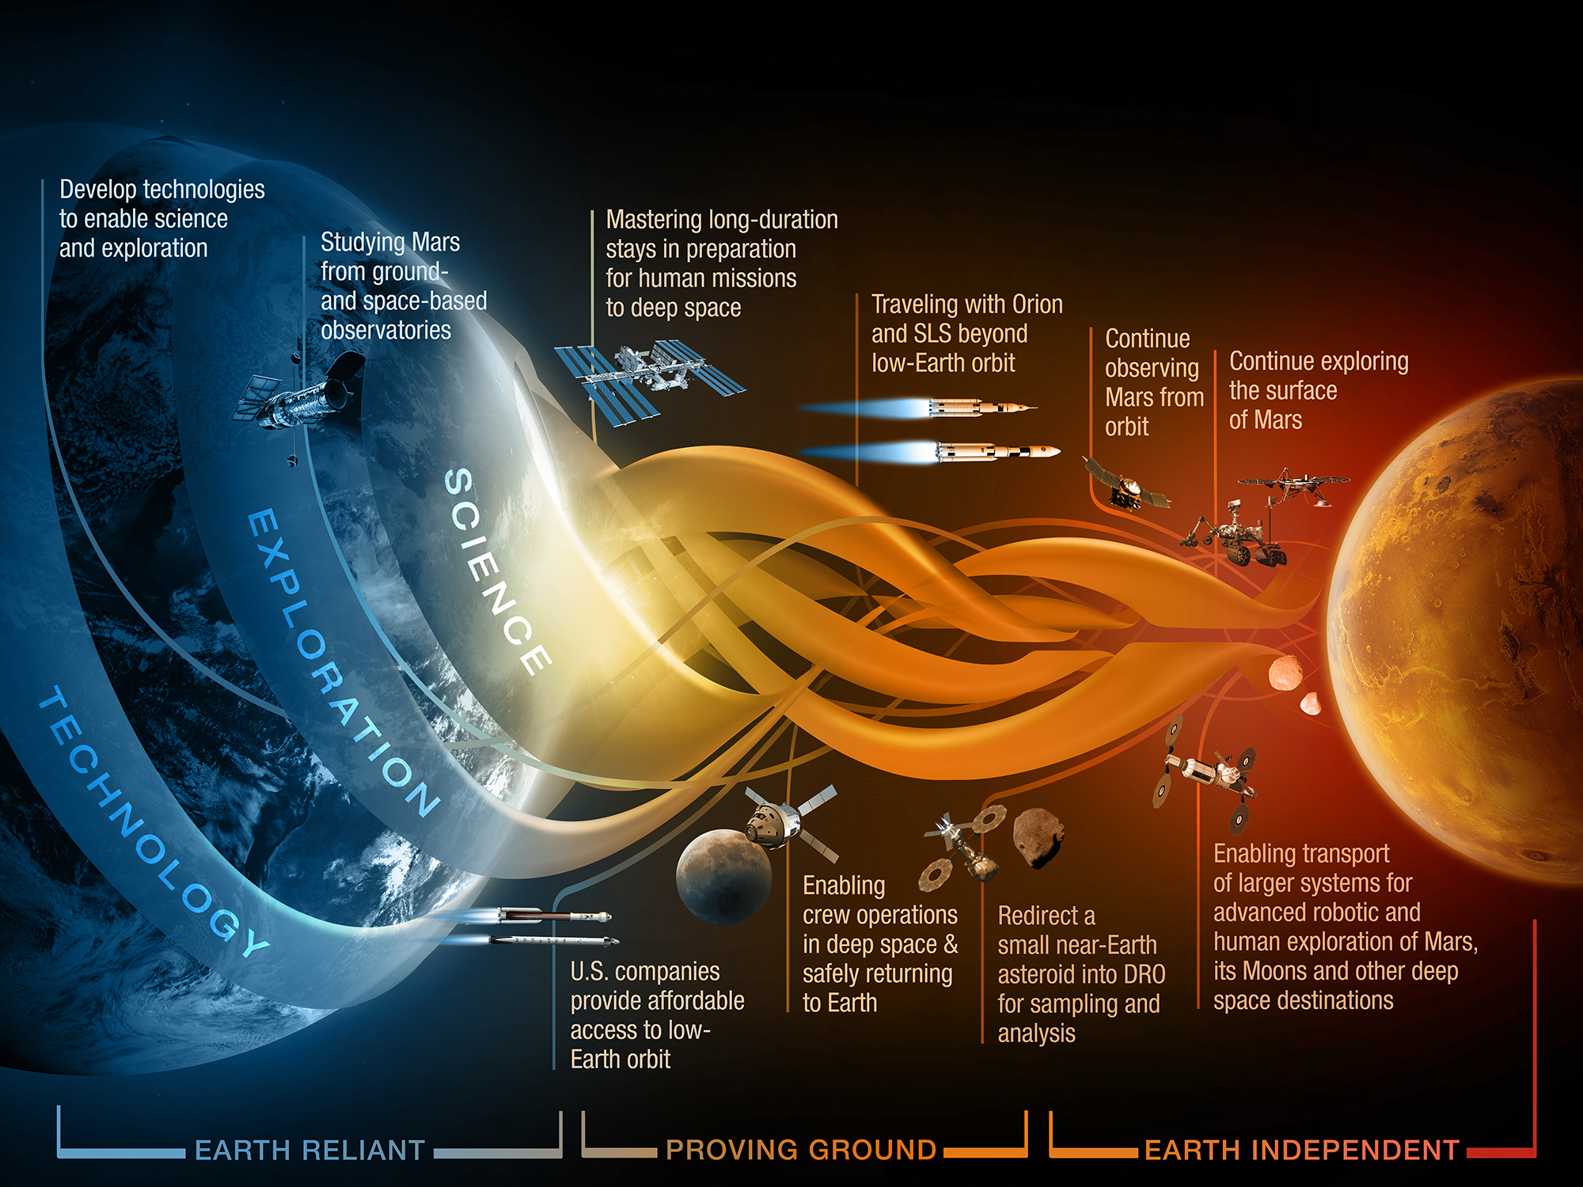



Slide 4
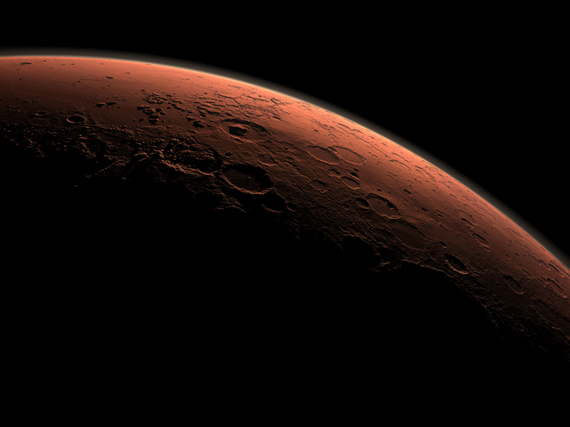
Evolvable Mars Campaign
EMC Goal: Define a pioneering strategy and operational capabilities that can extend and sustain human presence in the solar system including a human journey to explore the Mars system starting in the mid-2030s.
Identify a plan that:
  Expands human presence into the solar system to advance exploration, science, innovation, benefits to humanity, and international collaboration.
  Provides different future scenario options for a range of capability needs to be used as guidelines for near term activities and investments
    In accordance with key strategic principles
    Takes advantage of capability advancements
    Leverages new scientific findings
    Flexible to policy changes
  Identifies linkages to and leverage current investments in ISS, SLS, Orion, ARM, short-duration habitation, technology development investments, science activities
  Emphasizes prepositioning and reuse/repurposing of systems when it makes sense
    Use location(s) in cis-lunar space for aggregation and refurbishment of systems
Internal analysis team members:
  ARC, GRC, GSFC, HQ, JPL, JSC, KSC, LaRC and MSFC
  HEOMD, SMD, STMD, OCS and OCT
  External inputs from:
  International partners, industry, academia, SKG analysis groups

Slide 5
Strategic Guiding Principles
FISCAL REALISM: Implementable in near term with the buying power of current budgets
SCIENTIFIC EXPLORATION: Exploration enables science, and science enables exploration
TECHNOLOGY PULL & PULL: Application of high Technology Readiness Level (TRL) technologies and capabilities
GRADUAL BUILD UP OF CAPABILITY: Near-term mission opportunities
ECONOMIC OPPORTUNITY: Opportunities for U.S. commercial business
Architecture Openness and Resilience: Resilient architecture featuring multi-use, evolvable space infrastructure
  Logistics
  Modularity
  Commonality
  Extensibility
  Affordability
GLOBAL COLLABORATION & LEADERSHIP: New international and commercial partnerships
CONTINUITY OF HUMAN SPACEFLIGHT: Uninterrupted expansion of human presence into the solar system
Notes:
FISCAL REALISM: Implementable in the near-term with the buying power of current budgets and in the longer term with budgets commensurate with economic growth;
SCIENTIFIC EXPLORATION: Exploration enables science and science enables exploration; leveraging scientific expertise for human exploration of the solar system.
TECHNOLOGY PULL AND PUSH: Application of high Technology Readiness Level (TRL) technologies for near term missions, while focusing sustained investments on technologies and capabilities to address the challenges of future missions;
GRADUAL BUILD UP OF CAPABILITY: Near-term mission opportunities with a defined cadence of compelling and integrated human and robotic missions, providing for an incremental buildup of capabilities for more complex missions over time;
ECONOMIC OPPORTUNITY: Opportunities for U.S. commercial business to further enhance their experience and business base;
ARCHITECTURE OPENNESS AND RESILENCE: Resilient architecture featuring multi-use, evolvable space infrastructure, minimizing unique developments, with each mission leaving something behind to support subsequent missions;
Logistics
Design to minimize the number of systems, use them multiple times, refresh instead of replace them, and maintain with local resources to enable self-sufficient missions.
Modularity
Standardize for flexibility, simple interfaces to enhance complex subsystems and components.
Commonality
Develop systems that serve multiple purposes across the campaign at many destinations.
Extensibility
Develop initial hardware with paths for enhanced applications.
Affordability
Optimize system development across a campaign, not a mission to minimize development costs.
GLOBAL COLLABORATION AND LEADERSHIP: Substantial new international and commercial partnerships, leveraging current International Space Station partnerships and building new cooperative ventures for exploration; and
CONTINUITY OF HUMAN SPACEFLIGHT: Uninterrupted expansion of human presence into the solar system by establishing a regular cadence of crewed missions to cislunar space during ISS lifetime.

Slide 6
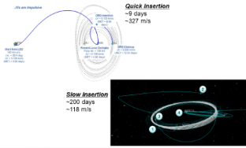
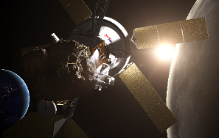
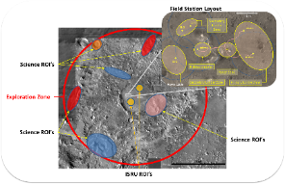
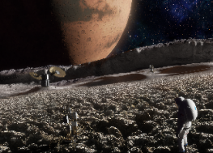
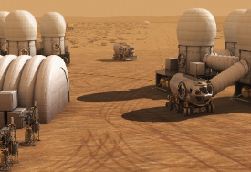
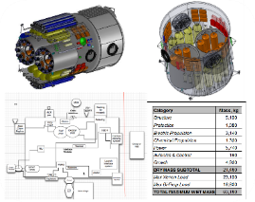
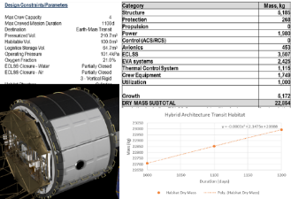
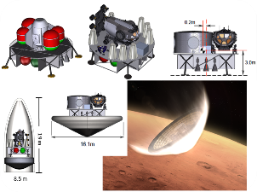
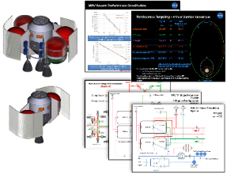
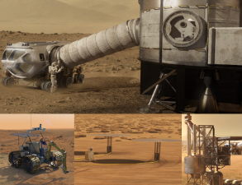
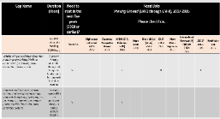
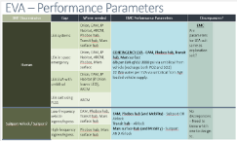
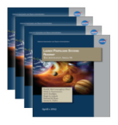
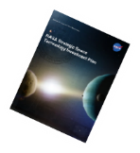
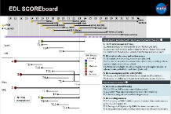
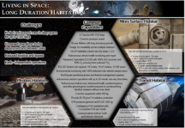
EMC Assessment Capability Requires Breadth and Depth…………………………………………….
Campaign Analysis, Timelines and Decision Needs
Congress
NAC
Int’l Partners
Industry
2025
2026
2027
2028
2029
2030
2031
2032
‘33
‘34
‘35
...
Public
2020
2021
2022
2023
2024
ARRM
Mars 2020
EM-4
EM-5
EM-6
EM-7
EM-8
Phobos
Mars 1
Mars 2
EM-2
EM-3
Mission Operations Development
Trajectory and Orbit Analysis
Proving Ground Ops
Landing Site Selection and Layout
Destination Operations
Element Conceptualization and Design
In-space Transportation Systems
Habitat Sizing
Lander
Mars Ascent Vehicle Design
Destination Systems
Capability Needs Analysis
Performance Parameter Definition
Strategic Planning
STMD
ISS
ESD
AES
NASA Decision Processes, Technology Roadmaps & Strategic Investment Plan
Capability Gap Analysis and Roadmap Development
Pioneering Space Challenges

Slide 7
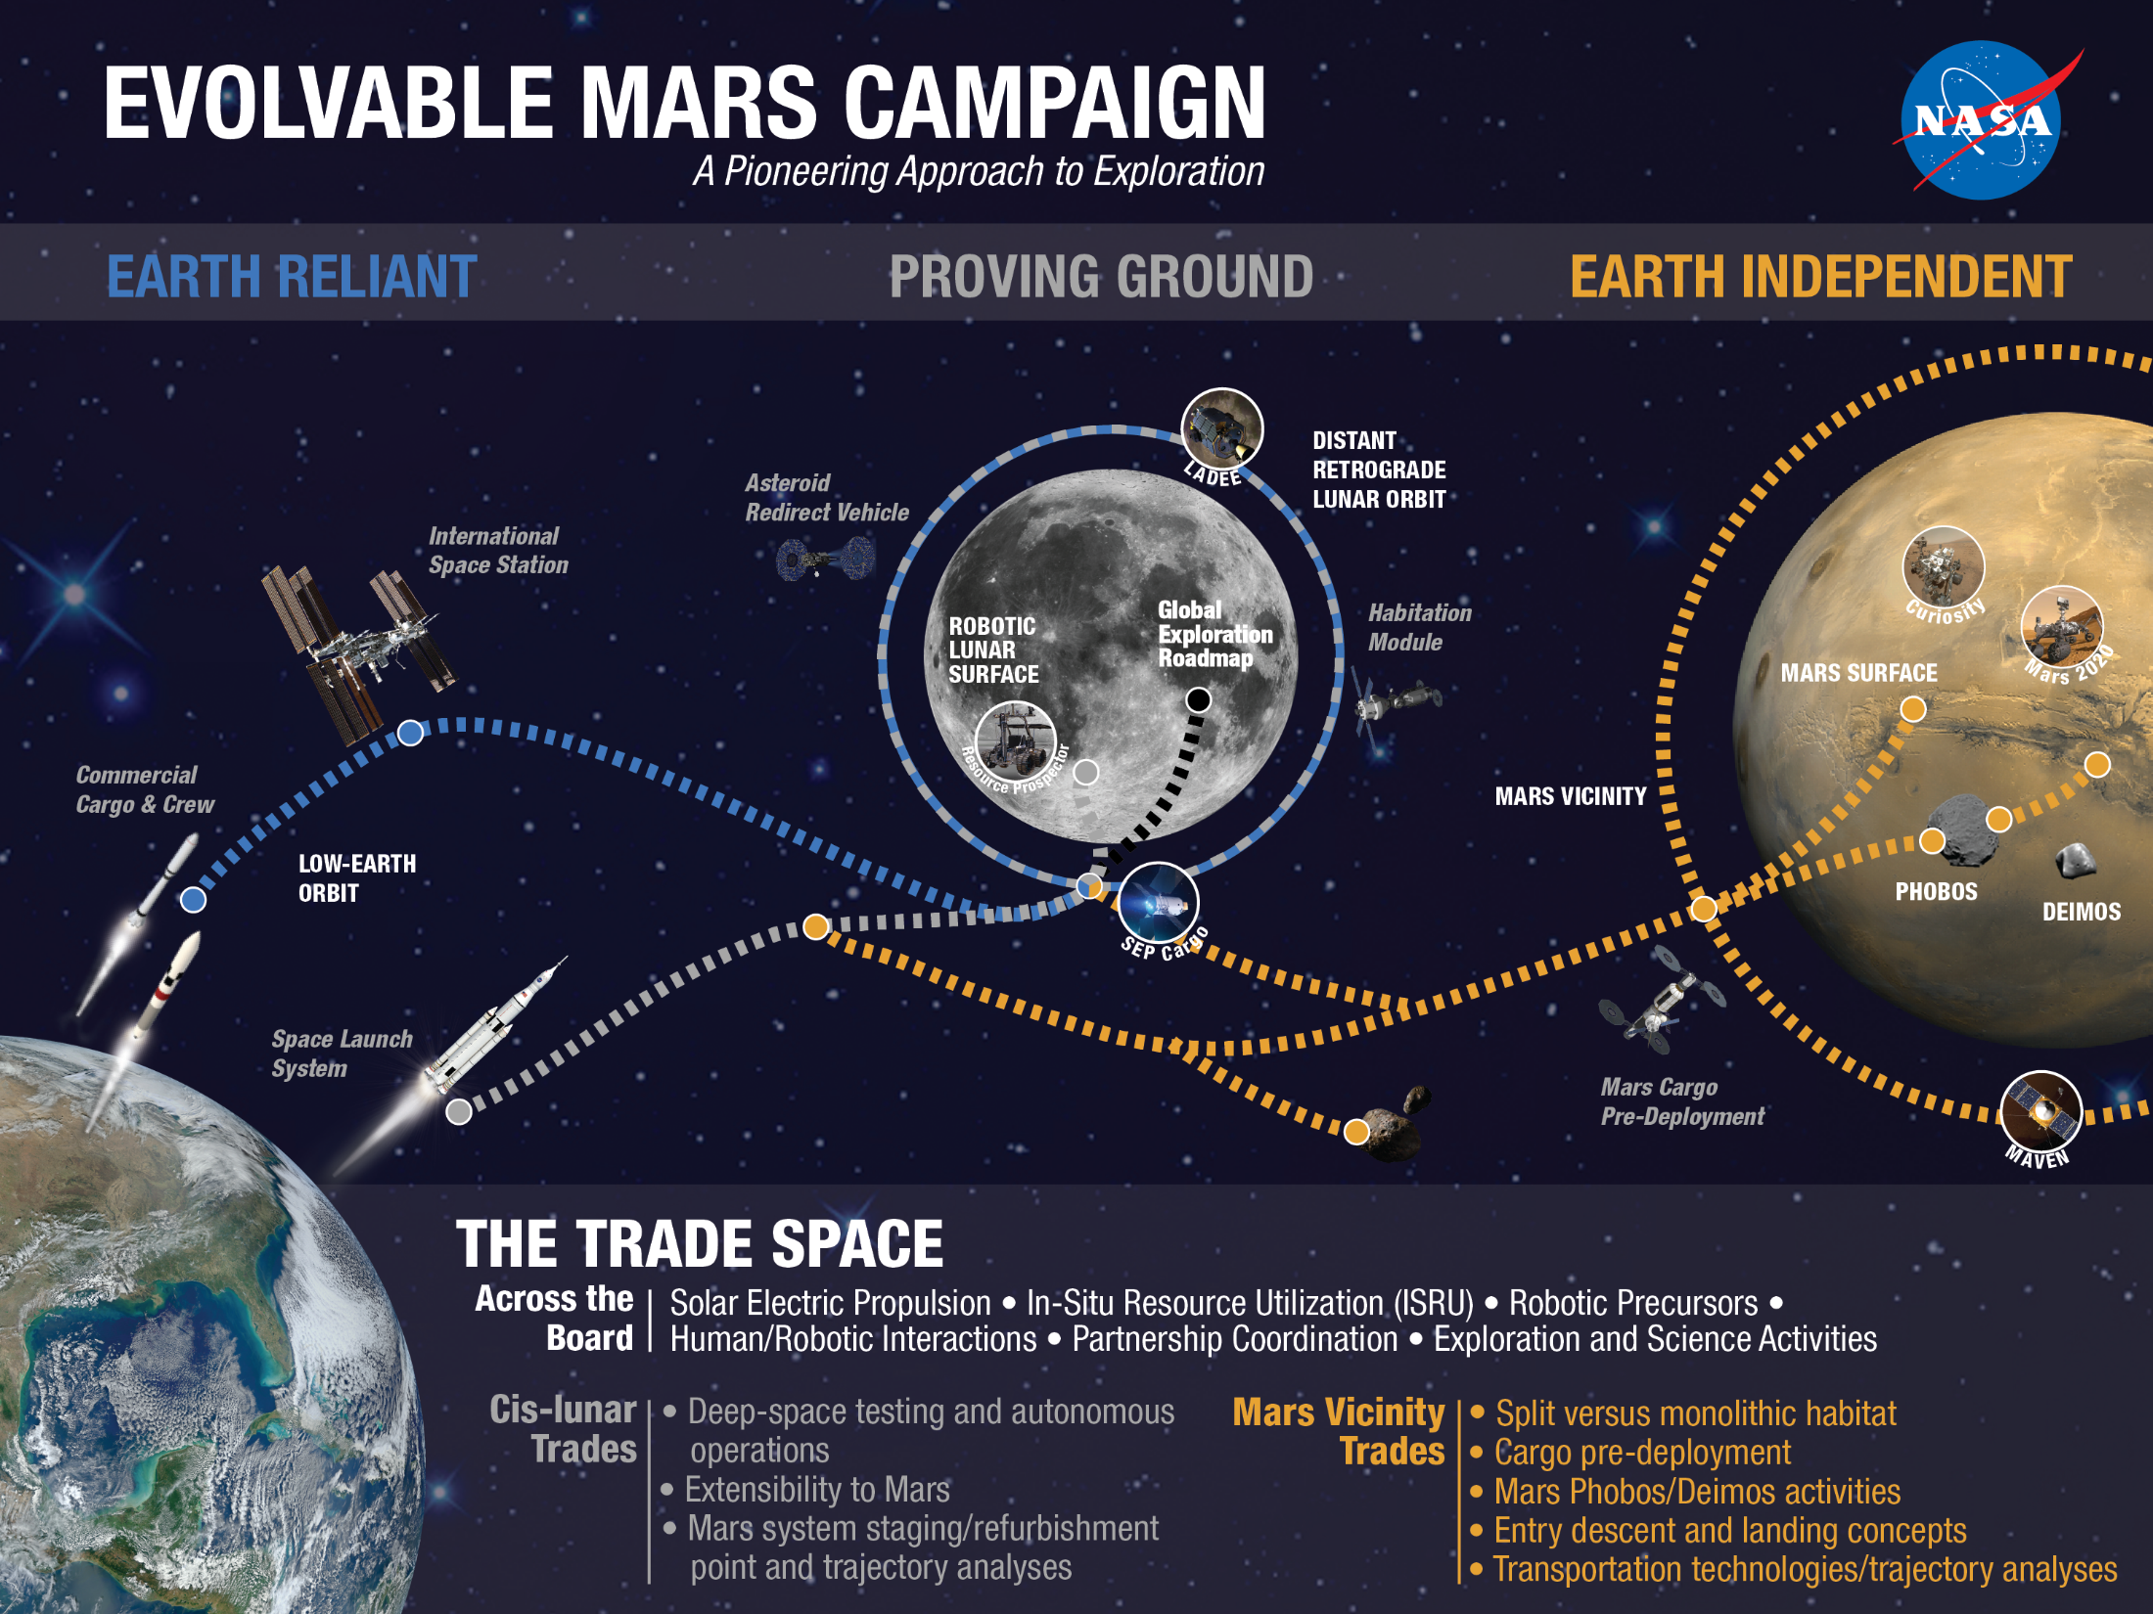
Notes:
NASA has identified specific scientific and technical challenges for the journey to Mars through rigorous studies, including an ongoing series of architectural trade analyses, external reviews, assessments of deep-space habitation options with international partners, and high-priority objectives of science decadal studies.
Transportation
Working in Space
Staying Healthy/Living in Space

Slide 8
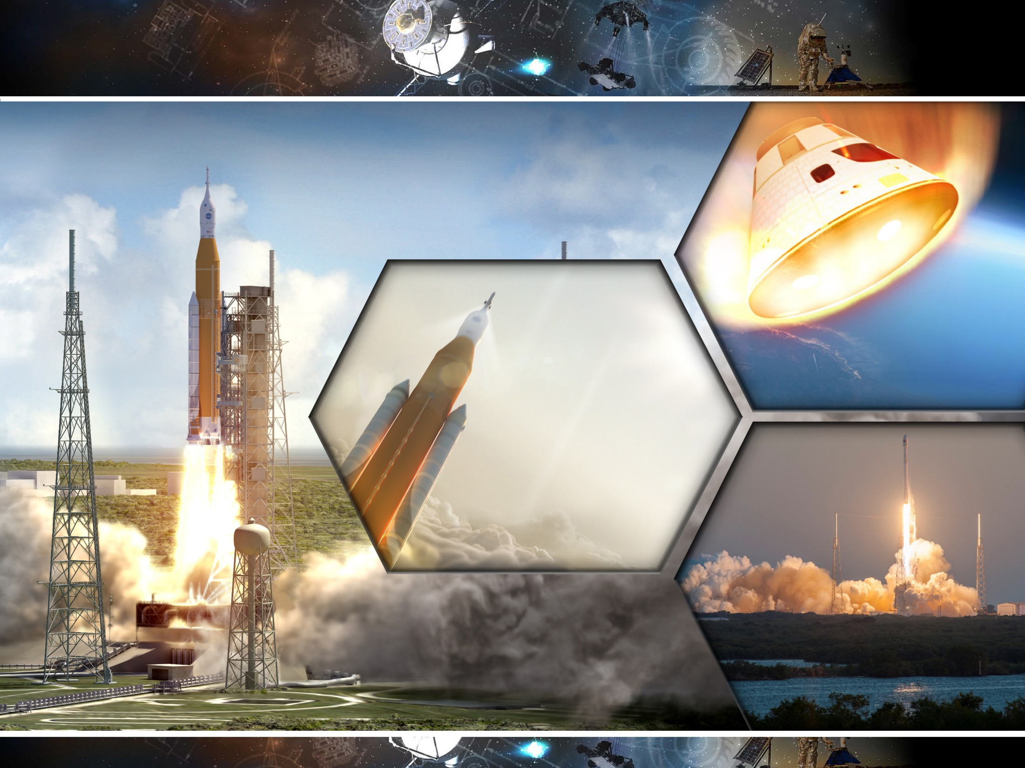
Transportation of Crew and Cargo To/From Deep Space
Challenges
Orion
Deliver crew and cargo to deep space
Return crew from deep space
Space Launch System
Support crew during trip to/from cis-lunar space
4 crew for 21 days
Contingency EVA in a Launch, Entry, and Abort (LEA) suit using umbilical life support
Ability to rendezvous and dock with other in-space elements
Earth to cis-lunar navigation
Earth entry from cis-lunar space: 11 km/s
Transport crew and cargo to cis-lunar space
Initial launch vehicle that can launch 36 t to TLI
Upgraded launch vehicle that can launch 43 t
to TLI
Option for 5, 8.4, or 10 m diameter shroud
1/year launch rate with surge to 2/year
for cis-lunar missions
2/year launch rate with surge to 3/year
for Mars missions
Commercial Launch
Use commercial launch vehicles to deliver logistics and small cargo to cis-lunar space
Small cargo vehicle to deliver up to 11 t to TLI
Shroud = 5 m diameter

Slide 9
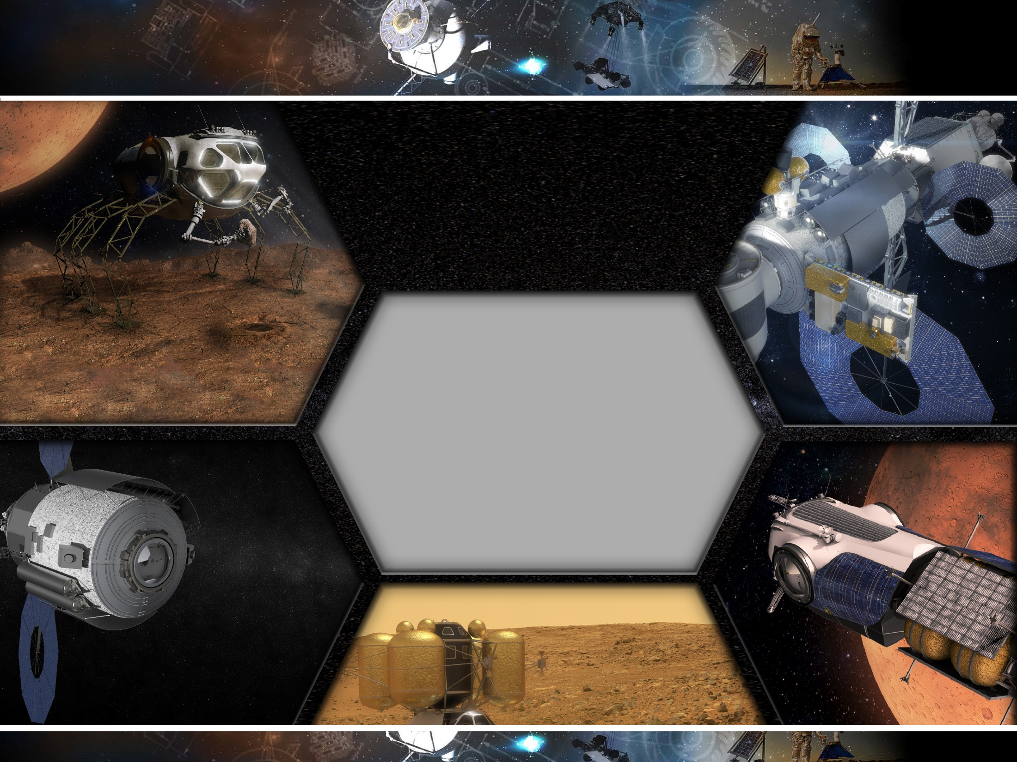
Living in Space:
Short Duration Habitation
Living in Space:
Short Duration Habitation
Excursion Vehicle
Challenges
Initial Cis - Lunar
Habitation
Protect and support crew in deep space for up to 60 days
Uncrewed operations during deployment and between uses
Earth - independent operations
Explore kilometers away from the destination habitat
2 crew for up to 2 weeks, contingency 4 crew for 1 week
EVA pressure garment and PLSS <200 kg with dual-band radio
avionics and radiation hardened bio-med sensors
High frequency EVA (15 min. ingress-egress time)
4 years dormant before first use and between uses
Design for reuse for 3 missions
Lightweight exercise equipment under 25 kg
Support crew each year for short duration stays in cis-lunar space
4 crew for up to 60 days
EVA pressure garment and PLSS <200 kg with dual-band radio avionics and rad-hardened bio-med sensors
High frequency EVA (15 min. ingress-egress time)
Lightweight exercise equipment under 25 kg
1 year dormant before use
Up to 300 days dormant between uses
Common Capabilities
4 crew for short durations (up to 60 days)
Support autonomous mission operations with time delay
Common, partially closed ECLSS under approx. 800 kg
(3 years MTBF and 2 crew per torr of CO₂ removal)
Autonomous rendezvous, prox ops, and docking
Ability to be teleoperated with <0.5 s latency
Communications to/from Earth and between elements
Common, lightweight pressure vessel and common hatch
15 year lifetime with long dormancy periods
Design for maintainability
Logistics Module
Mars Taxi
Mars Ascent Vehicle
Transport crew between Mars orbit and Mars Moons
4 crew for up to 2.5 day crewed duration
560 days operational (uncrewed) at Mars
2 years dormant before use
Up to 1.5 years dormant between uses
Logistics module to cis-lunar space
Launched on either SLS and ELV launch vehicles
Carries up to 5-10 t of pressurized logistics
10-15 t total mass
Return crew to Mars orbit
4 crew for up to 3 days flight duration
Open loop ECLSS under approx. 400 kg
5 years dormant before use
Notes:
Short duration ECLSS is common with Orion ECLSS
MTBF is reported at the component level

Slide 10
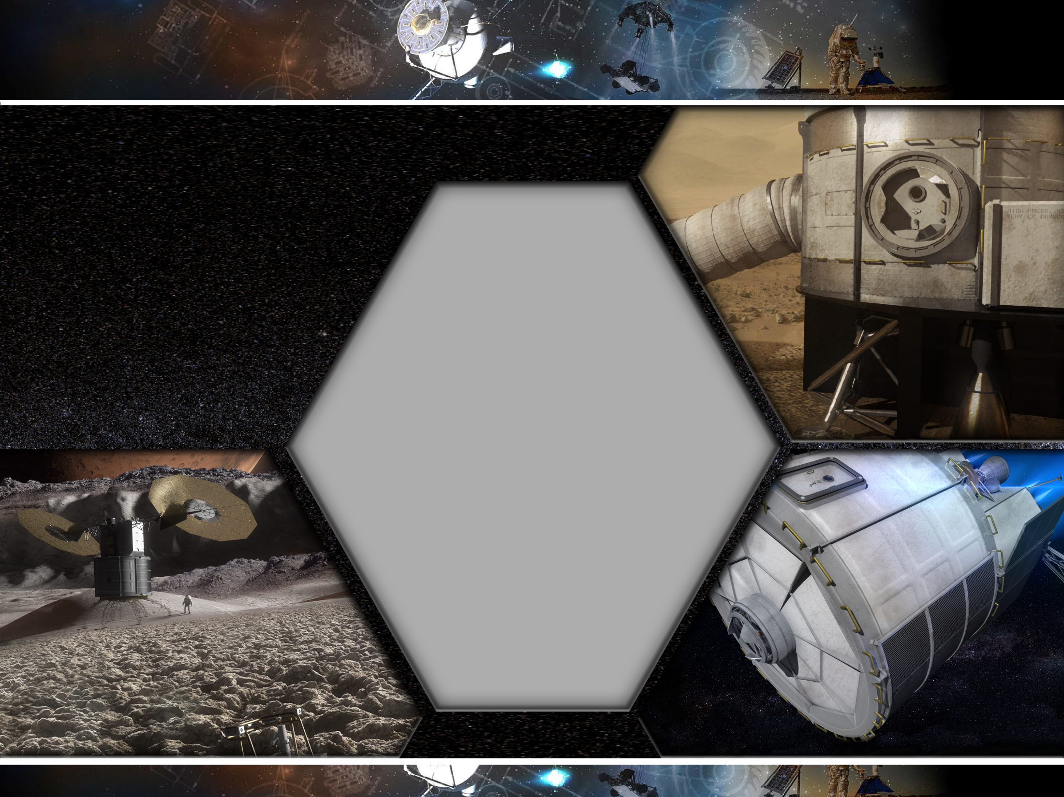
Living in Space:
Long Duration Habitation
Common Capabilities
Mars Surface Habitat
Challenges
Protect and support crew in deep space
for up to 1100 days
Uncrewed operations during
deployment and between uses
Reduced logistics and spares
Earth - independent operations
4 Crew for 500-1100 days
Common pressure vessel
15 year lifetime with long dormancy periods
Design for reusability across multiple missions
100 m³ habitable volume and dry mass < 22 t
Autonomous vehicle health monitoring and repair
Advanced Exploration ECLSS with >85% H₂O recovery and
50% O₂ recovery from reduced CO₂
ECLSS System (w/o spares): <5 t mass, <9 m² volume, <4 kW power
Environmental monitoring with >80% detection rate without sample return
14-kW peak operational power and thermal management required
Autonomous mission operations with up to 24 minute one-way time delay
Autonomous medical care, behavioral health countermeasures,
and other physiological countermeasures to counteract long
duration missions without crew abort
Exercise equipment under 500 kg
Provide 20-40 g/cm² of radiation protection
EVA pressure garment and PLSS <200 kg
Contingency EVA operations with
1 x 2-person EVA per month
Communications to/from Earth
and between elements
Live and operate on the Mars surface in 1/3 g
4 crew for up to approx. 500 days
48 m³ volume for logistics and spares
Logistics Mass: 10.7 t
4 years dormant before use
3-4 years dormant between uses
EVA system with surface mobility, dust mitigation, and atmospheric compatibility
Phobos Habitat
Transit Habitat
Live and operate in microgravity at Phobos
4 crew for up to approx. 500 days
48 m³ volume for logistics and spares
Logistics Mass: 10.7 t
EVA system with Phobos mobility and dust mitigation
4-5 years dormant before use
3 years dormant between uses
Live and operate in microgravity during
trip to/from Mars
4 crew for up to 1,100 days
93 m³ volume for logistics and spares
Logistics Mass: 21 t
4 years dormant before use and between uses

Slide 11
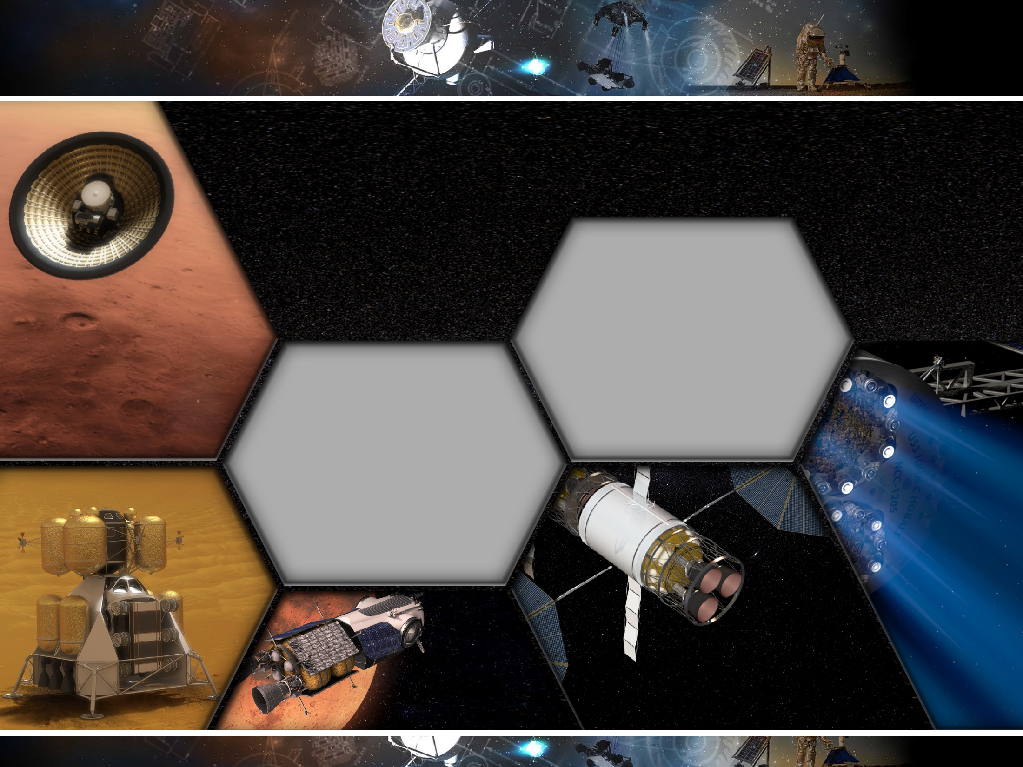
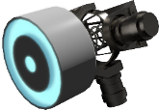
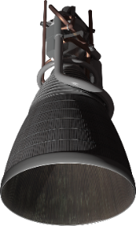
In-Space Transportation
Mars EDL
Challenges
Transport crew and cargo to/from Mars vicinity
Provide transportation within the Mars system
Provide access to Mars surface
Uncrewed operations during deployment and between uses
Electric Propulsion
Deliver approx. 40-60 t to Mars orbit
200-kW class solar array system (BOL at 1 AU)
using 30% efficient GaAs, triple junction solar cells
300 V array system converted to 800 V for EP and
28 V for spacecraft
Deliver crew and cargo to Mars surface
Possible aerocapture at 6.3 km/s if not propulsively delivered to orbit
Entry velocity of 3.8 – 4.7 km/s
100 m precision landing with hazard avoidance
Supersonic retropropulsion with LOX/CH₄ engine
Deployable/Inflatable (16-23 m) entry systems
Surface access at +2 km MOLA
20-30 t payload to the surface, 40-60 t
arrival at Mars
Common Capabilities
Chemical Propulsion
SEP - Hybrid
Common LOX/CH₄ Pump-Fed Engine:
ARRM-Derived Hall Thruster:
Common Xe storage and feed system with 13.3 kW thruster
Isp: 2000 s or 3000 s modes
Thrust: 25 klbf
Isp: 355-360 s
Up to 15 year lifetime
150-500 s burn time
5:1 throttling
Near-ZBO storage with
90 K cryocooler
Mars Ascent
SEP - Chemical
Combined SEP and hypergolic
propulsion system delivers
crew and cargo to Mars
vicinity
2 x 200-kW class arrays
1,100 days total trip mission time, 300 days at Mars
>16 kW thermal rejection
Ability to refuel
24 t of Xe on orbit
15 year lifetime, 3 uses, 3 refuelings
LOX/CH₄ Pressure-Fed RCS:
Thrust: 100-1000 lbf; Isp: 320 s
Return crew and cargo from Mars surface
4 crew and 250 kg payload from +30 deg
latitude, 0 km MOLA to Mars parking orbit
26 t prop (20 t O₂, 6 t CH₄), 35 t total liftoff
mass, 8 t Earth launch dry mass
Up to 3 days flight duration
5 years dormant before use
Use of ISRU-produced oxygen
Mars Taxi
Transport crew and cargo
within the Mars system
4 crew for up to 2.5 days
7 t inert mass, 14 t wet mass
8 kW EOL at Mars solar power
Reusable and refuelable
SEP delivers cargo to Mars vicinity, and LOX/CH₄
propulsion delivers crew to/from Mars vicinity
1 x 200-kW class solar array
>8 kW thermal rejection
Flight times to Mars approx. 1,400 days
4-6 years dormant before use

Slide 12
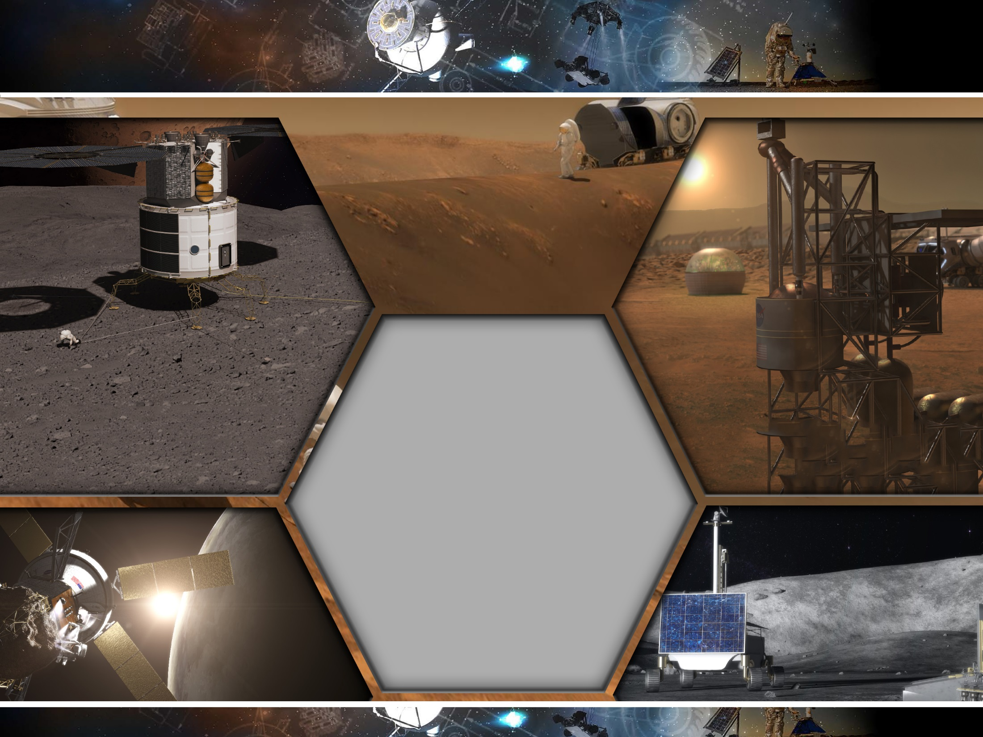
Destination Systems
Challenges
Phobos / Deimos
Mars Surface
Uncrewed operations during deployment and
between uses
Extracting and processing local resources
Operations in harsh environments
Common Capabilities
40 kW stationary Mars surface power
1-5 kW deployable/mobile Mars power
Mars surface rover for crew (2 nominal, 4 contingency) and cargo (up to
3 t) with a range of 90 km per charge and max speed of 10 km/hr
Mars surface ISRU plant capable of processing >2.2 kg/hr of atmosphere CO₂ into O₂ with a process efficiency of 36%, power of 20-22 kWe, and is less than 1 t
Liquification and cryogenic fluid storage in Mars atmosphere
All systems dormant for 4-5 years before first use and
between uses
All elements have 15 year lifetime
Offloading and transport systems capable of up to 10 t
Mobility power generation of 1-3 kW BOL and 120 kW-hr eclipse storage
Mobility systems for crew (2 nominal, 4 contingency) and cargo
(up to 3 t) with approx. 40 km range
RCS mobility sled for excursion vehicle
Dormant for 6 years at Phobos/Deimos before use
Dormant for 3 years between uses
All elements have 15 year lifetime
Low-g body docking and interaction
Ability to prospect for usable resources (e.g. water,
oxygen, carbon, nitrogen) to achieve Earth-independence
Ability to be teleoperated from other destination elements
Support autonomous mission operations with time delay
Communications to/from Earth and between elements
Robotic support for setup, operations, and maintenance
Sample acquisition
Dust mitigation
Cis - Lunar/Asteroid
Moon
Acquisition and processing of 0.08 – 1.6 kg/day
of water, oxygen, and/or hydrocarbons at
10 – 20 % efficiency
Low-g body grappling/capture and manipulation
Hub for exploration vehicle aggregation and servicing
Robotic rover with acquisition and processing of icy regolith

Slide 13
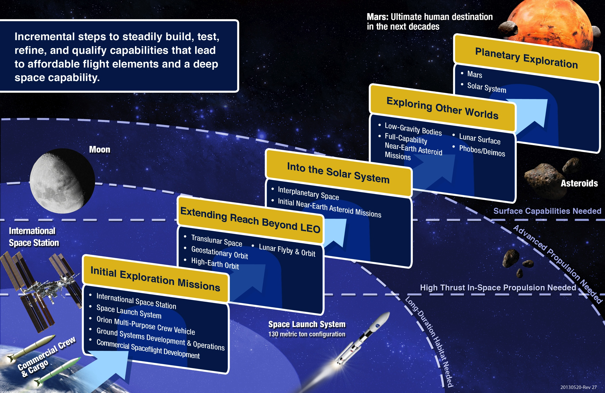
Capability Driven Framework: System Maturation Teams(SMT)

Slide 14
  System Maturation Teams - Integrated capability investment decisions with traceability to human exploration needs
A key piece to the Pioneering Space strategy is input from System Maturation Teams (SMTs). The SMTs bring together subject matter experts from across the agency. These experts have been involved in maturing systems and advancing technology readiness for NASA.
The SMTs are defining performance parameters and goals for each of the 12 capabilities, developing maturation plans and roadmaps for the identified performance gaps, specifying the interfaces between the various capabilities, and ensuring that the capabilities mature and integrate to enable future pioneering missions. The subject matter experts that compose each SMT are responsible for understanding their capabilities across all missions and elements within the Evolvable Mars Campaign.
The SMTs work closely with the Evolvable Mars Campaign to coordinate capability needs and gaps
System Maturation Team
Autonomous Mission Operations (AMO)
Communication and Navigation (Comm/Nav)
Crew Health & Protection and Radiation (CHP)
Environmental Control and Life Support Systems and Environmental Monitoring (ECLSS-EM)
Entry, Descent and Landing (EDL)
Extra-vehicle Activity (EVA)
Fire Safety
Human-Robotic Mission Operations
In-Situ Resource Utilization (ISRU)
Power and Energy Storage
Propulsion
Thermal (including cryo)
Discipline Team - Crosscutting
Avionics
Structures, Mechanisms, Materials and Processes (SMMP)

Slide 15
System Maturation Teams Organization
AES
ISS
HRP
STMD
Agency Level Prioritization & Integration
Capability Needs
DRMs, Architecture Guidance
System Advancement Coordination Group
Lead of each SMT and technical reps from programs/mission directorates perform technical integration
Discipline POC
Provide support as needed to SMT
SMT Integration Team
ISS, AES, HRP, etc. Rep
ECLSS SMT

Slide 16
Terminology
Discipline | OCT | CLT [TCAT]
Structures | 12.2: Structures | Structures, Loads and Dynamics
Mechanisms | 12.3: Mechanical Systems | Mechanical Systems
Materials | 12.1: Materials (and Processes) | Materials and Processes
Processes | 12.4: Manufacturing | Advanced Manufacturing

Slide 17
SMMP-Top Priorities from Capability Performance Gap Assessment
Gap | Chief Technical Challenge | SMT Capability Dependency | SMMP Discipline Dependency
Structures Discipline
Structures for Entry Descent and Landing (EDL) | Mass Reduction, Reliability | EDL | Materials, Processes
Pressurized Structures for Habitats | Mass Reduction, Reliability |  | Materials, Processes
Health Monitoring (Diagnosis & Prognosis) of Critical Elements | Mass Reduction, Reliability | AMO | Materials
Improved Design, Analysis and Certification (DAC) Capability Using Physics-based Models | Reliability |  | Materials, Processes
Mechanisms Discipline
Deployment Mechanisms for Solar Power Systems (SPS) | Mass Reduction | Power
Bearing and Gear Materials and Designs | Mass Reduction |  | Materials, Processes
Long-life Actuators for Deep Space Environments | Reliability
Materials Discipline
Modeling and Simulation for Thermal Protection Systems (TPS) | Reliability | EDL | Structures, Processes
Modeling and Testing of Materials Durability and Aging | Reliability |  | Structures, Processes
Materials for Deep Space Pressurized and Unpressurized Systems | Mass Reduction, Reliability |  | Structures, Processes
Processes Discipline
Sustainable Manufacturing of Launch Vehicles | Reliability | Propulsion | Structures, Materials
Advanced Manufacturing Methods | Mass Reduction, Reliability | Propulsion | Structures, Materials
In-space Manufacturing and Assembly | Mass Reduction, Reliability | Power | Mechanisms, Structures, Materials
Physics-based Modeling of In-space and Additive Manufacturing Processes | Reliability |  | Materials

Slide 18
Materials Capability Gaps
[EDL, STR]: Modeling and simulation for TPS: Improvements are needed in the modeling and simulation of the materials, thermal and structural response of ablative TPS.
[EDL, STR]: Materials for Entry Descent and Landing (EDL): Development of thermal protection system (TPS) materials and materials for insulated or hot load-bearing structures used in the EDL systems that enable missions to cis-lunar space and to Mars.
[Fire Safety]: Fire Prevention and Material Flammability: Incorporating fire prevention technology and protocols into the design of exploration vehicles is the first line of defense to minimize the risk of fire. During vehicle design, this includes selection of materials that are not flammable, control of materials that are flammable, and isolation of ignition sources.
[Thermal, STR]: Materials for thermal systems: Improve cryogenic storage system performance by reducing heat leaks through support structures built with more efficient insulating materials.
Notes:
12 gaps, 3 top priority

Slide 19
Materials Capability Gaps(2)
[ISRU, PRO, STR]: Selection, refinement and/or synthesis of materials (feedstock) from ISRU resources: ISRU resources for propulsion are critical, enabling technologies. For long-term missions ISRU for shielding will be enhancing. Enhancing for repair of structures, construction of landing pads, civ-eng structures.
[STR]: Modeling and testing of materials durability and aging: Long duration exposure to space environments (e.g., vacuum, temperature, radiation) can significantly affect material properties. Since positive structural margin is needed over the life of a structural systems, ability to determine material properties over the life of the system though modeling degradation and/or by accelerated aging protocols is critical.
[STR]: Materials for radiation protection of habitats and vehicles: Materials for structurally integrated radiation protection for habitat and vehicle structures.
[Power]: Materials for Solar Power Systems (SPS): Higher efficiency, rad hard photovoltaics will be needed to support long duration missions. Flexible photovoltaics can enable design improvements that contribute to reduced mass and volume requirements.

Slide 20
Materials Capability Gaps (3)
[AMO, STR]: Health Monitoring (Diagnosis & Prognosis) of Critical Elements: Integration of lightweight, advanced sensors can enable the sustainment of structural systems during exploration missions that require monitoring and/or evaluation of structural integrity, residual strength and life; and provide feedback to mission controllers to adapt mission parameters to ensure safety or to recommend repair and maintenance.
[Propulsion, STR]: Materials for Earth-to-orbit propulsion systems: Development of super-lightweight materials that allow the closure of launch vehicle designs for missions beyond LEO.
[STR]: Materials for deep space pressurized (tanks, habitats) and unpressurized systems Will need to include materials that provide more than one function (multifunctional) to enable a significant mass savings at a systems level. Additional functionalities needed: failsafe/self-healing for prevention of atmosphere leakage; autonomous self-healing/failsafe while dormant, un-crewed or crewed; self awareness to ensure certification/reliability.
[MEC]: Materials for bearings and gears: Development of the advanced high-performance alloys to enable reliable, long-life, mission critical mechanical systems.
Notes:
12 total gaps, 3 top priority

Slide 21
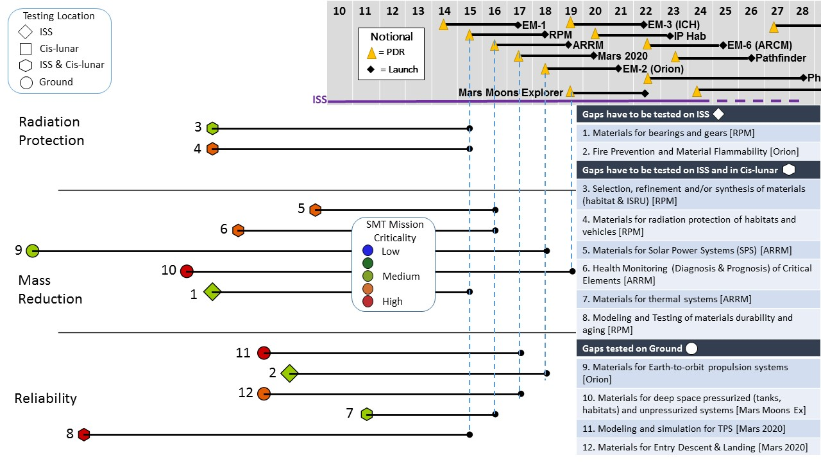
Materials SCOREboard Release 1
Updated 10/11/2015
First need date [mission] specified in brackets
21

Slide 22
Summary
Mars is an achievable goal with NASA’s Evolvable Mars Campaign defining a plan based on strategic guiding principles and a capability-driven framework for the extension and sustainment of human presence in the solar system including a human journey to explore the Mars system starting in the mid-2030s.
Near-terms steps include ISS, Earth-based labs, the Space Launch System (SLS), and Orion crewed spacecraft.
There are solvable challenges to pioneering Mars, and NASA is developing the capabilities needed to get there, land there, and live there.
With the cross-cutting materials discipline, NASA has identified various gaps in capability needed for space exploration requiring the next steps in advanced scientific and technical innovation to close.
Notes:
Mars is an achievable goal. We have spent more than four decades on the journey to Mars, with wildly successful robotic explorers. The first human steps have been taken through science and technology research aboard the International Space Station (ISS) and in laboratories here on Earth. We are taking the next steps by developing the Space Launch System (SLS) and the Orion crewed spacecraft, demonstrating new operations to reduce logistics, and preparing for human missions into cislunar space, such as exploring a captured asteroid. There are challenges to pioneering Mars, but we know they are solvable. NASA is developing the capabilities necessary to get there, land there, and live there. Within the materials discipline, there are several gaps in capabilities aligned with specific subsystem needs that when closed would push human and robotic exploration closer to the Mars horizon.

Slide 23
Structures, Mechanisms, Materials, and Processes (SMMP) Discipline Team
Structures:
  Timothy J. Collins (LaRC/TA6)
  David R. Lowry (JSC)
  Keith Belvin (LaRC/STMD PT for Lightweight Structures and Materials)
  Stephen C. Nunez (JSC)
  Stephen J. Scotti (LaRC/ Structures CLT Deputy)
  Kenneth N. Segal (GSFC)
  Judith J. Watson (LaRC/TA6)
Mechanisms:
  Chris J. Coppens (MSFC)
  Michael J. Dube (LaRC/ Mechanical Systems CLT Lead)
  Brandan R. Robertson (JSC/Mechanical Systems CLT TDT Deputy)
Materials:
  John W. Alred (JSC/Space Environments CLT Deputy)
  John W. Connell (LaRC)
  Sylvia M. Johnson (ARC)
  Gregory A. Lange, (JSC)
  Peter T. Lillehei (LaRC)
  Emilie J. Siochi, (LaRC/TA10)
Processes/Advanced Manufacturing:
  John H. Vickers (MSFC/STMD PT for Nanotechnology, Advanced Manufacturing, and Lightweight Materials)
  Frank Ledbetter (MSFC)
  Tawnya Laughinghouse (MSFC)

Slide 24
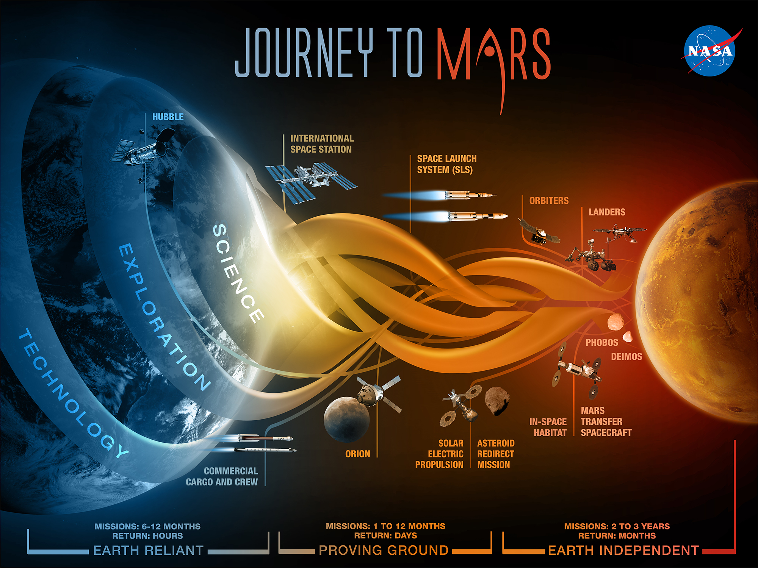
THANK YOU FOR YOUR ATTENTION

Slide 26
Why Mars?
In our lifetimes, NASA and it’s partners can answer some of humanity’s fundamental questions about life beyond Earth:
1. Was Mars home to microbial life? Is it today?
2. Could it be a safe home for humans one day?
3. What can it teach us about life elsewhere in the cosmos or how life began on Earth?
4. What can it teach us about Earth’s past, present and future?
Notes:
Mars is the horizon goal for pioneering space; it is the next tangible frontier for expanding human presence. Our robotic science scouts at Mars have found valuable resources for sustaining human pioneers, such as water ice just below the surface. These scouts have shown that Mars’ geological evolution and climate cycles were comparable to Earth’s, and that at one time, Mars had conditions suitable for life. What we learn about the Red Planet will tell us more about our Earth’s past and future, and may help answer whether life exists beyond our home planet. Together with our partners, we will pioneer Mars and answer some of humanity’s fundamental questions:
Was Mars home to microbial life? Is it today?
Could it be a safe home for humans one day?
What can it teach us about life elsewhere in the cosmos or how life began on Earth?
What can it teach us about Earth’s past, present, and future?

Slide 27
The Journey and Challenges
Today, our robotic scientific explorers are paving the way. NASA’s robotic expeditions have studied Mars for more than 40 years. Together, humans and robotics will pioneer Mars and the solar system.
We know there are solvable challenges for human missions to Mars:
  1. Getting there
  2. Landing
  3. Living and working on Mars
  4. Safely returning
We believe the journey is worth the risks.

Slide 28
The Journey and Challenges
The endeavor will improve lives on Earth by advancing:
1. Scientific knowledge and discovery
2. New technologies
  3. Economic opportunities (as all giant leaps in transportation and exploration have)
4. U.S. leadership in the peaceful, international exploration of space

Slide 29
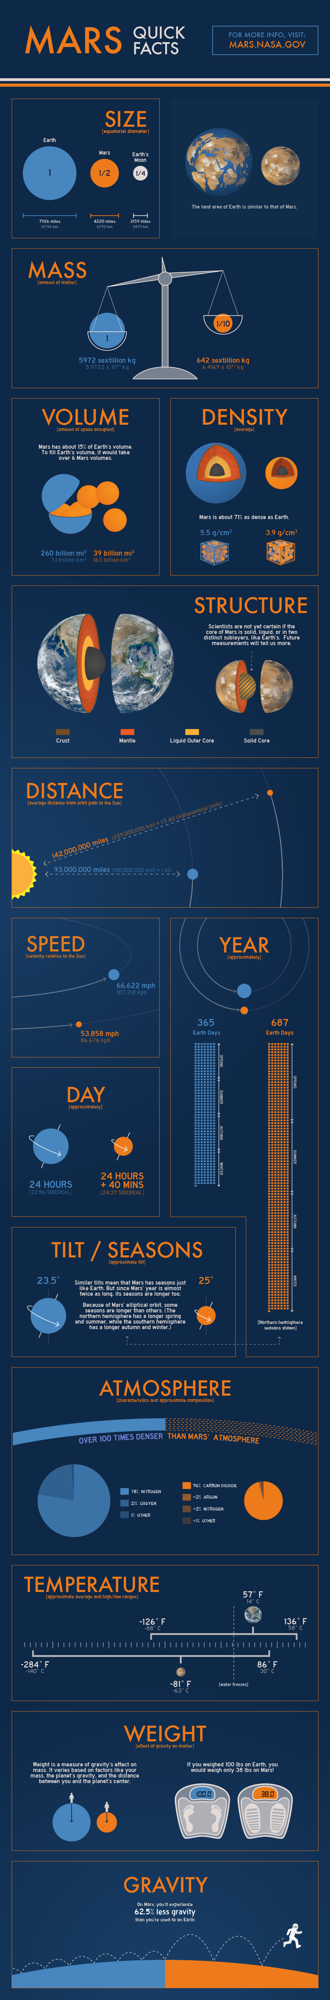
Mars Facts!
Mars has two tiny potato-shaped moons, Phobos and Deimos. They are 14 miles (22.5 km) and 8 miles (13 km) across, respectively.

Slide 30
Mars Facts!

Slide 31
Mars Facts!
Notes:
With half the diameter of the Earth, Mars has much lighter gravity and a much thinner atmosphere.
Mars’s air is about 1% the density of Earth’s and is composed of more than 95 percent carbon dioxide.
Lacking a magnetic field like Earth’s, Mars cannot deflect harmful radiation that comes from space.
Humans cannot survive unaided on the Martian surface.

Slide 32
EMC Pioneering Challenges
NASA has identified specific scientific and technical challenges for the journey to Mars through rigorous studies, including an ongoing series of architectural trade analyses, external reviews, assessments of deep-space habitation options with international partners, and high-priority objectives of science decadal studies.
Transportation
Working in Space
Staying Healthy/Living in Space
Notes:
Transportation:
Transportation capabilities are necessary to send humans to space affordably and reliably, provide high-thrust access to staging points in cislunar space, and efficiently and safely transport crew and exploration systems on the longer journey to Mars.
Working in Space:
Even with 50 years of human operations in space, new capabilities are necessary to sustain productive operations for crew and robotic systems at multiple destinations within the cislunar and Martian environments.
Staying Healthy:
Deep-space crewed missions will not have regular access to the Earth’s resources or the ability to rapidly return to Earth if a system fails. As crewed missions extend farther from Earth for longer periods, the habitation systems must become more reliable for safe, healthy, and sustainable human exploration.

Slide 33
Capabilities for Pioneering Space: Steps on the Journey to Mars
39

Slide 34
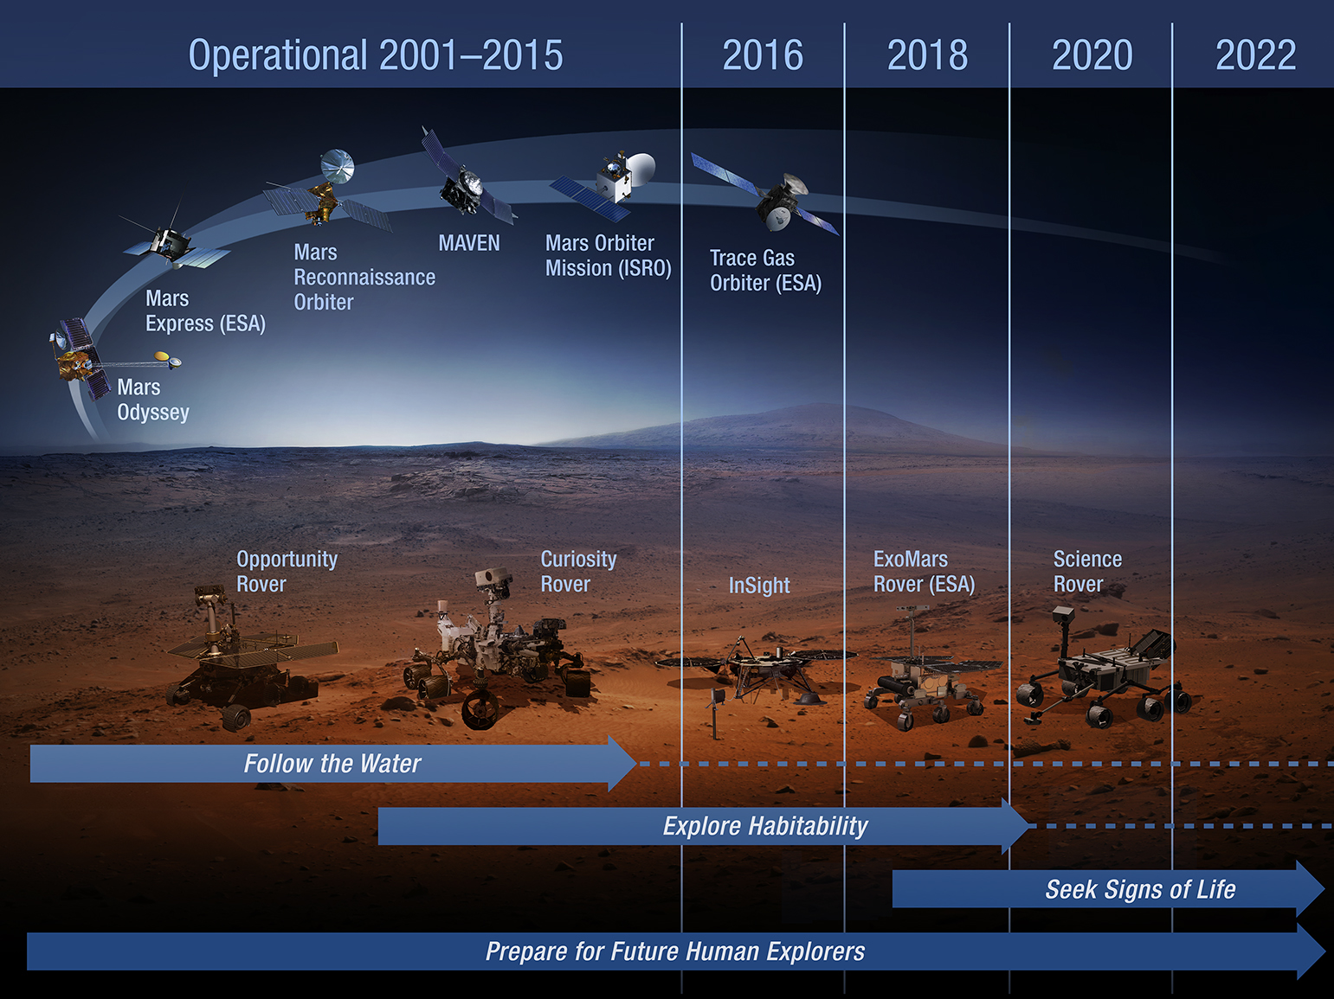

Slide 35
Transportation

Slide 36
Transportation

Slide 37
Transportation
Notes:
Orion spacecraft crew of 4 for mission duration of 21-210 days

Slide 38
SCOREboards: Introduction
The Systems Capability Organization Reporting Engine (SCOREboard) is a graphical visualization of System Maturation Team (SMT) capability data that enable the Evolvable Mars Campaign (EMC) architecture and missions.
The SMT data describe gaps in capability where performance beyond state of the art is required for human exploration missions.
The SCOREboards present an overview of the SMT capability gaps and their durations, the corresponding gap closing tasks, task testing locations, and task funding status.
The SMT data evolve over time as does the EMC architecture. After an EMC study cycle is complete, the SMT data are updated where applicable.
The SCOREboards are a snapshot in time:

Slide 39
SMT Leads
System Maturation Team | Lead
EVA | Raul Blanco, JSC
Human-Robotic Mission Ops | Rob Ambrose, JSC
Crew Health & Protection - Radiation
Autonomous Mission Operations | Jeremy Frank, ARC
Communications and Navigation | Jim Schier, HQ; Marc Seibert, KSC and Joe Guinn, JPL
ECLSS-EM (incl Environmental Monitoring) | Robyn Gatens, HQ
Entry, Descent and Landing | Michele Munk, LaRC
Power and Energy Storage | James Soeder, GRC
Thermal (including cryo) | Craig Dinsmore, JSC
Fire Safety | Gary Ruff, GRC
Propulsion | Mark Rogers, MSFC
ISRU | Jerry Sanders, JSC
Avionics (Discipline Team) | Wesley Powell, GSFC
Structures, Mechanisms, Materials and Process (Discipline Team) | Phillip Williams, LaRC

Slide 40
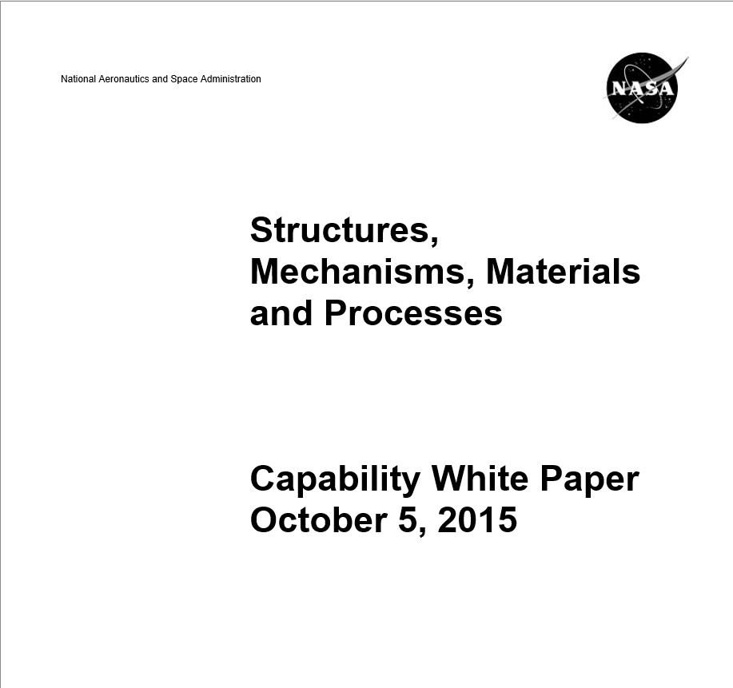
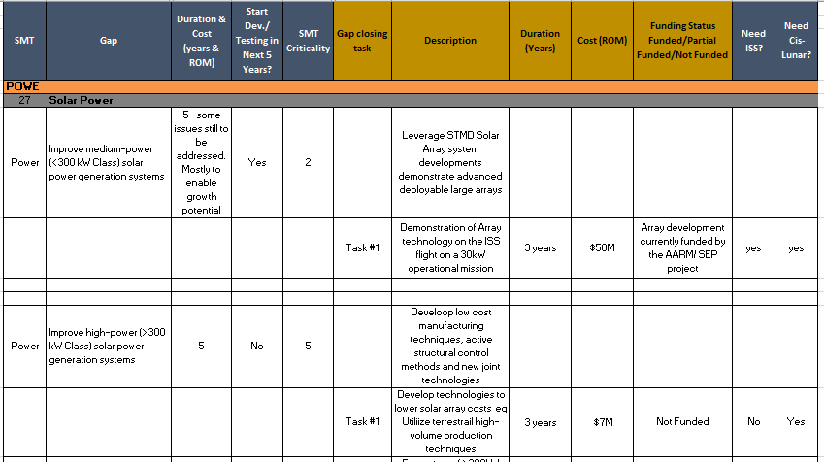
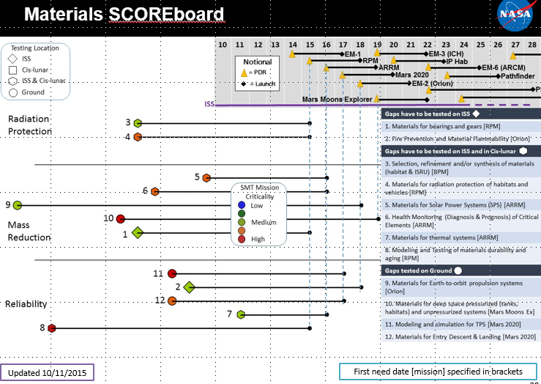
  Data Products
Capability Gap Spreadsheets
White paper
SCOREboards
Notes:
The SMTs are defining performance parameters and goals for each of the 12 capabilities, developing maturation plans and roadmaps for the identified performance gaps, specifying the interfaces between the various capabilities, and ensuring that the capabilities mature and integrate to enable future pioneering missions. By managing system development through the SMTs instead of traditional NASA programs and projects, the Agency is shifting from mission-driven development to a more flexible, capability-driven development.

Slide 41
System Maturation Team (SMT) Charter
The SMTs are a standing team of subject matter experts that will be asked to
  Identify capability needs for each mission identified in human exploration spaceflight studies
  Review ISS project proposals
  Make recommendations for integrated ISS, Cis-lunar space and ground testing development of identified capabilities
  Provide development status and budget input for their perspective areas

Slide 42
System Maturation Team Structure and Process
Each SMT will be established as an expert forum with representation from technology, system, and program personnel
  SMT lead is responsible for determination of members needed to identify and recommend agency capability maturation activities
  SMT to include the key stakeholders in a single capability area
  Initial task will be to fully develop capability roadmaps for each area
Integration across SMTs to be provided via a single technical forum, System Advancement Coordination Group (SACG)
  Membership to include each SMT lead, program representatives, and Mission Directorate representatives.
  The SACG to include the key stakeholders across all capability areas and programs
  Guidance from architecture teams to be provided to SMTs via SACG
  Actions and priorities of requests to SMTs to be provided via SACG
  Products of SMTs, such as capability roadmaps, to be delivered to SACG
When successful the SMTs will have met the agency goal to establish forums of subject matter experts and a means to coordinate their recommendations across all directorates, enabling steady progress toward exploration mission capabilities.

Slide 43
Objectives of System Maturation Team Activity
Need to develop core group of subject matter experts for each capability area to guide the maturation of their respective systems
  Develop system maturation roadmap with capability performance gaps identified for the different mission classes
  Using the roadmaps as a baseline framework for system maturation
  Aid in the development of budget submits
  Review of proposals for development and testing
  Support the OCT roadmap updating activity

Slide 44
System Maturation Road-mapping Activity
The goal is to no longer treat roadmap activities as discrete actions, rather developing a structure and the bodies of experts (SMTs) to make this viable as an ongoing support to STMD, AES, ISS, etc. decisions and needs
  Tactical
    Develop a system maturation roadmap that enables human Mars exploration missions
    Develop structure and process for a system maturation team
    Produce data products that determines capability performance gap identification and system maturation investment needs
  Strategic – After each study cycle, update system maturation roadmap as human exploration studies or design reference missions develop and use system maturation teams to assess testing opportunities
Develop a roadmap process that shows how a system or capability would mature, through testing and/or development effort, meeting exploration mission class capability needs
  Use exploration mission class needs to show how systems would mature to enable exploration missions
  Use design reference mission performance thresholds to identify capability SOA and development efforts need to enable missions
  Roadmaps would evolve and be updated as design reference missions are developed/evolved (e.g. HAT study cycle).

Slide 45
System Maturation Team Technical Integration
Provide technical integration and how best to feed agency priority decisions
  Develop a system maturation team structure and process. Provide updates to process when needed
  Establish a process for technical coordination, and identify dependencies between technical areas
  Provide an opportunity to discuss the next iteration of DRM development

Slide 46
Structures
[Power]: Structures for SPS: Design improvements in the stowed volume, strength, and deployed resonant frequency of solar power generation systems. Autonomous deployment of these structures is necessary for vehicle and surface systems.
[EDL, MAT]: Structures for Entry Descent and Landing (EDL): development of thermal protection system (TPS) structures that enable missions to cis-lunar space and to Mars. Increases are needed in the vehicle structure size for HIAD/rigid aeroshell concepts necessary to deliver 18t payloads to Mars.
[EDL, MAT]: Structures Modeling and Simulation for Thermal Protection System (TPS): Improvements are needed in the modeling and simulation of the materials, thermal and structural response of ablative TPS. In addition, validated concepts for thermal-structurally compatible joints/interfaces between sections of ablative TPS are critical.
[ISRU, MAT, PRO]: Structure Repair from In-Situ Resource Utilization (ISRU): Maintenance of spacecraft and habitat structures using ISRU derived materials and adapted manufacturing/repair processes.
Notes:
12 total gaps, 4 highest scoring, top-priorities

Slide 47
Structures (2)
[ISRU, MAT, PRO]: Radiation Protection Structures: Radiation protection for habitat and vehicle structures; includes the construction of radiation protection structures from ISRU resources on planetary surfaces.
[Propulsion, MAT]: Structures for Earth-to-Orbit Propulsion Systems for Mass Reduction: Ground testing and flight tests are necessary for certification of the structure and to gain engineering knowledge and confidence in the performance of the structures and loads environments for the propellant tanks and engine systems.
Propulsion, MAT]: Structures for Earth-to-Orbit Propulsion Systems for Increased Reliability: Ground testing and flight tests are necessary for certification of the structure and to gain engineering knowledge and confidence in the performance of the structures and loads environments for the propellant tanks and engine systems.
[Thermal]: Structures for Thermal Systems: Improve cryogenic storage system performance by reducing heat leaks through support structures.

Slide 48
Structures (3)
[MAT]: Pressurized structures for habitats: Robust and lightweight structural designs for primary pressure shell structures as well as for launch/lander integration, docking/berthing, personnel transfer tunnels/airlocks, and secondary structure including walls and partitions. Significantly lower mass than ISS heritage modules is required, failsafe/self-healing for prevention of atmosphere leakage. Improvements are needed to enable habitat mass reduction and to enable autonomous self-healing/failsafe while dormant, un-crewed or crewed.
[MAT]: Unpressurized structures for vehicles: Unpressurized structures found in transit vehicles, landers and other mission architectures. Need significantly lower mass than heritage structures, failsafe/self-healing for prevention of loss of mission. Improvements are needed to enable mass reduction and to enable autonomous self-healing/failsafe while dormant.

Slide 49
Structures (4)
[AMO, MAT]: Health Monitoring (Diagnosis & Prognosis) of Critical Elements: Sustainment of structural systems during exploration missions require monitoring and/or evaluation of structural integrity, residual strength and life; and providing feedback to mission controllers to adapt mission parameters to ensure safety or to recommend repair and maintenance.
[MAT]: Improved Design, Analysis, and Certification (DAC) capability using physics-based models: Validated, high-fidelity models with quantified uncertainty bounds for loads development, and predictions of structural response, failure, and life. Necessary to ensure a safe habitat environment for the crew, even during periods of extended dormancy. Also necessary to eliminate mass growth due to excessive conservatism in design loads, and structural margin determination.

Slide 50
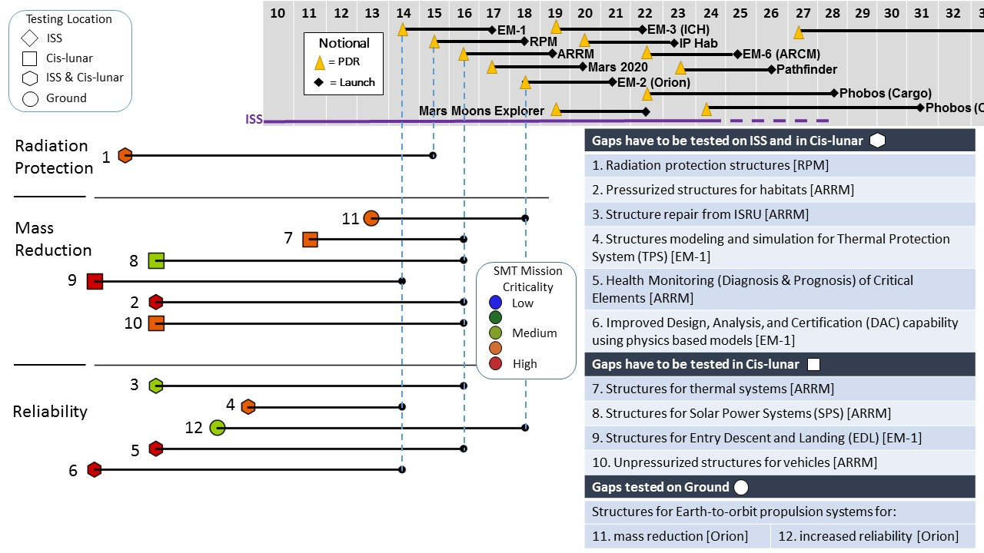
Structures SCOREboard
Updated 10/11/2015
First need date [mission] specified in brackets
50

Slide 51
Mechanisms
[AMO, Power]: Mechanical systems for Autonomous Mission Operations (AMO): design and analyze the mechanical systems suitable for human-rated vehicles to enable the desired AMO.
[Power]: Electromechanical and mechanical systems for Power and Energy Storage: design and analyze the electromechanical and mechanical systems for the power generation and energy storage systems to ensure that spacecraft(s) have power when, where, and how it’s needed.
[CHP]: Deployment mechanisms for Crew Health and Performance (CHP): Develop exercise equipment that can be rapidly deployed and stored.
[Power]: Deployment mechanisms for solar power systems (SPS): Design and development of deployment mechanisms for large solar array structures that can be autonomously deployed.
Notes:
8 total gaps, 3 top priority
Lubricants, bearing and gear materials and designs from 2012 OCT TA 12.3: … need for tribological and mechanical component innovations to enable future HSF missions. Reliable, long-life, mission critical systems such as cooling pumps, circulators and components for Zero Boil-Off systems, control moment gyros, robotic manipulation hardware, docking/hatch devices and pointing mechanisms must be more resilient and capable than current COTS technology allows. New lubricants, bearing and gear materials and designs are needed to ensure mission success.
[The current SOA: <10yr life, and can only sustain 6 g loads, and is heavy (steel).
Need >15 yr lifetime at +/–50 °C from operating temperature sustaining 10 g loads while achieving a 15 percent weight reduction with comparable capability (superelastic materials have shown potential to meet metrics) Novel mechanism designs, such as low-sliding high-contact ratio gears.]
Long-life actuators for deep space environment from OCT TA12.4 Future deep space missions will demand of the mechanical system technologies both safety and reliability over long durations, and in extremely challenging environments such as cryogenic temperatures and ultra-high vacuum. Long life, cryogenic actuators are a key technology challenge, and enabling for outer planet and deep space probe missions. Long-life-by-design, modular (for ease of integration) actuators consisting of motors, gearboxes, position/speed sensors, and motor controller electronics will need to be capable of operating in dusty NEO or lunar environments at temperatures between 400 and 40 K, for years, in order to meet those reliability demands.

Slide 52
Mechanisms (2)
[ ]: Power transfer technologies: There is a need for ultra-reliable mission critical spacecraft mechanical systems such as cabin blower motors and fans, thermal management pumps, etc. Innovative power transfer technologies such as magnetic gears are needed to ensure ultra-reliable spacecraft systems.
[MAT, PRO]: Bearing and gear materials and designs: For reliable, long-life, mission critical systems, new bearing and gear materials and designs are needed to ensure mission success.
[ ]: Lubricants: For reliable, long-life, mission critical systems, new lubricants are needed to ensure mission success.
[ ]: Long-life actuators for deep space environment: Need to be capable of operating in dusty NEO, lunar, Martian environments at temperatures between 400 and 40 K, for years, in order to meet reliability demands.
Notes:
Lubricants, bearing and gear materials and designs from 2012 OCT TA 12.3: … need for tribological and mechanical component innovations to enable future HSF missions. Reliable, long-life, mission critical systems such as cooling pumps, circulators and components for Zero Boil-Off systems, control moment gyros, robotic manipulation hardware, docking/hatch devices and pointing mechanisms must be more resilient and capable than current COTS technology allows. New lubricants, bearing and gear materials and designs are needed to ensure mission success.
[The current SOA: <10yr life, and can only sustain 6 g loads, and is heavy (steel).
Need >15 yr lifetime at +/–50 °C from operating temperature sustaining 10 g loads while achieving a 15 percent weight reduction with comparable capability (superelastic materials have shown potential to meet metrics) Novel mechanism designs, such as low-sliding high-contact ratio gears.]
Long-life actuators for deep space environment from OCT TA12.4 Future deep space missions will demand of the mechanical system technologies both safety and reliability over long durations, and in extremely challenging environments such as cryogenic temperatures and ultra-high vacuum. Long life, cryogenic actuators are a key technology challenge, and enabling for outer planet and deep space probe missions. Long-life-by-design, modular (for ease of integration) actuators consisting of motors, gearboxes, position/speed sensors, and motor controller electronics will need to be capable of operating in dusty NEO or lunar environments at temperatures between 400 and 40 K, for years, in order to meet those reliability demands.

Slide 53
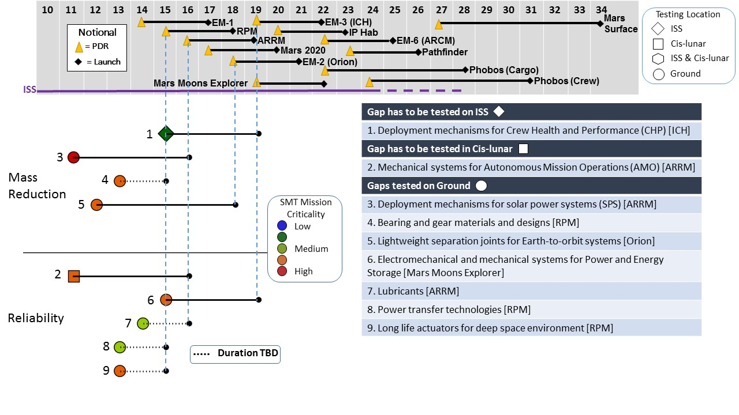
Mechanisms SCOREboard
Updated 10/11/2015
First need date [mission] specified in brackets
53

Slide 54
Processes
[Propulsion]: Sustainable manufacturing of launch vehicles: Advanced manufacturing to address cost-growth risk of launch and in-space propulsion vehicles.
[Propulsion, STR]: Advanced manufacturing methods: Advanced (digital) manufacturing methods that build confidence in the final structure to reduce the structural margins.
[ISRU, STR, MAT]: Manufacturing of radiation protection structures with ISRU produced materials. For manufacturing shielding structures in micro-g for spacecraft and habitats, construction of civil engineering structures on planetary surfaces: radiation shielding berms, landing pads, etc.
Notes:
6 total gaps, 4 top priority

Slide 55
Processes (2)
[MEC, MAT]: Manufacturing of high-performance alloys: These advanced high-performance alloys have significant manufacturing challenges that need to be overcome to enable new mechanical system designs.
[Power, MEC, STR, MAT]: In-space manufacturing and assembly: Development of technology advancements in techniques and processes that enable manufacturing of materials and parts and the assembly/construction of deployment mechanisms and large structures in space. These advancements will eliminate total reliance on launched materials and parts for resupply and repair and, for complex systems, will reduce the mass and reliability challenges associated with launching a completely integrated system for missions beyond LEO.
[MAT] Physics-based modeling of in-space/additive manufacturing processes: Continuation and integration of Materials Genome Initiative (MGI) into advanced in-space additive manufacturing processes.
Notes:
6 total gaps, 4 top priority

Slide 56
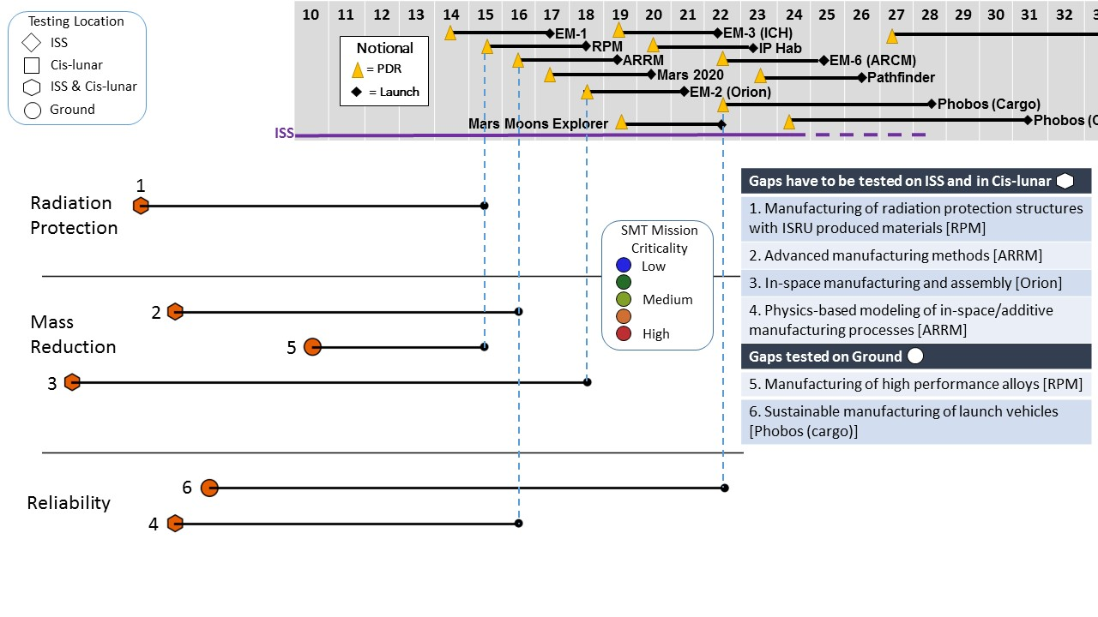
Processes SCOREboard
Updated 10/11/2015
First need date [mission] specified in brackets
56

Slide 57
Top 2 Priorities
Overall, the chief technical challenges of the Structures, Mechanisms, Materials, and Processes Disciplines are radiation protection, mass reduction, and reliability. The top 2 challenges in each discipline are:
Structures:
  Improvements are needed to enable habitat mass reduction and to enable autonomous self-healing/failsafe structures while dormant, un-crewed or crewed.
  Sustainment of structural systems during exploration missions requires monitoring, evaluation and modeling of structural integrity, residual strength and life; and providing feedback to mission controllers to adapt mission parameters to ensure safety or to recommend repair and maintenance.
Mechanisms:
  Design and development of reliable, autonomous-deployment of solar array structures and other ultra-large, mission-critical structures.
  New bearing and gear materials and designs are needed to enable ultra-reliable, long-life, mission critical systems.
  Long life, cryogenic actuators consisting of motors, gearboxes, position/speed sensors, and motor controller electronics will need to be capable of operating in dusty NEO, lunar, Martian environments at temperatures between 400 and 40 K, for years.
Materials:
  Development, testing and modeling of super-lightweight, durable, damage-tolerant, long-life materials that allow for significant mass reduction for deep-space spacecraft, habitats, and surface systems while providing structurally integrated radiation protection.
  Advanced modeling and simulation of the thermal and structural response of the materials in thermal protection systems.
Processes:
  Advanced manufacturing to address cost-growth risk of launch and in-space propulsion vehicles
  Manufacturing from ISRU, in-space manufacturing and assembly. ISRU based manufacturing for: mission consumables, civil engineering structures (radiation shields, landing pads), and other infrastructure. Other autonomous manufacturing and assembly in-space to enable the repair, refurbish, and repurpose structures and systems.
Notes:
Significantly lower mass than ISS heritage modules is required, failsafe/self-healing for prevention of atmosphere leakage. Improvements are needed to enable habitat mass reduction and to enable autonomous self-healing/failsafe while dormant, uncrewed or crewed.
Development of thermal protection system (TPS) structures that enable missions to cis-lunar space and to Mars. Increases are needed in the vehicle structure size for HIAD/rigid aeroshell concepts necessary to deliver 18t payloads to Mars.
Sustainment of structural systems during exploration missions require monitoring and/or evaluation of structural integrity, residual strength and life; and providing feedback to mission controllers to adapt mission parameters to ensure safety or to recommend repair and maintenance.
Validated, high fidelity models with quantified uncertainty bounds for loads development, and predictions of structural response, failure, and life. Necessary to ensure a safe habitat environment for the crew, even during periods of extended dormancy. Also necessary to eliminate mass growth due to excessive conservatism in design loads, and structural margin determination.
Design and development of deployment mechanisms for large solar array structures that can be autonomously deployed.
Reliable, long-life, mission critical systems such as cooling pumps, circulators and components for Zero Boil-Off systems, control moment gyros, robotic manipulation hardware, docking/hatch devices and pointing mechanisms must be more resilient and capable than current COTS technology allows. New bearing and gear materials and designs are needed to ensure mission success.
Need both safety and reliability over long durations, and in extremely challenging environments such as cryogenic temperatures and ultra-high vacuum. Long life, cryogenic actuators are a key technology challenge, and enabling for deep space missions. Long-life-by-design, modular (for ease of integration) actuators consisting of motors, gearboxes, position/speed sensors, and motor controller electronics will need to be capable of operating in dusty NEO, lunar, Martian environments at temperatures between 400 and 40 K, for years, in order to meet those reliability demands.

